Slide 1
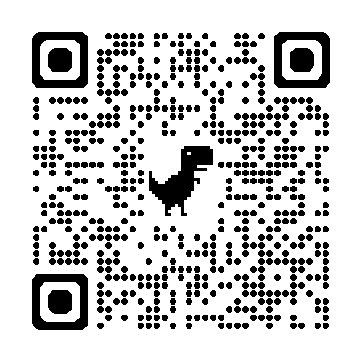
2024 Accountability Use of Data from the Data Pipeline & Assessment Collections
Why it Matters, What to Look for and How Collections Generally Occur
May 14, 2024
Please take our 2-question welcome POLL, so we can see who’s joining us. Thank you!!
https://forms.gle/QGWp1c8LkJXGBXWDA
or use the QR code
Notes:
Start recording

Slide 2

Agenda
Welcome
Introduction to new resource
  Cross Department
  Purpose & Features
Engage in the resource
  I DO – Walkthrough the Resource
  YOU DO – Choose your own Adventure
Questions & Answers
Meeting Norms
This webinar is being recorded.
Please mute your sound if you are not speaking.
Use the chat feature to ask questions throughout the presentation.
Q&A at the end of this session won’t be recorded.
Slides and the recording will be posted to the CDE website here.

Slide 3
Welcome
If you haven’t done so yet, please take our 2-question welcome POLL, so we can see who’s joining us. https://forms.gle/QGWp1c8LkJXGBXWDA
or use the QR code
From CDE on the Chat and for Q&A part
Accountability & Continuous Improvement
  Cross-unit support team
  Analytics
  School Improvement & Planning
Data Services Unit
Assessment Division

Slide 4

2024 Accountability Use of Data from the Data Pipeline & Assessment Collections Why it Matters, What to Look For and How Collections Generally Occur
Accountability & Continuous Improvement
Colorado’s Accountability System
Data Services
Data Pipeline
Assessment
Colorado Statewide Content Assessments
Federal Accountability
ESSA Identification

Slide 5
Resource Purpose
Help bridge understanding between leadership and technical staff
Provide technical connections in how data from Data Pipeline collections and State Assessment Systems apply to Accountability
  Why data accuracy matters.
  What to focus on during each collection in the context of accountability.
  How different collections generally work and connect.
Connect data collections across the department that are managed by various units
Make a connection – Based on the purpose, what question do you have that this document might help you answer?

Slide 6
Resource Features
Index/sections – Read this document through or go to a specific section or collection to inform planning work and identify key elements to consider
Defining or grounding in Colorado’s Accountability System – components are introduced and tagged within each section
Accountability Implications & Planning Considerations – Each section starts with accountability implications and planning considerations
Look fors within body of document – noted with check mark [✔] bullets and associated sub-bullets and blue call-out boxes highlighting best practices; text also provides a springboard to more accountability resources
Appendices – A, B & C are designed to provide a “snapshot” of the content of the resource

Slide 7
Engage in the Resource

Slide 8
Walkthrough Resource
Coming Soon ~ adding the associated READ Act collection connected to the bonus point in the Elementary Achievement indicator of the Frameworks!
Colorado’s Accountability System
District and School Performance Framework ratings and plan types are based on each site’s overall performance, which includes the following categories: Academic Achievement: Average scores on state assessments for all students as well as specific groups of students Academic Growth: Progress students make in their achievement on assessments from one year to the next Postsecondary Readiness: (high school level and district only) Graduation rates, dropout rates, average scores on the SAT, matriculation into college and other postsecondary options Note: Ratings are “decreased due to Participation” if the accountability participation rate in two or more content areas falls below 95%.
Unified Improvement Plans Framework ratings and plan types determine additional expectations for improvement planning requirements and stakeholder engagement.
State Accountability Data Tools & Reports Public reporting and analytics resources support data analysis and transparency.
Federal Accountability ESSA Identification requires states to identify schools for improvement and support under ESSA in two major categories: Comprehensive and Targeted Support and Improvement, with subcategories under each.
Link to Resource, walkthrough
Year-Round Collections: Directory, School Code Changes & RITS
Snapshot: Student October
State Assessment Vendor Systems
*Periodic Collections: Student Biographical Data (SBD)
*Snapshot: Student End of Year (SEY)
*Periodic Collections: Alternative Education Campus (AEC)
* Open/opening soon: SEY officially opened 5/2/2024; AEC 2025 Planned Measures & 2024 Actual Measures opened 5/8/2024; PSAT/SAT SBD opens 5/15/2024; and CMAS & CoAlt SBD opens 5/16/2024
Resource posted at: 2024 Accountability Resources
Notes:
DOC version of resource, if needed

Slide 9
Choose your own Adventure
Link to Resource
Select one section for a collection that you are either already working on (e.g., Student End of Year) or one that is about to start (e.g., SBD) or
Go straight to Appendix A, reviewing the appendices that collectively provide a “snapshot” of the content of this document

Slide 10
Questions & Answers

Slide 11

Open up for Questions
Please fill out our feedback form or use the QR code below.
Thank you!
Notes:
Link to feedback form
Return back reflecting on a question you may have based on the purpose or intention of this resource.

Slide 12
Contact Us
Accountability & Continuous Improvement
accountability@cde.state.co.us
Data Pipeline
posted by collection
Assessment
assessment@cde.state.co.us
Thank you!
Federal Accountability
ESSAquestions@cde.state.co.us

Slide 13
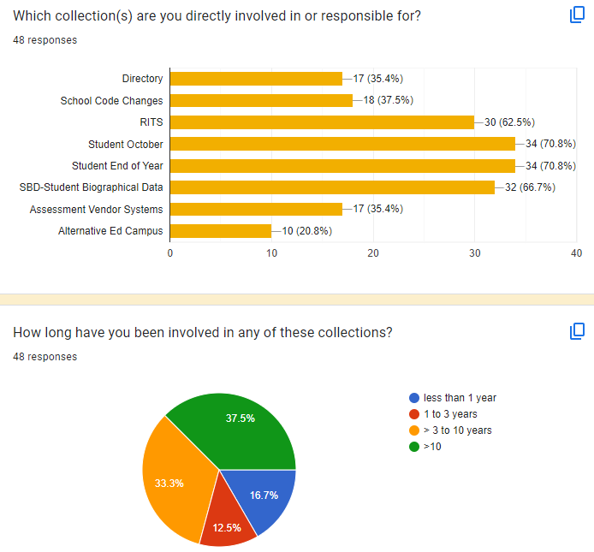
From the welcome poll!
Who attended.

