Slide 1
Indicator 11 (I 11): Timely Initial Evaluation
Indicator 12 (I 12): Part C to Part B Transition
Demonstration of Correction of Noncompliance
SY 2023-2024 Individual Student Corrections

Slide 2
Agenda
Indicators 11 and 12 – the basics
Data source
Valid and invalid delay codes
Demonstration of Correction – 2 Prongs
  “Individual Correction” - student-specific – focus of this training
  “Review of Updated Data” – Colorado Department of Education (CDE) is currently reviewing Administrative Unit (AU) September, October, and November 2024 Participation File data
AU reporting and data submission

Slide 3



Importance of Indicator 11
Critical first step in ensuring that we fulfill the purpose and spirit of Individuals with Disabilities Education Act (IDEA)
To ensure that all children with disabilities have available to them a free appropriate public education that emphasizes special education and related services designed to meet their unique needs and . . .
Prepare them for further education, employment, and independent living.
§ 300.1 Purposes
This Photo by Unknown Author is licensed under CC BY-NC-ND
This Photo by Unknown Author is licensed under CC BY
This Photo by Unknown Author is licensed under CC BY

Slide 4

What does Indicator 11 measure?
Indicator 11 measures the percent of children whose initial evaluations were completed within 60 days upon receipt of parental consent.
§300.301 (c)(1)(i)
Target for this indicator is 100% compliance.

Slide 5

Importance of Indicator 12
Critical step in ensuring that we fulfill the purpose and spirit of IDEA for our youngest children.
To ensure that all children with disabilities have available to them a free and appropriate public education that emphasizes special education and related services designed to meet their unique needs and . . .
Prepare them for further education, employment, and independent living.
§ 300.1 Purposes
This Photo by Unknown Author is licensed under CC BY-NC-ND
This Photo by Unknown Author is licensed under CC BY

Slide 6

What does Indicator 12 measure?
Indicator 12 measures the percent of children referred by Part C prior to age 3 who are found eligible for Part B, and who have an Individualized Education Program (IEP) developed and implemented by their third birthdays.
§300.301(d)
Target for this indicator is 100% compliance.
This Photo by Unknown Author is licensed under CC BY-SA-NC

Slide 7
How is compliance determined?
AU Data Submission
Data source – Special Education End of Year (SPED EOY) Data Collection
  Indicator 11
    Date of parental consent to evaluate
    Date evaluation completed
    Reason for any delay in completing the evaluation
  Indicator 12
    Date child is found eligible for Part C services
    Date of IEP eligibility meeting
    Date of IEP implementation
    Reason for delay in eligibility determination and delay in IEP implementation
Date range – July 1st - June 30th
Closing date of AU data submission – late September

Slide 8
What counts as noncompliance?
  Indicator 11
  One or more students' evaluations were completed more than 60 days after parental consent with an invalid delay code.
  Indicator 12
  One or more students’ eligibilities for Part B were not determined and/or the IEP did not start by the third birthday with an invalid delay code.

Slide 9

Know the valid and invalid delay codes (01, 03, 43)
Valid delay codes
01 Parent refused to provide consent or revoked consent during the process or child is never enrolled, process ended.
03 Deceased, process ended.
43 Mutual written agreement was made between parents and a group of qualified professionals to extend time for Specific Learning Disability (SLD) identification.
This Photo by Unknown Author is licensed under CC BY-SA

Slide 10
Know the valid and invalid delay codes (45, 46, 47)
Valid delay codes
45 Parent repeatedly failed or refused to: produce child; give consent, respond to meeting requests; attend scheduled meetings. Includes delays due to illness and any requested delays from parent. Process was delayed but did not end.
46 Student moved into district after process initiated in another district; current district is making sufficient progress to ensure a prompt completion of the initial referral process by the date which parent and the current district agree.
47 Student moved out of district after the initial referral process initiated, process ended.
This Photo by Unknown Author is licensed under CC BY-SA

Slide 11
Know the valid and invalid delay codes (49, 56, 41)
Additional valid delay codes for Indicator 12
49 Child's 3rd birthday occurred over the summer, parents and district determined the date the IEP services will begin.
56 No educational disability suspected. Prior Written Notice issued.
Indicator 12: Valid delay for IEP implementation only. Not a reason for a delay in eligibility determination.
41 Parent chose to extend Part C Services
This Photo by Unknown Author is licensed under CC BY-SA

Slide 12

Know the valid and invalid delay codes (58, 59, 60)
  Invalid delay codes
  58 Additional evaluations or special evaluations needed
  59 Other: (provide explanation in exception request)
  60 Staff missed the timeline
Notes:
During the COVID19 school closures, if the IEP process delay was due to a request from a parent (e.g., the parent would rather wait to have an implementation meeting until the COVID 19 school closure is over) or based on mutual agreement between the AU and parent to delay the timeline, please report such delay with a delay code 45 – parent reasons. If the IEP team was determining the existence of specific learning disability, and the COVID 19 school closure disrupted the progress monitoring necessary to evaluate the child (300.309(C)), please report such delay with a delay code 43 – mutual written agreement was made between parents and a group of qualified professionals to extend time for SLD identification. For any other delays related to the COVID-19 school closure, please report with a delay code 61 – NOT VALID – COVID19 School Closure. Because IDEA does not provide a waiver for a delay of IEP process due to any type of school closure, use of delay code 61 will be considered as not compliant. Because delay reasons in codes 45 and 43 are allowable in IDEA, the state would count as acceptable delays and would not be considered non-compliance. Please use code 59 when none of the delay codes adequately addresses the delay reasons and submit an exception request.

Slide 13

Consequences of Noncompliance
This Photo by Unknown Author is licensed under CC BY

Slide 14

What is demonstration of correction?
When an AU fails to meet 100% compliance with these indicators, the state must ensure the noncompliance is corrected in accordance with OSEP QA 23-01, which specifies that the CDE must:
  1. Ensure that each child’s evaluation was completed, or IEP was implemented, though late, and identify the root-cause of the delay (“Individual Correction”); and
  2. Review updated data to determine if the AU is correctly implementing the specific regulatory requirements related to the Indicator (“Review of Updated Data”).
This Photo by Unknown Author is licensed under CC BY-NC-ND

Slide 15

New Process Effective 2021-22 SY
No more Excel spreadsheet correction trackers to download, complete, and submit.
The process will be completed in the Data Management System (DMS)
Can you lighten the load a little please?

Slide 16
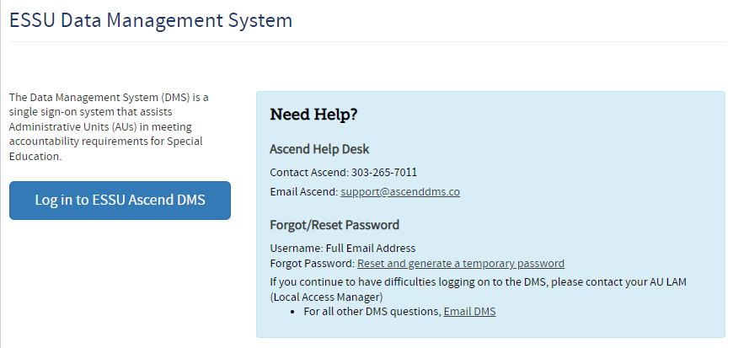
ESSU Data Management System (DMS)
https://www.cde.state.co.us/idm/essu-data

Slide 17
Access to the Ascend DMS
If you do not have access to the DMS, contact your AU LAM (Local Access Manager)
If you forget your password, there is a “Forgot Password” reset option on the login page
The CDE DMS application in Access Management is ASCDMS. Currently there are 3 roles that grant access to the correction process in the DMS:
  MD – For Monitoring Directors, all access
  MRR – For Record Review access
  GDnMD – For Gifted and Monitoring Directors, all access
Only one role can be assigned per user. If more than one is assigned, you may not be able to log in
If you get a security error message when logging in, have your IT person mark the page as safe. Updates to Firewall security may block the page
Questions about logging in or roles contact Josh Fails Fails_J@cde.state.co.us

Slide 18
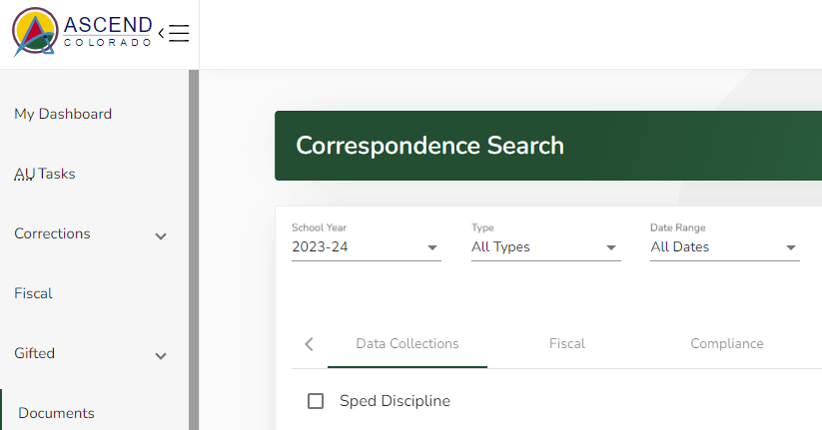
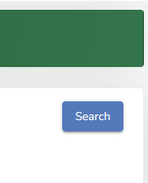
Where to find noncompliance letters
CDE uploaded the letters to the DMS Documents section. Once logged in to the DMS, click “Documents” on the left. Change the year to 2023-24, click on Compliance, filter by checking Indicator 11 and Indicator 12 boxes, and then click the “Search” blue colored button on the right.
Notes:
The sample size is not doubled if the AU has unusual population (e.g., ,limited or no early childhood, extremely small SPED population). In that case, the sampling is tailored for that AU, so the AU really needs to look at this guidance document.

Slide 19
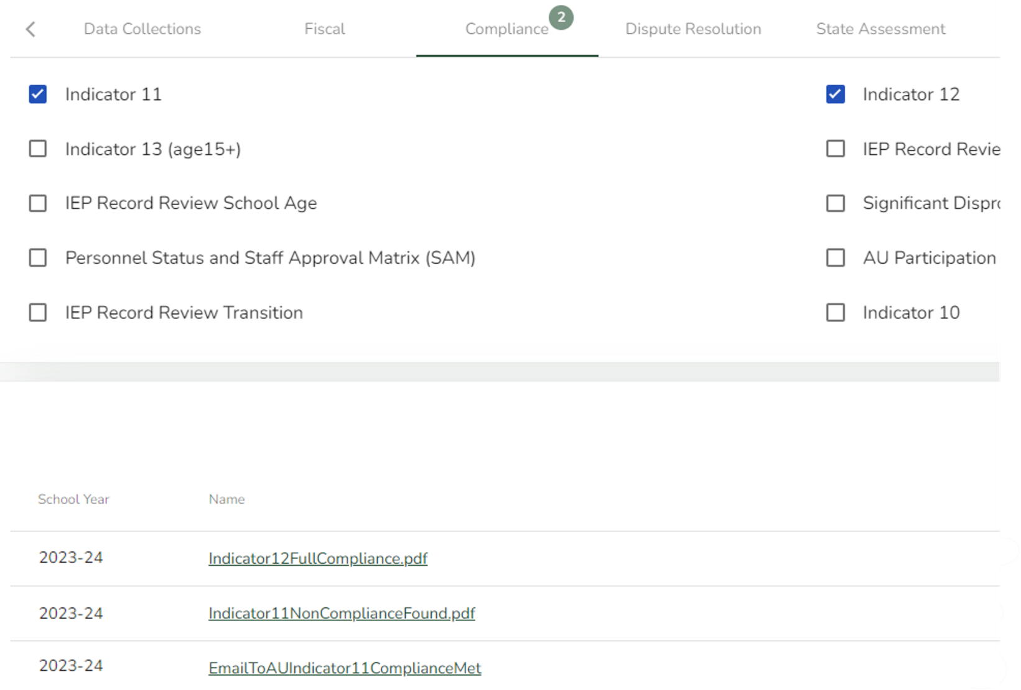
Downloading Letters
You can download your letters from the Documents list.

Slide 20
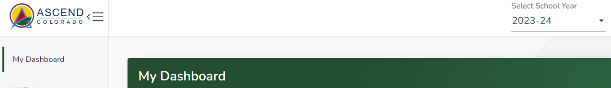
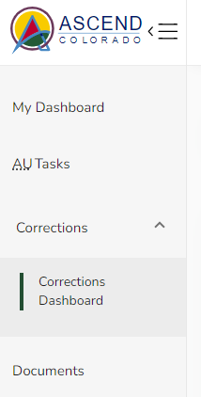
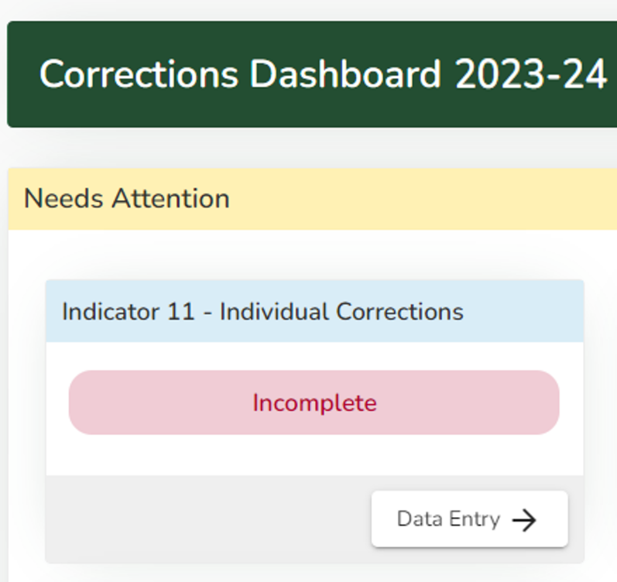
Starting the “Individual Correction” process
Step 1. Select SY 2023-24
Step 2. Click “Corrections” and “Corrections Dashboard”
Step 3. Click Data Entry to get started

Slide 21
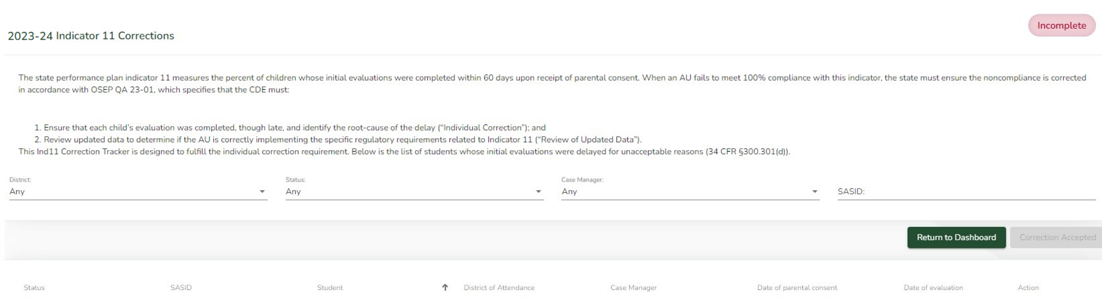
Online Correction Tracker – Indicator 11
Sorting/Filtering Options
District
Status – complete/incomplete
Case Manager
State Assigned Student Identifier (SASID)

Slide 22
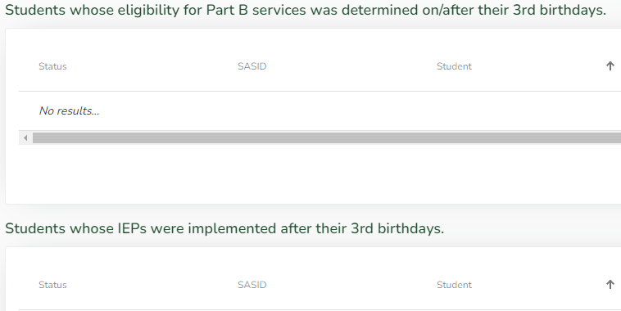
Online Correction Tracker – Indicator 12
Indicator 12 has two possible noncompliant measures; therefore, the tracking page is separated in two parts. You may have students in one or both categories.

Slide 23
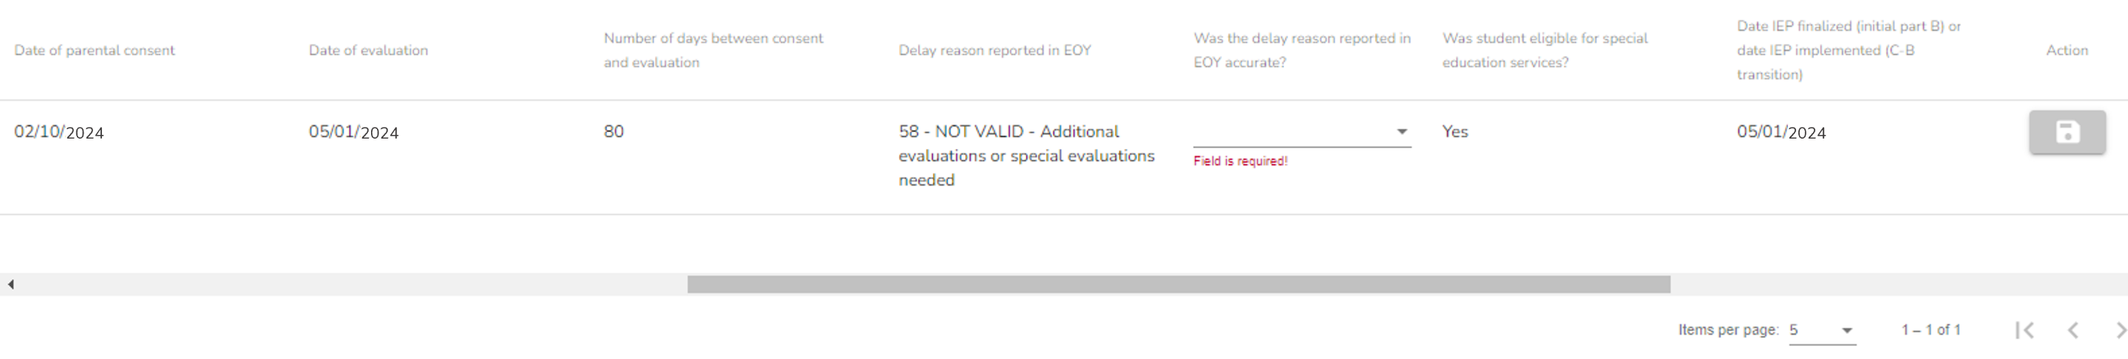
Navigating tips
Use the dropdown menu to confirm or correct the delay reason for each student
Use the scroll bar to navigate to the other required questions
5 students per page (default – can be increased)
Use the arrows to move to the next page of students

Slide 24
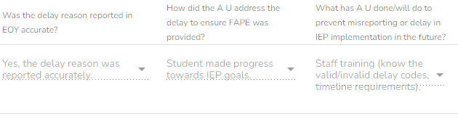
Dropdown menus
All question columns, except Case Manager, use dropdown menus. Look for the down arrow to find the available response choices.

Slide 25
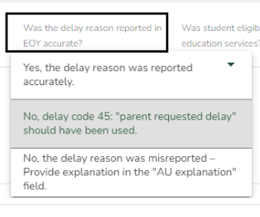
Adding an explanation when required
When you select an answer that requires an explanation, a text box will open automatically for your response.

Slide 26
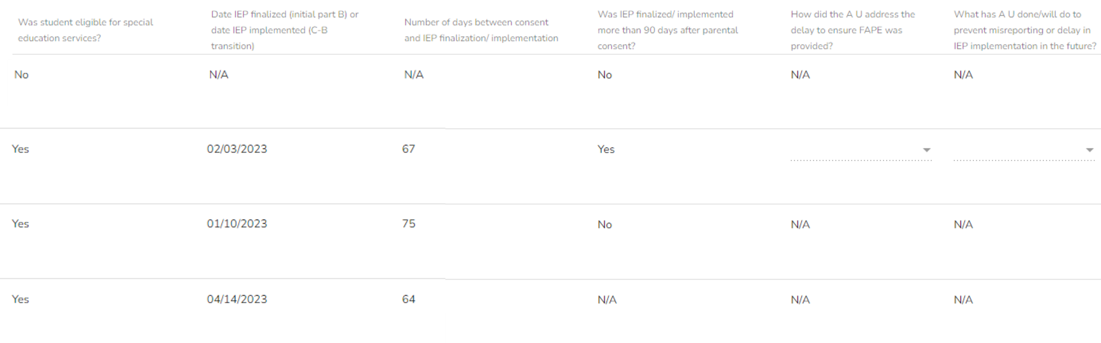
Irrelevant questions
When a question is not relevant to a particular student, you will see Not Applicable (N/A) in the column.
2024
2024
2024

Slide 27
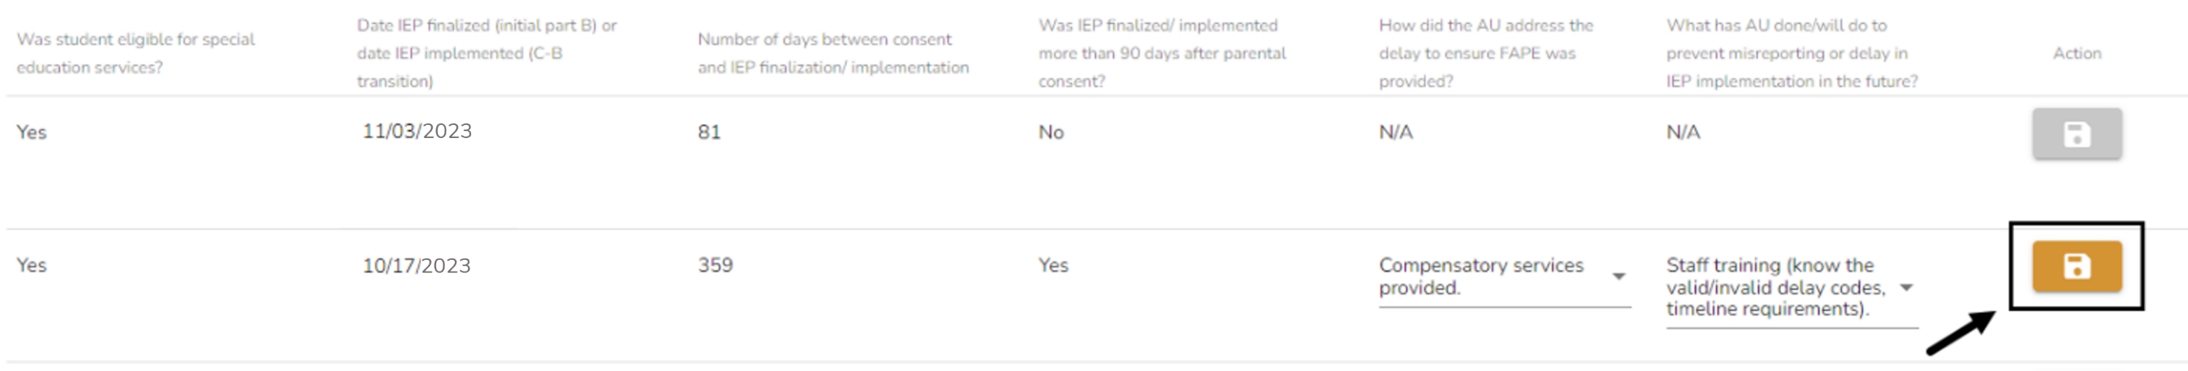
Saving your work
You must click the “Save” icon to save your data input. Navigating away from this page without saving the answers for the record will lose the data entered.
Pay attention to this one! Save, save, save!

Slide 28
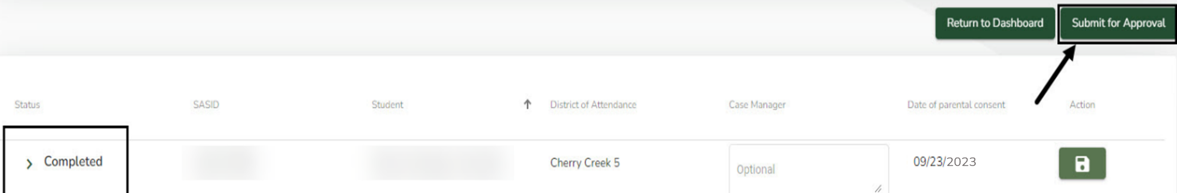
Submitting completed corrections
When all records have been completed, click “Submit for Approval”.
“Submit for Approval” button
“Save” icon will be green
Status will change to “Completed”
Clicking on “Submit for Approval” triggers an email to CDE that your AU has completed the “Individual Correction” process.

Slide 29
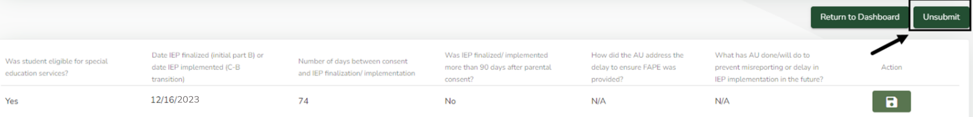
Unsubmitting corrections
Prior to CDE’s review, you can “Unsubmit” the corrections to make changes.
Once CDE begins reviewing your records, you cannot undo the submission.
  The “Unsubmit” button will not be available once CDE begins the review.

Slide 30
Data submission and reporting
Complete corrections in the DMS.
Save your data entry.
Click on the “Submit for Approval” button.
This automatically triggers an email to CDE that your AU has completed the corrections.
Deadline for submission of completed corrections: April 1, 2025
The CDE will verify “Individual Correction” and “Review of Updated Data” via a desk audit process and confirm the results to the AU by July 1, 2025.
If the AU does not meet both parts of the demonstration of correction requirements, additional monitoring activities will be required.
Data will be reported in the SPP/APR in February 2026 to demonstrate Colorado's correction of noncompliance for Indicator 11 and Indicator 12.

Slide 31
ESSU Contact Information
For questions, contact these folks! They are super helpful!
Orla Bolger
Supervisor, Data and Monitoring Liaison
State Collections, Data Pipeline, Data Inquiries
Bolger_o@cde.state.co.us
Josh Fails
Online Program Coordinator & Data Consultant
Ascend Data Management System (DMS)
Fails_j@cde.state.co.us

