Slide 1
Student Discipline Collection Training February 28th, 2025
Dawna Gudka
Student Discipline Snapshot Collection lead
Notes:
Good morning my name is Dawna Gudka and I will be your host today for Student Discipline Collection training.

Slide 2

Agenda
Student Interchange Files
Discipline Action Files
District Provided guidance on:
Discipline Matrix
Policy
Examples of Restraint and Seclusion record in Discipline Action file
Behavior Incident Examples
Data Pipeline Process
Frequently Asked Questions
Additional Information/Collection Resources
Questions
School Accreditation Report
Notes:
Today's agenda

Slide 3
Student Interchange files Student Demographics Student School Association

Slide 4
Student Interchange files
Student Demographics File Layout-The purpose of the Student Demographic (DEM) file is to capture and verify the attributes of a student while they attended your Local Education Agency (LEA) in the current school year.
Student School Association File Layout-The purpose of the Student School Association (SSA) file is to capture the school(s) in which a student attends in your Local Education Agency (LEA) district throughout the current school year for funding and accountability purposes.

Slide 5
Discipline Interchange file Discipline Action

Slide 6

Discipline Data
The Student Discipline collection is an annual collection.
In the file, all students who were disciplined during the reporting school year will be reported. This information is used in the Student Discipline Snapshot for all students and Special Education Discipline snapshot for students with an active IEP.
Who is included in the file?
All students violating a state reportable behavior and the discipline action given
All students restrained
All students placed in seclusion
Optional for LEA’s CRDC reporting behaviors

Slide 7
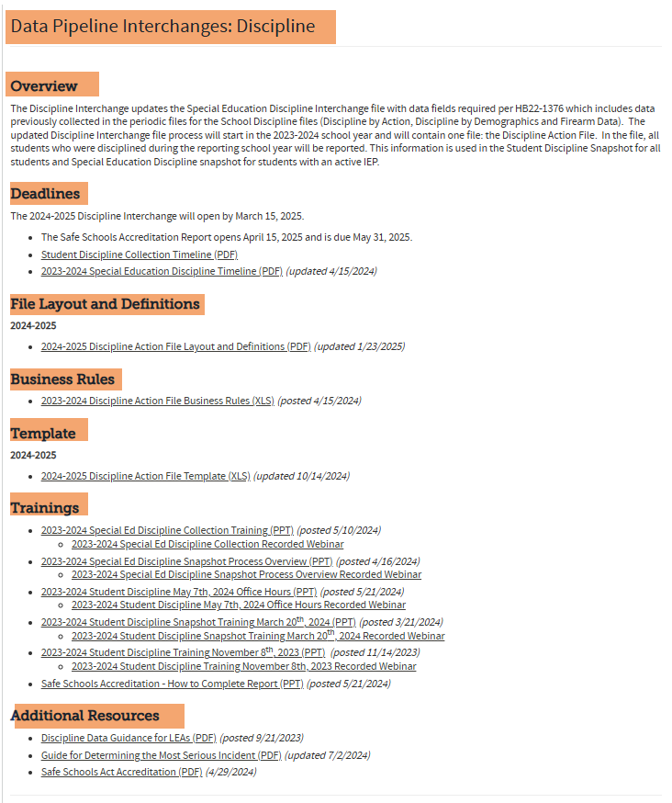
Discipline Resources
Discipline Interchange website

Slide 8
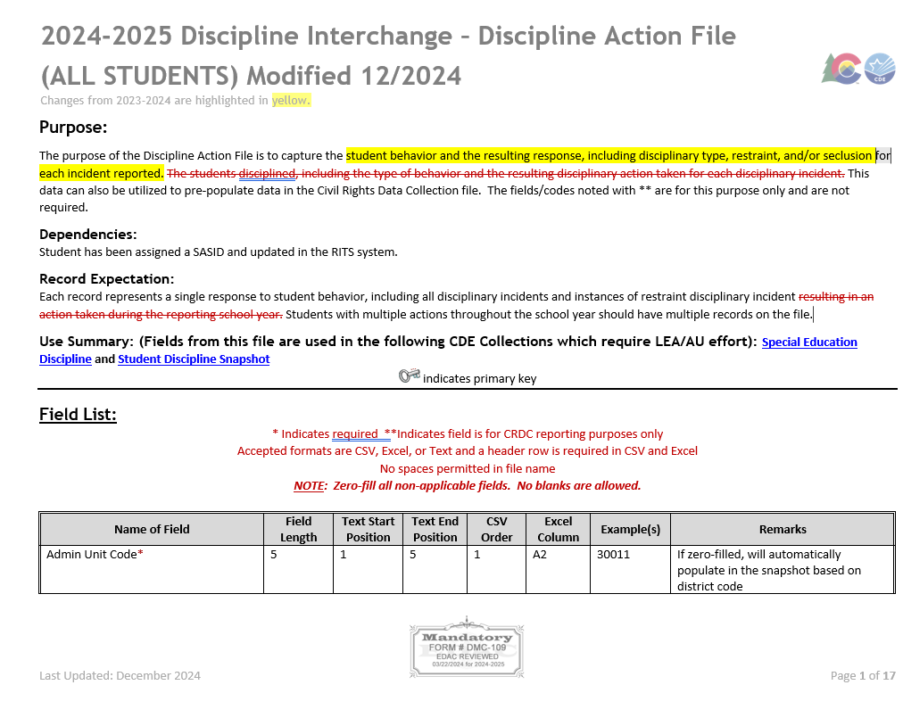
Student Discipline
Discipline Action File Layout

Slide 9
Discipline Interchange-Discipline Action File (ALL STUDENTS)
Discipline Action File Layout-The purpose of the Discipline Action File is to collect students’ discipline actions with the most severe behavior type, along with any students restrained or placed in seclusion. This data can also be utilized to pre-populate data in the Civil Rights Data Collection file. The fields/codes noted with ** are for this purpose only and are not required.

Slide 10
Determining “Most Serious” Incident
Website resource
Guide for Determining “Most Serious” Incident
Important: The guidance applies only when a situation includes more than one behavior violation. Incidents considered only one violation will be reported as that behavior.

Slide 11
Let's take a deeper look at this guide
1. 1st, 2nd Degree or Vehicular Assaults
2. Rape or Attempted Rape
3. Dangerous Weapons - Unless weapon was used to inflict death or serious bodily injury in which case it would be
reported under the 1st, 2nd Degree or Vehicular Assaults category.
4. Sexual Violence/Battery (other than Rape)
5. 3rd Degree Assaults/Disorderly Conduct
6. Robbery
7. Other Felony (not reported in another descriptive category)
8. Bullying (New code for 2022-2023 Collection)
9. Detrimental Behavior
10. Drug Violations
11. Marijuana Violations
12. Alcohol Violations
13. Destruction of School Property
14. Disobedient/Defiant or Repeated Interference
15. Tobacco Violations
16. Other Violations of Code of Conduct
Incident Ranking: Most Severe to Less Severe (a guide)
This ranking is intended as guidance only. Incidents can vary in seriousness on a case-by-case basis that would deviate
from the order listed.

Slide 12
What should I do if more than one behavior occurred during an incident?
Select only the most severe behavior
Link: Guide for Determining "Most Serious" Incident (PDF)
Example: If a student scuffled with another student in the parking lot which was considered to be a fight, then pulled out a knife (measuring longer than 3”) and threatened but did not harm the other student and was found to have a six-pack of beer in his car, the student has committed three violations. The school official would weigh the harm and potential harm caused by the student and determine the appropriate action for one or more of the violations. The potential for the knife to cause death would most likely be considered the most dangerous of the behaviors so it would be reported in the dangerous weapons category. (This may also be considered a felony menacing crime reportable as “Other Felony”.)

Slide 13
Student Discipline-Discipline Action File Layout Recent Change Approved by EDAC January 10th, 2025
Discipline Action File Layout
New Behavior Code of 00

Slide 14
District Provided guidance on Discipline Matrix

Slide 15


Purpose of the Discipline Matrix: Families
Families:
Clear outline of conduct code violations
Levels of offenses/definitions & examples
Range of disciplinary responses (ie. Suspensions, expulsions)
Links to District Policy
External links to resources (ie. Substances/counseling)
Notes:
The purpose of a discipline matrix varies depending on the stakeholder.
For families, it provides at minimum a clear outline of what is considered to be a violation of the conduct code, the levels of offenses based on severity or repeated conduct, and the range of possible disciplinary responses at each offense level. You may want to consider having a public version of your matrix, with links to external resources and supports for families, but the bulk of the information included should be identical to the internal version. This level of transparency helps families understand the expectations and consequences, fostering trust and cooperation.
This information should be consistent with what is in your District policies, as well as any other Student or Family Handbook., and it should be shared publicly and made accessible if there are different language preferences or other specific needs in your community.

Slide 16

Purpose of the Discipline Matrix: School-Based Staff
School-based Staff
Clear outline of conduct code violations
Levels of offenses/definitions & examples
Range of disciplinary responses (ie. Suspensions, expulsions)
Links to District Policy
AND:
Resources/alternatives to exclusionary practices
Guidance on when appropriate or mandatory to involve Law Enforcement
Guidance on when an offense may cross into Title IX/Discrimination space
When a Behavior Threat Assessment should be considered
Notes:
For school-based staff, the matrix offers that same clear outline of what is considered to be a violation of the conduct code, the levels of offenses based on severity or repeated conduct, and the range of possible disciplinary responses at each offense level. And, this should also provide resources and options to consider as alternatives to exclusionary discipline practices, especially for lower-level offenses where that type of response may not be appropriate. Having these additional resources support the teaching of positive behaviors, ensures that these practices are available to all staff, and can complement any disciplinary action that may be taken.
Additionally, your Matrix for school staff can include guidance on when conduct may cross into Title IX or discrimination spaces, when it is appropriate or mandatory to involve law enforcement, and when to initiate a behavior threat assessment to ensure school and student safety. These elements could also be included in your family version as well, but should absolutely be in any internal version of your Matrix.
By including this information, you are facilitating consistent, systemic responses that are aligned to you District policies and legal statute.

Slide 17
Purpose of the Discipline Matrix: District Administrators
District Administrators:
All of the same as for families and school-based staff
AND
Coaching and onboarding resource for new administrators
It provides data that facilitates accurate reporting to the state and the Office of Civil Rights
It ensures compliance with legal requirements
identify areas for improvement regarding student discipline
Notes:
For district administrators, the matrix serves all of the same purposes as for families and for school;-based staff.
And, when this is in place, it ensures that discipline practices are consistent and equitable across all district schools.
It can serve as a valuable coaching and onboarding resource for new administrators, helping them understand and implement district policies effectively.
And one of the most important “value adds” at the district level is what an effective discipline matrix can provide beyond healthy school environments.
It provides data that facilitates accurate reporting to the state and the Office of Civil Rights
It ensures compliance with legal requirements
And it can help to identify areas for improvement regarding student discipline and shine a light on what is truly happening in schools.

Slide 18
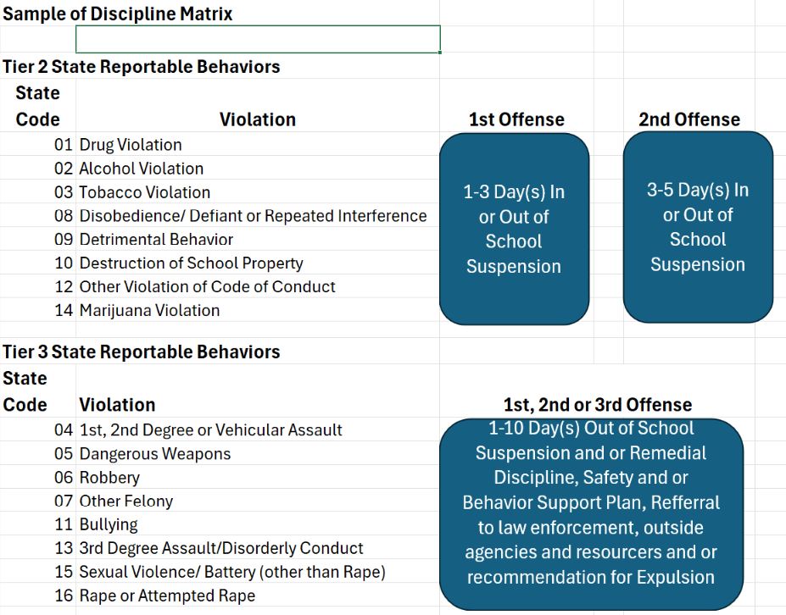
Example of a Discipline Matrix
The Discipline Action file lists all state reportable behaviors
Use your Districts Discipline Matrix to determine the violation and discipline action
Notes:
In this case, their Tier 1 is discipline that is not state reportable, Tier 2 is the first level of state reporting behavior, and Tier 3 is more serious violations

Slide 19
District Provided guidance on Policy

Slide 20


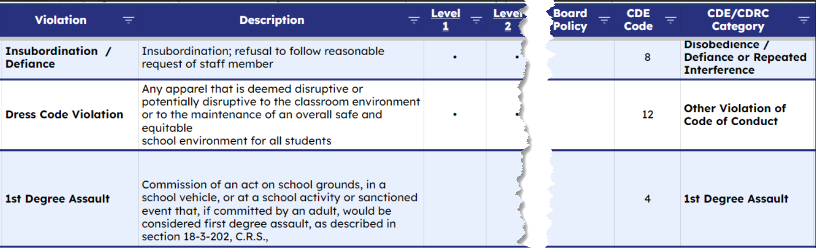
Essential Check #1: What is the Policy?
Federal and State Legislature
Local school board policies
Find your district matrix/flowchart
Notes:
Knowing how each policy may interchange with another will help give you a more global understanding of the collection. However, it is equally important to comprehend the internal process of handling discipline data. Give consideration to both ‘external’ and ‘internal’ policies.
Ask yourself and find the answers to questions like:
Which data elements are supposed to be included and what are the definitions? Can I find them in my district procedures?
View 2024-25 Discipline Interchange – Discipline Action File (see page 5-9)
Does your district have an established process for handling behavior incidents?
Consult your districts Matrix/Flowchart level based system centered around board policy, that is inclusive of state and federal statute requirements (CDE and CRDC guidelines). It should include best practices to help identify and provide appropriate interventions, supports, and consequences to address wrongdoing. While every attempt should be made to maximize the time that students are engaged in the learning process, interventions, supports, and consequences should be enacted that support students and maintain an orderly and safe learning environment.
The objectives of disciplining any student must be to help the student develop self-discipline, responsibility, respect for self and others, and socially acceptable behavior.
https://www.cde.state.co.us/datapipeline/dis_guide_determinemostseriousincident
https://www.cde.state.co.us/dropoutprevention/disciplinepolicy
https://safesupportivelearning.ed.gov/discipline-compendium?state=Colorado&sub_category=Restraint%20and%20Seclusion

Slide 21

Where Does the Discipline Data Go?
* Website: Discipline, Behavior, and School Climate
The Discipline collection is an annual collection of incidents that resulted in a student missing regular learning opportunities.
CRDC
CDE Statistics
School View
Colorado Department of Education
“Student Discipline Collection”
State Collection
Student Level
Office of Civil Rights (OCR)
“Civil Rights Data Collection (CRDC)”
Federal Collection
School Level with student level demographic data
Notes:
The Discipline Action Collection records students who are disciplined, including the type of behavior and disciplinary action taken and is submitted to the Colorado Department of Education (CDE) for specific initiative evaluations. This same data file can also be used to pre-populate the Civil Rights Data Collection (CRDC) discipline sections.
The overall goal of this CDE discipline collection is to track student level data in order to better support districts/schools who can engage with their students! This is something that all educators can agree with… keep students in class so they can continue to learn, grow, and thrive. We accomplish this by decreasing the number of behavior incidents such as detrimental behavior, drug or alcohol violations, and threats of physical attack that subsequently result in classroom removals, suspensions, and expulsions which can mean the student is missing regular instructional time.
CDE uses this data within their Dropout Prevention Office for the Supportive School Discipline Initiative and the School Discipline Task Force to assist with local discipline guidance needs for districts. Not only can this data be used for local district review and reflection, but it is also used federally, from the the Office of Civil Rights. Through the CRDC, they focus on complaints alleging discrimination to determine whether the civil rights laws have been violated and if determined so they will then initiate proactive compliance reviews, and provides policy guidance and technical assistance to schools and school districts.
These collective efforts ensure we are doing everything in our power to keep students safe and protected during their time in our educational care. Note, there are some additional links on the slide to various public release websites that in some way or another utilize this data.

Slide 22
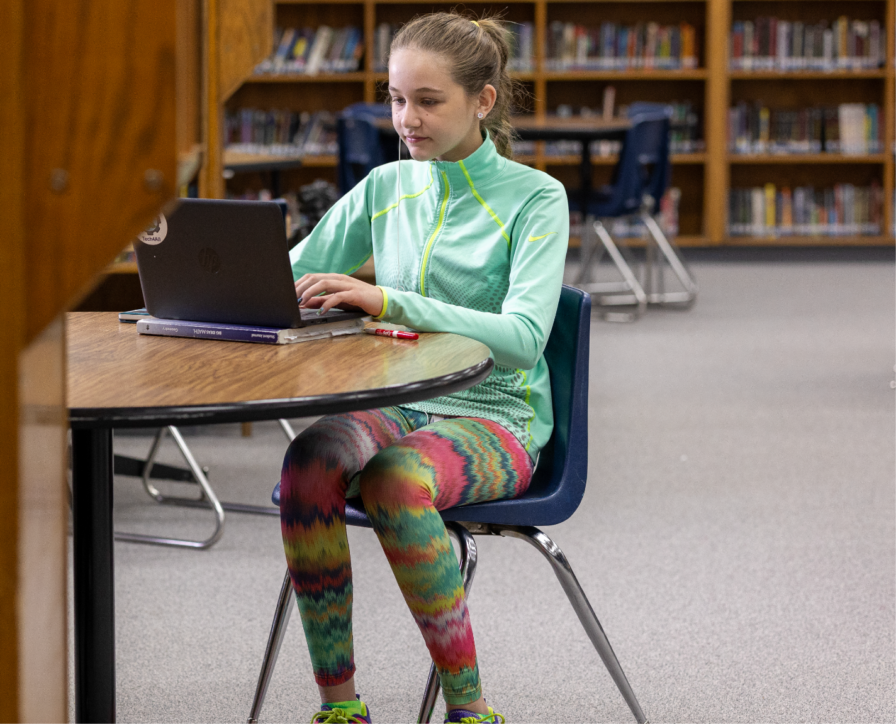
District Profile Reports
* Websites: Stakeholder Report & HB 22-1376 Summary
Data driven decision making should not be viewed as a challenge to the positions of power, but rather a tool to engage schools and the community.
House Bill 22-1376 (concerning Supportive Learning Environments for K-12) tasked CDE with development of data reports for discipline, behavior, school climate, and other measures. This aggregated data will be easily accessible through District Profile Reports made for each school district and charter school institute.
Notes:
When we allow ourselves the ability to have the decisions we make to be better informed, we make better quality decisions with a higher level of confidence.
A stakeholder group last year completed work around the necessity for data standardization as part of House Bill 22-1376. Through this bill it was determined that CDE needed to implement a global resource option for public viewing of school data that is collected.
What does this mean? The data you are supplying is what will contribute to the dashboard of data available within the new District Profile. District profile reports are available to the public, are to be user-friendly, updated annually, and be disaggregated by gender, grade, ethnicity, disability, ELL, free and reduced-price lunch, and homeless statuses.
Various measures are required to be represented in the district profile reports, which include the following: the number and type of disciplinary incidents and actions taken in response at a student level, chronic absenteeism rates, number of in-school suspensions/out-of-school suspensions/expulsions, count of referrals to law enforcement, school-related arrests, students handcuffed, students physically restrained, and students placed in seclusion. Within the district profile there are also mental health provider ratios, school climate surveys, and any other existing district-level measures that CDE determines relevant and related to school climate.
Click here to view the stakeholder report.
H.B.22-1376 details are available.

Slide 23
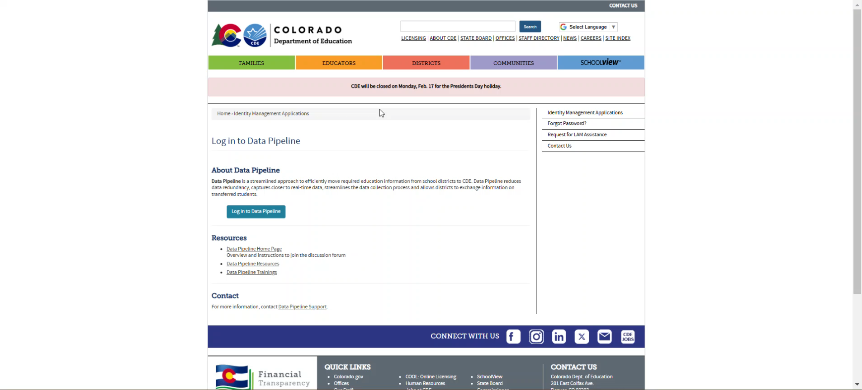
Published District Profile Reports
Notes:
House Bill 22-1376 (concerning Supportive Learning Environments for K-12) tasked CDE with development of data reports for discipline, behavior, school climate, and other measures. This aggregated data will be easily accessible through District Profile Reports made for each school district and charter school institute.

Slide 24
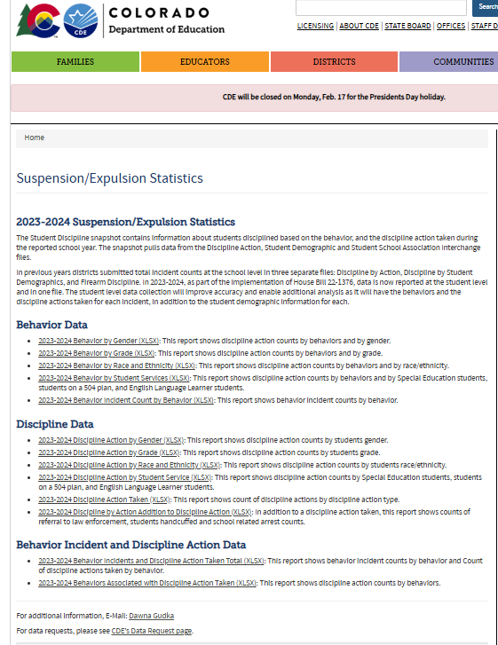
Published Discipline Data Reports on website
2023-2024 Suspension/Expulsion Statistics

Slide 25
Restraint or Placed in Seclusion Examples of record in Discipline Action file

Slide 26
Reporting Physical restraint should be included in the Discipline Interchange File
The following data fields must be zero-fille for these records:
Behavior Type (00)
Weapon Type (00)
Discipline Action Identifier (0000000000)
Discipline Action Type (00)
Referral to Law Enforcement (0 for No)
Handcuffed Status (0 for No)
School Related Arrest (0 for No)
Mechanically Restrained (for CRDC reporting purposes only) (0 for No)
Received Education Services During Expulsion (0 for No)
Transferred to Alternative School (0 for No)
Discipline Action Length (0000)
Discipline Start Date (00000000)
Special Education Removal Type (00 N/A)
Special Education Removal Reason (00 N/A)
When the incident involved the student being restrained and placed in seclusion you would only have 1 record.
Except for mechanically restrained, mechanically restraints are for CRDC reporting only.

Slide 27
Reporting Student Placed in Seclusion should be included in the Discipline Interchange File
The following data fields must be zero-fille for these records:
Behavior Type (00)
Weapon Type (00)
Discipline Action Identifier (0000000000)
Discipline Action Type (00)
Referral to Law Enforcement (0 for No)
Handcuffed Status (0 for No)
School Related Arrest (0 for No)
Mechanically Restrained (for CRDC reporting purposes only) (0 for No)
Received Education Services During Expulsion (0 for No)
Transferred to Alternative School (0 for No)
Discipline Action Length (0000)
Discipline Start Date (00000000)
Special Education Removal Type (0 for No)
Special Education Removal Reason (0 for No)
When the incident involved the student being restrained and placed in seclusion you would only have 1 record.
Except for mechanically restrained, mechanically restraints are for CRDC reporting only.

Slide 28

Student Discipline-Discipline Action File Example of Student Physically Restrained
Example of Student Physically Restrained
Discipline Action File
Behavior 00 (Column G, Behavior code)
Discipline 00 (Column P, Discipline Action Type)
Physically Restrained 1 indicating yes (Column T, Physically Restrained)
Discipline Action Length should be zero filled
Discipline Action record

Slide 29
Student Discipline-Discipline Action File Example of Student Placed in Seclusion
Example of Student Placed in Seclusion
Discipline Action File
Behavior 00 (Column G, Behavior code)
Discipline 00 (Column P, Discipline Action Type)
Placed in Seclusion 1 indicating yes(Column V, Placed in Seclusion)
Discipline Action Length should be zero filled
Discipline Action record

Slide 30
Behavior Incident and Discipline Action taken Examples of record in Discipline Action file

Slide 31
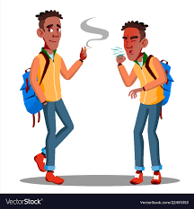
Student Discipline-Discipline Action File Example of reporting incident involving a state reportable behavior and discipline action 1 Student involved in incident
One student was caught smoking in the school
1 student and 1 unique incident ID, the incident date
Behavior of (03) Tobacco violation
Student received 1 day, discipline action length 0010
Discipline Action Type (11) In school suspension

Slide 32
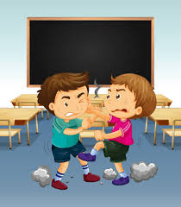
Student Discipline-Discipline Action File Example of reporting incident involving a state reportable behavior and discipline action 3 Student involved in incident
Three students were caught fighting in the school
After investigation 2 students received 2 days of out of school suspension, and 1 student received 4 days of out of school suspension
3 students and 1 unique incident ID, the incident date
Behavior of (09) Detrimental Behavior
Discipline Action (12) Out of School Suspension

Slide 33
Student Discipline-Discipline Action File Example when multiple behaviors are violated in the same incident
5 students were involved in a fight in the parking lot
After the investigation to determine what happened school admin determined:
(Student A) 1 student was being bullied
(Student B &C) students defended the student being bullied and confronted the 2 students and pushing them to the ground
(Student D) student got into his vehicle and tried to run over the 2 students (Students B& C) that pushed him to the ground.
(Student E) This student got into her vehicle and was found to be smoking in her vehicle
Student A : was being bullied was not disciplined, therefore no record needed in the discipline action file for this student
Student B that pushed the two students that were bullying received 3 days in school suspension
Student C that pushed the two that were bullying received 5 days in school suspension since student also was caught with a tobacco product.
Student D got into his car and tried running over the students that pushed him to the ground received 10 days out of school suspension
Student E was found smoking received 5 days out of school suspension.
The Behavior incident was recorded as 1st, 2nd, Degree or Vehicular Assault after determining the “most serious behavior”
All students will have the same incident identifier, and same incident date, but all students will have different discipline actions according to the discipline action taken.

Slide 34

Students vaping
Example: Two students were found vaping in the bathroom and they both received an out of school suspension.
Incident: Students vaping and the consequence of OSS
Behavior: Tobacco violation for vaping (03 Behavior Type)
Discipline Action: Out of school suspension (12 Discipline Action Type)
Incident Identifier same for both students
Incident date same for both students
1 record for Student A
1 record for Student B
Behavior: Tobacco violation for vaping (03 Behavior Type)
Discipline Action: Out of school suspension (12 Discipline Action Type)

Slide 35
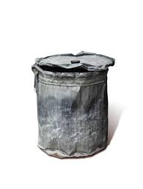
Example when a Behavior Incident involves a discipline action and restraint, or student placed in seclusion.
Example 1 student was found smashing metal trash cans in the locker-room.
The student continued smashing the metal trash cans and would not stop when asked to. This student was restrained.
Two records needed to properly report this file in the Discipline Action Interchange file
1st record with the behavior of 00 to indicate the restraint
2nd record with the behavior of Destruction of School Property (Behavior code 10) and the discipline action type of out of school suspension (Discipline Action Type code 12).

Slide 36
Data Pipeline Process

Slide 37
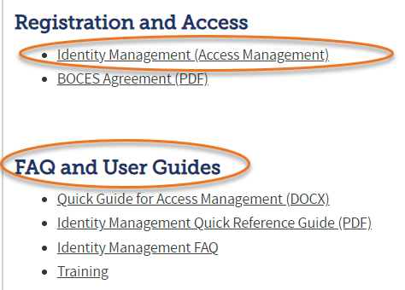
Data Pipeline Roles in the Identity Management (IdM)
Identity Management (IdM)
Student Interchange Roles
STD-VIEWER
STD-LEAUSER
Discipline Interchange Roles
DIS-LEAVIEWER
DIS-LEAUSER
Discipline Snapshot Roles
STU-LEAVIEWER
STU-LEAUSER
STU-LEAAPPROVER
*Note: can only have 1 role under each role category
or you will get locked out of Data Pipeline

Slide 38
How the Interchange files work together to create the Student Discipline Snapshot
Student
Demographics Interchange file
Student School Association Interchange file
Discipline Interchange-Discipline Action file
Student Discipline Snapshot

Slide 39
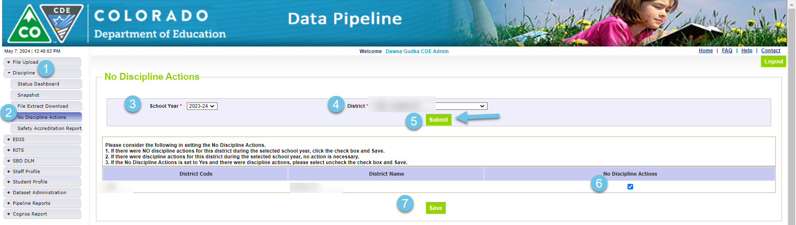
Data Pipeline Process If there is NO incidents to report, the Discipline Action is not uploaded into Data Pipeline
THIS IS ONLY NEEDED IF YOUR DISTRICT HAS NO DISCIPLINE DATA TO REPORT

Slide 40
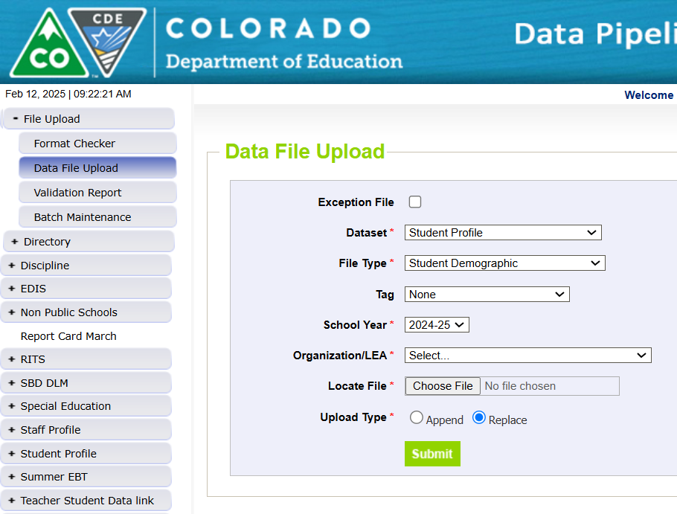
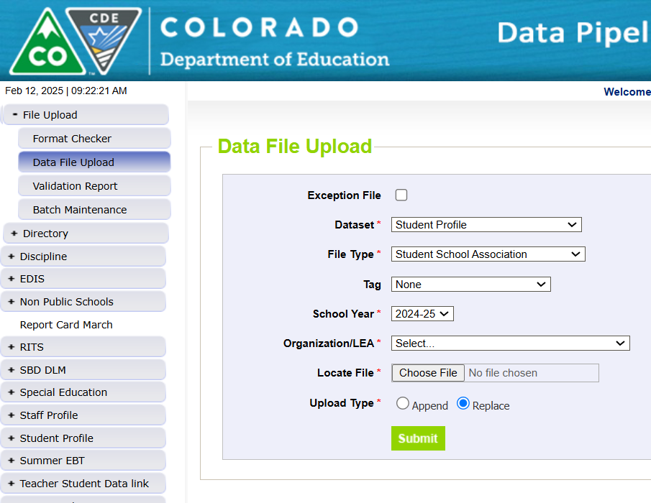
Interchange files need to be uploaded into Data Pipeline Student Profile Demographics and School Association file

Slide 41
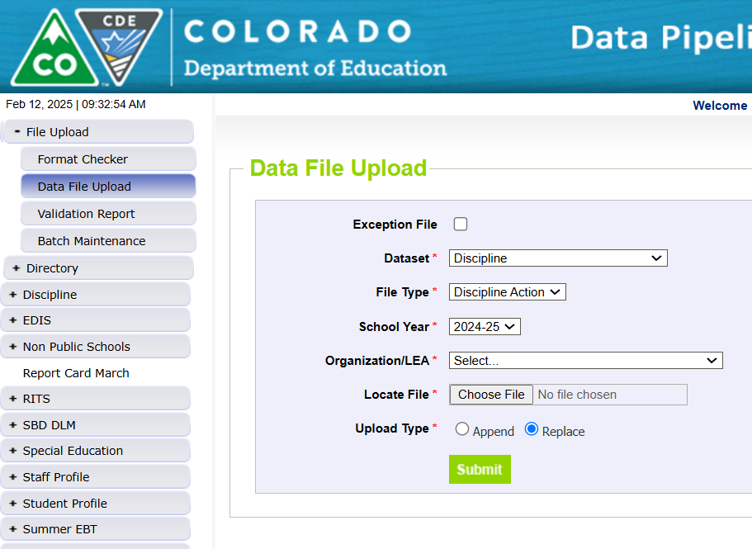
Interchange files need to be uploaded into Data Pipeline Discipline Interchange file

Slide 42
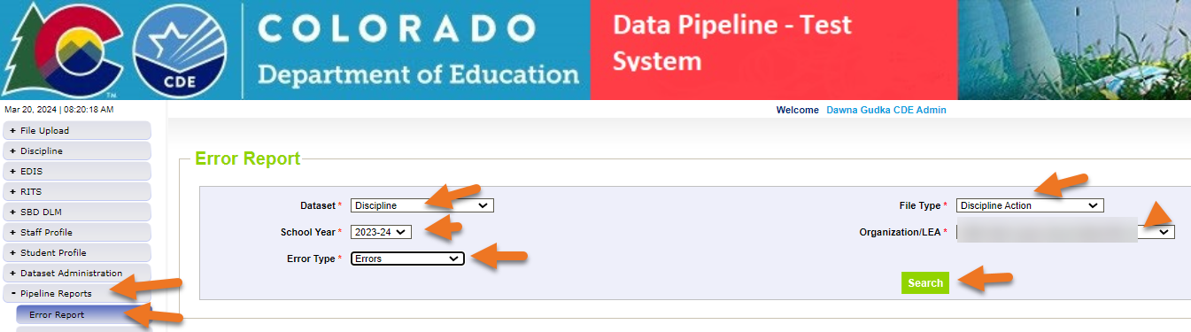
Discipline Action Interchange file Checking for Student Discipline Interchange errors
Then click on View Details to see the errors in Detail

Slide 43
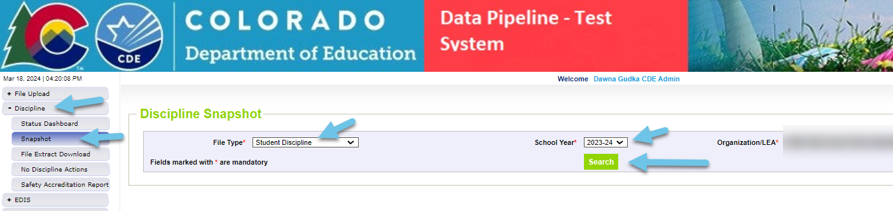
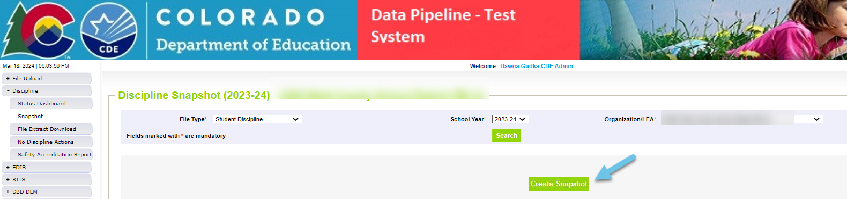
Creating a Student Discipline Snapshot
Creating a snapshot in Data Pipeline-by clicking on the create snapshot button Data Pipeline merges all 3 interchange files together pulling in the Snapshot records

Slide 44
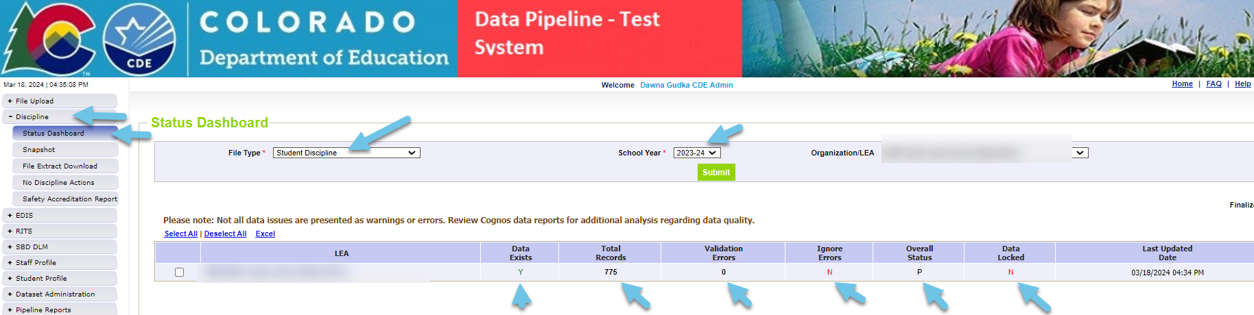
Interchange files Checking status of snapshot

Slide 45
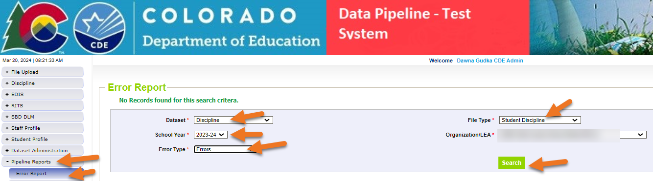
Data Pipeline Checking for Student Snapshot errors
Then click on View Details to see the errors in Detail

Slide 46
Frequently Asked Questions

Slide 47
Collection Terms
Discipline incident: The discipline event that occurred, including both the behavior and the discipline action
Behavior: The act that the student engaged in that resulted in them receiving a discipline action
Discipline Action: The consequence for the student's behavior

Slide 48
How do I know which behaviors should be reported?
Go back to your discipline matrix to see which behaviors are state reportable
Usually found in the district handbook

Slide 49
How should I report behavior that happened off campus?
A district can suspend for off-campus conduct and should first consider whether off-campus conduct is something that can be subject to discipline. The grounds for suspension and expulsion are in C.R.S. 22-33-106(1).
The ground that is commonly used for off-campus conduct is this:
“Behavior on or off school property that is detrimental to the welfare or safety of other pupils or of school personnel, including behavior that creates a threat of physical harm to the child or to other children; except that, if the child who creates the threat is a child with a disability pursuant to section 22-20-103(5), the child may not be expelled if the actions creating the threat are a manifestation of the child's disability.” C.R.S. 22-33-106(1)(c).
In short: suspension or expulsion for off-campus conduct is permitted by law; however, there must be a nexus to the school. It must be detrimental to the welfare or safety of other pupils or of the school personnel. It cannot just be punishment for what the student did if it doesn’t impact other students or school personnel.
If a student is disciplined for off-campus bullying that has a nexus to school, that can be reported in the bullying category.
All other off-campus behavior subject to discipline should be coded as “other violation of code of conduct – 12”

Slide 50
What should I report if multiple incidents happened on the same day?
Report each instance that occurred
Make sure each are a unique incident and have their own incident identifier
May be worth bringing this up with the administrator if the student is receiving several incidents in one day
Example: A student got kicked out of every class period.
Here is how this would be reported: Classroom removal

Slide 51
How should I code if a seclusion and restraint happened during the same situation?
Both can be selected within the same incident line
Example: During a crisis situation and the last resort option, a student was physically restrained. The physical restraint became too dangerous and the student was then placed in seclusion.
Since both a physical restraint and a seclusion happened during the same situation, they both can be selected in the same incident line.

Slide 52
Additional Information Collection Resources

Slide 53
What is PII? Personally Identifiable Information (PII)
Student Personally Identifiable Information (PII) is defined by state and federal laws as information that, alone or in combination, personally identifies an individual
This includes direct identifiers (i.e. student and staff names, SASID, EDID, etc.)
Includes information that when combined is identifiable
Colorado’s Student Data Transparency and Security Act outlines requirements for how Student PII is collected, used and shared
CDE has prepared guidance on how to comply with this and other privacy laws which can be found here.

Slide 54

Sharing Data
Use secure methods to transfer any PII to CDE
Contact Data Collection leads with questions about how to transmit PII securely
Each Data Collection leads maintains their own Syncplicity folders for specific collections, reach out to the collection lead for access
Use Syncplicity to encrypt emails to CDE
Avoid sending PII via unencrypted email or to unsecured faxes when sharing data between or within districts
Use Syncplicity to encrypt emails to CDE
Check local policies for restrictions, requirements, etc. regarding PII
Do not use PII in trainings, presentations, etc.
Do not share PII with unauthorized individuals
Do not share passwords
Follow local policies when transmitting PII to any third party

Slide 55
Collection Resources
Student Interchange website
Student Demographics File Layout
School Association File Layout
Discipline Interchange website
Discipline Action File Layout
Discipline Snapshot website
Data Pipeline Home Page
Town Hall
Upcoming Town Hall
Archived Town Hall Presentations
CDE Website
Frequently Requested Codes

Slide 56

Q

Slide 57
Safe Schools Accreditation Report

Slide 58
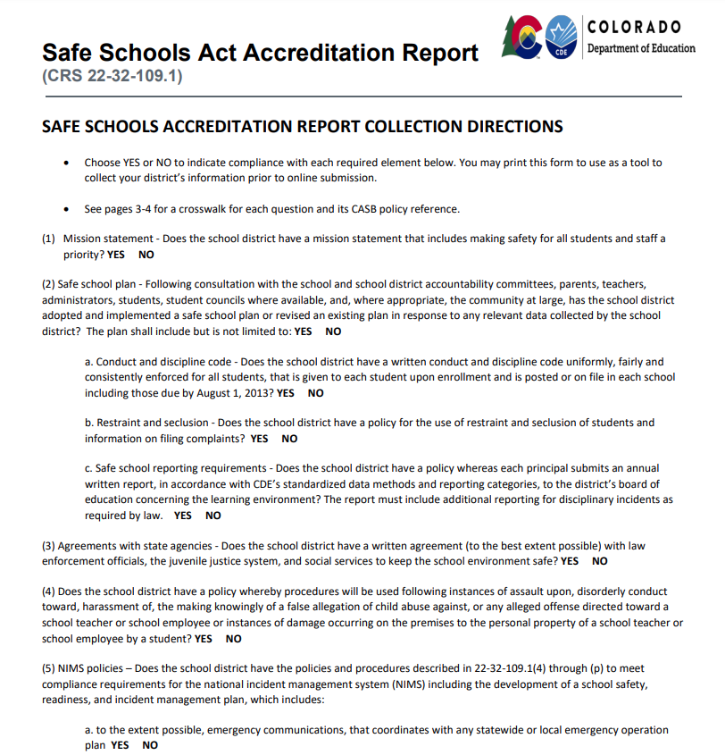
Safe Schools Act Accreditation Report Resource
Safe Schools Act Accreditation Report Resource

Slide 59
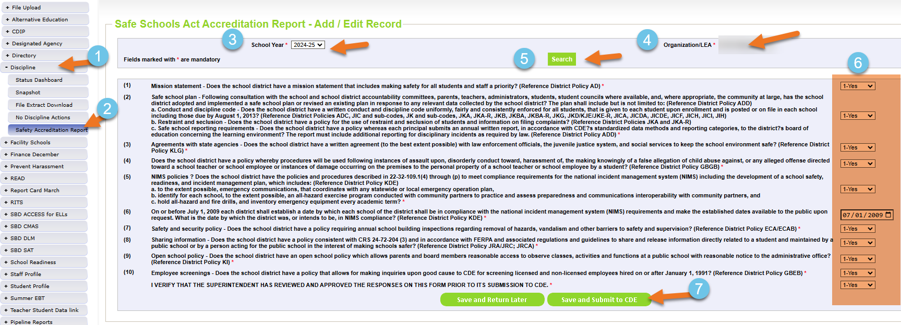
Safe Schools Act Accreditation Data Pipeline Process

Slide 60

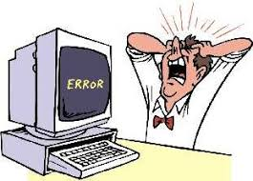
StudentDisciplineSnapshot@cde.state.co.us Dawna Gudka (303) 598-7901

