Slide 1
August 14, 2025
Data Pipeline Town Hall
The goal of the webinar is to provide updates on the Data Pipeline, current, and upcoming data collections. These webinars also provide a forum for districts, BOCES, and Administrative Units to have questions answered about Data Pipeline.

Slide 2
Colorado Department of Education
Identity Management (IdM)
Identity Management Site
Frequently Asked Questions
How do I add myself or others to the email listserv for town hall emails and/or a specific collection?
  Email lists are dependent on a person’s access rights in IdM. Contact your LAM to get an account or be assigned to a specific collection.
Where can I find the IdM role mappings for Data Pipeline and other applications?
  Role Mapping (XLS)
I am a LAM. How do I update the user permissions for someone in my district?
  Follow the steps outlined in the IdM Quick Guide for Access Management (DOCX)
Important: Users are not automatically removed from IdM when their email address is no longer active in your district. The LAM must deactivate their IdM account to ensure only designated staff can access CDE’s data reporting system.
Support:
  Michael Threlkeld
  Forgot Password
  Request LAM Assistance
Notes:
LAMs, please check the IdM roles for your district. Remove permissions for users who have retired, left your district, or are no longer assigned to a collection. Add roles for new hires and newly assigned respondents for specific collections.

Slide 3

What is PII?
Student and Staff Personally Identifiable Information (PII) is defined by state and federal laws as information that, alone or in combination, personally identifies an individual
  This includes direct identifiers
  (i.e. student and staff names, SASID, EDID, etc.)
  Includes information that when combined is identifiable
Colorado’s Student Data Transparency and Security Act outlines requirements for how Student PII is collected, used and shared
See the Data Privacy and Security website for prepared guidance on how to comply with this and other privacy laws.

Slide 4

Sharing Data
Use secure methods to transfer any PII to CDE
  Contact Data Collection leads with questions about how to transmit PII securely
    Each Data Collection leads maintains their own Syncplicity folders for specific collections, reach out to the collection lead for access
  Use Syncplicity to encrypt emails to CDE
Avoid sending PII via unencrypted email or to unsecured faxes when sharing data between or within districts
  Use Syncplicity to encrypt emails to CDE
Check local policies for restrictions, requirements, etc. regarding PII
  Do not use PII in trainings, presentations, etc.
  Do not share PII with unauthorized individuals
  Do not share passwords
  Follow local policies when transmitting PII to any third party

Slide 5
Today’s Agenda
Agenda Topic | Presenter
Open Data Collections and Upcoming Deadlines in Data Pipeline | Host: Reagan Ward
Student End of Year | Reagan Ward
Human Resources | Dawna Gudka
Staff Evaluation | Dawna Gudka
Special Education End of Year | Lindsey Heitman
Instructional Days and Hours | Jessica Tribbett
RITS: SASID Updates | Jessica Tribbett
READ Collections | Tara Rhodes

Slide 6
Open Collections and
Upcoming Deadlines in
Data Pipeline

Slide 7
Open Collections and Upcoming Dates:
Year-Round & Interchanges
Name | Category | Status | Key Dates
RITS | Year Round | Open | N/A
EDIS | Year Round | Open | N/A
Directory | Year Round | Open | District Calendars: Open, due 8/20/25
Student | Interchange | 2025 & 2026 Open | 2024-2025: Maintain error free files 2025-2026: Open, ML Collaborative Webinar 8/19 (Registration Link)
At-Risk | Interchange | Open | 2025-2026: Overview Training 8/21/25, 10am (Registration Link)
Title I | Interchange | Open | 2024-2025: Maintain error free file 2025-2026: Coming Soon! Scheduled to open in Aug
Special Education IEP | Interchange | Open | Maintain error free files
Staff | Interchange | Open | Staff Profile and Staff Evaluation interchange files are needed for the Staff Evaluation Snapshot
Discipline Action | Interchange | Open | This interchange file is needed for Student Discipline Snapshot and Special Education Discipline Snapshot
Teacher Student Data Link | Interchange | Open | Maintain error free file
Data Pipeline Resources: Data Pipeline Collection Dates (XLS)

Slide 8
Open Collections and Upcoming Dates:
Snapshots
Name | Category | Status | Final Deadline Date | Next Milestone | Looking Ahead
Teacher Student Data Link | Snapshot | Open | Aug. 29, 2025 | Interim Deadline: 8/22/25 error free interchange and snapshot | Report Review: 8/25 to 8/28 Final snapshot report review
Staff Evaluation | Snapshot | Open | Oct. 15, 2025 | Report Review: 7/15 to 8/15 Final snapshot report review | State Deadline: 10/15
Student End of Year: Regular Phase | Snapshot | Open | Sept. 4, 2025 | Interim Deadline: 8/14/25 error free snapshot | Report Review: 8/14/25 to 9/4/25 Review and validate data
Special Education EOY | Snapshot | Open | Oct. 3, 2025 | Interim Deadline: 9/4/25 all exception requests submitted to CDE for review | Interim Deadline: 9/11/25 error free snapshot
Student Attendance | Snapshot | Closed | July 25, 2025 |  | Data Release: 8/21/25
Special Education Discipline | Snapshot | Closed | Aug. 1, 2025
Student Discipline | Snapshot | Closed | July 31, 2025
Data Pipeline Resources: Data Pipeline Collection Dates (XLS)

Slide 9
Open Collections and Upcoming Dates:
Periodic
Name | Category | Status | Final Deadline Date | Next Milestone | Looking Ahead
Summer EBT: Corrections Period | Periodic | Open | Sept. 3, 2025 | Corrections Period: 5/19/2025 to 9/3/2025
READ Training | Periodic | Open | Aug. 30, 2025 | Other Date: 8/15/25 Teachers, Principals, and Administrators should have their respective READ training designations added to their COOL accounts | Interim Deadline: 8/19/25 initial file upload
Prevent Harassment or Discrimination | Periodic | Closed
Data Pipeline Resources: Data Pipeline Collection Dates (XLS)

Slide 10
Student End of Year
Reagan Ward

Slide 11
SEY Collection Timeline
Date | Event | Event Description
8/14/2025 | Interim Deadline | Error free SEY snapshot
8/14/2025 to 9/4/2025 | Report Review | Validate SEY data using CEDAR/COGNOS reports.
9/4/2025 | State Deadline | Submit SEY snapshot
9/5/2025 to 9/17/2025 | Closed | SEY Snapshot is closed until the start of the Cross LEA phase
9/18/2025 to 10/16/2025 | Cross LEA Phase | See the SEY Website for the detailed timeline
10/23/2025 to 11/18/2025 | Post-Cross LEA Phase | See the SEY Website for the detailed timeline
12/2/2025 | Deadline | Superintendent Verification (Sign-Off) form due. Collection Closes.
Student End of Year
StudentEndOfYear@cde.state.co.us

Slide 12
SEY Status as of 8am on 8/14
To be ‘on track’ for this collection, the following tasks should have been completed:
  Error free interchange files (DEM, SSA, GG, Title 1 if applicable, IEP interchange if applicable) with an upload date after 4/1/25
  Error free SEY Snapshot 8/14
    Pending possible summer graduates/completers
    Pending submitted exception requests
Student End of Year
StudentEndOfYear@cde.state.co.us

Slide 13
Report Review Window: Report Checklist
August SEY Office Hours: CEDAR/COGNOS Reports to Validate Data
Recording and Slides posted on SEY Website
School Summary of All Rates
Mobility: District and School Rates
  Dig Deeper?
    Student List: District and School Mobility Instances
Dropout: District and School Rates
  Dig Deeper?
    Student List: Dropout
Graduation: 3-,4-,5-,6-,7- year Rates by School Year
  Dig Deeper?
    Graduation Rates: District and School by AYG
    Still Enrolled Rates: District and School by AYG
    Student List: AYG Cohort
    Student List: AYG Cohort Adjustments
Student End of Year
StudentEndOfYear@cde.state.co.us

Slide 14
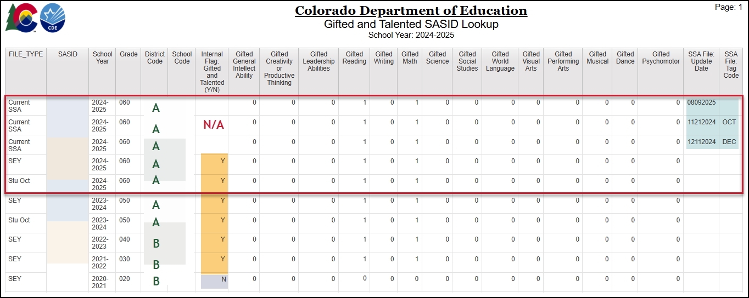
COGNOS Report Highlight:
Gifted and Talented SASID Lookup
Report Category: Student Interchange
Report Updated: Aug 2025 (expanded years)
Reflects:
  Current SSA file
  SEY Snapshot History (all years)
  Current year + 1 Prior year Student October
Researching SEY Errors:
  SE163 Prior SEY compared to current SEY
  SE312 Current OCT compared to SEY
Student End of Year
StudentEndOfYear@cde.state.co.us

Slide 15
Questions & Resources:
Student End of Year
StudentEndOfYear@cde.state.co.us
720-484-9057
  Student End of Year Collection Website
  Student Interchange Website
  Graduation Guidelines (Program) Website

Slide 16
Human Resources
Dawna Gudka

Slide 17
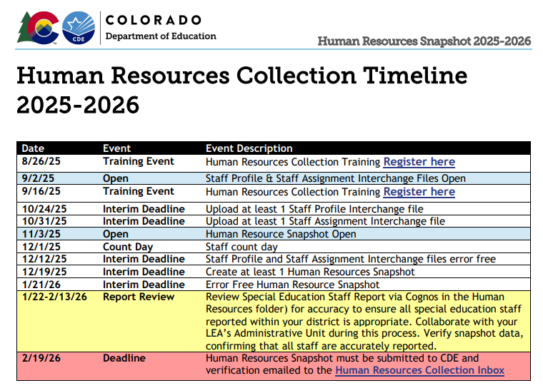
Human Resources Collection Timeline
2025-2026 Human Resources Collection Timeline
Human Resources Snapshot Collection
HumanResourcesData@cde.state.co.us

Slide 18

Register for Human Resources collection training
August 26th 10-11am
Register here
September 16th, 10-11am
Register here
Human Resources Snapshot Collection
HumanResourcesData@cde.state.co.us

Slide 19
Questions & Resources:
Human Resources
Human Resources Snapshot Collection
Staff Interchange website
Staff Profile file layout
Staff Assignment file layout
Human Resources Snapshot website
Dawna Gudka-collection lead
HumanResourcesData@cde.state.co.us
(303) 598-7901

Slide 20
Staff Evaluation
Dawna Gudka

Slide 21

Staff Evaluation Snapshot Collection Status
Staff Evaluation Snapshot Collection
StaffEvaluation@cde.state.co.us

Slide 22
Staff Evaluation Collection Reminders
Complete this collection early
Extract your staff evaluation data from COPMS (RANDA)
  Step by step guide to extract file
Refer to the collection manual for complete steps to complete the collection
If a teacher, special service provider, or principal left prior to the evaluation being completed, use a 06 in their overall rating, and 00 in the other evaluation ratings. This indicates the evaluation was not fully completed.
EV004, EV005, EV006 errors trigger when you go over the 5% threshold of staff not evaluated. In the error message you will find an URL address, copy and paste in a new browser window and fill out the exception request. This request goes to our Ed Talent team for approval.
Staff Evaluation Snapshot Collection
StaffEvaluation@cde.state.co.us

Slide 23
Questions & Resources:
Staff Evaluation
Staff Evaluation Snapshot Collection
Staff Interchange website
Staff Profile file layout
Staff Evaluation file layout
Dawna Gudka-collection lead
StaffEvaluation@cde.state.co.us
(303) 598-7901

Slide 24
Special Education End of Year
Lindsey Heitman

Slide 25
Special Education End of Year
Timeline
May 1, 2025 - SPED EOY Snapshot official open
June 26, 2025 – IEP Interchange files error-free
September 4, 2025 - All Exception requests submitted to CDE
September 11, 2025 – All errors resolved at snapshot/interchange
September 12 -19, 2025 -Initial Report Review
September 22 - 26, 2025 – Resolving duplicates
September 29 – October 1, 2025 – Final Report Review
October 3, 2025 - Final submission due to CDE
Reminders for snapshot error work:
Be sure to check for new interchange errors each time you transfer revised files from Enrich to Pipeline!
Interchange errors are different between Enrich and Pipeline so you cannot rely on Enrich for those errors.
Be sure to check Batch Maintenance screen after each and every file upload or transfer from Enrich to ensure the latest version of your files have processed before creating a snapshot.
Special Education EOY – Lindsey Heitman
SpedEndofYear@cde.state.co.us

Slide 26
Special Education End of Year
Reporting Reminders
Initial Referrals that do not go to start school/services in your AU do not need a SASID. You can report a LASID (made up by the AU) and zero-fill SASID.
  This includes those you evaluated and found not eligible or those that were referred but did not have an evaluation by your AU or those who started an evaluation and did not complete it
Compare exits to your district’s Student EOY records
  Be sure you are capturing all exits from Special Education that occurred between 7/1/24 – 6/30/25
  Remember that missing exits affect your indicators 1, 2, and 14
  Check all warnings that help you locate possible exit data that is coded incorrectly
  Check ‘Records Not in Snapshot’ to be sure records aren’t being excluded due to a criteria issue
  Those uploading/maintaining a manual file after 7/1 may need to physically recollect your data again and compare to the file you’ve been working in
Check your Year-to-Year Comparison Report #’s 8 and 9 to find possible missing data
  Found in Special Education EOY Cognos folder
Special Education EOY – Lindsey Heitman
SpedEndofYear@cde.state.co.us

Slide 27
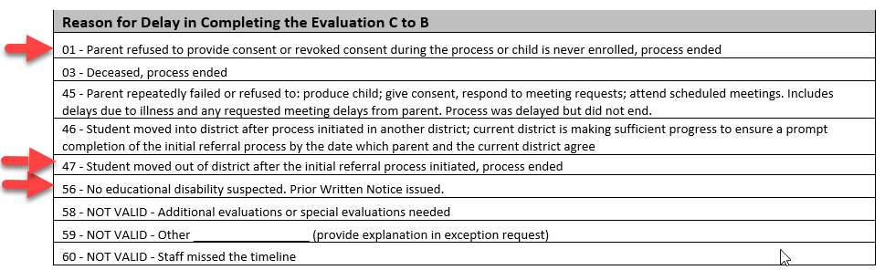
Special Education EOY:
Delay Codes for C to B Referrals that weren’t evaluated
Delay code 01 should be used when process ended – parent wouldn’t provide consent to evaluated or revoked consent during the process or child was never enrolled
Delay code 47 – student moved after initial referral process started – you would need a ‘Date of Parental Consent to Evaluate C to B’ to use this delay
Delay code 56 – no educational disability suspected after screening
SpedEndofYear@cde.state.co.us
Special Education End of Year – Lindsey Heitman

Slide 28
Special Education EOY:
Path 2 C to B Referral - Child Not Evaluated
In the Participation file for Path 2 you will have the following fields filled out:
Path 2 - Date Child is Found Eligible for Part C Services (date related to early intervention services)
Path 2 - Date of Referral to Administrative Unit from the Local Community Centered Board
The following fields zero-filled:
Path 2 - Date of Parental Consent to Evaluate C to B
Path 2 - Date Evaluation Completed C to B
Path 2 - Date of Initial Eligibility Meeting C to B
Path 2 - Date IEP was Implemented C to B
Path 2 - Eligibility and Services
The following Reasons for Delay all matching with the applicable reason:
Path 2 - Reason for Delay in Completing the Evaluation C to B
Path 2 - Reason for Delay in Initial Eligibility Meeting C to B
Path 2 - Reason for Delay in IEP Implementation C to B
How to report a child who was referred to the AU from the CCB (outside vendor providing early intervention services) that did not go on to be evaluated because parent wouldn’t provide consent to evaluate or no disability suspected after screening:
SASID = 0000000000
LASID = 0000000012 (10 digit # made up by AU)
Special Education Referral Type = 02
Path 2 - Date Child is Found Eligible for Part C Services = 04/01/2024
Path 2 - Date of Referral to Administrative Unit from CCB = 03/15/2025
Path 2 - Date of Parental Consent to Evaluate C to B = 00000000
Path 2 - Date Evaluation Completed C to B = 00000000
Path 2 - Reason for Delay in Completing the Evaluation C to B = 01 or 56
Path 2 - Date of Initial Eligibility Meeting C to B = 00000000
Path 2 - Reason for Delay in Initial Eligibility Meeting C to B = 01 or 56
Path 2 - Date IEP was Implemented C to B = 00000000
Path 2 - Reason for Delay in IEP Implementation C to B = 01 or 56
Path 2 - Eligibility and Services = 00
SpedEndofYear@cde.state.co.us
Special Education End of Year – Lindsey Heitman

Slide 29
Questions & Resources:
SPED End of Year
SpedEndofYear@cde.state.co.us
Lindsey Heitman
(720) 456-2033
Special Education IEP Interchange Webpage
Special Education End of Year Snapshot Webpage

Slide 30
Instructional Days and Hours
Jessica Tribbett

Slide 31
Instructional Days and Hours: Updated Collection Timeline
UPDATED! Collection Timeline
OPEN: Wednesday, September 17th
CLOSE: Friday, December 19th
Instructional Days and Hours
DirectoryData@cde.state.co.us

Slide 32
Instructional Days and Hours: IDM Roles
IDM ROLES NOT YET AVAILABLE
IDH APPROVER
IDH USER
IDH VIEWER
Until IDM roles are available to assign, I will be emailing respondents with Pipeline DIR access and district LAMs.
Instructional Days and Hours
DirectoryData@cde.state.co.us

Slide 33
Instructional Days and Hours: Training and Office Hours
TRAINING
  Wednesday, September 10th @ 10 a.m. Register here.
OFFICE HOURS
  Wednesday, September 24th @ 10 a.m. Register here.
Registration links can also be found on the Instructional Days and Hours website.
Instructional Days and Hours
DirectoryData@cde.state.co.us

Slide 34
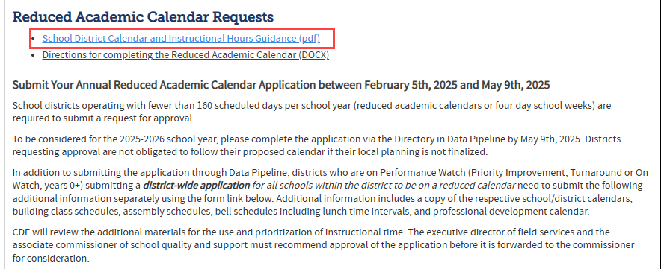
Update on requested document: School District Calendar and Instructional Hours Guidance
Data Pipeline Home>Year-Round Collections>Directory
Scroll to 'Reduced Academic Calendar Requests' section.
Instructional Days and Hours
DirectoryData@cde.state.co.us

Slide 35
Questions & Resources:
Instructional Days and Hours
Instructional Days and Hours website: Frequently Asked Questions
DirectoryData@cde.state.co.us
More information each week at DSU Town Halls
Trainings coming soon

Slide 36
RITS: SASID Updates
Jessica Tribbett

Slide 37
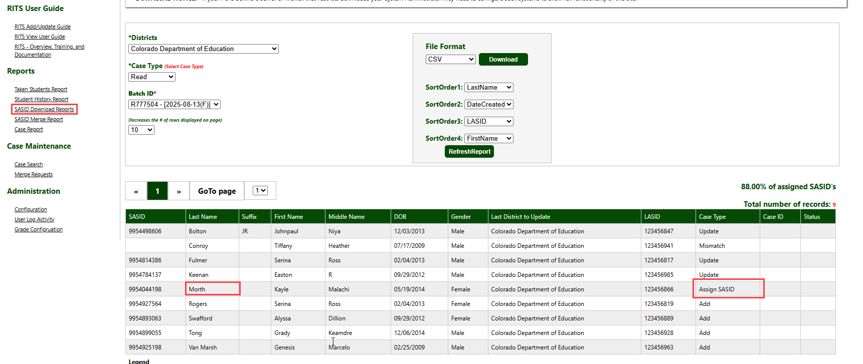
RITS Web: Case Type 'Assign SASID'
Made up student names and DOB for testing and training purposes.
SASIDS and RITS Web
RITS@cde.state.co.us

Slide 38
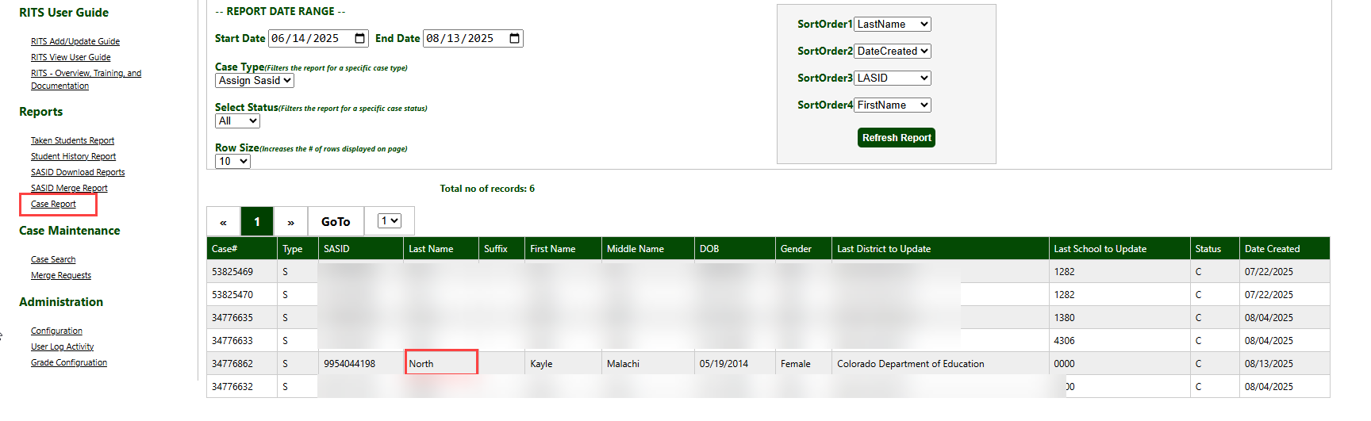
RITS Web: Case Report
Made up student names and DOB for testing and training purposes.
SASIDS and RITS Web
RITS@cde.state.co.us

Slide 39
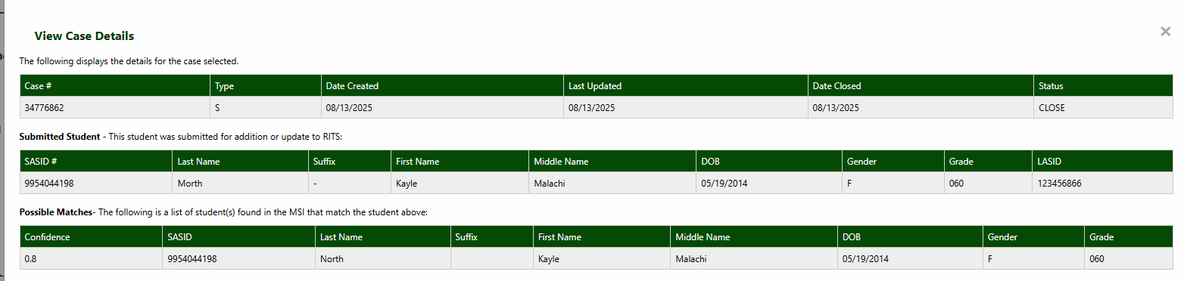
RITS Web: View Case Details
Made up student names and DOB for testing and training purposes.
SASIDS and RITS Web
RITS@cde.state.co.us

Slide 40
Questions & Resources:
RITS
RITS@cde.state.co.us
RITS Collection Website

Slide 41
READ Training Data Collection
Tara Rhodes

Slide 42
Collection Timeline
Date | Event | Event Description
7/15/2025 | Training Event | This training event will cover changes for the 25-26 READ Training collection. This is a live event from 1-2pm and will be recorded.
8/1/2025 | Open | The 25-26 READ Training collection opens in Data Pipeline.
8/15/2025 | Other Date | This is the date by which teachers, principals, and administrators should have their respective READ training designations added to their COOL accounts.
8/19/2025 | Other Date | This is the target upload date for the collection. Please complete an upload by this date.
8/26/2025 | Other Date | This is the target date for an error-free submission for the collection. Please resolve errors by this date.
8/30/2025 | Deadline | The 25-26 READ Training collection closes in Data Pipeline and sign-off forms are due.
9/8/2025 | Other Date | CDE prepares preliminary State Board of Education documents for any extension requests. Any districts requesting a good cause extension for their educators must have their submission locked by this date.
10/8/2025 | Other Date | State Board of Education hears extension requests and provides the final decision around the approval of any extension requests.
READ Training
READActData@cde.state.co.us

Slide 43
READ Training:
Frequently Asked Questions
Should we only be reporting staff that we have not yet reported in a previous collection or each year do we report ALL staff who should hold the designation?
  If the educator has already been reported as completing the appropriate training, they do not need to be re-reported. The only exceptions to this are when:
    The educator was previously reported as a new hire (code 12). They would need to be reported again as completed (code 10).
    The educator was previously reported as not having completed the training (in previous years: code 13). They would need to be reported again as completed (code 10).
    The educator was previously reported as completed the teacher training, but now has also completed the administrator training.
READ Training
READActData@cde.state.co.us

Slide 44
READ Training:
Manual Review Process – Background and Purpose
It is important to understand that not all staff who have completed the training will be able to add their respective designations using COOL, as there are limitations based on licenses. These circumstances are detailed below:
Unlicensed teachers, as they cannot have a COOL account; and
The READ Administrator Training is tied to a specific type of license in COOL. Only individuals who hold the following active, specific licenses are able to add the READ Admin Designation in COOL:
  Principal or Administrator license
  Principal Authorization
  Emergency Authorization with either a Principal or Administrator Endorsement
  Interim Authorization with either Principal or Administrator Endorsement
However, districts may have required individuals to complete the READ Admin/Principal Training who fall outside of the above license perimeters. These individuals should still be reported on the READ Training Export Report and districts should then initiate a Manual Review Request so they can receive credit for completing the training.
The Manual Review Request Process was developed to overcome these barriers, and it is reserved only for circumstances in which the district must submit evidence of completion (EOC) on behalf of their staff when COOL cannot be used.
READ Training
READActData@cde.state.co.us

Slide 45
READ Training:
Manual Review - Process
Steps:
1.Report all individuals on the READ Training Export Report, even those that may require a manual review.
2.Resolve all errors on your READ Training Export Report that are not related to the manual review process. Before initiating the Manual Review Request, you should ensure the only errors left are TR026 and TR035 errors that cannot be resolved by the individual adding their designation in COOL.
3.Send an email to READActData@cde.state.co.us with Manual Review Request – District Name and Code in the subject, i.e. Manual Review Request [District Name] [District Code]
4.The CDE data team will first confirm all errors other than TR026 and TR035 errors related to COOL licensure conflicts have been resolved. The team will send a link for you to complete a Smartsheet Form in which you will need to add your Evidence of Completion (EOC) files for each error line on your READ Training file submission.
5.Once the manual data review has been completed by CDE staff, you will receive a follow-up email that informs you that the EOC has been manually validated and to reupload your file. After you receive this email, you will need to submit and finalize your report in Data Pipeline.
READ Training
READActData@cde.state.co.us

Slide 46
READ Training:
Manual Review – Common Problems
Common Problems:
Identifying information on certificate does not match identifying information in Data Pipeline
  Solution: Please make sure that the correct names are used in the Data Pipeline file upload submission. If there is a name change, please notify us prior to manual review.
Certificate does not match the training noted as completed in Data Pipeline (i.e., the administrator training will be marked as completed, but the certificate is for the teacher training)
  Solution: Please double-check your coding in your file submission.
The evidence of completion (EOC) submitted is not an accepted or approved form of EOC.
  Solution: Please check the linked Google doc on the Smartsheet form that holds the approved forms of EOC for the different pathways
READ Training
READActData@cde.state.co.us

Slide 47
READ Training:
Next Steps
Reminders:
Please advise your educators to submit their documentation to COOL. The only exceptions to this are unlicensed teachers and individuals who took the administrator training but do not hold one of the four following licenses:
  Principal or Administrator license
  Principal Authorization
  Emergency Authorization with either a Principal or Administrator Endorsement
  Interim Authorization with either Principal or Administrator Endorsement
Please complete a preliminary upload by Tuesday, 8/19. This helps me understand who is aware of the collection, is receiving my emails, and who also might need extra support and/or outreach.
READ Training
READActData@cde.state.co.us

Slide 48
READ Training:
Upcoming Topics
Topics that will be covered during Data Pipeline Town Hall:
August 7: 25-26 Changes and Background
August 14: Manual Review Process
August 21: No Report of Training Screen
August 28: Any last reminders before collection close
READ Training
READActData@cde.state.co.us

Slide 49
Questions & Resources:
READ Data Collections
Tara Rhodes
Phone: 720.601.4125
READActData@cde.state.co.us
READ Data Collections Link
READ Training Data Collection Website

Slide 50

Thank you for Joining Today!
Next Town Hall will be August 21st
Reminder:
When emailing us, please provide your 4-digit district number or 5-digit AU number.
It’s super helpful if this code is part of the subject line in the email.

