Slide 1
Report Card March
2024-2025 School Year Training
1

Slide 2
Report Card March
What is Report Card March?
IDM Role
Updates to RCM 2024-2025
RCM Timeline
FAQs
Step by Step Instructions for Submitting Data
Final Thoughts
Questions
Contact
2

Slide 3

Report Card March-What Is It?
➢The Report Card March is a mandatory collection that contains school descriptors such as a school’s course offerings, health and wellness information, and programs offered.
➢A mandatory collection is defined by the Education Data Advisory Committee (EDAC) as a statutorily required collection to be completed by all appropriate agencies. Funding or services may be withheld if not submitted.
➢Legislation: Performance reports – contents – rules, 22-11-503, C.R.S.; Courses and 1 CCR 301-1 11.05(5)(G) – (G)Professional Development Days, 22-32-109 Safe Schools Reporting Requirements, 22-93-101 School Bullying Prevention
3

Slide 4
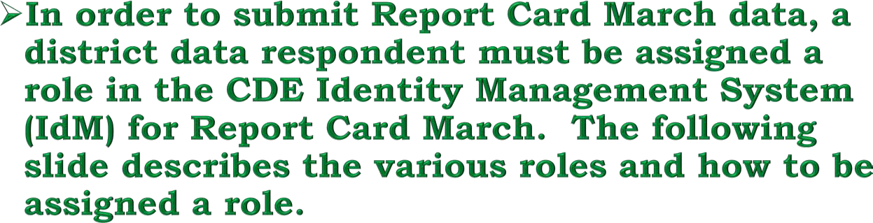
Report Card March-IdM Role
4

Slide 5
➢Identity Management groups are available.
Report Card March-IdM Role
Acronym is RCM
Examples:
MOFFAT_2 PIPELINE-2800-RCM~LEAVIEWER Read-Only Role
SILVERTON_1 PIPELINE-2820-RCM~LEAUSER Submit and Modify Role
CENTER_26_JT PIPELINE-2810-RCM~LEAAPPROVER Approver Role
➢Work with your LAM to get the role assigned before the collection opens.
➢Only one role can be assigned.

Slide 6
Report Card March Updates
Please visit the Report Card March web page for an updated and finalized 24-25 file layout at:
https://www.cde.state.co.us/datapipeline/per_report-march
For 24-25, there are 3 new fields for Report Card March from HB22-1376
District Wide Climate Survey
Climate Survey Results Posted Publicly
If Posted (Specify)
6

Slide 7
Report Card March Updates Continued
HB 22-1376
3 Fields Added
Updates to this house bill caused three new fields to be added to RCM
Link to HB 22-1376
District Wide Climate Survey (yes – 1 or no – 0)
Climate Survey Results Posted Publicly (yes – 1 or no -0)
If Posted (Specify) Text field up to 50 characters.

Slide 8
Report Card March Timeline
Collection opens March 5, 2025
Collection closes April 11, 2025
8

Slide 9
Report Card March-FAQs
There are two ways to submit your school data, either by a file upload (Excel is the easiest format) or by the Edit Record screen to submit by form. You must commite to one or another as you cannot submit by file and then by form or vice versa as this will result in errors.
When submitting data by file use the number ‘0’ for no and the number ‘1’ for yes.
9

Slide 10
Report Card March-FAQs Continued
To report professional development days, use only whole numbers or for half
days use .5 as the system will not allow any other decimals. This year the number of professional days reported can e up to 21 before a warning message is generated.
Reportable professional days for the 2024-2025 School Year are any days between July 1, 2024 until June 30, 2025
The Report Card March data is reported on CDE’s School View Web page in Data Center. This data collection is mandated by state statute and is used by parents, policymakers, advocacy organizations, and the media.
10

Slide 11



Report Card March-FAQs and Tips
Important FAQS for Report Card March
In the text fields avoid using apostrophes as this causes a fatal errors when saving the file/form.
Remember that if you are uploading a file, the file name should not contain spaces.
Don’t forget to finalize the data and submit the superintendent sign-off sheet.

Slide 12
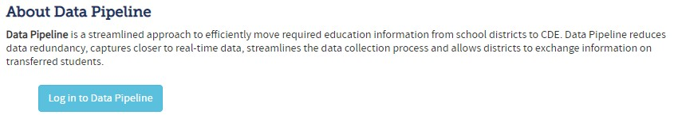
Report Card March-Submission Steps
Go to Data Pipeline through the IDM single sign on link.
There are two methods to submit the Report Card March data; either through form submission using the edit screen or through file submission using file upload.

Slide 13
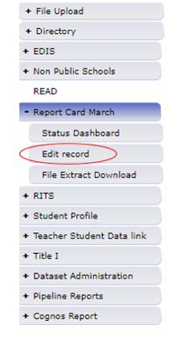
Report Card March-Submission Steps Form Submission
Form Submission Method
➢If using form submission to submit data, go to the Report Card March link on the left side of the Data Pipeline homepage. Select Edit record.

Slide 14
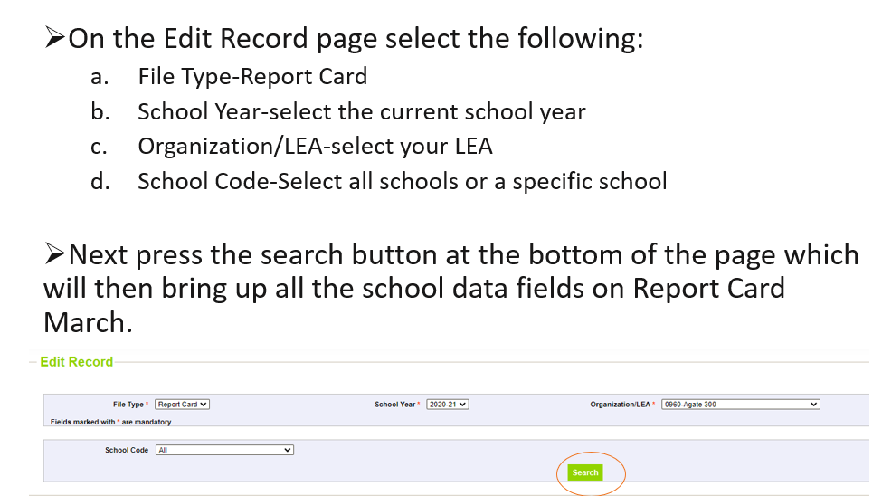
Report Card March-Submission Steps Form / Edit Record

Slide 15
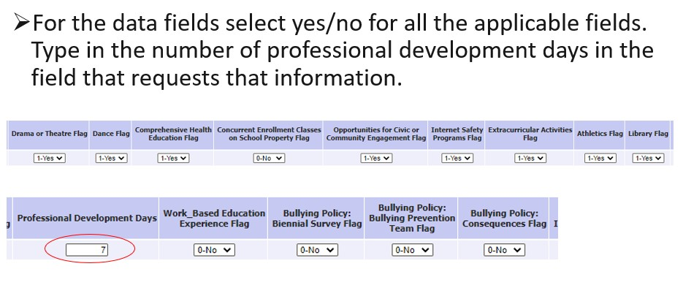
Report Card March-Submission Steps
Form / Edit Record Continued

Slide 16
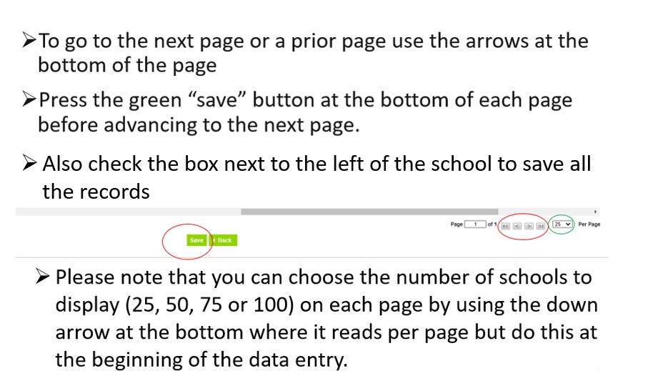
Report Card March-Submission Steps
Edit Record Save

Slide 17
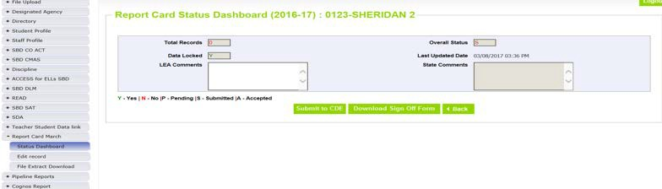
Report Card March-Step by Step Instructions
If you submitted by Form please note that under Total Records, it will show 0. This is because a number other than 0 will only show up when submitting via a file upload.

Slide 18
Report Card March-Submission Steps File Upload
File Submission Method
➢You can do any of the following: 1)download the spreadsheet of the prior years’ data and make any needed changes and then re-upload; or 2) download the file extract your vendor has established; or 3) use the file upload template on the Report Card March Web page at: https://www.cde.state.co.us/datapipeline/per_report-march
➢Save the file using any name but file name should not contain spaces.

Slide 19
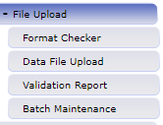
Report Card March-Submission Steps Data Pipeline File Upload
➢To upload Report Card March into Data Pipeline, first go to the File Upload link located on the left top of the screen and click on it.

Slide 20
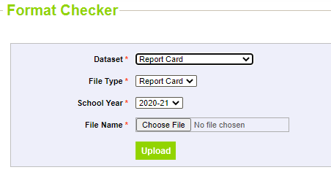
Report Card March-Submission Steps
Format Checker
➢Check file in Format Checker using the link on the left that has the lable “Format checker” under the “File Upload” link.
Format checker just checks the first line of your spreadsheet to ensure the formatting is correct. Select the following:
Dataset-Report Card
File Type-Report Card
School Year-Select the current school year
File Name-Locate file by using the browse button at the bottom of the blue box.
20

Slide 21
Report Card March-Submission Steps
Data File Upload
➢If after uploading your file in Format Checker all the rows indicated “pass” in green, then precede to the next step of uploading your file. If there is a row with an error marked in red, go back and redo the file layout. Please note that Format Checker only checks the first row.
➢Next click on the Data File Upload button and select the following (see screenshot on next slide):
Dataset-Report Card
File Type-Report Card
School Year-Select the current school year
Organization/LEA-Select your LEA
Locate file by using the browse button and attach. Then press the green submit button at the bottom of the blue box.

Slide 22
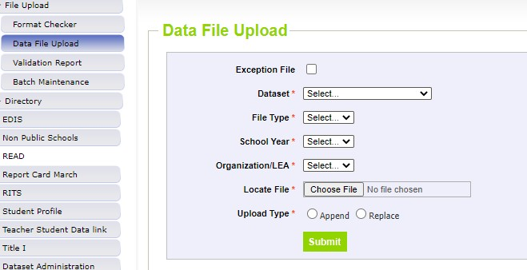
Report Card March-Submission Steps
Data File Upload Continued

Slide 23
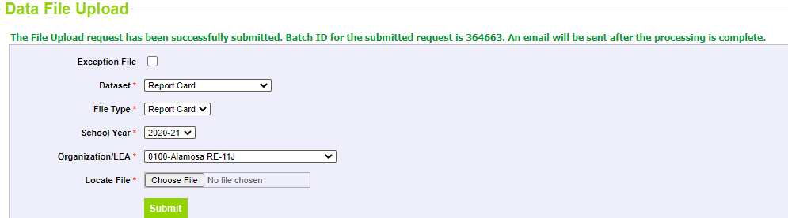
Report Card March-Submission Steps
Batch Number
➢Once the file is successfully uploaded you will receive a message saying so, as well as you’ll receive a batch number. You will also receive an email. See example below:

Slide 24
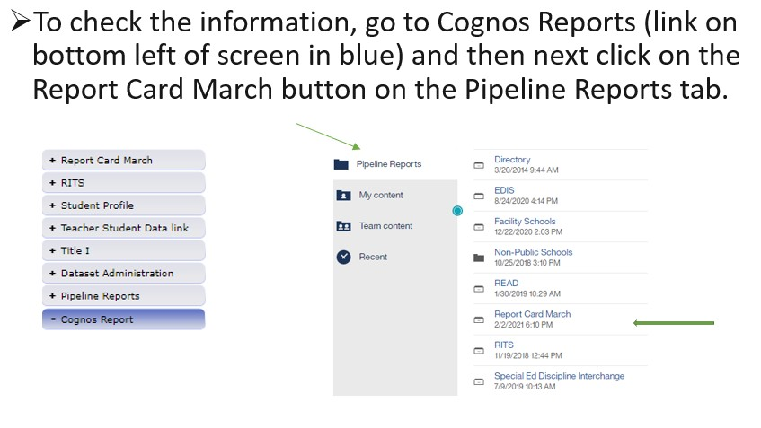
Report Card March-Submission Steps
Cognos Reports

Slide 25
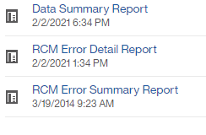
Report Card March-Submission Steps
Cognos Reports Continued
➢There are three reports you may review:
Data Summary Report
RCM Error Detail Report
RCM Error Summary Report
These reports are helpful in locating and correcting any errors. It’s highly recommended that you refer to these reports.

Slide 26
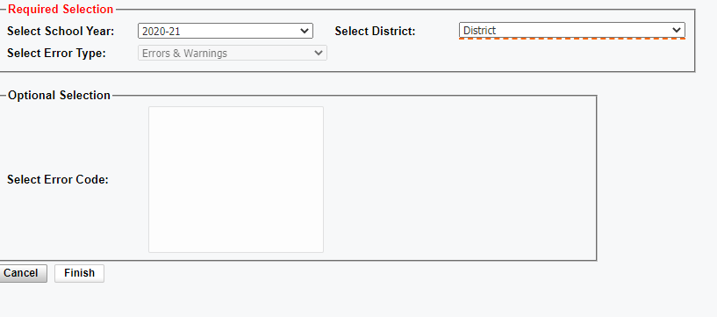
Report Card March-Submission Steps
Viewing Cognos reports
➢To review the Cognos Reports do the following:
Click on desired report
Fill in boxes as previously done
Click the “finish button”
Please note that warnings won’t prohibit the data from being submitted but you may still want to look the warnings over in addition to correcting the errors.

Slide 27
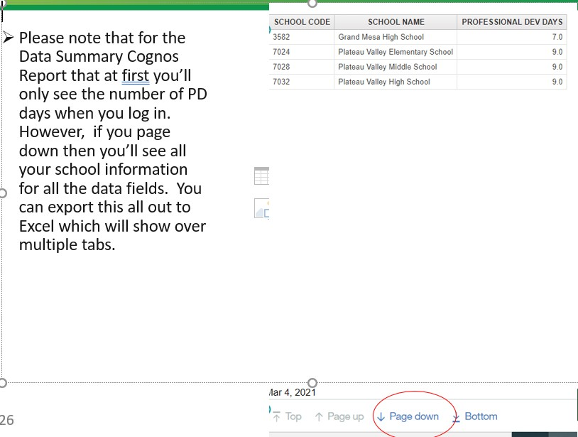
Report Card March-Submission Steps
Viewing Cognos Reports Continued

Slide 28
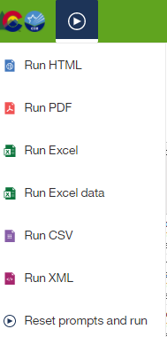
Report Card March-Submission Steps
Exporting Cognos Reports
➢You can view any of the Cognos reports in Excel (or other formats). Simply press the arrow button on the top left-hand side of your screen next to the State/CDE logos and select the format wanted.

Slide 29
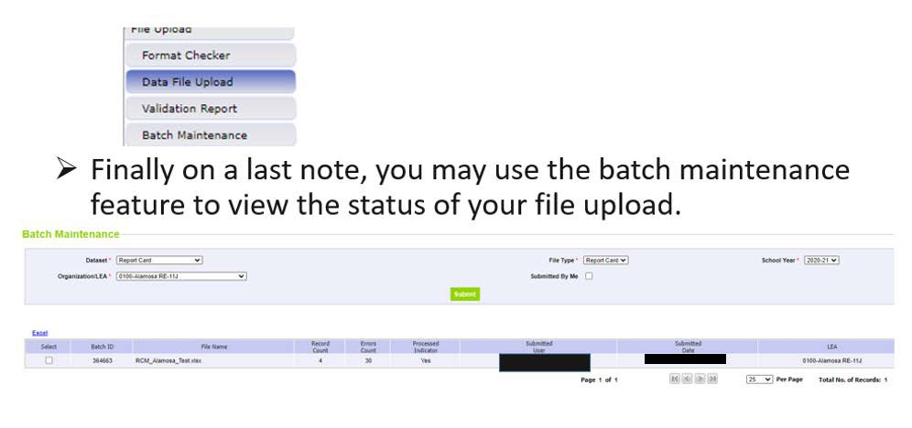
Report Card March-Submission Steps
Batch Maintenance Screen

Slide 30
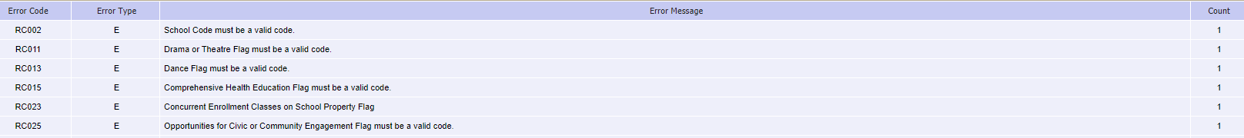
Report Card March-Submission Steps
Error Report
The Data Pipeline Error Report will allow you to see error codes, messages and the error count by each type of error.
30

Slide 31
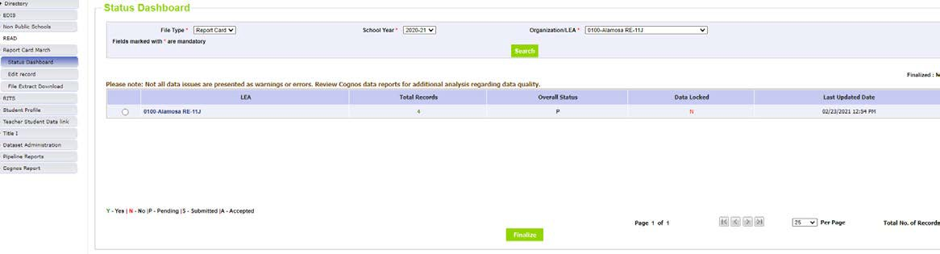
Report Card March-Submission Steps
Status Dashboard
Once all the data is correct, go to the Status Dashboard (located on the main Data Pipeline page on the left side under the Report Card March link) and press approve/finalize button.

Slide 32
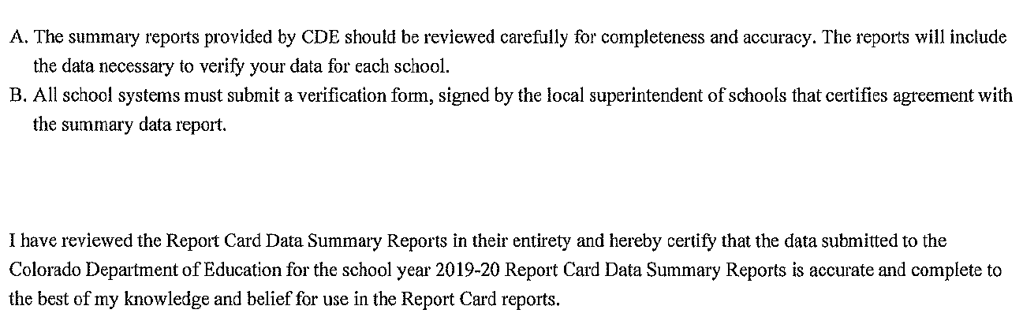
Report Card March-Submission Steps
Sign-off Form
After all the data is submitted, have your district superintendent sign off on the superintendent letter that will come up and email it back to CDE following the instructions that will come with the letter.
Below is what is being certified:

Slide 33

Report Card March-Final Thoughts
The key to success is submitting data early! The last day to submit data before the collection closes is April 9th! This is one of the quicker and easier data collections to complete.

Slide 34

Report Card March-Step by Step Instructions
Data Corrections
If you discover that you need to make any corrections and need to have your data unlocked, please email Jessica Tribbett at ReportCard@cde.state.co.us who can unlock your data for you to re-submit however, this all must be done by Friday, April 11th!

Slide 35
Report Card March-Contact
Report Card March Contact Jessica Tribbett ReportCard@cde.state.co.us

Slide 36

The End

