Slide 1
Student Interchange
2025-2026 Overview

Slide 2
Agenda
General Data Respondent Information
Student Interchange Files
Connected Collections
Timeline
Demographic Data Reporting Cycle
SSA File: Enrollment/Attendance Records
Business Rules
Data Pipeline Basics
Upload File
Batch Maintenance
Error Report
Edit Record
Resources and Contacts

Slide 3
General Data Respondent Information

Slide 4
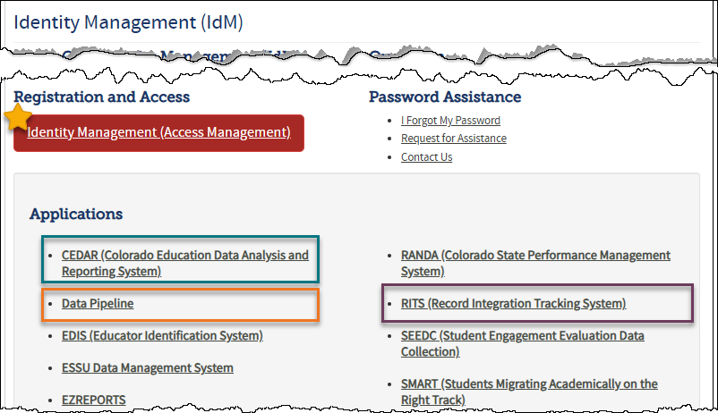
Identity Management and CDE Applications
Identity Management System (IdM):
CDE’s system for assigning permissions to CDE Applications
Each collection requires assigned permissions
Interchange permissions are separate from other collection permissions
LEAs have an individual as the designated Local Access Manager (LAM) who assigns permissions for your LEA
Identity Management Website link
Access Management (for LAMs)
Links to CDE Application Logins
Data Pipeline
CEDAR (aka COGNOS)
RITS
FAQs and User Guides
Student Interchange IdM Roles
Application = Pipeline
Collection = Student Interchange
LEA User: Upload files & review reports
LEA Viewer: Reports only

Slide 5

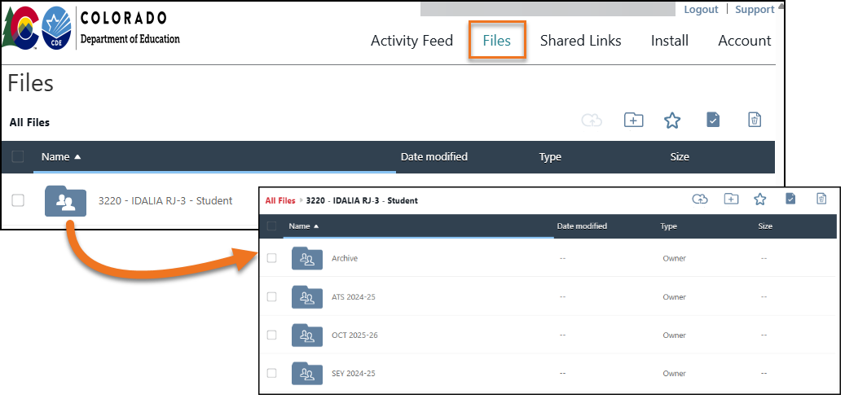
PII & Syncplicity
Personally Identifiable Information (PII)
Syncplicity
State and Federal laws protect information that, alone or in combination, personally identifies an individual
E.g., name, SASID, date of birth, etc.
Includes information that when combined is identifiable
Email is not a secure method for sharing PII
More Information: Data Privacy and Security Website
Secure method to transfer PII to CDE
Syncplicity folders are specific to collections
Access is not automatic, email Reagan Ward if you need access for the student interchange
Student Interchange, Student October, Student End of Year, and Student Attendance all utilize the same folder
District Code – District Name – Student

Slide 6
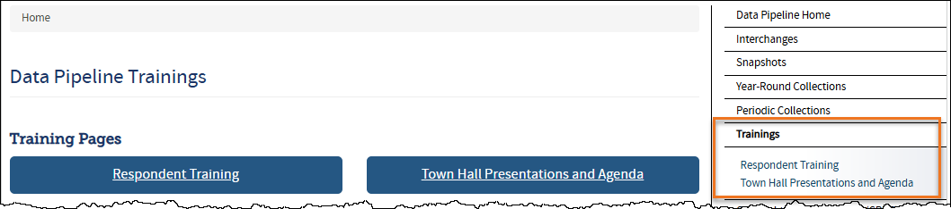
Data Pipeline Training Websites
Respondent Training
Information and resources for all data respondents, regardless of collection
Topics Include…
Data Pipeline Respondent Overview
Collection overview, IdM Roles, Data Pipeline website resources
Data Pipeline Reporting Process
How-to guides for data file upload, reviewing errors and validating data, finalize submission process
Additional Tools/Resources
Town Hall Presentations and Agenda
Ongoing information/updates about Data Pipeline Collections
Weekly on Thursdays from 9 – 10 am
Email to subscribe to listerv for reminders: DATASERVICES-subscribe-request@cdelist.cde.state.co.us
Website includes agenda, weekly meeting link, and recorded prior presentations

Slide 7

Pipeline Maintenance Window
Every Tuesday around 4:00 p.m. there is a Pipeline Maintenance Window
Possible Impacts
Uploading Interchange Files unavailable
Creating snapshots unavailable
Reports unavailable
Suggestion
Avoid work in pipeline
Why?
Could cause files or snapshots to be stuck in processing
Unnecessary errors may occur

Slide 8
Student Interchange Files & Process

Slide 9



Student Information System (SIS) Extracts
Download reports (files) from your Student Information System (SIS)
Student Demographic, Student School Association, Graduation Guidelines
Files could be named differently in SIS
.xlsx is recommended format
Do not open file!
Save each file in an accessible location with naming convention
Example: 0110_DEM_10112025.xls
No spaces in file name are allowed
Keep filing system organized
Upload each file to Data Pipeline (steps shown later)

Slide 10





Student Interchange Files
Student Demographic File
One record per student
Student School Association File
At least one record per student
May include multiple records per student
Student Interchange
Graduation Guidelines File
Secondary students only
Expect multiple records per student
Adjustment File
As needed for SEY Collection

Slide 11
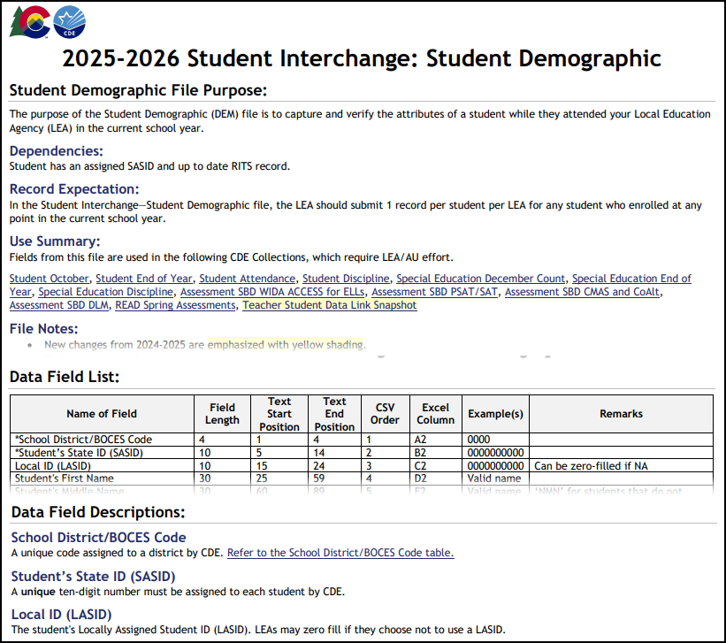
Student Demographic (DEM) File Layout
Data Expectation: One Record per SASID
2025-2026 Changes:
No new data fields
Changed ‘English Learners’ to ‘Multilingual Learners’ throughout file
English learner history COGNOS reports updated and renamed to Multilingual Learner history (SASID Lookup and District List)
Types of Data:
Race/Ethnicity
Language Fields (background, proficiency, instruction program)
Homelessness Information (homeless, primary nighttime residence, cause of housing crisis, etc.)
SPED information (primary disability, alternate assessment participant, transition)
Other (military connected, HSED program, etc.)

Slide 12
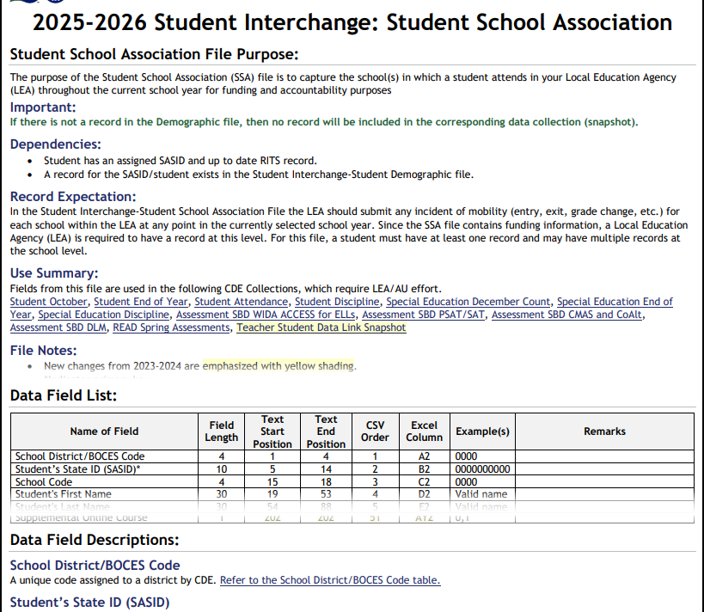
Student School Association (SSA) File Layout
Data Expectation: One record per attendance/enrollment timeframe
May include multiple records per SASID
Types of Data:
Basic Enrollment Information
e.g., grade level, school entry/exit dates, school entry/exit types, retention code
Funding
e.g., public school finance funding status, student pupil attendance information, district of parent’s residence, etc.)
Attendance
e.g., total days attended, total days excused, etc.
Other descriptors of education services/setting
e.g., expelled education, non-school program, homebased education, etc.
Resource: 2025-2026 Student Interchange Updates/Changes

Slide 13
2026 SSA File Changes
New data fields
Abbreviated School Day Schedule Status
Total Days on an Abbreviated School Day Schedule
Removed Data Field
ILOP (Innovative Learning Opportunities Pilot)
Renamed Field
Student Pupil Attendance Information
Definition Updates
Added clarifying verbiage to various fields such as attendance fields, school entry and exit date, primary school, postsecondary program enrollment, and alternative instruction courses
New School Entry Type Codes
31 = Transfer from a HS Diploma Program at a Colorado Community College
60 = Enrollment Status Change in the same School
98 = Prior Graduate from a public school in another Colorado LEA transferring to participate in Special Ed 18-21 services
New School Exit Type Codes
31 = Transfer to a HS Diploma Program at a Colorado Community College
60 = Enrollment Status Change in the same School
88 = TBD—waiting on documentation of transfer; Student absent 10+ days

Slide 14
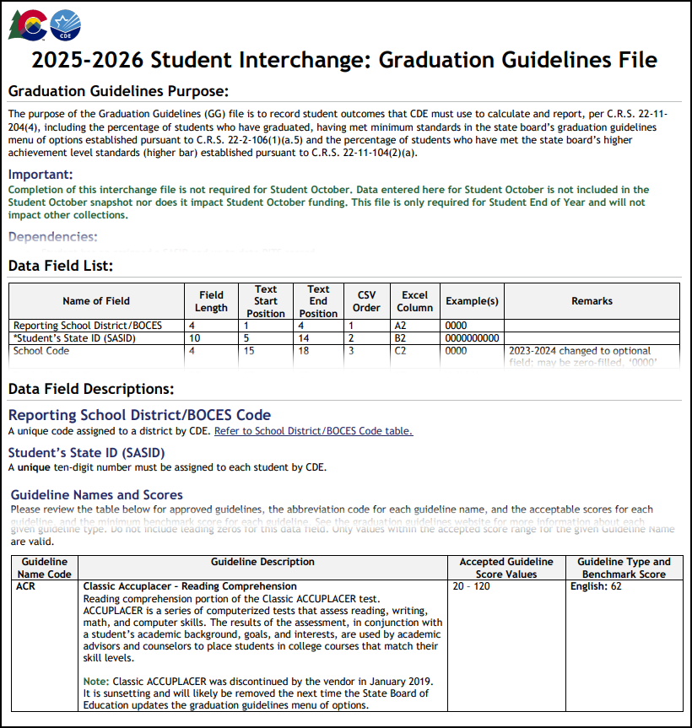
Graduation Guidelines (GG) File Layout
Data Expectation: Secondary students only; One record per attempted graduation guideline
Multiple records per student expected
GG Required at point of Graduation: At the point of graduation in the SEY collection, students must have at least one reported English and one reported Math guideline at or above the cut point for that guideline. This can occur in the same year or in a prior year GG file.
2025-2026 Changes:
No new data fields
Field Expectation update: School Year of Completion is required and cannot be zero filled
Type of Data:
English Guideline (name, score, completion year)
Math Guideline (name, score, completion year)

Slide 15
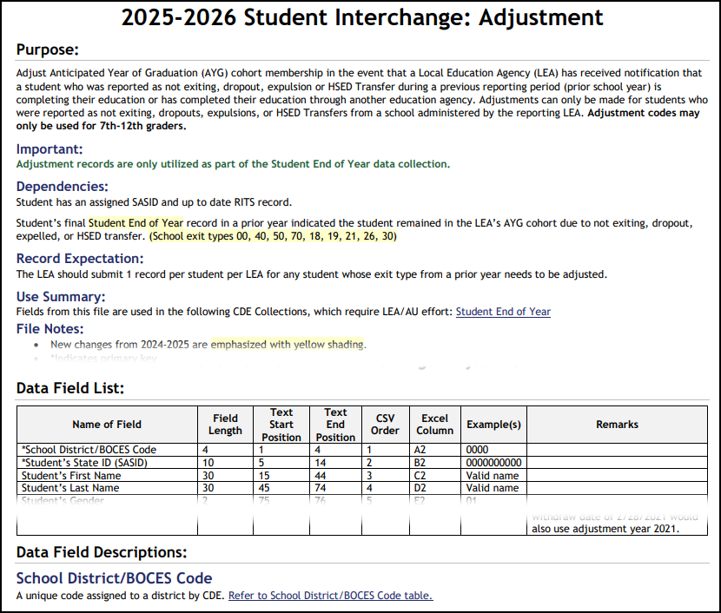
Adjustments (ADJ) File Layout
Purpose:
Only used for Student End of Year (SEY) collection in select circumstances
Adjusts final school exit type in a prior school year under very specific circumstances
Data Expectation:
Grades 7-12 only
Only one record per SASID
2025-2026 Changes:
No new data fields
Some language updates for clarification
Timing Note:
Opens in May 2026 when student end of year collection officially begins
Additional Note:
Most student information systems do not have an extract as this file may be used for one or two students every few years

Slide 16

Student Interchange Process
Extract data from your SIS
Upload interchange files
DEM first
Must fully process before uploading other files
SSA second
GG and ADJ in any order
Wait for the File Upload Confirmation Email from the Pipeline System
Will receive 2 emails, the first is just the RITS validation email, the second is the file upload confirmation
The email will show you the number of errors in your upload
Check your error reports
Update your Interchange files to address the errors
Update in SIS → Extract → Upload to Pipeline
Repeat

Slide 17
Connected Collections

Slide 18
What Collections (Snapshots) use the Student Interchange?
Student October
DEM & SSA
Student Attendance
DEM & SSA
Student End of Year
DEM, SSA, GG, and ADJ
Student Discipline
DEM & SSA
Teacher Student Data Link
DEM only
Special Education Collections
December Count
Discipline
End of Year
SBD Assessment Collections
Initial “pre-id” assessment files based upon Student October data
READ Act Assessments
Validates enrollment against SSA file
Utilizes DEM & SSA fields in reports
AEC Renewal File
Includes values from Student Interchange

Slide 19
What is a Snapshot?
Data collection that combines applicable data fields from interchange files based on a set of parameters for a set date or timeframe
Snapshots typically won’t use every data element on a source interchange file
Snapshots may include information called “internal flags.” These are calculated pieces of data from information provided on the interchange files or from other internal data in data pipeline.
Errors on the DEM or SSA file prevent records from pulling into a snapshot and may cause collection errors
Errors on the GG or ADJ file prevent the related information from being used in a snapshot, causing snapshot errors
Source File A
Source File B
Internal Flags
File A: Element 2
File A: Element 5
File B: Element 3
Internal Flag: 3
Snapshot
File A: Element 1
File B: Element 1
File A: Element 3
File A: Element 4
File B: Element 2
File B: Element 4
Internal Flag: 1
Internal Flag: 2

Slide 20
Timeline

Slide 21
Overlapping Years
July: 7/1 Reporting Year Begins Interchange opens
April/May: Spring Student Collections Open
January: Spring Semester
June 30: Reporting Year Ends
December 1: Interchange Closes
Student October
SPED DEC Count
ACCESS for ELs Administered
Spring Assessments Administered
SPED Discipline & End of Year
Teacher Student Data Link
Student End of Year
Assessment SBDs
AEC Renewal File
Student Attendance & Student Discipline
READ Spring Assessments
2024-2025
July: 7/1 Reporting Year Begins Interchange opens
December
2025-2026
Student October
SPED December Count

Slide 22
Student Interchange 2025-2026
Date | Event | Event Description
7/14/2025 | Open | DEM, SSA, and GG files open
10/2/2025 | Interim Deadline | Student October: Upload initial DEM & SSA files
10/9/2025 | Interim Deadline | Student October: Error-free DEM & SSA files
12/17/2025 Tentative | Interim Deadline | SPED December: Error-Free DEM & SSA files
11/1/2025 | Other Date | Upload GG file to utilize CEDAR/COGNOS reports to monitor potential 2025-2026 graduates for GG completion, allowing ample time for LEAs to work with students to complete any missing measures during the year.
1/30/2026 | Other Date | Upload DEM, SSA, and GG files and address errors related to mid-year transfers.
4/1/2026 | Other Date | Prepare for Spring student level collections, uploading interchange files and addressing errors as needed.
4/30/2026 | Open | ADJ file opens
5/8/2026 | Interim Deadline | Upload the initial end of year interchange files. (DEM, SSA, GG) LEAs are expected to have an upload date 4/1/2026 or later to meet this interim deadline.
6/1/2026 | Other Date | Error free DEM and SSA records for K-3 students and 4-12 READ Cohort students to prevent errors in the READ Spring Assessments collection
6/10/2026 | Interim Deadline | Error free interchange files. (DEM, SSA, GG)
12/1/2026 | Closed | DEM, SSA, GG, and ADJ files close
Primary Point of Contact:
July 2025 to December 2025 – StudentOctober@cde.state.co.us
January 2026 to December 2026 – StudentEndofYear@cde.state.co.us
Student Interchange
StudentOctober@cde.state.co.us StudentEndOfYear@cde.state.co.us

Slide 23
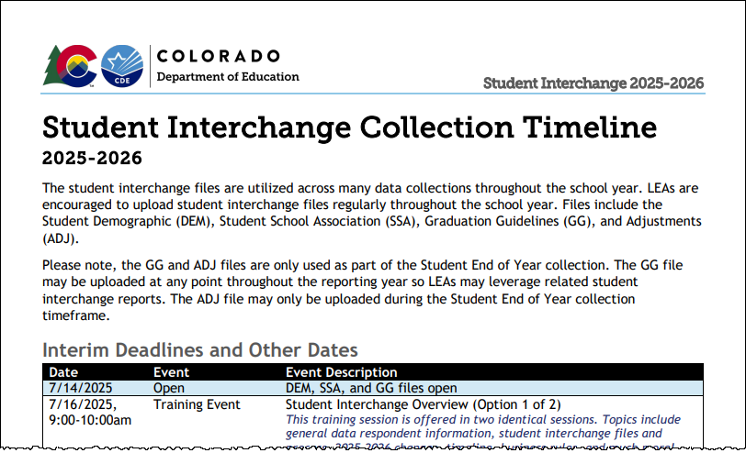
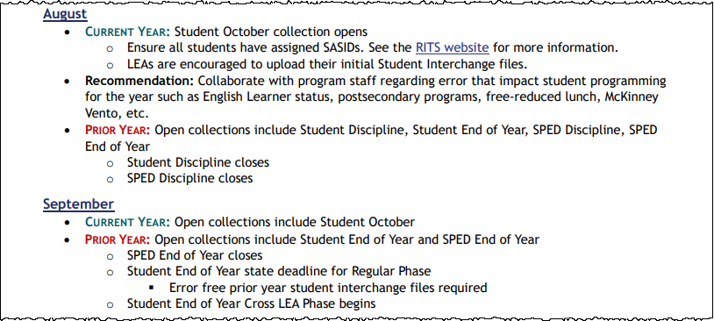
Interchange Timeline Resources
Collection Timeline: Combined Interim Deadlines
Month-by-Month Timeline
Interim Deadlines for file uploads and error free files
Combines interim deadlines across student data collections
Broad overview of how Student Interchange is utilized throughout the school year
Highlights Prior Year and Current Year tasks each month when two interchange years are open

Slide 24
Demographic Data Reporting Cycle

Slide 25
Demographic Data Types
Cumulative (Reporting Year)
Homeless Data Fields
*Homeless
Primary Nighttime Residence
Cause of Housing Crisis
Additional Cause of Housing Crisis
English Learner Data Fields
*Language Proficiency
Language Instruction Program
Language Background
*Military Connected
Free/Reduced Lunch Fields
**Free/Reduced Lunch Eligibility
Free Lunch Eligibility Identification
**Immigrant
**Special Education Transition
**Attends District Funded HSED Program
Section 504 Having a Disability
Point in Time
Name, Date of Birth, Gender
**Race/Ethnicity
Military Enlisted
Alternate Assessment Participant
Primary Disability
Note:
*Error triggers if Student End of Year does not match Student October and/or State Assessment
**Warning triggers if Student End of Year does not match Student October

Slide 26
Cumulative Demographic Data
Beginning of the Year: Student October
7/1 reporting cycle begins
Student October represents status on count day
During the Year:
Update coding for students who newly qualify for a given DEM status, moving from ‘no’ to ‘yes’ in that category
ML Coding remains the same as OCT for continuously enrolled students
End of the Year
6/30 reporting cycle ends
Cumulative fields match October or move student from ‘no’ to ‘yes’ in a category for students who qualified mid-year
Summer
Review demographic fields to determine if remain eligible next year
Move students along ML Progression as applicable
New coding begins 7/1
Reminders:
Students who become eligible for a given cumulative data field at some point during the year remain reported as such until the end of the reporting year, 6/30
Multilingual Learner status should not change from OCT to SEY if student is continuously enrolled in the LEA
FRL Eligibility may change if OCT status based upon a carry-over status and the student is no longer eligible for free or reduced lunch after the carry-over status expires

Slide 27
SSA File: Enrollment/Attendance Records

Slide 28
SSA File Design
File Design
One record per enrollment (attendance) timeframe
Multiple records required when capturing movement between schools or instances of mobility
Multiple records required when capturing critical changes to the mode of educational services provided to a student
Typical Enrollment Changes:
Movement between schools (exit/entry 11)
Movement in/out of district (applicable exit/entry)
Instances of Mobility (exit/entry 25 or 45)
Critical ‘status’ Changes (exit/entry 60):
*Expelled Education
**Non-School Program
*Postsecondary Program
**Home Based Education (part-time)
Other changes impacting inclusion of a SSA record in a snapshot collection:
Pupil Attendance Information
Moving between Group A and Group B codes
Primary School
Optional Changes (Exit/Entry 60)
Other SSA fields only utilized in OCT collection
e.g., public school finance funding status, county code of residence, independent study course, blended learning course, etc.
Note:
The Gifted and Talented data fields and the Date First Enrolled in the US data field should be treated like demographic information with identical information on each SSA record

Slide 29
Capturing Enrollment Status Changes
Scenario: student remains enrolled in the same school code, but one of the critical SSA enrollment fields has changed mid-year
This change captures a significant change to how the student is experiencing their education within the LEA
Using back-to-back exit/entry dates at the same school code (less than 10 days apart)
This is not considered an instance of mobility
SSA Record | School Code | Entry Date | Entry Type | Exit Date | Exit Type | Homebased Education | PAI
#1: Point ___ status changes | 8765 | 08/15/2025 | 02 | 10/15/2025 | 60 | 1 | 01 – 08
#2: new ___ status | 8765 | 10/16/2025 | 60 | 00000000 | 00 | 0 | 01 – 08

Slide 30
Instances of Mobility: Reporting extended absences
Per state board rule, districts should indicate an instance of mobility for a student after ten consecutive days of absence as part of the Student End of Year (SEY) collection.
Instances of mobility capture extended timeframe of non-attendance
Used to calculate mobility rates
Requires multiple attendance records (PAI 01-08, Primary School 1)
School Exit/Entry 25 used if student’s absence is 10+ days to 6 weeks
School Exit/Entry 45 used if student’s absence is 6+ weeks
School exit date indicates last date of attendance
School entry date indicates date student began attending district again
LEAs should follow local policies and procedures used to track steps taken to attempt to reengage student/pursue truancy/etc. during timeframe where student is not attending the LEA (mobility instance)
The time-period of extended absence/discontinued education is not state reportable for student collections
Local policy/procedure may or may not include records in the LEA’s SIS
Other expected impacts of mobility instances
Attendance Collection: No attendance data reported for the timeframe of the extended absence
Assessment Collections: Impact ‘continuous in school’ or ‘continuous in district’ calculations because the student was not continuously enrolled due to the mobility instance
SSA Record | School Code | School Entry Date | School Entry Type | School Exit Date | School Exit Type
Mobility Instance Initiated | 1234 | 08152024 | 02 | 02012026 | 25
LEA internal record | Not reportable | Not reportable | Not reportable | Not reportable | Not reportable
Mobility Instance Resolved | 1234 | 04012026 | 25 | 00000000 | 00

Slide 31
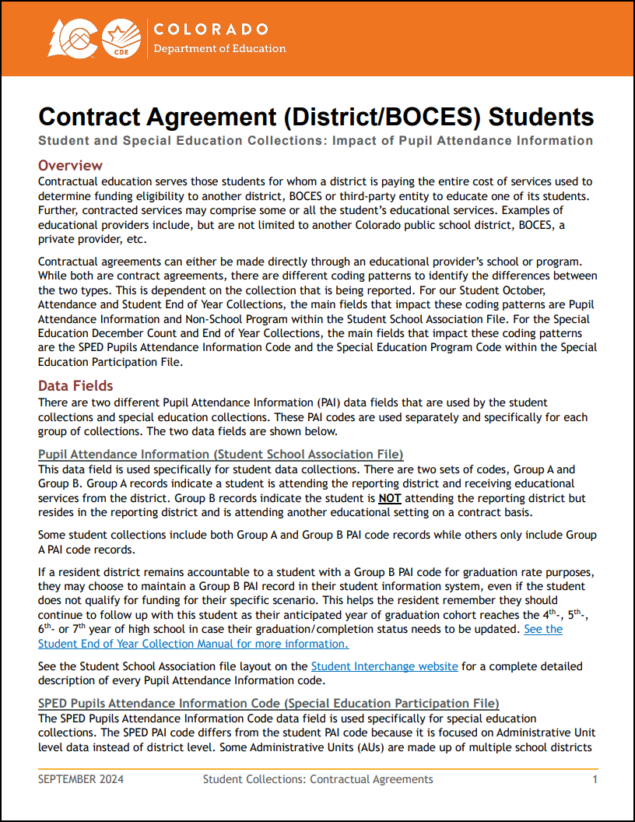
Resource Highlight: Contract Students—Impact of PAI Codes
Available on Student Interchange Website
Student Pupil Attendance Information (PAI) codes determine if a record is included at the district/LEA level in a student collection
Student October
All Student PAI codes (Group A and B)
Student Discipline
All Student PAI codes (Group A and B) where school code matches location of discipline indicent
Student Attendance
Group A Student PAI Codes 01-08 only
Student End of Year
Group A Student PAI Codes 01-08 only
School Entry/Exit types tracked across PAI 01-08 records only
Point student leaves a LEA (Group A) to a contract scenario (Group B) will require an applicable school exit type
Special Education PAI Codes determine inclusion of a record at the AU level for SpED collections and may not align with Student PAI codes

Slide 32
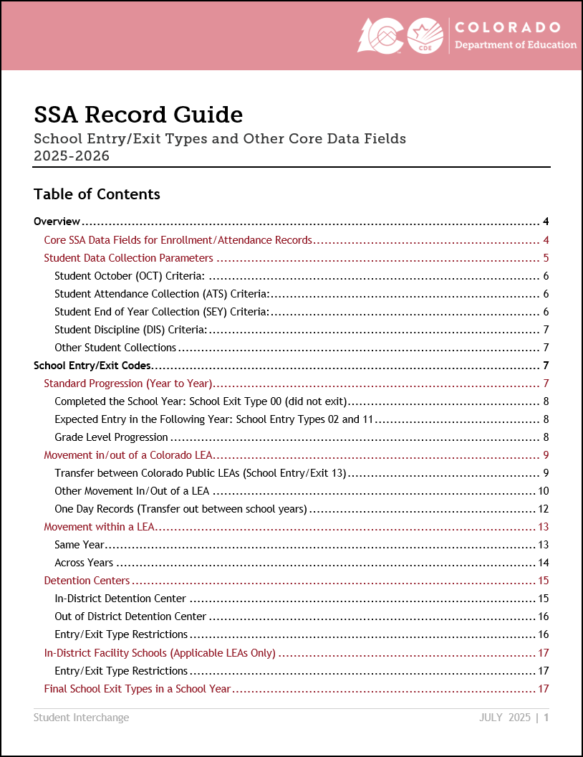
Resource Highlight: SSA Record Guide
Available on Student Interchange Website
Topics include
Overview
Critical SSA fields used to determine if a record is pulled into specific snapshot collections
School Entry/Exit Codes
Different types of student movement and the related school entry/exit types needed to capture the movement
Anticipated Year of Graduation Cohort connection to exit types
Data Implications
Data implications based upon SSA records, especially accurate school entry and exit dates
Common Coding Scenarios
Enrollment Status Changes
Instances of Mobility
Much more!

Slide 33
Business Rules

Slide 34
Errors/Warnings: Overview
Errors
Warnings
Must be addressed
Update data fields to clear
Request reporting exception if student data is accurate but does not follow the typical coding pattern as indicated by the error message
Prevent records from pulling into data collections
Indicate possible data inconsistencies/coding issues
Do not prevent record from pulling into data collections
Pro Tip: Review warnings to look for patterns/areas where LEA data could be documented in a more accurate manner
Note: Student interchange business rules address data inconsistencies that apply to multiple data collections (snapshots)

Slide 35
Addressing Errors/Warnings
Preferred Method:
Correct the related data field in your SIS
Extract a new file from your SIS
Upload the new file to Data Pipeline
Alternate Method:
Correct the related data field using the Edit Record screen in data pipeline
This is not the preferred method for correcting errors because uploading a new file will wipe out any manual edits done in pipeline
This method is designed for use during the Post-Cross LEA phase of the Student End Year collection

Slide 36
2025-2026 Business Rule Changes
DEM File: Updated ML business rules
Consolidated many errors into a single ‘out of sequence’ error code → SP570
‘Error Details’ column on error reports will show prior year coding for many ML rules
SSA File: Grade Level sequence warnings
Helps LEAs catch out of sequence issues earlier in the year instead of waiting until the errors in the SEY collection
SP572: First record should be one grade higher than prior year (if not retained)
SP573: First record should be same as prior year because student indicated as retained in prior year
SSA File: Moved Gifted and Talented year-to-year checks to October and SEY Snapshots
SSA level business rule had to be deactivated last year due to processing issues, in researching issue snapshot level rules were deemed the better solution for this check
GG File: Completion Year
Completion year is required and cannot be zero filled
Completion year cannot be in a future year

Slide 37
Data Pipeline Basics

Slide 38
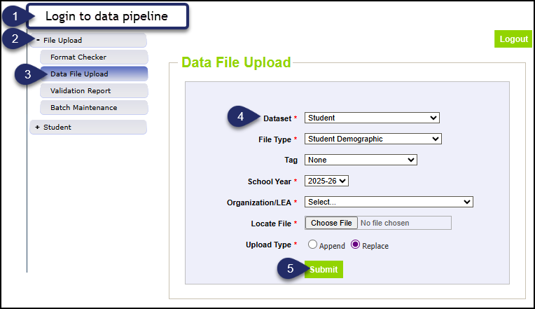
Data File Upload
Dataset = Student
File Type = applicable file
Student Demographic
Student School Association
Graduation Guidelines
Adjustments
Tag = *None
*Review tagging interchange files resource to determine if tagging files would benefit your workflow (DEM and SSA only)
School Year = applicable year
Caution, two years open throughout the fall
Defaults to 2025-2026
Organization/LEA = defaults to your LEA
Upload Type = *Replace
*Append is reserved for nuanced situations that do not apply to most LEAs

Slide 39
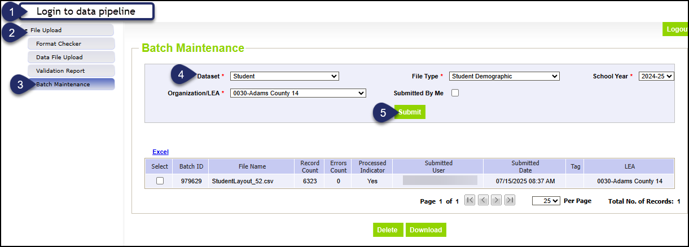
Batch Maintenance
Processed Indicator
Record Count
Error Count
Batch ID
Submitted Date
Delete file
Download file
Lists multiple files when…
Tag files used
‘Append’ file upload used

Slide 40
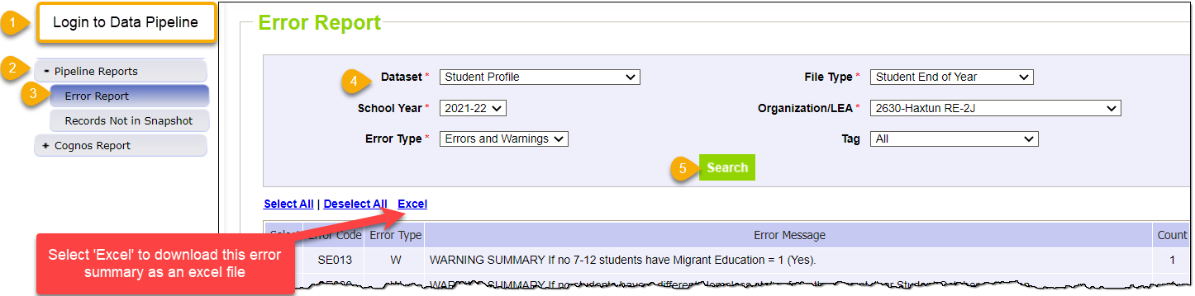
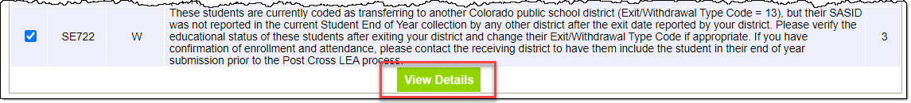
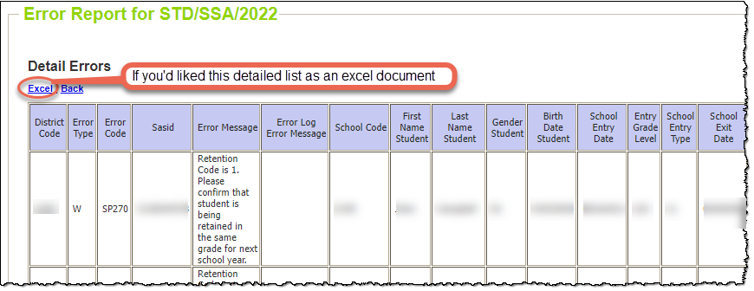
Checking Errors/Warnings: Pipeline Error Report
Preferred method for checking errors/warnings
Some errors and warnings are being updated to use the ‘error log error message’ column that used to be blank on this report
Pro Tip: Use check boxes to select a specific error/warning code before reviewing error details as it may be simpler to focus on one business rule topic at a time
To view specific student records that are triggering an error/warning, select View Details at the bottom of the screen.

Slide 41
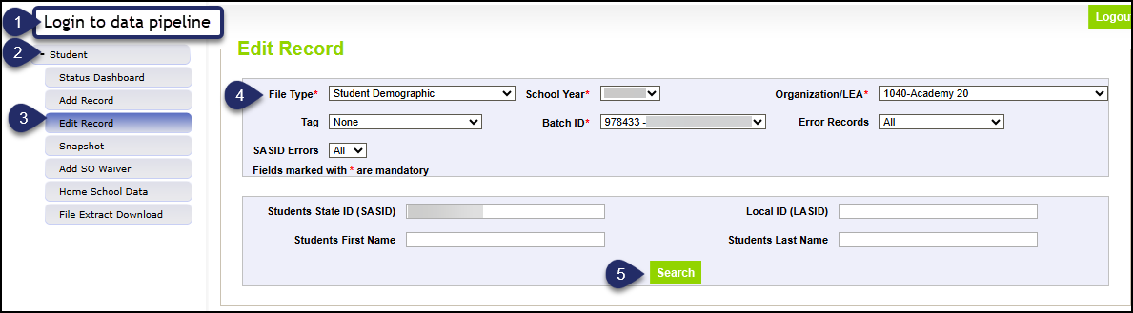
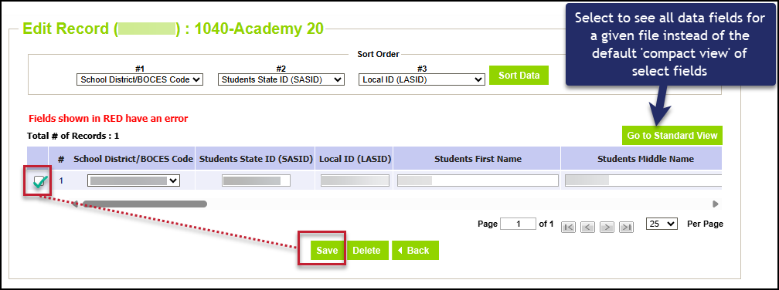
Edit Record
2025-2026 update:
Dataset and sidebar menu ‘Student’ replaced ‘Student Profile’
COGNOS reports category renamed ‘Student Interchange’
Note: A new file upload (replace) will delete any changes made through the edit record screen

Slide 42
Resources and Contacts

Slide 43
Resources/Helpful Webpages
Site Name/Link | Information/Uses
Data Pipeline Home | Main landing page for the data pipeline information/resources. From here you can navigate to all the various data collection sites
Student Interchange | Contains file layouts, templates, business rules, training materials, and resources
Identity Management (IdM) | This is the landing page with login links to the various CDE data applications. Data Pipeline, COGNOS/CEDAR Reporting, RITS
Data Pipeline Training | General training resources for all data respondents and weekly data pipeline town hall meetings
Frequently Requested Codes and Resources | Supporting code lists (school codes, detention centers, SPED Programs, facility schools, etc.) and other pipeline resources
Syncplicity | Secure file transfer site used to communicate personally identifiable information with CDE if you have questions on specific students during reporting or have exception requests. New respondents (LEA Users) can expect an email in the next week to set up an account and access the student file for your LEA.

Slide 44
Student Interchange Contacts
Collection Lead | Collection Site | Contact | Notes
Reagan Ward | Student Interchange | 720-484-9057 ward_r@cde.state.co.us | Interchange questions unrelated to a specific collection
Reagan Ward | Student End of Year | StudentEndOfYear@cde.state.co.us 720-484-9057 | 2024-2025 Questions and Exception Requests 2025-2026 Exception Requests beginning January 2026
Collin Slutzky | Student October | StudentOctober@cde.state.co.us 720-760-3569 | 2025-2026 Exception Requests now through December 2025
Peter Hoffman | Student Attendance | Attendance@cde.state.co.us 720-925-8611 | Attendance data fields

