Slide 1
August 28, 2025
Data Pipeline Town Hall
The goal of the webinar is to provide updates on the Data Pipeline, current, and upcoming data collections. These webinars also provide a forum for districts, BOCES, and Administrative Units to have questions answered about Data Pipeline.

Slide 2
Colorado Department of Education
Identity Management (IdM)
Identity Management Site
Frequently Asked Questions
How do I add myself or others to the email listserv for town hall emails and/or a specific collection?
  Email lists are dependent on a person’s access rights in IdM. Contact your LAM to get an account or be assigned to a specific collection.
Where can I find the IdM role mappings for Data Pipeline and other applications?
  Role Mapping (XLS)
I am a LAM. How do I update the user permissions for someone in my district?
  Follow the steps outlined in the IdM Quick Guide for Access Management (DOCX)
Important: Users are not automatically removed from IdM when their email address is no longer active in your district. The LAM must deactivate their IdM account to ensure only designated staff can access CDE’s data reporting system.
Support:
  Michael Threlkeld
  Forgot Password
  Request LAM Assistance
Notes:
LAMs, please check the IdM roles for your district. Remove permissions for users who have retired, left your district, or are no longer assigned to a collection. Add roles for new hires and newly assigned respondents for specific collections.

Slide 3

What is PII?
Student and Staff Personally Identifiable Information (PII) is defined by state and federal laws as information that, alone or in combination, personally identifies an individual
  This includes direct identifiers
  (i.e. student and staff names, SASID, EDID, etc.)
  Includes information that when combined is identifiable
Colorado’s Student Data Transparency and Security Act outlines requirements for how Student PII is collected, used and shared
See the Data Privacy and Security website for prepared guidance on how to comply with this and other privacy laws.

Slide 4

Sharing Data
Use secure methods to transfer any PII to CDE
  Contact Data Collection leads with questions about how to transmit PII securely
    Each Data Collection leads maintains their own Syncplicity folders for specific collections, reach out to the collection lead for access
  Use Syncplicity to encrypt emails to CDE
Avoid sending PII via unencrypted email or to unsecured faxes when sharing data between or within districts
  Use Syncplicity to encrypt emails to CDE
Check local policies for restrictions, requirements, etc. regarding PII
  Do not use PII in trainings, presentations, etc.
  Do not share PII with unauthorized individuals
  Do not share passwords
  Follow local policies when transmitting PII to any third party

Slide 5
Today’s Agenda
Agenda Topic | Presenter
Open Data Collections and Upcoming Deadlines in Data Pipeline | Host: Peter Hoffman
Instructional Days & Hours | Jessica Tribbett
Student End of Year | Reagan Ward
Title 1 Interchange | Melissa Chaffin
Summer EBT | Collin Slutzky
Student October | Collin Slutzky
Special Education End of Year | Lindsey Heitman
READ Collections | Tara Rhodes

Slide 6
Open Collections and
Upcoming Deadlines in
Data Pipeline

Slide 7
Open Collections and Upcoming Dates:
Year-Round & Interchanges
Name | Category | Status | Key Dates
RITS | Year Round | Open | N/A
EDIS | Year Round | Open | N/A
Directory | Year Round | Open | N/A
Student | Interchange | 2025 & 2026 Open | 2024-2025: Maintain error free files 2025-2026: Open, ML Collaborative Webinar 9/4 (Registration Link)
At-Risk | Interchange | Open | Geocoder Tool Deep Dive 8/27/25, 1pm (Registration Link)
Title I | Interchange | Open | 2024-2025: Maintain error free file 2025-2026: Coming Soon! Scheduled to open 8/29
Special Education IEP | Interchange | Open | Maintain error free files
Staff | Interchange | Open | Staff Profile and Staff Evaluation interchange files are needed for the Staff Evaluation Snapshot
Discipline Action | Interchange | Closed
Teacher Student Data Link | Interchange | Open | Maintain error free file
Data Pipeline Resources: Data Pipeline Collection Dates (XLS)

Slide 8
Open Collections and Upcoming Dates:
Snapshots
Name | Category | Status | Final Deadline Date | Next Milestone | Looking Ahead
Teacher Student Data Link | Snapshot | Open | Aug. 29, 2025 | Deadline – 8/29 Submit TSDL Snapshot to CDE | Report Review: 8/25 to 8/28 Final snapshot report review
Staff Evaluation | Snapshot | Open | Oct. 15, 2025 | Report Review: 7/15 to 8/15 Final snapshot report review | State Deadline: 10/15
Student End of Year: Regular Phase | Snapshot | Open | Sept. 4, 2025 | State Deadline: 9/4/25 Submit error-free SEY Snapshot | Training Event: 9/16/25 September SEY Office Hours (register)
Special Education EOY | Snapshot | Open | Oct. 3, 2025 | Interim Deadline: 9/4/25 all exception requests submitted to CDE for review | Interim Deadline: 9/11/25 error free snapshot
Data Pipeline Resources: Data Pipeline Collection Dates (XLS)

Slide 9
Open Collections and Upcoming Dates:
Periodic
Name | Category | Status | Final Deadline Date | Next Milestone | Looking Ahead
Summer EBT: Corrections Period | Periodic | Open | Sept. 3, 2025 | Corrections Period: 5/19/2025 to 9/3/2025
READ Training | Periodic | Open | Aug. 30, 2025 | Interim Deadline: 8/26/25 Error-free submission | Deadline: 8/30/25 collection closes, submit sign-off forms to CDE
Data Pipeline Resources: Data Pipeline Collection Dates (XLS)

Slide 10
Instructional Days and Hours
Jessica Tribbett

Slide 11
Instructional Days and Hours:
Timeline & Submission Determination
Collection Timeline
OPEN: Wednesday, September 17th
CLOSE: Friday, December 19th
Required to Submit
  Districts,
  BOCES operating schools,
  and the Charter School Institute
will need to submit data for all public schools serving grades K-12 (006-120).
Do NOT submit data for:
  Pre-K
  Public schools serving only grades 004-004
  100% Home Options Schools (school system code 10)
Instructional Days and Hours
DirectoryData@cde.state.co.us

Slide 12
Instructional Days and Hours:
IDM Roles
IDM ROLES ARE AVAILABLE
IDH APPROVER
IDH USER
IDH VIEWER
Instructional Days and Hours
DirectoryData@cde.state.co.us

Slide 13
Instructional Days and Hours:
Training and Office Hours
TRAINING
  Wednesday, September 10th @ 10 a.m. Register here.
OFFICE HOURS
  Wednesday, September 24th @ 10 a.m. Register here.
Registration links can also be found on the Instructional Days and Hours website.
Instructional Days and Hours
DirectoryData@cde.state.co.us

Slide 14
Questions & Resources:
Instructional Days and Hours
DirectoryData@cde.state.co.us
Instructional Days and Hours Website

Slide 15
Student End of Year
Reagan Ward

Slide 16
SEY Collection Timeline
Date | Event | Event Description
8/14/2025 to 9/4/2025 | Report Review | Validate SEY data using CEDAR/COGNOS reports.
9/4/2025 | State Deadline | Submit error-free SEY snapshot
9/5/2025 to 9/17/2025 | Closed | SEY Snapshot is closed until the start of the Cross LEA phase
9/16/2025 10:30-11:30am | Training Event | September SEY Office Hours (Registration Link) Focus: Cross-LEA Phase
9/18/2025 to 10/16/2025 | Cross LEA Phase | See the SEY Website for the detailed timeline
10/23/2025 to 11/18/2025 | Post-Cross LEA Phase | See the SEY Website for the detailed timeline
12/2/2025 | Deadline | Superintendent Verification (Sign-Off) form due. Collection Closes.
Student End of Year
StudentEndOfYear@cde.state.co.us

Slide 17
SEY Status as of 8am on 8/28
Submission Checklist:
*LEA Approvers*
Error free interchange files
  Student Demographic
  Student School Association
  Graduation Guidelines
  Title 1 (Targeted Assistance Programs Only)
  IEP Interchange Files
Validate Data
  Review Warnings
  Review CEDAR/COGNOS reports
  (rates and lists)
Error free SEY Snapshot
Student End of Year
StudentEndOfYear@cde.state.co.us

Slide 18
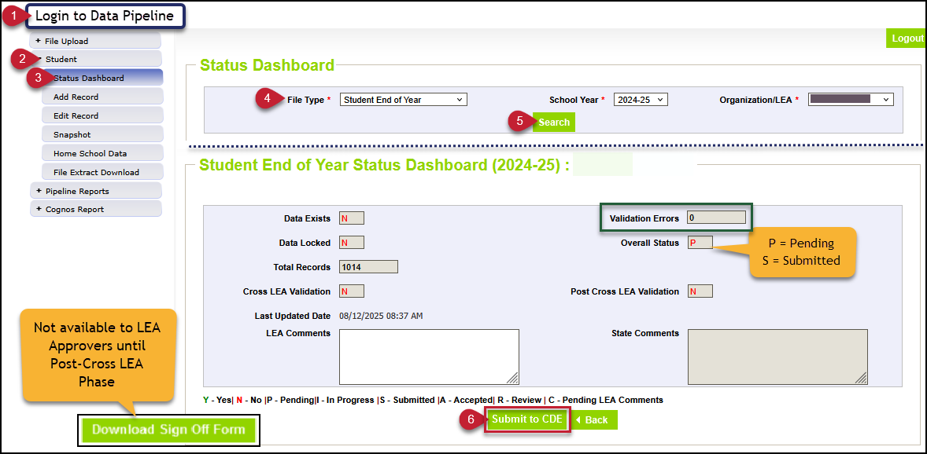
SEY Snapshot Submission Steps
Login to Data Pipeline
Select student
Select status dashboard
Select file type Student End of Year
Click Search
Click Submit to CDE
Student End of Year
StudentEndOfYear@cde.state.co.us

Slide 19
Questions & Resources:
Student End of Year
StudentEndOfYear@cde.state.co.us
720-484-9057
  Student End of Year Collection Website
  Student Interchange Website
  Graduation Guidelines (Program) Website

Slide 20
Title 1 Interchange
Melissa Chaffin

Slide 21
2024-2025 Title 1 Interchange
Date | Event | Event Description
9/4/2024 | Student End of Year Regular Phase Deadline | Error free Title 1 Interchange file required for LEAs with TA programs.
10/16/2025 | Student End of Year Cross-LEA Deadline | Error free Title 1 Interchange file required for LEAs with TA programs. Last opportunity to update Title 1 TA data for 2024-2025 school year.
10/17/2025 | Closes | 2024-2025 Title 1 Interchange closes.
Title 1 Interchange
Chaffin_m@cde.state.co.us

Slide 22
2025-2026 Title 1 Interchange
Date | Event | Event Description
8/29/2025 | Open
10/2/2025 | Interim Deadline | Upload initial file
10/9/2025 | Interim Deadline | Error free file for use in Student October collection
11/10/2025 12:00pm | Student October Deadline | Error free Title 1 Interchange file required
5/8/2026 | Interim Deadline | Upload initial end of year file encompassing all students receiving TA services during the current year for use in Student End of Year collection
6/10/2026 | Interim Deadline | Error free Title 1 Interchange File
Fall 2026 | Student End of Year Deadline | Error free Title 1 Interchange File required for LEAs operating TA programs
Title I Part A
Chaffin_m@cde.state.co.us

Slide 23
Types of Title I Part A and which is Reported
Two types of Title I Part A:
  Targeted Assistance (TA)
  Schoolwide (SW).
SW schools and students are not reported in the Data Pipeline Title I Interchange.
They will be automatically provided to the Student October Count when the snapshot is taken.
If you report them, you will get an error.
Only students within eligible TA schools and grade spans are reported in a file which is uploaded to the Data Pipeline.
Include students in TA grade schools/grade spans who received Title I services/resources any time during the year, even if student left school/district or services were stopped.
Title I Part A Designation List
Title I Part A
Chaffin_m@cde.state.co.us

Slide 24
Title I Interchange Targeted Assistance (TA)
The student data in the file must match the exact data in the Student School Association file in the Data Pipeline.
If the file needs to be updated, then override or replace the old file with the updated file.
Maintain a complete data file at district or school level, make updates to this file if needed.
Make sure to include leading zeros, for example, district codes, school codes, DOB.
  District code example: 0123 or 1122 (must have 4 digits)
  School code example: 0123 or 1122 (must have 4 digits)
  DOB example: 05102019 or 11232018 (must have 8 digits)
Indicate resource(s) students received (reading, math, etc.): 1 for yes, 0 for no. All service cells must be either 1 or 0.
More than 1 school can be listed on the same file for the same district.
Title I Part A
Chaffin_m@cde.state.co.us

Slide 25
New template for Student October 25-26
Important template change for Student October 25-26
The Title I template for Student October 25-26 no longer collects the gender option.
For Student October, please choose 25-26 in the dropdown.
No Gender template = Student October 25-26
The new Title I file template can be found on the Title 1 Interchange site
If you are updating the EOY 24-25, please use the old template with the Gender option.
Title I Part A
Chaffin_m@cde.state.co.us

Slide 26
Title I Part A Status Designation List
List of schools and grade spans to check status (TA, SW, NS): Title I Part A Designation List (25-26 is now posted).
Note: 2 different grade spans at the same school can have 2 different Title I status designations, so please make sure your template has students within the TA status grade span.
If you think there is a discrepancy in the Title I Part A school/grade span list for your LEA, please check with your Title I coordinator at your district.
Title I Part A
Chaffin_m@cde.state.co.us

Slide 27
Common Errors After Uploading file in Data Pipeline for Title I file
Most common Title I Interchange data does not match Student Interchange data:
TI003: This school is not a Targeted Assistance school for the grade of the student’s enrollment in the Student Profile
  Check the Title I Status Designation list for the school and grade span status.
TI004: There must be a School Association record for this student in the Student Profile at this school for the current School Year.
  Make sure the Student School Association file is uploaded first.
OC067: At least one student should be reported in the Title I Interchange as participating in Title I services within a school that implements a Targeted Assistance program. Please update/upload your Title I Interchange file.
  May have to refresh October Count file for system to re-read the files.
General data errors
  Invalid SASID, first and last name swapped, missing letters.
Services not marked 0 or 1 in template; blanks=errors
May have to refresh October Count file for system to re-read the files
The full list of business rules for Title I can be found here: Business Rules Title I Part A
Title I Part A
Chaffin_m@cde.state.co.us

Slide 28
Who To Contact for Title I Part A collection questions
If you have questions regarding:
  Which Title I template to use, email me chaffin_m@cde.state.co.us
  Errors for your Title I upload in the Data Pipeline, or how to upload, email me chaffin_m@cde.state.co.us
  If you think your school or school grade span is incorrectly identified (TA, SW, NS), please see your Title I Part A coordinator first. If there are still questions, they can contact either me or the Regional Coordinator that handles their Consolidated Application.
  Thanks!
Title I Part A
Chaffin_m@cde.state.co.us

Slide 29
Questions & Resources:
Title 1 Interchange
Melissa Chaffin
chaffin_m@cde.state.co.us
720-908-1379

Slide 30
Summer EBT
Collin Slutzky

Slide 31
Summer EBT Corrections Period
Corrections opened May 19th and close on September 3rd.
File layout is unchanged from the regular collection.
Submission is optional but recommended if your district has changes.
Districts have the following options for submitting student records:
  Submit data for all students enrolled in National School Lunch Program sites only.
  Submit data for all students enrolled in NSLP sites and data for any F/R eligible transfer students to non-NSLP sites during the school year (any student that was enrolled at a NSLP site, even for a short period of time, would be eligible for S-EBT benefits)
  Submit data for all enrolled students at both NSLP sites and non-NSLP sites.
Submitting data for all enrolled students will be the easiest option for most districts, as your S-EBT reports from your SIS likely use this option.
Summer EBT
S-ebt@cde.state.co.us

Slide 32
Summer EBT Data Collection:
Additional Notes
You do not need to email us to submit your initial file.
If you need to submit additional changes after finalizing, contact
s-ebt@cde.state.co.us to unlock your collection.
You may submit multiple files over the Summer as long as your file is finalized by September 3rd, 2025.
Summer EBT
S-ebt@cde.state.co.us

Slide 33
Questions & Resources:
Summer EBT
Collin Slutzky
s-ebt@cde.state.co.us
(720) 760-3569
S-EBT Data Collection Resources
S-EBT Office Hours Sign-up

Slide 34
Student October
Collin Slutzky

Slide 35
October Count Timeline
Date​ | Event​ | Event Description​
07/14/2025 | Open​ | Districts may begin uploading Student Interchange Files (Student Demographic and Student School Association).​
08/29/2025 | Open​ | Districts may begin creating snapshots. Student October Snapshot dependencies are the Student Demographic File, Student School Association File, Title I File (if applicable) and At-Risk File.​
09/02/2025​ | Training Event​ | Data Pipeline Training 10-11 a.m.​ Registration Link
09/04/2025 | Training Event​ | New Respondent Training 1-2 p.m.​ Registration Link
09/10/2025 | Training Event​ | Multilingual Learner (English Learner) Training 11-12 p.m.​ Registration Link
09/16/2025 | Training Event​ | Veteran Respondent Training 11:30-12:30 p.m.​ Registration Link
09/17/2025 | Training Event​ | Postsecondary Program Coding Training 11-12 p.m.​ Registration Link
10/01/2025 | Other Date​ | Official Count Day for 2025
10/02/2025 | Interim Deadline​ | Upload Student Demographic and Student School Association Files. Upload Title I Interchange File (if applicable). Upload At-Risk Interchange File.​
10/09/2025 | Interim Deadline​ | Error-free Student Interchange File Uploads (DEM and SSA)
10/14/2025 | Training Event​ | Mid-Collection Office Hours 1-2 p.m. Registration Link
10/14/2025 | Interim Deadline​ | Create an initial Student October Snapshot​
10/27/2025 | Interim Deadline​ | Submit any necessary reporting exceptions for review.
10/27/2025 | Interim Deadline​ | Error free Student October Snapshot​
10/28/2025 | Training Event​ | Data Validation, Transfer Enrollment Exceptions and Cognos Reports 1-2 p.m.​ Registration Link
10/30/2025 | Training Event​ | Data Pipeline Duplicate Process and Submission 11-12 pm Registration Link
11/03/2025 | Report Review​ | Review Student October Cognos Reports for data validation. Submit Student October Snapshot data as soon as review is complete.​
11/10/2025, 12:00 p.m.​ | State Deadline​ | Submit Student October Snapshot data​
Student October
StudentOctober@cde.state.co.us

Slide 36
October Count Timeline:
Duplicate Phase
Date​ | Event​ | Event Description​
11/13/2025 | Deadline | Duplicate count funding documentation due to School Auditing Office​
11/19/2025 | Other Date | School Auditing makes decisions on funding duplicates
11/26/2025 | Deadline​ | Resubmit Student October Snapshot data to CDE based on decisions from School Auditing
12/05/2025 | Deadline​ | Collection Closes Secretary of the Board of Education Verification (sign-off) form due Data remains embargoed until the official release in January
01/21/2026 | Data Release​ | Official data release
Student October
StudentOctober@cde.state.co.us

Slide 37
Student October Training Schedule
Data Pipeline Training
  Date/Time: 09/02/2025, 10-11 a.m.
  Click here to register for the Data Pipeline Training
New Respondent Training
  Date/Time: 09/04/2025, 1-2 p.m.
  Click here to register for the New Respondent Training
Multilingual Learner Training
  Date/Time: 09/10/2025, 11-12 p.m.
  Click here to register for the Multilingual Training
Veteran Respondent Training
  Date/Time: 09/16/2025 11:30-12:30 p.m.
  Click here to register for the Veteran Respondent Training
Postsecondary Program Coding Training
  Date/Time: 09/17/2024, 11-12 p.m.
  Click here to register for the Postsecondary Training
Mid-Collection Office Hours
  Date/Time: 10/14/2025 1-2 p.m
  Click here to register for the Mid-Collection Office Hours
Data Validation and Cognos Reports Training
  Date/Time: 10/24/2025 1-2 p.m.
  Click here to register for the Data Validation and Cognos Training
Data Pipeline Duplicate Process and Submission Training
  Date/Time: 10/28/2025 9-10 a.m.
  Click here to register for the Duplicate Process and Submission Training
Student October
StudentOctober@cde.state.co.us

Slide 38
Warnings – Helpful Tool for Data Reporting
OC182: This year's Student October grade level is not showing an advance (+1) from last year's Student October grade level. Please verify the student's grade level.
OC183/OC184 (BOCES School Contract Situations): You currently have a student that is being contracted through a BOCES (Pupil Attendance Information = '31' or '33') and is not being picked up by a BOCES. Please verify with your BOCES contact(s) that this student will be picked up by the BOCES for educational services…. You currently have a student that is coded as a Schools of Choice student (Pupil Attendance Information = '02' or '04') and is not being picked up by a district. Please verify with your district contact(s) that this student will be picked up by the district for funding purposes.
OC201: Possible PAI Duplicate: The following students were submitted by another district causing an enrollment duplicate. Verify the Pupil Attendance Information Code for enrollment purposes.
Various Codes: Your district reported no _____ students.
Various Codes: Your district’s ____ count for October is considerably different compared to last year's count. The tolerance for this warning is +- 25% and only includes K-12 students.
Student October
StudentOctober@cde.state.co.us

Slide 39
Questions & Resources:
October Count
Collin Slutzky
studentoctober@cde.state.co.us
(720) 760-3569
Student October Website
Student Interchange Website
School Auditing Office Website

Slide 40
Special Education End of Year
Lindsey Heitman

Slide 41
Special Education End of Year
Timeline
May 1, 2025 - SPED EOY Snapshot official open
June 26, 2025 – IEP Interchange files error-free
September 4, 2025 - All Exception requests submitted to CDE
September 11, 2025 – All errors resolved at snapshot/interchange
September 12 -19, 2025 -Initial Report Review
September 22 - 26, 2025 – Resolving duplicates
September 29 – October 1, 2025 – Final Report Review
October 3, 2025 - Final submission due to CDE
Exception Request Reminders:
The SPED EOY exception template is found on the Special Education End of Year Snapshot webpage under Additional Resources.
Detailed exception request explanations are much appreciated, but the comments box should not have more than 400 characters.
  The excel formula LEN function will give you the # of characters in a cell.
Please double check that each cell and column are not losing the leading zeros (i.e. school codes, AU codes, primary disability – they can all start with a 0).
For SY108 – SASID merges – please include the new SASID # in the comments box.
  Old SASID will be in the SASID column since that is the one we do the exception on becuase you are no longer reporting it
Special Education EOY – Lindsey Heitman
SpedEndofYear@cde.state.co.us

Slide 42
Special Education End of Year
Reporting Reminders
AU respondent contact list found in Special Education EOY cognos folder
Please check for SY282 warnings
  indicates a student coded as a dropout but being reported by another AU later in the 24-25 school year
  Other AU listed in right column of error report
    Now includes other AU Start Date of SPED
Check for warning SY258- these are repeat graduates, completers, age outs
Error reports – Pipeline error reports are recommended over cognos error reports
  If you use cognos keep in mind:
    the global and summary level errors are broken out in a separate section at the bottom of the cognos error reports. This includes your SY108 and SY107 errors.
SY307 – about 900 records overlapping SPED start and end dates statewide
  Enrich system student transfers still not reflecting the correct Start Date of Sped in some cases
  Please try to clear these- other AU and start and end dates listed in error report
SpedEndofYear@cde.state.co.us
Special Education End of Year – Lindsey Heitman

Slide 43
Special Education End of Year
Reconciling Summer Exits
Some AUs are still reporting a large number of ‘EOY Summer Exits’ (from prior summer)
  These exits affect your indicator 1 (graduates), 2 (dropouts), and 14 (post school outcomes)
  So that you don’t have a large number of summer/missed exits next year in your 25-26 SPED EOY we recommend doing this now:
    Compare exits with your Student EOY counterpart (district respondent)
      If you’ve been working in a manual file and not receiving nightly updates from your SIS for a couple of months, you will need to manually update and add additional exits into your file that are being captured now
    Come up with a data process for the Aug-Sept timeframe to be you are catching the later exits. Exit those who have not come back in the 25-26 school year in your 24-25 file.
      Check warning SY296
SpedEndofYear@cde.state.co.us
Special Education End of Year – Lindsey Heitman

Slide 44
Special Education End of Year
Error SY295
Error SY295:
This edit compare the Student EOY exit to the SPED EOY exit field
  Record may be correct in SPED EOY – please confer with district on the situation
  If AU confirms student is returning in 25-26 to attend a SPED transition program, no exit is necessary in SPED EOY
  AU will want to check with district respondent to be sure they know student is returning in 25-26
    The district SSA file record should have a Retention Code of 03
  This error will help you catch missed graduates or completers that are have been recently updated in your SIS
SpedEndofYear@cde.state.co.us
Special Education End of Year – Lindsey Heitman

Slide 45
Questions & Resources:
SPED End of Year
SpedEndofYear@cde.state.co.us
Lindsey Heitman
(720) 456-2033
Special Education IEP Interchange Webpage
Special Education End of Year Snapshot Webpage

Slide 46
READ Training Data Collection
Tara Rhodes

Slide 47
Collection Timeline
Date | Event | Event Description
7/15/2025 | Training Event | This training event will cover changes for the 25-26 READ Training collection. This is a live event from 1-2pm and will be recorded.
8/1/2025 | Open | The 25-26 READ Training collection opens in Data Pipeline.
8/15/2025 | Other Date | This is the date by which teachers, principals, and administrators should have their respective READ training designations added to their COOL accounts.
8/19/2025 | Other Date | This is the target upload date for the collection. Please complete an upload by this date.
8/26/2025 | Other Date | This is the target date for an error-free submission for the collection. Please resolve errors by this date.
8/30/2025 | Deadline | The 25-26 READ Training collection closes in Data Pipeline and sign-off forms are due.
9/8/2025 | Other Date | CDE prepares preliminary State Board of Education documents for any extension requests. Any districts requesting a good cause extension for their educators must have their submission locked by this date.
10/8/2025 | Other Date | State Board of Education hears extension requests and provides the final decision around the approval of any extension requests.
READ Training
READActData@cde.state.co.us

Slide 48
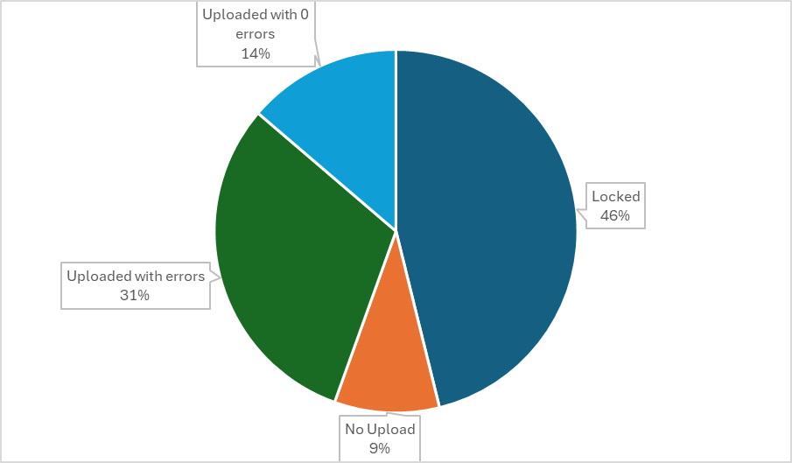
READ Training:
Status Update
Thanks to those districts that have already locked their submissions!
If you have not yet uploaded, please do so. I will be sending reminder emails later today.
Please also keep in mind that for some of these errors, you may have to check in with educators.
READ Training
READActData@cde.state.co.us

Slide 49
READ Training:
Reminders
Reminders:
Collection close is 8/30. (I know this is a Saturday; I will periodically be checking my work email.)
We are looking for on-time submissions this year so that CDE leadership can take all extension requests to the State Board at the October State Board of Education meeting.
Please don't hesitate to reach out with any questions: 720.601.4125 or READActData@cde.state.co.us.
I will be sending reminder emails later today to inform you of your status, if you have not yet locked.
READ Training
READActData@cde.state.co.us

Slide 50
Questions & Resources:
READ Data Collections
Tara Rhodes
Phone: 720.601.4125
READActData@cde.state.co.us
READ Training Data Collection Website
READ Training Website (Pathway Information and How to Add Documentation in COOL)

Slide 51

Thank you for Joining Today!
Next Town Hall will be September 4th
Reminder:
LAMs, please review your IdM users to ensure accurate permissions for data respondents in your district. Deactivate users who no longer oversee a data collection in your district.

