Slide 1
August 21, 2025
Data Pipeline Town Hall
The goal of the webinar is to provide updates on the Data Pipeline, current, and upcoming data collections. These webinars also provide a forum for districts, BOCES, and Administrative Units to have questions answered about Data Pipeline.

Slide 2
Colorado Department of Education
Identity Management (IdM)
Identity Management Site
Frequently Asked Questions
How do I add myself or others to the email listserv for town hall emails and/or a specific collection?
  Email lists are dependent on a person’s access rights in IdM. Contact your LAM to get an account or be assigned to a specific collection.
Where can I find the IdM role mappings for Data Pipeline and other applications?
  Role Mapping (XLS)
I am a LAM. How do I update the user permissions for someone in my district?
  Follow the steps outlined in the IdM Quick Guide for Access Management (DOCX)
Important: Users are not automatically removed from IdM when their email address is no longer active in your district. The LAM must deactivate their IdM account to ensure only designated staff can access CDE’s data reporting system.
Support:
  Michael Threlkeld
  Forgot Password
  Request LAM Assistance
Notes:
LAMs, please check the IdM roles for your district. Remove permissions for users who have retired, left your district, or are no longer assigned to a collection. Add roles for new hires and newly assigned respondents for specific collections.

Slide 3

What is PII?
Student and Staff Personally Identifiable Information (PII) is defined by state and federal laws as information that, alone or in combination, personally identifies an individual
  This includes direct identifiers
  (i.e. student and staff names, SASID, EDID, etc.)
  Includes information that when combined is identifiable
Colorado’s Student Data Transparency and Security Act outlines requirements for how Student PII is collected, used and shared
See the Data Privacy and Security website for prepared guidance on how to comply with this and other privacy laws.

Slide 4

Sharing Data
Use secure methods to transfer any PII to CDE
  Contact Data Collection leads with questions about how to transmit PII securely
    Each Data Collection leads maintains their own Syncplicity folders for specific collections, reach out to the collection lead for access
  Use Syncplicity to encrypt emails to CDE
Avoid sending PII via unencrypted email or to unsecured faxes when sharing data between or within districts
  Use Syncplicity to encrypt emails to CDE
Check local policies for restrictions, requirements, etc. regarding PII
  Do not use PII in trainings, presentations, etc.
  Do not share PII with unauthorized individuals
  Do not share passwords
  Follow local policies when transmitting PII to any third party

Slide 5
Today’s Agenda
Agenda Topic | Presenter
Open Data Collections and Upcoming Deadlines in Data Pipeline | Host: Carrie Martin
READ Collections | Tara Rhodes
Teacher Student Data Link | Peter Hoffman
Attendance Data Release | Peter Hoffman
Student End of Year | Reagan Ward
Title 1 Interchange | Melissa Chaffin
Summer EBT | Collin Slutzky

Slide 6
Open Collections and
Upcoming Deadlines in
Data Pipeline

Slide 7
Open Collections and Upcoming Dates:
Year-Round & Interchanges
Name | Category | Status | Key Dates
RITS | Year Round | Open | N/A
EDIS | Year Round | Open | N/A
Directory | Year Round | Open | District Calendars: Open, due 8/20/25
Student | Interchange | 2025 & 2026 Open | 2024-2025: Maintain error free files 2025-2026: Open, ML Collaborative Webinar 9/4 (Registration Link)
At-Risk | Interchange | Open | 2025-2026: Overview Training 8/21/25, 10am (Registration Link)
Title I | Interchange | Open | 2024-2025: Maintain error free file 2025-2026: Coming Soon! Scheduled to open 8/29
Special Education IEP | Interchange | Open | Maintain error free files
Staff | Interchange | Open | Staff Profile and Staff Evaluation interchange files are needed for the Staff Evaluation Snapshot
Discipline Action | Interchange | Open | This interchange file is needed for Student Discipline Snapshot and Special Education Discipline Snapshot
Teacher Student Data Link | Interchange | Open | Maintain error free file
Data Pipeline Resources: Data Pipeline Collection Dates (XLS)

Slide 8
Open Collections and Upcoming Dates:
Snapshots
Name | Category | Status | Final Deadline Date | Next Milestone | Looking Ahead
Teacher Student Data Link | Snapshot | Open | Aug. 29, 2025 | Interim Deadline: 8/22/25 error free interchange and snapshot | Report Review: 8/25 to 8/28 Final snapshot report review
Staff Evaluation | Snapshot | Open | Oct. 15, 2025 | Report Review: 7/15 to 8/15 Final snapshot report review | State Deadline: 10/15
Student End of Year: Regular Phase | Snapshot | Open | Sept. 4, 2025 | Report Review: 8/14/25 to 9/4/25 Review and validate data | State Deadline: 9/4/25 Submit error-free SEY Snapshot
Special Education EOY | Snapshot | Open | Oct. 3, 2025 | Interim Deadline: 9/4/25 all exception requests submitted to CDE for review | Interim Deadline: 9/11/25 error free snapshot
Student Attendance | Snapshot | Closed | July 25, 2025 |  | Data Release: 8/27/25
Special Education Discipline | Snapshot | Closed | Aug. 1, 2025
Student Discipline | Snapshot | Closed | July 31, 2025
Data Pipeline Resources: Data Pipeline Collection Dates (XLS)

Slide 9
Open Collections and Upcoming Dates:
Periodic
Name | Category | Status | Final Deadline Date | Next Milestone | Looking Ahead
Summer EBT: Corrections Period | Periodic | Open | Sept. 3, 2025 | Corrections Period: 5/19/2025 to 9/3/2025
READ Training | Periodic | Open | Aug. 30, 2025 | Interim Deadline: 8/26/25 Error-free submission | Deadline: 8/30/25 collection closes, submit sign-off forms to CDE
Prevent Harassment or Discrimination | Periodic | Closed
Data Pipeline Resources: Data Pipeline Collection Dates (XLS)

Slide 10
READ Training Data Collection
Tara Rhodes

Slide 11
Collection Timeline
Date | Event | Event Description
7/15/2025 | Training Event | This training event will cover changes for the 25-26 READ Training collection. This is a live event from 1-2pm and will be recorded.
8/1/2025 | Open | The 25-26 READ Training collection opens in Data Pipeline.
8/15/2025 | Other Date | This is the date by which teachers, principals, and administrators should have their respective READ training designations added to their COOL accounts.
8/19/2025 | Other Date | This is the target upload date for the collection. Please complete an upload by this date.
8/26/2025 | Other Date | This is the target date for an error-free submission for the collection. Please resolve errors by this date.
8/30/2025 | Deadline | The 25-26 READ Training collection closes in Data Pipeline and sign-off forms are due.
9/8/2025 | Other Date | CDE prepares preliminary State Board of Education documents for any extension requests. Any districts requesting a good cause extension for their educators must have their submission locked by this date.
10/8/2025 | Other Date | State Board of Education hears extension requests and provides the final decision around the approval of any extension requests.
READ Training
READActData@cde.state.co.us

Slide 12
READ Training:
Frequently Asked Questions
Should we only be reporting staff that we have not yet reported in a previous collection or each year do we report ALL staff who should hold the designation?
  If the educator has already been reported as completing the appropriate training, they do not need to be re-reported. The only exceptions to this are when:
    The educator was previously reported as a new hire (code 12). They would need to be reported again as completed (code 10).
    The educator was previously reported as not having completed the training (in previous years: code 13). They would need to be reported again as completed (code 10).
    The educator was previously reported as completed the teacher training, but now has also completed the administrator training.
READ Training
READActData@cde.state.co.us

Slide 13
READ Training:
No Report of Training Screen – Background and Purpose
For some districts, all of their educators have previously taken the training and have been reported as such through the READ Training data collection. No additional educators were hired for the current year, or no additional educators were hired for the current year that required the training.
For these districts, they have no additional staff to report for the READ Training data collection.
Due to this, CDE created a "No Report of Training" screen in Data Pipeline. This serves as the avenue for these districts to complete the collection.
READ Training
READActData@cde.state.co.us

Slide 14
READ Training:
No Report of Training Screen - Process
Steps:
First, confirm that your district has no additional staff to report for the collection. This means ensuring that all code 12s or code 13s from previous years have been reported as completing the training or have left your district.
Once this is confirmed, please click on the "READ" gray box along the left-hand side in Data Pipeline.
Then, click on the "No Report of Training" gray box in the submenu.
On the main screen, the school year and your district should prepopulate. Click on "Search".
Then, please read the language that we have provided in the text box and make sure that you agree with it.
Then, click on the "No Additional Staff to Report" radio button.
Click on "Save".
You will still need to go to the Status Dashboard and lock your submission. The "Data Exists" column will not turn over to "Y", but the "No Additional Staff to Report" column show now display "Y" instead.
READ Training
READActData@cde.state.co.us

Slide 15
READ Training:
Reminders
Reminders:
Please advise your educators to submit their documentation to COOL. The only exceptions to this are unlicensed teachers and individuals who took the administrator training but do not hold one of the four following licenses:
  Principal or Administrator license
  Principal Authorization
  Emergency Authorization with either a Principal or Administrator Endorsement
  Interim Authorization with either Principal or Administrator Endorsement
Please note that the designation cannot attach to an expired credential.
Code 12 can only be used once, regardless of district. This is checked by the EDID, not the EDID/district combination.
Codes, 14, 15, 16, or 17 can only be used once, regardless of district. If the educator had previously been coded as a code 13, you will hit an error for them if you attempt to code them with a 14, 15, 16, or 17.
READ Training
READActData@cde.state.co.us

Slide 16
READ Training:
Next Steps
Reminders:
Process for Adding Documentation or Evidence of Completion in COOL:
  Educator downloads certificate out of Playbook;
  Educator completes the appropriate designation application in COOL, including uploading their certificate or evidence of completion as part of the application (See this link);
  Educator Talent Office reviews and approves the application (this can take up to 3 business days to occur);
  COOL syncs with Pipeline overnight;
  District data respondent reuploads their file and the TR026 and TR035 errors should clear.
Our next interim deadline is 8/26. This is the target deadline to have an error-free submission. I know the collection doesn't close until 8/30, but this gives you the necessary 4 days to process any educators that had thought they had added their designation in COOL, but didn't.
READ Training
READActData@cde.state.co.us

Slide 17
READ Training:
Upcoming Topics
Topics that will be covered during Data Pipeline Town Hall:
August 7: 25-26 Changes and Background
August 14: Manual Review Process
August 21: No Report of Training Screen
August 28: Any last reminders before collection close
READ Training
READActData@cde.state.co.us

Slide 18
Questions & Resources:
READ Data Collections
Tara Rhodes
Phone: 720.601.4125
READActData@cde.state.co.us
READ Training Data Collection Website
READ Training Website (Pathway Information and How to Add Documentation in COOL)

Slide 19
Teacher Student Data Link
Peter Hoffman

Slide 20
Teacher Student Data Link Timeline
Date | Event | Event Description
Friday August 21, 2025 | Interim Deadline | TARGET: Date by which you should have a complete Teacher Student Data Link Snapshot. Complete Teacher Student Data Link Snapshot means: ◻ All TSDL interchange errors are resolved ◻ All TSDL snapshot errors are resolved If you anticipate that you will not be able to meet this deadline, please contact CDE at TeacherStudentDataLink@cde.state.co.us
Monday August 25, 2025 – Thursday August 28, 2025 | Report Review | Final Snapshot Report Review – This is your opportunity to review reports in detail and make any data corrections you deem necessary to make sure you are reporting valid and reliable data. All data corrections must be completed during this time.
Friday August 29, 2025 | Deadline | Required to have TSDL snapshot error free and finalized before or on this date. TSDL closed and final report is signed and provided to CDE via email TeacherStudentDataLink@cde.state.co.us
Teacher Student Data Link
TeacherStudentDataLink@cde.state.co.us

Slide 21
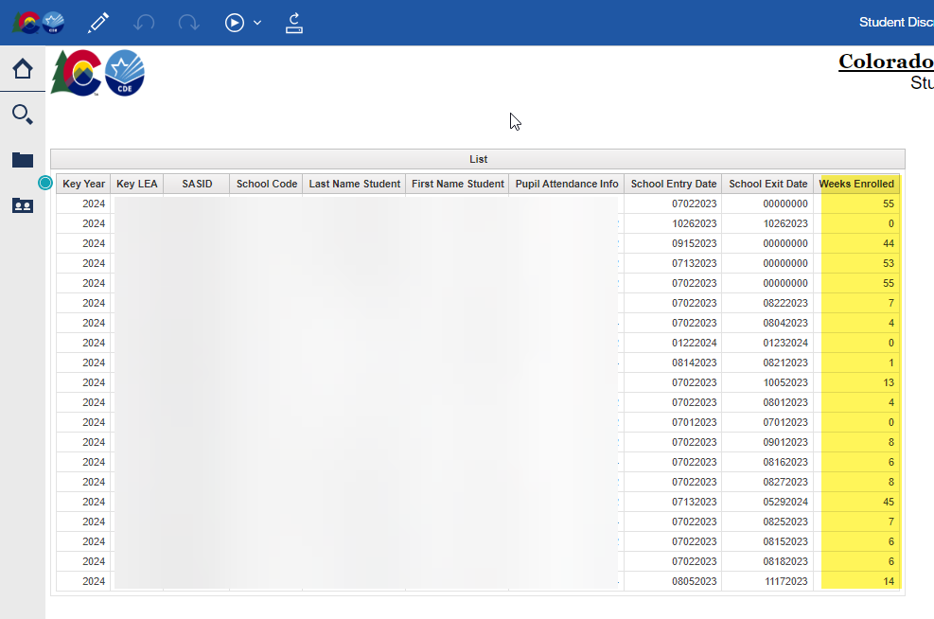
Teacher Student Data Link – Cognos Reports and Exceptions
COGNOS/CEDAR Reports:
  Student Discrepancy Report is all students reported in the Student Interchange that were not included in the TSDL Snapshot. Verify if the omission is correct using the weeks enrolled field.
If you are getting TD110, TD111, TD112 or TD113 snapshot errors, and it is accurate that a class of that course code should not be appearing at that school, please reach out for an exception.
Teacher Student Data Link
TeacherStudentDataLink@cde.state.co.us

Slide 22
Questions & Resources:
TSDL
Peter Hoffman
720-925-8611
TeacherStudentDataLink@cde.state.co.us
TSDL Interchange Webpage

Slide 23
Attendance Data Release
Peter Hoffman

Slide 24
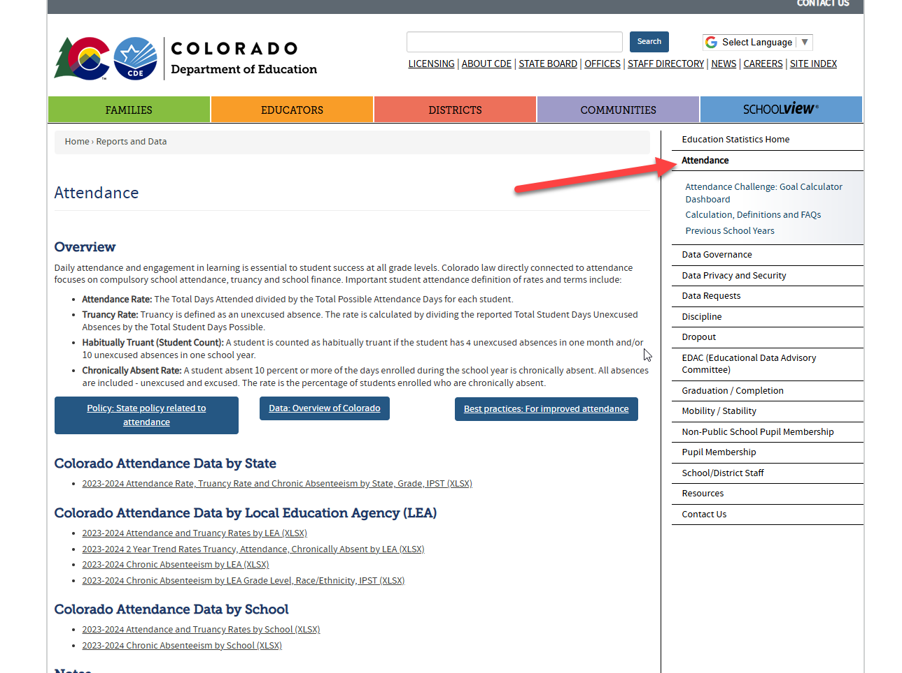
Attendance Data Release Information
August 27th – Public Data Release
  Education statistics based upon this collection are publicly released and the embargo is lifted for this dataset (cannot send/use this data externally until embargo is lifted)
August 20th – Embargoed Data was Sent
  Will be sent:
    2 Year Trend Rates Truancy, Attendance, Chronically Absent by District
    Attendance Rate, Truancy Rate and Chronic Absenteeism by State, Grade, IPST
Student Attendance
Attendance@cde.state.co.us

Slide 25
Questions & Resources:
Student Attendance
Peter Hoffman
Attendance@cde.state.co.us
720-925-8611
Attendance Webpage​
Student Interchange Webpage

Slide 26
Student End of Year
Reagan Ward

Slide 27
SEY Collection Timeline
Date | Event | Event Description
8/14/2025 to 9/4/2025 | Report Review | Validate SEY data using CEDAR/COGNOS reports.
9/4/2025 | State Deadline | Submit error-free SEY snapshot
9/5/2025 to 9/17/2025 | Closed | SEY Snapshot is closed until the start of the Cross LEA phase
9/18/2025 to 10/16/2025 | Cross LEA Phase | See the SEY Website for the detailed timeline
10/23/2025 to 11/18/2025 | Post-Cross LEA Phase | See the SEY Website for the detailed timeline
12/2/2025 | Deadline | Superintendent Verification (Sign-Off) form due. Collection Closes.
Student End of Year
StudentEndOfYear@cde.state.co.us

Slide 28
SEY Status as of 10pm on 8/20
To be ‘on track’ for this collection, the following tasks should have been completed:
  Error free interchange files
  (DEM, SSA, GG, Title 1 if applicable, IEP interchange if applicable)
  with an upload date after 4/1/25
  Error free SEY Snapshot 8/14
    Pending possible summer graduates/completers
    Pending submitted exception requests
  Begun reviewing reports to validate data
Student End of Year
StudentEndOfYear@cde.state.co.us

Slide 29
Report Review Window: Report Checklist
August SEY Office Hours: CEDAR/COGNOS Reports to Validate Data
Recording and Slides posted on SEY Website
School Summary of All Rates
Mobility: District and School Rates
  Dig Deeper?
    Student List: District and School Mobility Instances
Dropout: District and School Rates
  Dig Deeper?
    Student List: Dropout
Graduation: 3-,4-,5-,6-,7- year Rates by School Year
  Dig Deeper?
    Graduation Rates: District and School by AYG
    Still Enrolled Rates: District and School by AYG
    Student List: AYG Cohort
    Student List: AYG Cohort Adjustments
LEA Approvers:
Submit error-free snapshot once report review is complete
Student End of Year
StudentEndOfYear@cde.state.co.us

Slide 30
Questions & Resources:
Student End of Year
StudentEndOfYear@cde.state.co.us
720-484-9057
  Student End of Year Collection Website
  Student Interchange Website
  Graduation Guidelines (Program) Website

Slide 31
Title 1 Interchange
Melissa Chaffin

Slide 32
2024-2025 Title 1 Interchange
Date | Event | Event Description
9/4/2024 | Student End of Year Regular Phase Deadline | Error free Title 1 Interchange file required for LEAs with TA programs.
10/16/2025 | Student End of Year Cross-LEA Deadline | Error free Title 1 Interchange file required for LEAs with TA programs. Last opportunity to update Title 1 TA data for 2024-2025 school year.
10/17/2025 | Closes | 2024-2025 Title 1 Interchange closes.
Title 1 Interchange
Chaffin_m@cde.state.co.us

Slide 33
2025-2026 Title 1 Interchange
Date | Event | Event Description
8/29/2025 | Open
10/2/2025 | Interim Deadline | Upload initial file
10/9/2025 | Interim Deadline | Error free file for use in Student October collection
11/10/2025 12:00pm | Student October Deadline | Error free Title 1 Interchange file required
5/8/2026 | Interim Deadline | Upload initial end of year file encompassing all students receiving TA services during the current year for use in Student End of Year collection
6/10/2026 | Interim Deadline | Error free Title 1 Interchange File
Fall 2026 | Student End of Year Deadline | Error free Title 1 Interchange File required for LEAs operating TA programs
Title I Part A
Chaffin_m@cde.state.co.us

Slide 34
Brief Overview of Title I Part A
Title I, Part A of the Elementary and Secondary Education Act (ESEA), as amended by the Every Student Succeeds Act (ESSA) provides financial assistance to local educational agencies (LEAs) and schools with high numbers or high percentages of children from low-income families to help ensure that all children meet challenging academic standards.
Title I Part A file is uploaded in the Data Pipeline during Student October in the Fall and again during EOY collection in the Spring.
Schools and grade spans are identified as either SW (Schoolwide), TA (Targeted Assistance), or NS (Not Serviced) during the Consolidated Application period.
Title I Part A
Chaffin_m@cde.state.co.us

Slide 35
Title I Interchange Targeted Assistance (TA)
Only students within eligible TA schools and grade spans are reported in a file which is uploaded to the Data Pipeline.
Include students in TA grade schools/grade spans who received Title I services/resources any time during the year, even if student left school/district or services were stopped.
The student data must match the data in the Student School Association file in the Data Pipeline.
If the file needs to be updated, then override or replace the old file with the updated file.
Maintain a complete data file at district or school level, make updates to this file if needed.
Title I Part A
Chaffin_m@cde.state.co.us

Slide 36
New template for Student October 25-26
Important template change for Student October 25-26
The Title I template for Student October 25-26 no longer collects the gender option.
For Student October, please choose 25-26 in the dropdown.
No Gender template = Student October 25-26
The new Title I file template can be found on the Title 1 Interchange site
If you are updating the EOY 24-25, please use the old template with the Gender option.
Title I Part A
Chaffin_m@cde.state.co.us

Slide 37
Title I Interchange Targeted Assistance (TA)
Only students in Targeted Assistance schools and grade spans need to be reported in the file.
Make sure to include leading zeros, for example, district codes, school codes, gender, DOB.
Indicate resource(s) students received (reading, math, etc.): 1 for yes, 0 for no. All service cells must be either 1 or 0.
More than 1 school can be listed on the same file for the same district.
Title I Part A
Chaffin_m@cde.state.co.us

Slide 38
Title I Interchange Schoolwide (SW)
SW schools and students are not reported.
There is no need to put SW schools and students in this file as they are automatically provided to the Student October Count when the snapshot is taken.
If you report them, you will get an error.
Title I Part A
Chaffin_m@cde.state.co.us

Slide 39
Title I Status Designation List
Note: 2 different grade spans at the same school can have 2 different Title I status designations, so please make sure your template has students within the TA status grade span.
Title 1-A School List Site: Includes a list of schools and grade spans to check status (TA, SW, NS).
  25-26 will be posted early next week
If you think there is a discrepancy in the Title I Part A school/grade span list for your LEA, please check with your Title I coordinator at your district.
Title I Part A
Chaffin_m@cde.state.co.us

Slide 40
Title I Common Errors
Most common Title I Interchange data does not match Student Interchange data
  TI003: This school is not a Targeted Assistance school for the grade of the student’s enrollment in the Student Profile.
    Check the Title I Status Designation list for the school and grade span status.
  TI004: There must be a School Association record for this student in the Student Profile at this school for the current School Year.
    Make sure the Student School Association file is uploaded first.
  OC067: At least one student should be reported in the Title I Interchange as participating in Title I services within a school that implements a Targeted Assistance program. Please update/upload your Title I Interchange file.
  May have to refresh October Count file for system to re-read the files.
General data errors
  Invalid SASID, first and last name swapped, missing letters.
Services not marked 0 or 1 in template; blanks=errors
May have to refresh October Count file for system to re-read the files
The full list of business rules for Title I can be found on the Title I Interchange Site
Title I Part A
Chaffin_m@cde.state.co.us

Slide 41
Questions & Resources:
Title 1 Interchange
Melissa Chaffin
chaffin_m@cde.state.co.us
720-908-1379

Slide 42
Summer EBT
Collin Slutzky

Slide 43
Summer EBT Corrections Period
Corrections opened May 19th and close on September 3rd.
File layout is unchanged from the regular collection.
Submission is optional but recommended if your district has changes.
Districts have the following options for submitting student records:
  Submit data for all students enrolled in National School Lunch Program sites only.
  Submit data for all students enrolled in NSLP sites and data for any F/R eligible transfer students to non-NSLP sites during the school year (any student that was enrolled at a NSLP site, even for a short period of time, would be eligible for S-EBT benefits)
  Submit data for all enrolled students at both NSLP sites and non-NSLP sites.
Submitting data for all enrolled students will be the easiest option for most districts, as your S-EBT reports from your SIS likely use this option.
Summer EBT
S-ebt@cde.state.co.us

Slide 44
Summer EBT Data Collection:
Additional Notes
You do not need to email us to submit your initial file.
If you need to submit additional changes after finalizing, contact
s-ebt@cde.state.co.us to unlock your collection.
You may submit multiple files over the Summer as long as your file is finalized by September 3rd, 2025.
Summer EBT
S-ebt@cde.state.co.us

Slide 45
Questions & Resources:
Summer EBT
Collin Slutzky
s-ebt@cde.state.co.us
(720) 760-3569
S-EBT Data Collection Resources
S-EBT Office Hours Sign-up

Slide 46

Thank you for Joining Today!
Next Town Hall will be August 28th
Reminder:
Syncplicity folders are specific to a collection. Email the collection lead if you need access to your LEA’s Syncplicity folder for a collection.
Tip: Bookmark the Syncplicity login site.

