Slide 1
Federal ESSA Identification: CS Y3+
Understanding Identification and Implications
AEC Presentation
October 30, 2024

Slide 2
Welcome!
As you enter, please add your school and/or district to the chat.

Slide 3
Training and Support for Alternative Education Campuses
2019 - 2024 | 2024-25 school year
Trainings Site Visits Diagnostic Reviews | Informational sessions Networking and topic related discussions Site visits (Spring) Diagnostic Reviews Webpage
AECs serve 1 out of every 12 high school students in CO
Most AECs are the only one in their district
Notes:
Johann

Slide 4
AEC Presentation: CS-Y3+
Topics:
Overview of ESSA Identification Methodology, Categories and Exit Criteria
Explanation: How Graduation Rate is Determined for ESSA Identification - Comprehensive Support - Low Graduation Rate (less than 67%)
Implications for Schools Identified as Comprehensive Support for Three Years or More (CS Y3+)

Slide 5
Acronyms - ESSA School Improvement
ESSA - Every Student Succeeds Act (Federal law)
TS - Targeted Support and Improvement
ATS - Additional Targeted Support and Improvement
CS - Comprehensive Support and Improvement
CS-Y3+ - Comprehensive Support for Three Years or More
UIP - Unified Improvement Plan

Slide 6
ESSA Identification
Notes:
Nazie

Slide 7
Overview
Every state that accepts funds under the Every Student Succeeds Act (ESSA), the most recent reauthorization of the Elementary and Secondary Education Act (ESEA) must have a process for identifying schools for support and improvement that is approved by the U.S. Department of Education
  Must include all public schools in methodology for identification, including Alternative Education Campuses (AECs) and schools with Grade K-2 only
The State (CDE) must notify the districts of their schools that have been identified for ESSA support and improvement
Districts must notify schools and support them in the development of an improvement plan that meets ESSA requirements
Notes:
Nazie/Tina

Slide 8
ESSA Identification Update
Districts with identified schools (except K-2 schools) received notifications from Dr. Haniford (CDE) by September 13, 2024!
  Sent to Superintendent, Title I Contact (if provided in GAINS), Authorized Representative, and District Accountability Contact
  One week later sent to the Local Board
  Includes
    Outline of changes in state and federal (ESSA) accountability
    Resources and grants (EASI) available for identified schools
    Improvement planning requirements
    Link to a Data Dashboard
ESSA School Profiles are shared with districts via Syncplicity
The list of all ESSA identified schools is posted on the CDE ESSA Identification website
Notes:
Nazie/Tina

Slide 9
Indicators Used in School Identification Methodology
K-2 Only Schools
READ Act Data is used for the Academic Achievement and Growth indicator
Alternative Education Campus (AECs)
When necessary, the following indicators are also used to differentiate among lowest performing AECs, in addition to the other indicators listed to the left
Attendance rate
Truancy rate
Academic Achievement
  English Language Arts (ELA) and Math mean scale scores
Academic Progress (Growth)
  ELA and Math median growth percentiles
Progress in Achieving English Language Proficiency (ELP)
  ACCESS median growth percentiles
  Percent on-track to attaining proficiency
School Quality or Student Success
  Chronic absenteeism rate, unexcused absences only (elementary/middle)
  Dropout rate (high)
Graduation Rates (will change beginning in 2025)
  4-year adjusted cohort rate
  7-year adjusted cohort rate
Notes:
Nazie/Tina This slide provides a brief overview of the five indicators used in the ESSA Identification process.
Colorado utilizes mean scale scores on the CMAS, COALT, and SAT assessments, in both English language arts and math, for the Academic Achievement indicator. Please note that this includes students in grades 3-8 and grade 11.
Median growth percentiles for the CMAS and SAT English language arts and math assessments are utilized for the Academic Progress indicator, for students in grades 4-8 and grade 11.
The Progress in Achieving English Language Proficiency Indicator is based on median growth percentiles from the ACCESS assessment, as well as the percentage of English learners that are on-track to attaining fluency within a six-year timeline.
The School Quality or Student Success Indicator, often referred to as the SQSS indicator, consists of two measures. Chronic absenteeism rates for elementary and middle schools only. And dropout rates for high schools only.
The last indicator, Graduation Rates, includes both 4-year and 7-year graduation rates.
Please note the box on the right, which outlines identification criteria for alternative education campuses or AECs. Colorado is required to include all schools in the ESSA identification process and use a consistent identification process across all schools. When necessary, Colorado utilizes attendance and truancy rates in addition to the other indicators, to further differentiate among the lowest performing AECs.

Slide 10
Student Groups Included in Identification Methodology
ESSA includes review of schools based on performance of:
All students
Multilingual/English learners (ML/EL)
Students with disabilities
Students experiencing poverty
Students from each racial/ethnic group, separately
  Aggregated Non-White group - Any non-White students from racial/ethnic groups that do not meet the minimum number of students to be reported on their own will be combined into one group for accountability purposes
Notes:
Nazie/Tina ESSA requires that states look at the performance of individual student groups in addition to the performance of all students. The following student groups are included in the ESSA identification process: English learners, students with disabilities, students experiencing poverty, and students from each racial or ethnic group. In addition, in order to maximize the number of students that can be included in the accountability process, Colorado has developed an “Aggregated Non-White group”. Any non-White students from racial or ethnic groups that do not meet the minimum number of students to be reported on their own, will be combined into one Aggregated Non-White group for accountability purposes.

Slide 11
Identification Categories
Annual identification of schools for Support and Improvement under ESSA:
Comprehensive Support and Improvement (CS) ~ 3 Year Designation
  CS - Lowest 5%
    Title I schools with the lowest total percentage points earned
  CS - Low Graduation Rate
    All public high schools with 4-year and 7-year graduation rates below 67 percent for three consecutive years
  CS - Former ATS
    Title I schools identified for Additional Targeted Support for four consecutive years for the same student group will be moved to this category
Targeted Support and Improvement (TS) ~ 1 Year Designation
  TS
    Schools with at least one consistently underperforming student group
  Additional Targeted Support (ATS)
    Subset of TS schools with at least one disaggregated group that, on its own, meets the criteria for CS - Lowest 5%
Notes:
Nazie/Tina Colorado annually identifies schools for support and improvement. Schools can be identified based on one of two categories: Comprehensive Support and Improvement, or CS, and Targeted Support and Improvement, or TS.
Within Comprehensive Support and Improvement, there are three sub-categories: CS – Lowest 5 Percent, CS – Low Graduation Rate, and CS – Former ATS.
The CS – Lowest 5 Percent category includes Title I schools with the lowest total percentage points earned, based on a composite scores calculated from the 5 indicators mentioned on the previous slide.
The CS – Low Graduation category includes all public high schools, including AECs, with 4-year AND 7-year graduation rates below 67 percent for three consecutive years.
The CS – Former ATS category includes Title I schools that have been identified for Additional Targeted Support and Improvement for four consecutive years for the same student group.
Within Targeted Support and Improvement, there are two sub-categories: Targeted Support (TS) and Additional Targeted Support (ATS).
The Targeted Support category includes schools with at least one consistently underperforming student group.
The Additional Targeted Support category is a subset of TS and includes schools with at least one disaggregated group that, on its own, meets the criteria for CS – Lowest 5 percent.
Please keep in mind that it is possible for a school to be identified for CS or TS based on participation only. Under ESSA, schools are required to assess at least 95 percent of students on the state assessments. Non-participants, including parent excusals, in excess of 5 percent must be counted as non-proficient and assigned the lowest possible scale score on the missed assessment. Colorado identifies schools for support and improvement based on actual mean scale scores first, then runs a second round of identifications based on participation-adjusted mean scale scores.

Slide 12
Exiting Identification
CS - Lowest 5%, 3 year designation, can exit when
  Has not been re-identified for 3 consecutive years
  Has a higher performance (percentage points earned) than the year of identification
CS - Low Grad Rate, 3 year designation, can exit when
  Has not been re-identified for 3 consecutive years
  No longer has 3 consecutive years of Graduation rate below 67% on either the 4- or 7- year rates
TS or ATS - exit criteria and timeline is established by the district
Notes:
Nazie/Tina

Slide 13
Graduation Rate Data Examples
School Identified in 2024
School Was Move to on Watch
Year Span | 2021 | 2022 | 2023
4-Year | 32.2% | 29.3% | 25.0%
7-Year | 50.6% | 48.1% | 45.0%
Year Span | 2021 | 2022 | 2023
4-Year | 49.1% | 67.2% | 72.7%
7-Year | 56.1% | 53.1% | 67.9%

Slide 14
Beginning in Fall 2025
Year Span | 2021 | 2022 | 2023 | 3-Year Average
4-Year | 49.1% | 67.2% | 72.7% | N/A
7-Year | 56.1% | 53.1% | 67.9% | 59.4%

Slide 15
Fall 2024 ESSA Identification Results
Notes:
Now that we’ve provided a high-level overview of the ESSA Identification process, we will walk through the Fall 2024 ESSA Identification Results.

Slide 16
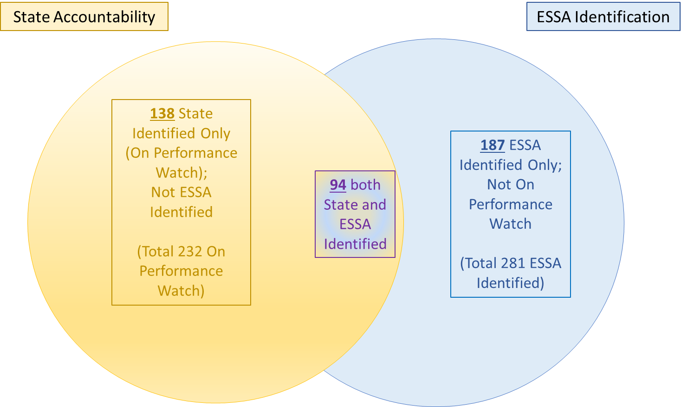
Fall 2024 Schools Eligible for EASI Supports
384 total
114 State Identified Only (On Performance Watch);
Not ESSA Identified
(Total 196 On Performance Watch)
188 ESSA Identified Only; Not On Performance Watch
(Total 270 ESSA Identified)
82 both State and ESSA Identified
Notes:
Nazie/Tina This slide shows the overlap between the School Performance Framework ratings and ESSA identifications. Please note these numbers are based on preliminary SPF ratings and do not reflect the request to reconsider process. There are a total of 196 schools on Performance Watch based on the Fall 2024 SPF preliminary ratings. Of those, 114 schools are state identified only, not ESSA identified. There are a total of 270 schools identified under ESSA. Of those, 188 are ESSA identified only, not on Performance Watch. There are a total of 82 schools that both state and ESSA identified.

Slide 17
ESSA Support and Improvement - School Identified Due to Graduation Rates
Current Identification | # Total | # First Year ESSA Identified
Comprehensive Support and Improvement – Low Graduation | 38 | 0
Year 1 - 2 | 6 | 0
Year 3 | 4 | 0
Year 4 or More | 28 | 0

Slide 18
ESSA Identified AECs
ESSA Identification Category | Number of Schools
Comprehensive Support - Lowest 5% | 1
Comprehensive Support - Lowest 5% - On Watch | 1
Comprehensive Support - Low Graduation Rate | 38
Comprehensive Support - Low Graduation Rate - On Watch | 7
Additional Targeted Support | 4
Targeted Support | 30
Targeted Support Due to Participation | 2
Notes:
11 not identified
94 total AECs included in accountability file

Slide 19
Reminder: ESSA School Profiles
Shared via Syncplicity with:
Superintendents
District Accountability Contacts
Authorized Representatives in Consolidated Application
The above individuals can also request access for additional school and/or district personnel by sending an email to Yazmine Patino (patino_y@cde.state.co.us).
The school profiles provide detailed information about the data that led to ESSA Identification.
Notes:
Nazie/Tina ESSA School Profiles were created for every school identified for support and improvement under ESSA. Profiles were shared via Syncplicity with superintendents, district accountability contacts, and authorized representatives from the Consolidated Application. Authorized individuals can request access for additional school and/or district personnel by sending an email to Yazmine Patino.

Slide 20
Requirements and Supports
ESSA identified schools
Must develop and implement an improvement plan, in partnership with stakeholders, that addresses the reasons for identification
Are eligible for supports and services, including grant opportunities through the Empowering Action for School Improvement (EASI) grant
  Application open until December 4, 2024, 4 p.m.
  LEA is the fiscal agent and must submit the application

Slide 21
Implications for CS-Y3+

Slide 22
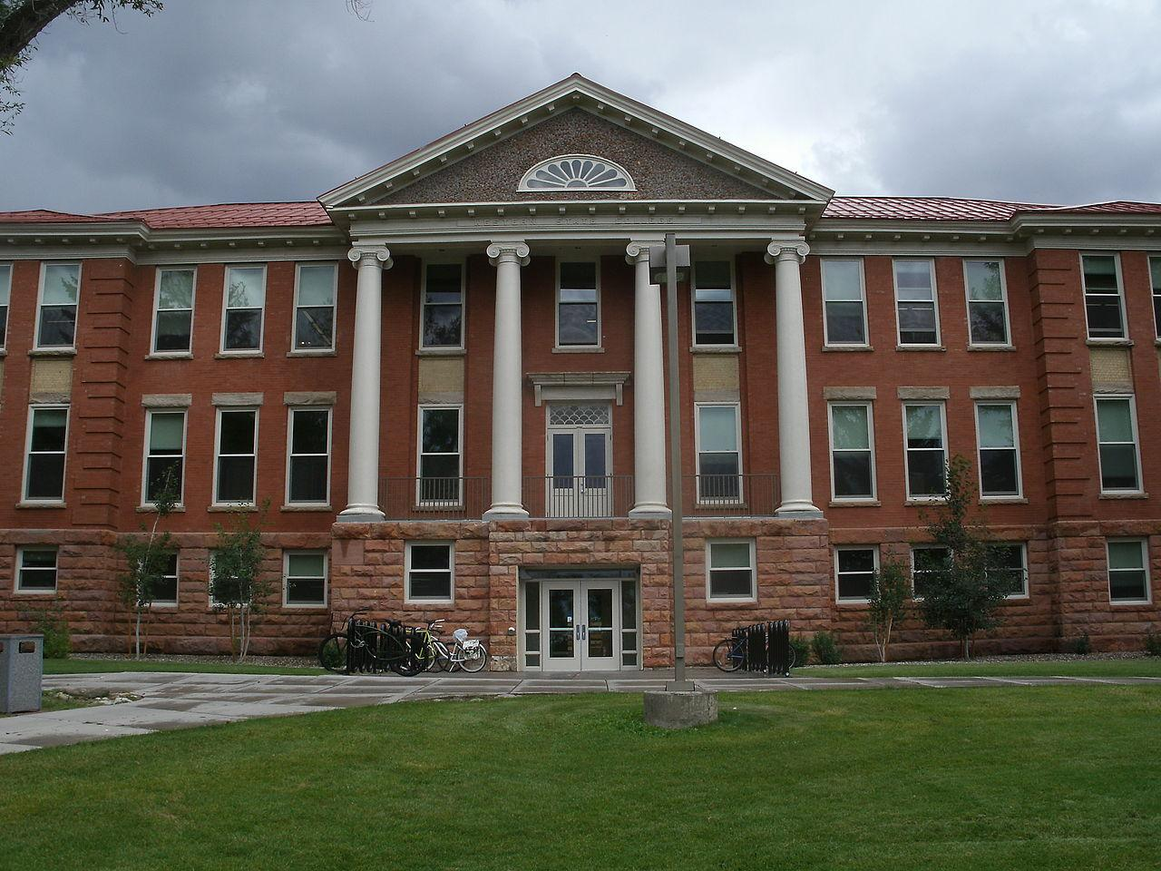
At a Glance - CS Y3+ Schools
37 schools identified as CS Y3+
6 on State Accountability
3 are Elementary Schools
34 are High Schools
32 are Alternative Education Campuses (AEC) ESSA-Identified as CS - Low Graduation Rate
15 Charter Schools
2 Online Schools
Mix of Metro, Urban/Suburban and Rural
18 are rated as AEC - Performance on State Accountability Framework
Notes:
Sue

Slide 23
More Rigorous Action: CS-Y3+ ESSA Sections 1111(d)(3)(A)(i) and 1111(d)(1)(C)
…schools identified by the State for comprehensive support and improvement under subsection (c)(4)(D)(i), which, if not satisfied within a State-determined number of years (not to exceed four years), shall result in more rigorous State-determined action, such as the implementation of interventions….
STATE EDUCATIONAL AGENCY DISCRETION.—With
respect to any high school in the State identified under sub- section (c)(4)(D)(i)(II), the State educational agency may—
(i) permit differentiated improvement activities that utilize evidence-based interventions in the case of such a school that predominantly serves students—
(I) returning to education after having exited secondary school without a regular high school diploma; or
(II) who, based on their grade or age, are significantly off track to accumulate sufficient academic credits to meet high school graduation requirements, as established by the State
Notes:
Sue

Slide 24
Differentiated More Rigorous Action:
UIP Planning Support
UIP Re-Review
BEGIN with the School Improvement Planning
Diagnostic Review (EASI)
EASI Cohort 8: Matched to Local Need and Context
PROVIDE Funding for School Improvement
State Accountability Support and Monitoring
Implementation Partner - EASI (Consultant or District)
CONTINUE Implementation and Monitoring

Slide 25

CS-Y3+ LEAs and Schools - Fall Convening
*Letters are going out to districts 10/30/2024
When: November 13, 2024
9:00 - 10:30 am
Where: On Zoom
Who: School Leaders, District Leaders, and CDE Support Staff
Content: Support and Collaboration for Differentiated Next Steps
UIP Consultations, EASI Supports, Implementation Partners
Notes:
Sue

Slide 26
School Improvement Planning Requirements

Slide 27
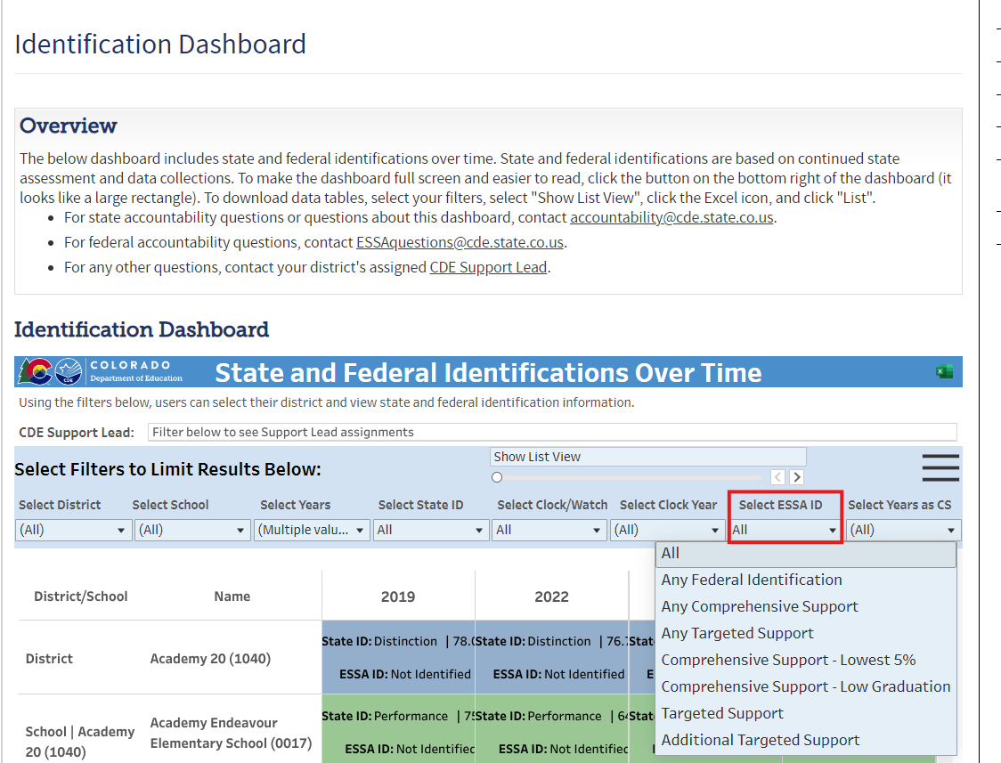
How do I know if my school has been identified?
Identification Dashboard: https://www.cde.state.co.us/accountability/district_identification_dashboard
The Identification Dashboard is a one-stop-shop for State and Federal Identifications.
Notes:
Sue. The one-stop shop is the identification dashboard. For ESSA identification, see the drop-down. You can view all schools ESSA identified, or select by CS, TS, and ATS. For in-depth information, view school profiles in Syncplicity.

Slide 28
How do I know if my school has been identified cont’d?
Districts must notify schools and support them in the development of an improvement plan that meets ESSA requirements.
ESSA Identification Page: Download a list of all ESSA Identified Schools for 2024-2025 and prior years.
Notes:
The one-stop shop is the identification dashboard. For ESSA identification, see the drop-down. You can view all schools ESSA identified, or select by CS, TS, and ATS. For in-depth information, view school profiles in Syncplicity.

Slide 29
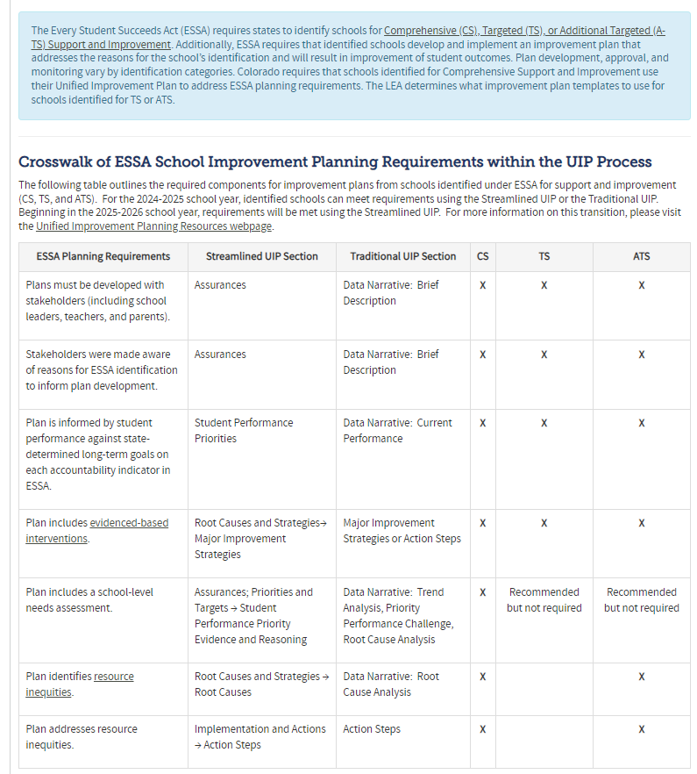
What are the requirements in the UIP?
https://www.cde.state.co.us/fedprograms/essaplanningrequirements
Schools may use the Traditional UIP OR Streamlined UIP to meet ESSA Requirements when submitting the 2024-2025 UIP.
Beginning in 2025-2026 only the Streamlined UIP will be available.
Notes:
Sue. This spring, Erin Loften from our School Improvement Team joined us to roll out the streamlined UIP. We have developed resources so schools can use either template to meet the requirements. This website provides information on the requirements for CS, TS, and ATS schools using either template.

Slide 30




What are the requirements in the UIP cont’d?
UIP Page: https://www.cde.state.co.us/uip/uip_general_resources
Quality Criteria: https://www.cde.state.co.us/uip/202425streamlineduipschoolqualitycriteria-0
This resource provides guidance for all schools.
Quality Criteria Rubric - ESSA Identified Schools: https://www.cde.state.co.us/UIPSchoolQC-CSRubricPDF
This resource supports planning with all ESSA-identified schools. LEAs can use this tool for reviewing CS, TS and ATS school. The state will use this tool for reviewing and approving CS-Identified UIPs.
Notes:
Erin. On the UIP page, you will find resources for both the traditional template and the streamlined template. In this slide I am highlighting the new, colorful resources for the streamlined UIP. We feel these resources are much clearer and supportive of guiding districts and school leaders in meeting requirements. (demonstrate)

Slide 31

Planning for AECs - How am I addressing Low Graduation?
Identify strategies that support moving students toward the ultimate goal of graduation.
Foundational strategies create the conditions that allow for improved outcomes, specifically those grounded in the dropout prevention framework.
Specifically consider strategies that build the foundation in support of improved graduation outcomes by focusing on leading indicators of graduation: attendance, behavior systems and course/credit completion.
Notes:
Erin.

Slide 32
Questions?

Slide 33
Resources

Slide 34
Contacts
Nazie Mohajeri-Nelson, Executive Director Federal Programs
mohajeri-nelson_n@cde.state.co.us
Tina Negley, Program Effectiveness Supervisor
negley_t@cde.state.co.us
Sue Miller Curley, ESEA Consultant and Monitoring Specialist
miller-curley_s@cde.state.co.us
Erin Loften, School Improvement and Planning Supervisor
loften_e@cde.state.co.us

Slide 35
Resources cont’d:
Resources cont’d
Identification Dashboard
Unified Improvement Planning: Quality Criteria Rubrics
ESSA Planning Requirements
ESSA School Profiles from Syncplicity
*Resource Inequities: CDE Website for Resource Inequities (CS and ATS)
EASI Grant Opportunities

