Slide 1
Emergency Assistance to Non-Public Schools Program
Reimbursement and
Procurement Training

Slide 2
Objectives of Training
Provide an overview of the Emergency Assistance to Non-Public Schools (EANS I) program;
Outline Colorado Department of Education (CDE) Reimbursement process for allowable purchases;
Describe CDE Procurement processes for allowable purchases; and
Identify available CDE resources to assist non-public schools (schools).

Slide 3
EANS I Overview
Purpose of EANS I program is to provide services or assistance to eligible non-public schools to address educational disruptions caused by COVID-19.
CDE is the administrator of EANS I program for Colorado.
All services or assistance must be “secular, neutral, and non-ideological”.

Slide 4
EANS I Deadlines
April 12, 2021 | Applications for funding due to CDE
April 26 - 30, 2021 (estimated) | Notification letters and/or clarification questions sent from CDE to schools.
August 11, 2021 | Funds through CDE procurement must be obligated. Obligated means a contract or purchase order must be issued to vendor(s) to commit funds.
1st day of every month | Reimbursement requests
September 30, 2023 | 1) All goods/services delivered and performed, and 2) All invoices from schools sent to CDE for payment
To be determined | EANS II is coming….

Slide 5
EANS I Overview
Examples of Services or Assistance:
Sanitization supplies
Barriers
Personal protective equipment (PPE)
COVID testing
Training on sanitization and PPE
Educational technology to support remote or hybrid learning.
For purposes of this training, “Services or Assistance” is also referred to as “goods and services” and the term “funding” refers to reimbursement or payment through CDE Procurement.

Slide 6
EANS I Overview
Funding may be used for:
Window repair
Ventilation system repair
Portable air purifiers
Funding may not be used for:
Window replacement
Ventilation system replacement
Other capital expenses (purchases) that cannot be removed from a school

Slide 7
EANS I Overview
All items purchased by CDE or for which schools are reimbursed through the EANS I program will remain the property of CDE.
Items may continue to be used by a school after September 30, 2023, if used for other allowable purposes under another federal education program (such as ESEA, IDEA).
Schools will make best efforts to keep items in good condition and in working order. This includes assuming all repairs and/or maintenance costs for goods/services purchased by on or behalf of a school.
CDE assumes no liability for goods/services purchased by or on behalf of schools under the EANS I program.

Slide 8
Conflict of Interest/Ethics
Federal and state laws and policies require ethical behavior and avoidance of conflicts of interest.
EANS I program reimbursements and procurements are subject to audit.
When spending public funds, it is essential to always act ethically.
DO | DO NOT
Treat all potential vendors equally | Purchase from family members or business associates
Seek vendor competition (multiple quotes) | Restrict your purchase request to a specific make/model number to favor a vendor
Avoid even the appearance of impropriety | Accept gifts from vendors or potential vendors
 | “Auction” - tell a vendor another vendor’s price to get a better deal

Slide 9
EANS I Funding
Two ways to obtain goods/services or funding assistance:
Reimbursement
CDE Procurement
REQUIRED PRIOR TO EITHER OPTION:
A school must have applied by the deadline (April 12,2021);
A school has received notification from CDE that the application is approved (estimated week of April 26, 2021); and
The category for the goods/services must be identified in the school’s application and allowable under EANS I.

Slide 10
Reimbursement Process
CDE uses the online platform Formsite to collect Request for Funds (RFF) forms
The RFF form is done in two parts.
The first part is completed by whomever is tasked with filling out the form
The second part is done by an Authorized Representative – the person who can submit requests on behalf of the organization
Deadline for submission: 1st of every month

Slide 11
Reimbursement Process: Becoming an Authorized Representative
Fill out the Authorized Representative designation form and email to GFRFF@cde.state.co.us
We will respond with a 4-digit signature code that must be entered in every RFF form submitted
This code acts as a signature, so it is imperative that only the person who the code was assigned to is entering the code into the RFF form. Do not share your code with anyone else
More than one person can be an Authorized Rep. They will each have a separate signature code
If necessary, the Authorized Rep can complete both parts of the RFF form. However, if possible, it is best to have multiple people involved in the RFF process
If you do not have more than one person who can work on the RFF process, make sure you have documented systems in place that show segregation of duties with requesting and receiving federal funding

Slide 12
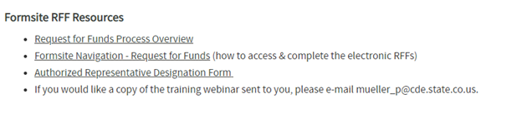
Authorized Representative Form
https://www.cde.state.co.us/cdefisgrant/requestforfundsforms

Slide 13
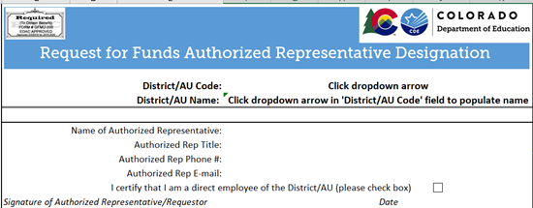
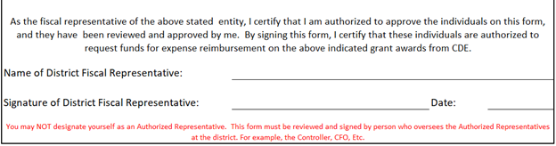
Authorized Representative Form
Once you are assigned a School Code, it will be available in this dropdown
This piece is to be completed by the Authorized Representative who will receive the signature code for the RFF
The Fiscal Representative is the person who is authorizing the Authorized Rep

Slide 14
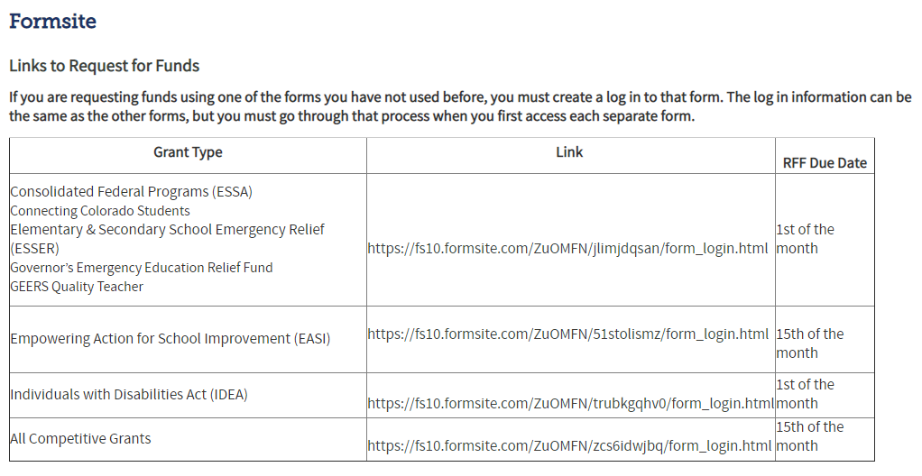
Submitting the Request for Funds (RFF) Form
https://www.cde.state.co.us/cdefisgrant/requestforfundsforms

Slide 15
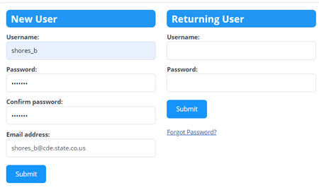
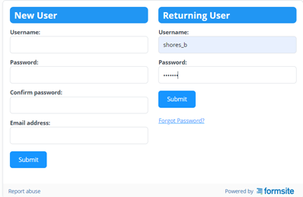
Submitting the Request for Funds (RFF) Form
Creating an Account in Formsite
Logging in to an Existing Account

Slide 16
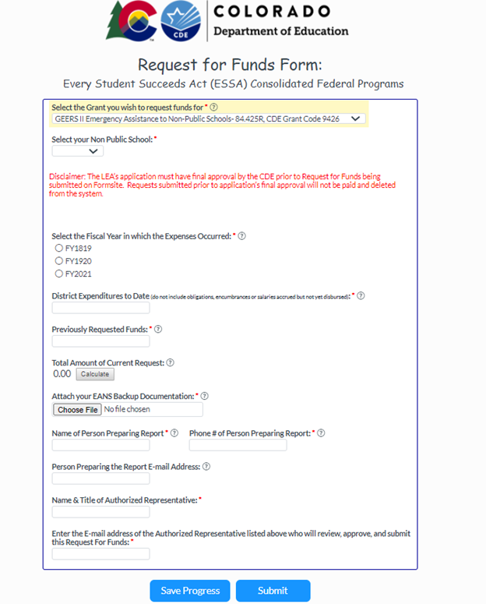
Request for Funds Form

Slide 17
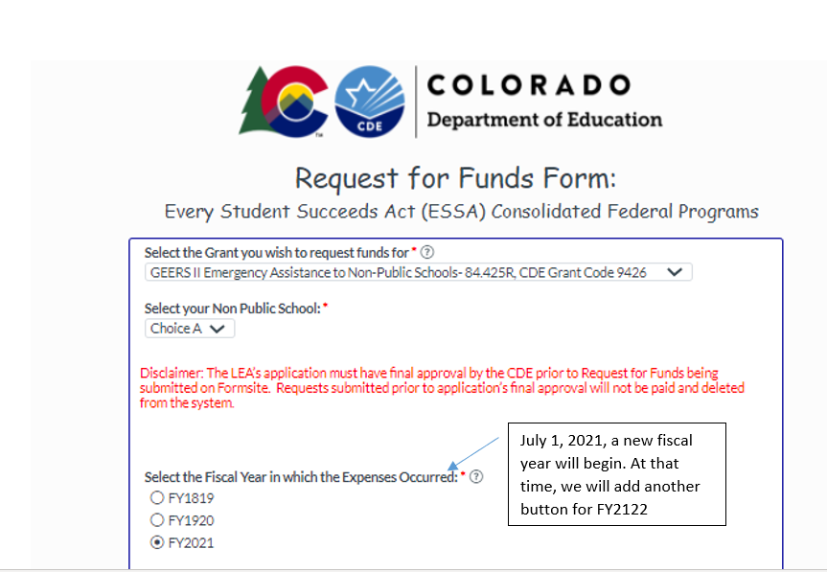
Request for Funds Form Cont’d

Slide 18
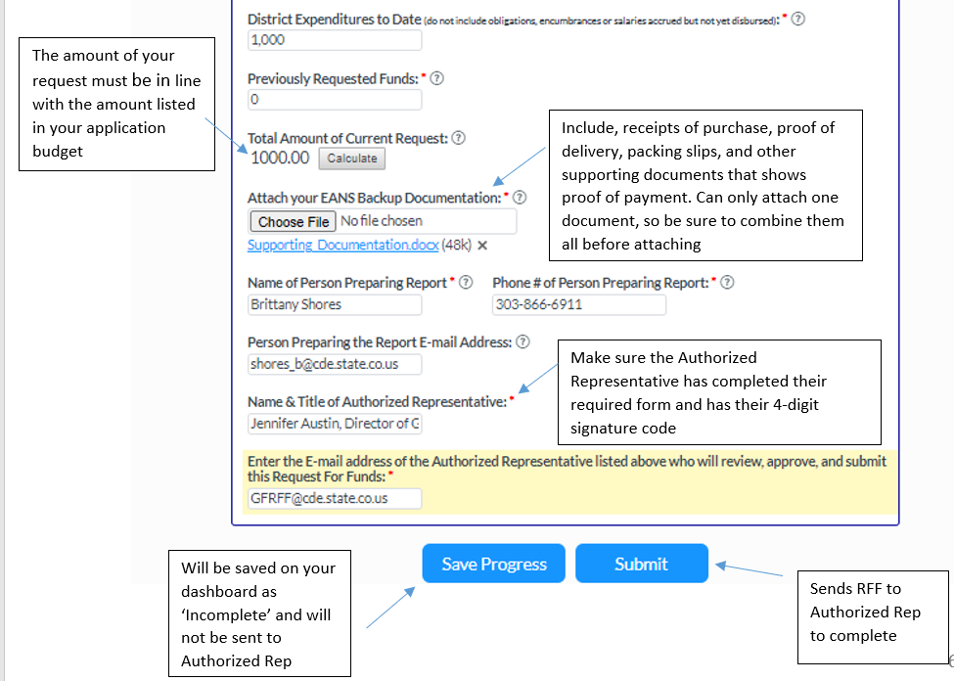
Request for Funds Form Cont’d

Slide 19
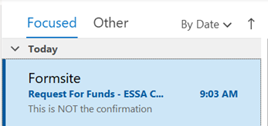
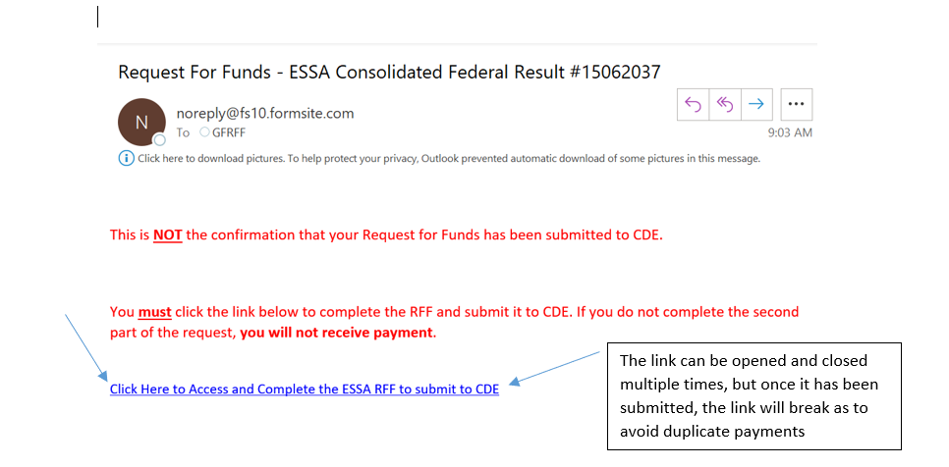
Email Workflow: Part 1 to Part 2
*Make sure to check your Spam/Junk folders as this email is often sent there by firewalls

Slide 20
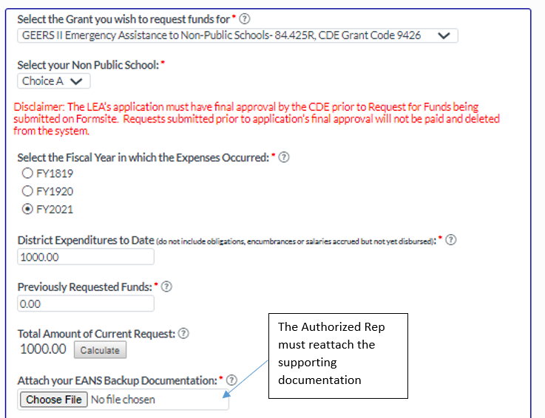
Request for Funds Form Cont’d

Slide 21
Request for Funds Form Cont’d

Slide 22
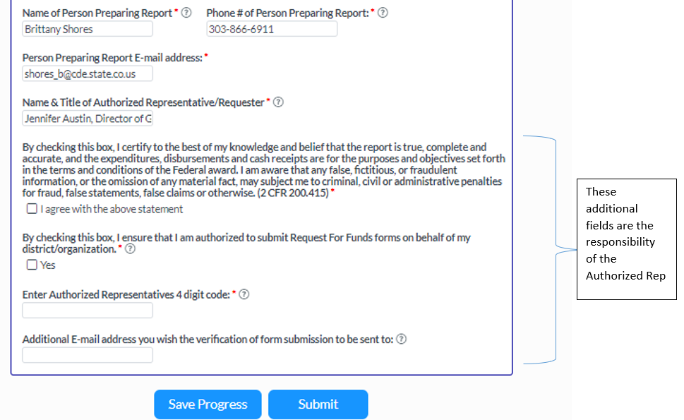
Request for Funds Form Cont’d

Slide 23
Request for Funds Form Cont’d

Slide 24
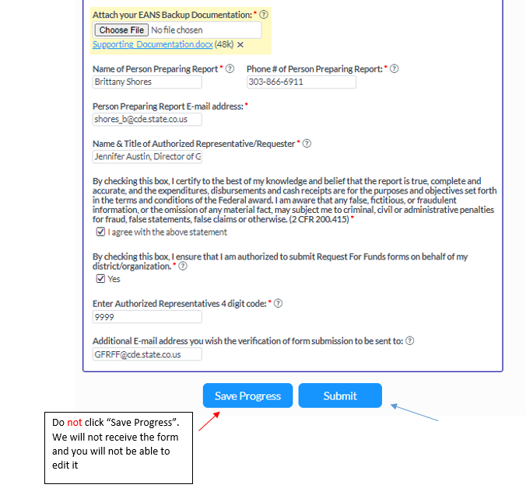
Request for Funds Form Cont’d

Slide 25

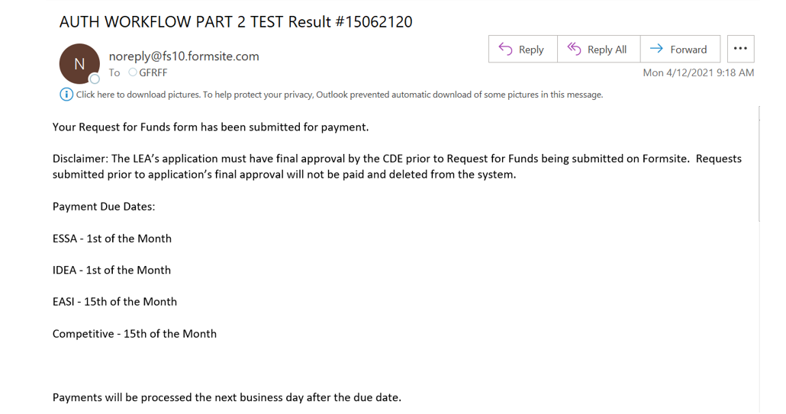
Email Confirmation
*The confirmation email will be sent to the email address entered in ‘Person Preparing Report Email Address’ & the ‘Additional Email Address’ entered on the form

Slide 26
CDE Procurement
CDE must follow State laws and rules.
Overview of CDE Procurement Process
School has submitted application by the deadline.
CDE notifies school in writing that application is approved and includes packet explaining how school requests a purchase.
School requests a purchase.
CDE reviews requests and determines proper method of selecting vendor, which is based on several factors, including dollar threshold.
Notes:
Carey

Slide 27
CDE Procurement
Overview of CDE Procurement Process (continued)
State procurement and fiscal laws, rules and policies required for CDE will apply to purchases.
Foster broad competition
Protect integrity of public procurement in Colorado
CDE Procurement works with school, vendor(s), makes selection of vendor.
CDE handles obligation as appropriate (i.e., p-card, purchase order, or contract).

Slide 28
CDE Procurement
Overview of CDE Procurement Process (continued)
School must ensure that no goods/services are delivered prior to issuance of a purchase order or contract, if required (violation of law and delays processing).
Vendor delivers goods/performs services.
School confirms delivery or performance to CDE.
CDE pays vendor.

Slide 29

CDE Procurement
The procurement and fiscal thresholds are established in State rules.
Procurement thresholds determine method of choosing a vendor, when competition is required, and what type of competition can be used.
Fiscal thresholds determine method of payment by procurement card, purchase order (PO), or a contract. POs and contracts are considered obligations.
To estimate the threshold, CDE Procurement considers the total amount of the purchase.
A school is not permitted to divide purchases to stay under thresholds.

Slide 30
CDE Procurement - Thresholds
Threshold | Procurement | Fiscal
Up to $5,000 | No competition required | Vendor paid via CDE procurement card or other method
$5,001 – $25,000 | No competition required | CDE purchase order to vendor
$25,001+ | Competition Required | CDE purchase order or CDE contract to vendor

Slide 31
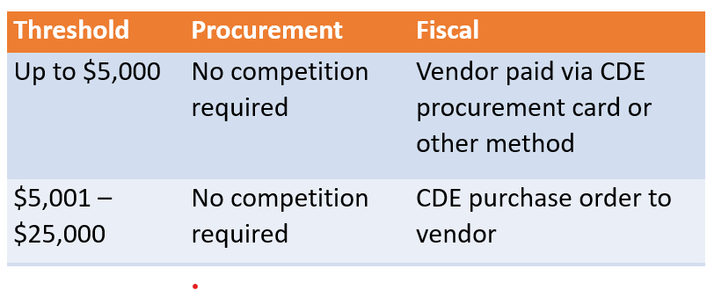
CDE Procurement
Scenario 1: A purchase is estimated at $4,000 and the vendor can be paid by P-Card. You discover the purchase will actually be $5,300 (exceeding $5,001).
Result: A purchase order is now required by fiscal rule so the vendor cannot be paid by P-Card.

Slide 32
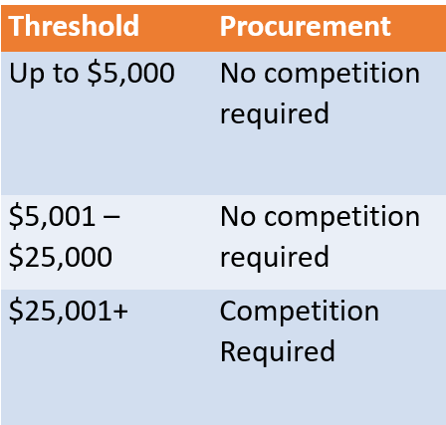
CDE Procurement
Scenario 2: Your purchase is estimated at $3,000 each for 10 units (total of $30,000). The total of $30,000 exceeds the $25,000 procurement threshold requiring competition.
Result: This purchase requires competition. This is based upon total price, not unit price.

Slide 33
CDE Procurement
CDE Procurement will consider all methods available and decide on the best method to use for each purchase.
There are several methods to choose a vendor, including but not limited to:
No competition
State price agreements
Competitive solicitations
The process can be time consuming – plan ahead!

Slide 34
CDE Procurement
No Competition Required
If the purchases is guaranteed to be $25,000 or less, then the school can choose the vendor.
Follow your school’s purchasing guidelines.
Follow ethics and avoid conflicts of interest.
Don’t allow goods/services to be delivered or performed before you finalize the purchase, especially if any obligation is required.
If over $5,000 but less than $25,001, CDE will work with the school on a purchase order or contract (obligation).

Slide 35
CDE Procurement
State Price Agreements
State contracts for commonly sourced goods/services
Solicited, negotiated, managed, and maintained by State
Available to state agencies
Limited to goods/services on agreement
Only with vendors having existing agreement
Includes PPE, sanitization supplies, certain models of Chromebooks, some Software
Benefits
Convenient and efficient
Terms are negotiated
Competitive pricing

Slide 36
CDE Procurement
Competitive Solicitations
CDE Procurement will determine the appropriate solicitation type, use of evaluation criteria (if needed), makeup of evaluation committee (if needed), and make any awards.
Different solicitation methods are available.
Evaluation of bids/proposals range from lowest responsive bidder to “most advantageous”.
CDE Procurement will work with the school on any competitive solicitations.

Slide 37
CDE Procurement
What does CDE Procurement need from you?
Detailed specifications or statement of work for what needs to be purchased
Examples for goods: model numbers, part numbers, quantity, size, location for delivery, quotes, related services (installation)
Examples for services: scope of the project, expected outcome, timeline, location of services, quotes
School resources such as potential evaluators or subject matter experts
Any other information that may be relative to the purchase (i.e., compatibility concerns)

Slide 38
Vendor Agreements
DO NOT SIGN VENDOR AGREEMENTS
Often vendors will provide agreements for software, leased space, services, and maintenance or support.
Sometimes vendors will include terms and conditions on an estimate or invoice. Do not sign. If the vendor requires a delivery signature, line through the terms and initial.
Reasons not to sign vendor agreements:
A non-public school does not have authority to bind CDE or the State.
Signing an agreement puts the school at risk as well as CDE and the State.
Certain terms in vendor agreements are not permissible for the State (ex: indemnification, binding arbitration, certain limitations of liability, automatic renewals).
Vendor agreement fine print may include additional costs/requirements.
If the vendor insists upon a signature, contact CDE Procurement.

Slide 39
Responsibilities of non-public schools
Comply with application and EANS I requirements.
Follow the State’s rules and guidance regarding ethics and conflicts of interest.
Provide documentation as requested by CDE. Be responsive to CDE requests for information.
Draft statements of work and obtain vendor quotes if CDE is purchasing on behalf of school
Obtain completed W9s from vendors (for payment).
Ensure vendors do not provide goods/services prior to a purchase order/contract issued by CDE, if required.
Retain records for all purchases and reimbursements.

Slide 40
Responsibilities of non-public schools
Keep an inventory and track all goods purchased by CDE or by school.
Maintain goods in acceptable working condition.
Follow guidance on returning goods when no longer needed by school.
School must ship or otherwise deliver remaining goods to CDE as directed by CDE
Follow guidance on school requests to keep goods.
Provide CDE with written request to keep goods, identify allowable purpose (other federal education programs such as ESEA or IDEA).
CDE reviews request.

Slide 41
Where do we go from here?
Next Steps:
Application Review
Application review scheduled from April 16 – April 23
Notifications
Final award amount
Need more information
Rinse and repeat
Reimbursement and procurement instructions
Instructions for requesting reimbursement
Instructions on procurement next steps

Slide 42
Contacts
Program Questions:
DeLilah Collins collins_d@cde.state.co.us
Budget/Fiscal Questions:
Robert Hawkins hawkins_r@cde.state.co.us
Application Process Questions:
Kim Burnham (burnham_k@cde.state.co.us)
Purchasing Questions:
Sharon Meyer (Meyer_S@cde.state.co.us)
Cindy Lombardi(Lombardi_C@cde.state.co.us)
Website:
EANS

Slide 43
Any Questions??

