Slide 1
CDE Office Hours
January 12, 2023

Slide 2
ESSER Office Hours
Topics
Updates and Reminders
Communications Update
ESSA Identified Schools
ESSER Reporting Templates
Monitoring Q&A
Notes:
Nazie

Slide 3
Updates, Reminders, and Clarifications
Notes:
Nazie

Slide 4
Upcoming Regional Network Meetings
Content: The Winter RNMs will focus on supporting LEAs in creating a Consolidated Application that is driven by student needs and will result in improved student outcomes. In addition to providing updates on the 23-24 Consolidated Application, CDE staff will offer training and resources to help LEA staff evaluate current uses of federal funds and plan for the upcoming application. The training will include networking opportunities and collaborative work time.
Target Audience: LEA staff or school leaders who support the development of the Consolidated Application or manage federal programs.
Dates and Locations:
Douglas County Board Room: Wednesday, February 22nd, 2023 12:30-3:30pm
Greeley-Evans Family Center: Tuesday, February 28th, 2023 12:30-3:30pm
Summit RE-1 Professional Development Building: Wednesday, March 1st 2023 12:30-3:30pm
Pueblo 60 Board Room at the Administration Office: Tuesday, March 7th 2023 12:30-3:30pm
Virtual Session: TBD
See full details and registration links at the RNM webpage
Notes:
Rachel E.

Slide 5
Monitoring Self-Assessment Deadlines
Deadline January 13, 2023 (38 LEAs)
Upcoming Deadline February 3, 2023 (44 LEAs)
Refer to your email from Kim Boylan from November 18, 2022 to see which date applies to your LEA.
Complete and submit your Program Monitoring Self-Assessment (PMSA) and Fiscal Self-Assessment (FSA).
The PMSA will be submitted through Google forms.
The FSA will be uploaded to Syncplicity. Both self-assessments can be found on the Federal Programs Monitoring webpage.
Please also note that
A narrative response must be included for each section of the PMSA as the information provided by the district is critical to CDE reviewers when reviewing processes the LEA has in place, and
The FSA may have additional documentation that needs to be uploaded to Syncplicity.
If you or another team member need Syncplicity access, please request this from Kristin Crumley at Crumley_K@cde.state.co.us.
Please ensure your LEA’s contacts in the ESSER III application and Consolidated application are current. All monitoring communication is sent to these contacts.

Slide 6
Communications Update: ESSER Website
Dana Smith
Notes:
Dana

Slide 7
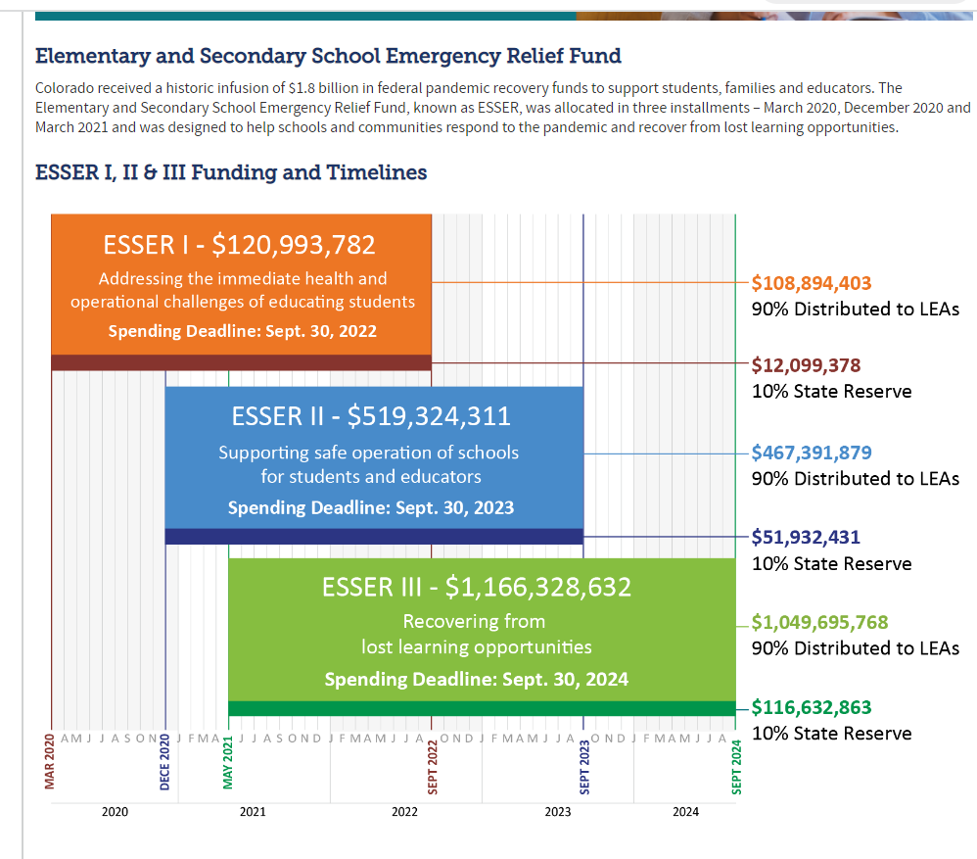
CDE Website Updates
Notes:
Shannon

Slide 8
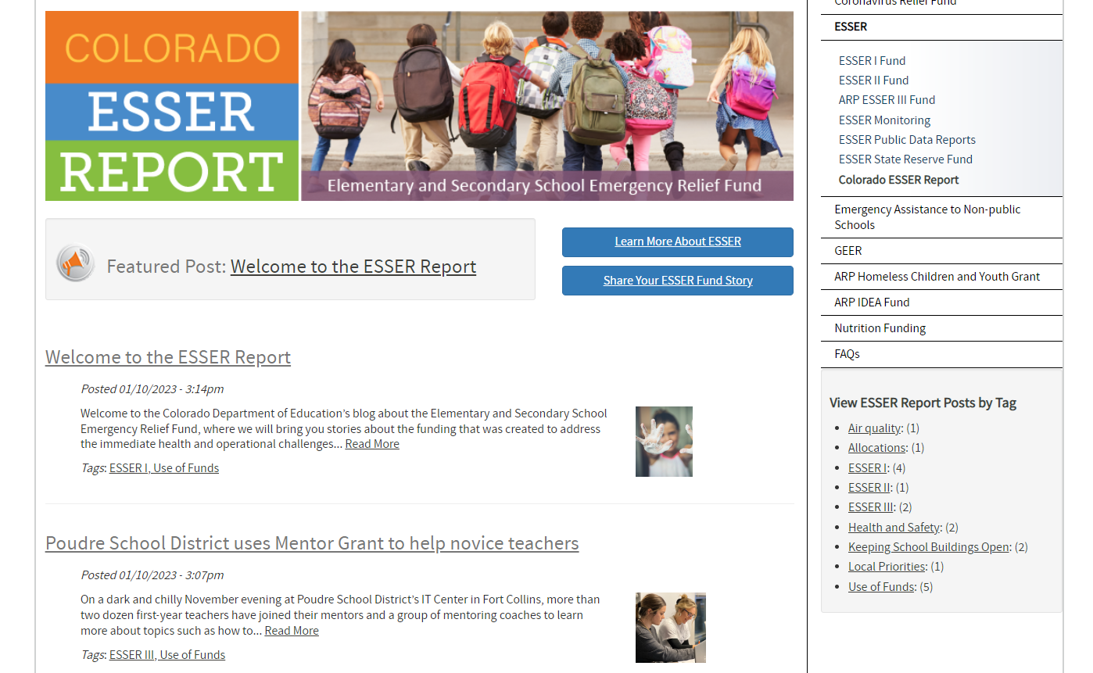
ESSER Blog

Slide 9
LEA Responsibilities for ESSA Identified Schools’ Improvement Planning
Comprehensive Support (CS),
Targeted Support (TS), or
Additional Targeted Support (ATS)
Notes:
Karen

Slide 10
ESSA Improvement Planning Requirements (CS,TS, ATS)
ESSA requires that identified schools develop and implement an improvement plan that addresses the reasons for the school’s identification, and the plan will result in improvement of student outcomes.
Plan development, approval, and monitoring vary by identification categories (CS, TS, ATS).
Comprehensive Support Plans (CS):
School, LEA and and CDE must review and approve plan and upon approval and implementation, CDE will monitor and conduct periodic reviews
ESSA requirements must be documented in the UIP
CS plans must consider resource allocations and identify any resource inequities
Targeted Support (TS) & Additional Targeted Support (ATS):
Only the LEA approves plan prior to implementation and LEA will monitor and review plan upon submission and implementation
May use UIP, but LEAs may choose format to document ESSA requirements
ATS plans must consider resource allocations and identify any resource inequities

Slide 11
Addressing CS, TS & ATS in the Consolidated Application
The following areas are required to be addressed in the Consolidated Application for CS, TS or ATS identified schools.
The LEA’s process for reviewing, approving and monitoring TS/ATS plans.
How the LEA will annually exit schools no longer meeting the state’s identification criteria for TS/ATS (using state’s exit criteria or have established other exit criteria).
Question be added to 23-24 Consolidated application: Describe the LEA’s process for identifying resource inequities amongst and within ATS schools and the support provided to address those inequities.
LEAs with schools identified as CS & ATS must identify any resource inequities (which may include a review of LEA and school level budgeting), to be addressed in the district or school’s improvement plan.
Federal funds can be used to support improvement interventions and strategies identified in plans and should be prioritized for schools identified for CS, TS, ATS.

Slide 12
Update on Current Reviews
CDE is currently conducting Comprehensive Support (CS) UIP reviews and feedback will be shared with LEAs soon.
Because of CDE’s capacity, not all 22-23 CS UIP submissions will be reviewed.
Communication will be sent to notify the LEA if plan was not reviewed and will include directions for requesting a review.
After receiving feedback, LEAs will have the opportunity to make revisions and resubmit if the plan is not yet approved.
More information to follow
Notes:
Complete the tables below to describe how the LEA will prioritize Title II, Part A funds to schools implementing comprehensive or targeted and additional targeted support and improvement activities, and among those schools, have the highest percentage of children identified as low-income. / TIV… The LEA or consortium will prioritize the distribution of funds to schools served by the LEA, or consortium of LEAs, that are among the schools with the greatest needs, have the highest percentages or numbers of children in poverty, are identified for comprehensive support and improvement, are implementing targeted support and improvement plans, or are identified as a persistently dangerous public elementary school or secondary school under section 8532. § 4106(e)(2)(A).

Slide 13
Trainings and Support for ESSA Identified Schools for
CS, TS, ATS
ESSA Methods and Criteria for Identification of Schools for Support and Improvement: https://www.cde.state.co.us/fedprograms/essa_csi_tsi
ESSA Planning and Improvement Requirements: https://www.cde.state.co.us/fedprograms/essaplanningrequirements
Evidence-Based Interventions Requirements: https://www.cde.state.co.us/fedprograms/evidence_based_interventions
Resource Inequities Requirements: https://www.cde.state.co.us/fedprograms/resource_inequities_planning_requirements
ESSA Empowering Action for school Improvement (EASI): https://www.cde.state.co.us/fedprograms/easiapplication
ESSA Planning and Improvement Rubric (CS,TS,ATS): https://www.cde.state.co.us/fedprograms/essa_support_and_improvement_pan_rubric_cs-ts-ats
Quality Criteria Rubric (CSUIP): https://www.cde.state.co.us/uip/school_qcrubric

Slide 14
ESSA Identification and Improvement Planning Contacts
Questions related to Identification:
Tina Negley
negley_t@cde.state.co.us
720-766-2793
Questions related to Improvement Planning Requirements:
Karen Bixler Tammy Giessinger
bixler_k@cde.co.state.us giessinger_t@cde.state.co.us
720-357-4864 720-827-5291
ESEA Regional Contacts
ESEA Regional Contacts

Slide 15
ESSER Reporting Templates
Notes:
Tina

Slide 16
ESSER Data Reporting
The U.S. Department of Education has been authorized by Congress to collect data from all ESSER I, II, and III grantees, including but not limited to the uses and impact of funds. CDE is able to use the ESSER I, II, and III applications to provide the vast majority of the requested data on behalf of our grantees, with the exception of the following data points:
How students with poor attendance or participation have been re-engaged;
How school level allocations were determined; and
LEA participation in ESSER activities.

Slide 17
Student Re-Engagement Survey
All LEAs that received ESSER I, II, or III funds must report on whether the LEA sought to re-engage students with poor attendance or participation (regardless of whether ESSER funds were used for this purpose).
Applies to districts only.
Annual survey (Google Form) consisting of two questions:
Did the LEA seek to re-engage students with poor attendance or participation?
If so, how? (check all that apply)
LEAs previously submitted the SY 2020-21 survey in Spring 2022.
SY 2021-22 survey will be due March 31, 2023 (to be sent out next week).
SY 2022-23 survey will be due September 30, 2023.

Slide 18
School-Level Allocation Survey
All LEAs allocating at least a portion of ESSER funds to schools in the reporting period must report on the criteria used to allocate funds to schools within the LEA.
Applies to districts that budgeted funds at the school-level only.
Annual survey (Google Form) consisting of one question:
What criteria was used to allocate ESSER funds to schools? (check all that apply)
LEAs previously submitted the SY 2020-21 survey in Spring 2022.
SY 2021-22 survey will be due March 31, 2023 (to be sent out next week).
SY 2022-23 survey will be due September 30, 2023.

Slide 19
NEW - LEA Participation in ESSER Activities
All LEAs that received ESSER I, II, or III funds must report on how ESSER funds were used to support learning recovery or acceleration for student groups who were disproportionately impacted by the COVID-19 pandemic.
Includes all grantees of ESSER I, II, or III funds, including districts, BOCES, Administrative Units (AUs), facility schools, and tribal nations.
Data collection template to be submitted via Syncplicity.
SY 2022-23 template will be due September 30, 2023.

Slide 20
Reporting Question Overview
How did this LEA use ESSER (ESSER I, II, or III) funds to support learning recovery or acceleration for student groups who were disproportionately impacted by the COVID-19 pandemic?
Evidence-based summer learning or summer enrichment programs
Evidence-based afterschool programs
Extended instructional time (including extended school day, week, or year)
Evidence-based high dosage tutoring
Early childhood education program expansion or enhancement
Full-service community schools
Purchasing educational technology
For each of these programs, LEAs will have to report the number of students who participated in the programs and the total number eligible to participate.

Slide 21
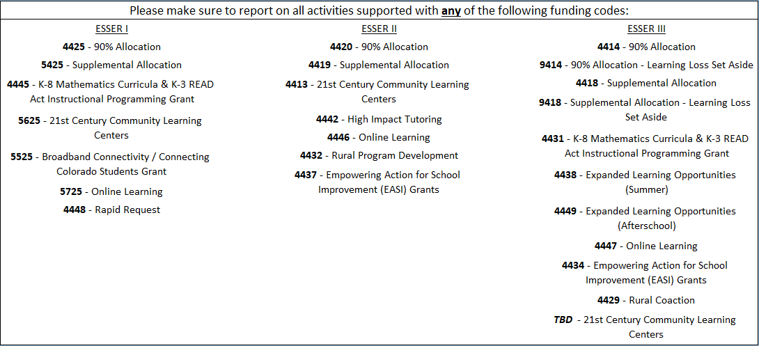
ESSER Funding Codes
Inclusive of all ESSER I, II, and III funds, including state reserve activities:

Slide 22
Data Collection Templates
Stakeholders indicated that, for some LEAs, reporting student level data would be more convenient, while for others it would be easier to report aggregated data. To best meet the needs of all LEAs and create options that meet varying needs, LEAs can choose to submit either LEA-level or student-level data. LEAs should submit one of the following templates:
LEA-Level Survey
Student-Level (Combined) Survey
Single spreadsheet for reporting each student’s participation in a variety of programs.
Student-Level (Separate) Survey
Multiple spreadsheets to report student participation for each program separately.

Slide 23
Resources
CDE has created an ESSER Grantee/Subgrantee Reporting webpage to share resources, trainings, and data collection templates/surveys, to support grantees in successfully meeting these reporting requirements.
Recorded trainings, instructional manuals and FAQs, and links to surveys and data collection templates will be available starting next week.
CDE will also continue to dedicate time during upcoming Office Hours to provide updates and host Q&A sessions concerning these reporting requirements:
February 9, 2023
March 23, 2023
April 13, 2023
Contact:
Tina Negley (negley_t@cde.state.co.us)
or
Mackenzie Owens (owens_m@cde.state.co.us)

Slide 24
Monitoring Q&A
Notes:
Kristin & Kim

Slide 25
Upcoming Meetings
Notes:
Nazie

Slide 26
Any Requests for Upcoming Topics or Questions!
Upcoming Office Hours
January Changes!
January 26 - BruMan Training
February Changes!
February 9
February 23

Slide 27
CDE Contacts!
Emails: Lastname_Firstinitial@cde.state.co.us
(e.g., Smith_a@cde.state.co.us)
Federal Programs & Supports (ESEA/ESSER Program Supports) | School Finance & Operations (Fiscal and Systems Supports)
Nazie Mohajeri-Nelson, Executive Director of Federal Programs & Supports Unit Program Specialists Program Implementation Supervisor: Laura Meushaw Program Monitoring Supervisor: Tammy Giessinger Program Effectiveness Supervisor: Tina Negley ESEA Programs Specialists and ESEA Regional Contacts (assigned by district) Title I: Laura Meushaw, Evita Byrd, Rachel Echsner Title II: Karen Bixler Title III: Rachel Temple Title IV: Tammy Giessinger, Nathan Hickman Title V: Shannon Wilson ESSER Program Specialists Kristin Crumley Jonathan Schelke Kim Boylan Shannon Wilson ESEA and ESSER Data and Reporting Specialists Tina Negley Mary Shen Mackenzie Owens | Coming Soon! Executive Director of School District Operations Unit Fiscal Specialists Jennifer Austin, Director of Grants Fiscal Management ESEA Robert Hawkins, Grants Fiscal Analyst Steven Kaleda, Grants Fiscal Analyst ESSER Fiscal Specialist Steven Kaleda Grants Fiscal Analyst ESSER Monitoring Bill Parsley, ESSER Fiscal Monitoring Supervisor Hilery Morris, ESSER Fiscal Monitoring Kristina Jones, Federal Fiscal Monitoring and Reporting Specialist Werner Hagemann, ESSER Fiscal Monitoring Specialist Application Systems Specialists DeLilah Collins, Director of Grants Program Administration Online Applications Systems Technical Support Michelle Prael

