Slide 1
CDE Office Hours
September 7, 2023

Slide 2
ESSER Office Hours
Topics
Reminders
Annual Financial Report (AFR)
Monitoring Training

Slide 3
Reminders
Notes:
Kristin

Slide 4
Reminders
Important Dates
ESSER II funds must be spent on or before September 30, 2023
ESSER II Request for Funds are due by November 1, 2023
ESSER II request for a liquidation extension form by October 31, 2023.

Slide 5
Annual Financial Report (AFR)
Notes:
Michelle Prael

Slide 6

AFR Reporting Period
Annual Financial Reports due this year:
  22-23 Consolidated Application
  ESSER II
  ESSER III
In each application, please report expenditures from July 1, 2022 - June 30, 2023 (FY22-23)
The AFRs will open in the next couple of days!
All AFRs are due on October 9th, 2023

Slide 7
Consolidated Application AFR

Slide 8
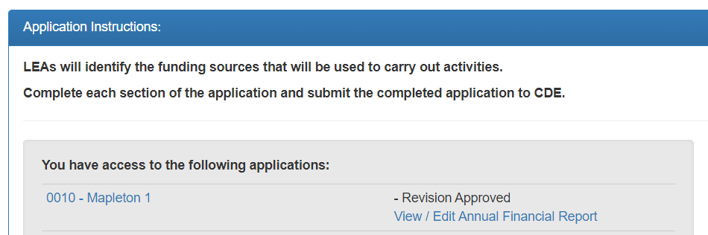
Accessing the Consolidated Application AFR
When you go to login to the application, you will see your LEA or BOCES name and a new link that says, “View/Edit Annual Financial Report.”
You will click on that link to open the AFR.

Slide 9
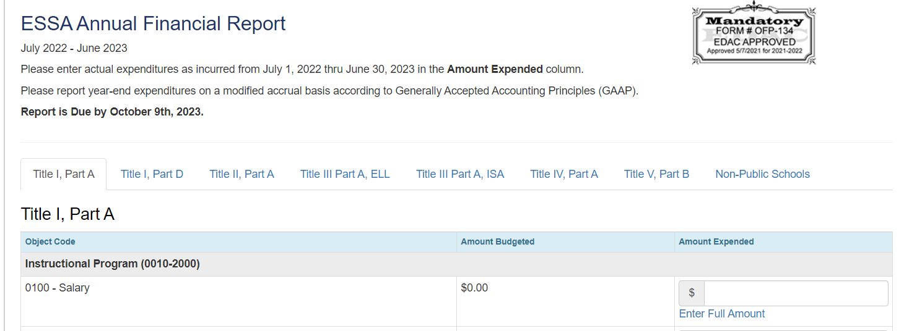
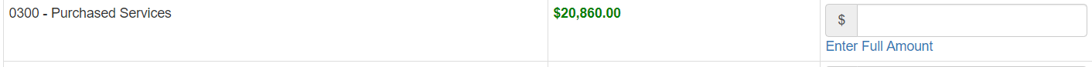
ESEA AFR
Once inside your AFR, you will see that the format hasn’t changed from the past couple of years and each program has a tab across the top.
Any amounts budgeted in your application will appear in green under the “Amount Budgeted” column.

Slide 10
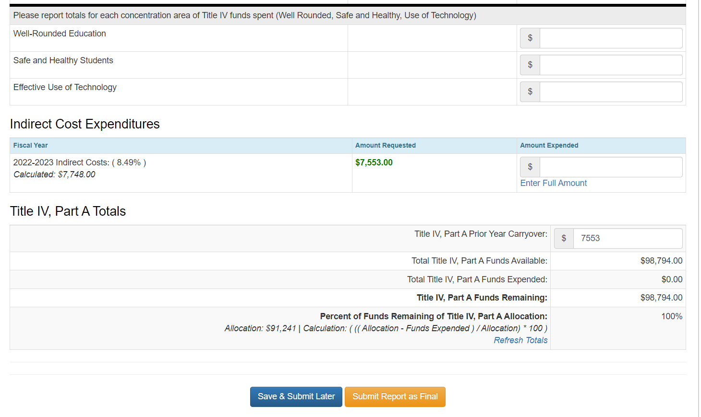
ESEA AFR - Title IV, Part A
Title IV, Part A has a specific section to report on the Concentration Areas of Title IV (Well Rounded, Safe and Healthy, and Effective Use of Technology).
Please report how much was spent in each concentration area! This is reported to the US Department of Education.
  If we don’t receive your numbers, CDE will be reaching out for the information.

Slide 11
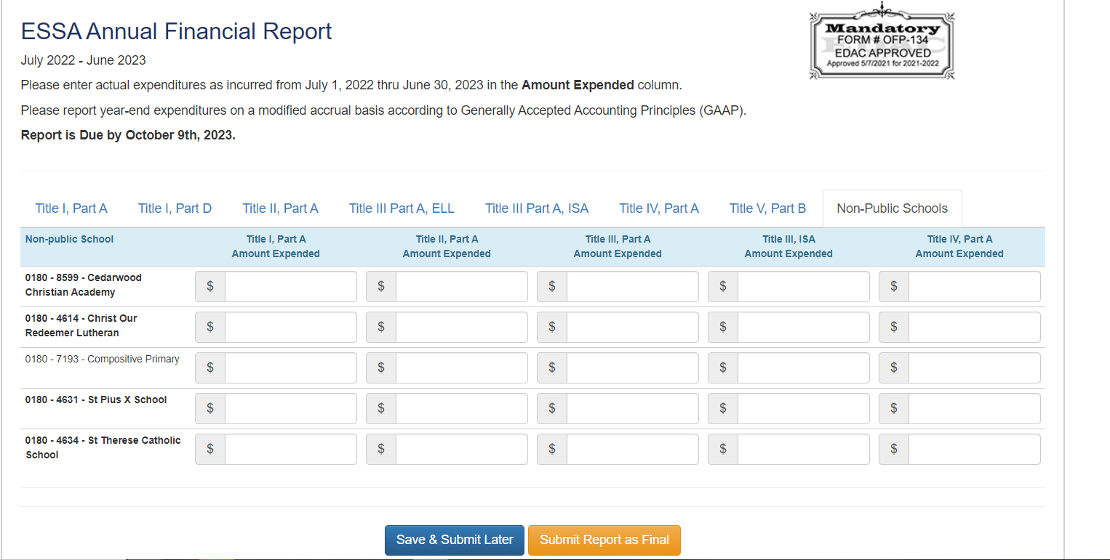
ESEA AFR - Non-Public Schools
Please ensure to report expenditures for each non-public school. If the school name is bolded, it means that they were budgeted funds in your application.

Slide 12

ESEA AFR Reminder!
Ensure you go through ALL of the tabs across the top of your AFRs before selecting “Submit Report as Final.”
Please do not submit any Post Award Revisions (PARs) as this year is closed.

Slide 13
ESSER AFRs

Slide 14
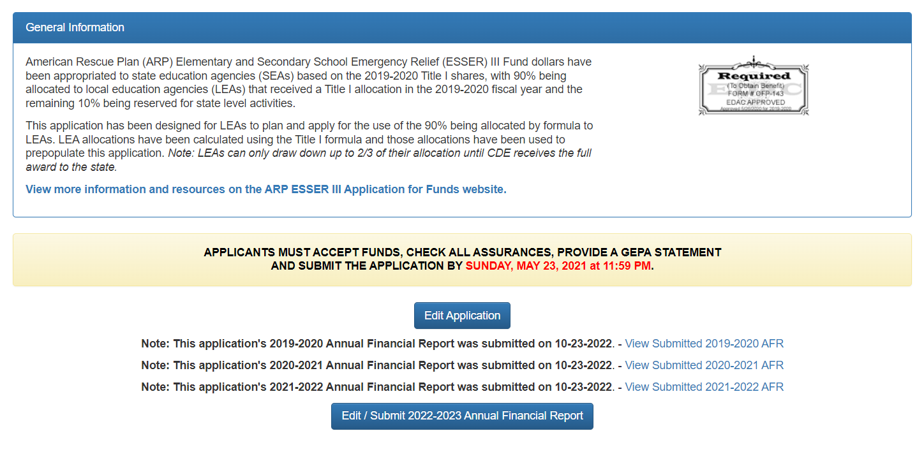
Accessing the ESSER AFR
When you go to edit your application, you will see an Edit/Submit Annual Financial Report button. You will also be able to see the AFRs from the past three years.
Select the Edit/Submit Annual Financial Report to access ESSER’s AFR for FY22-23 .

Slide 15
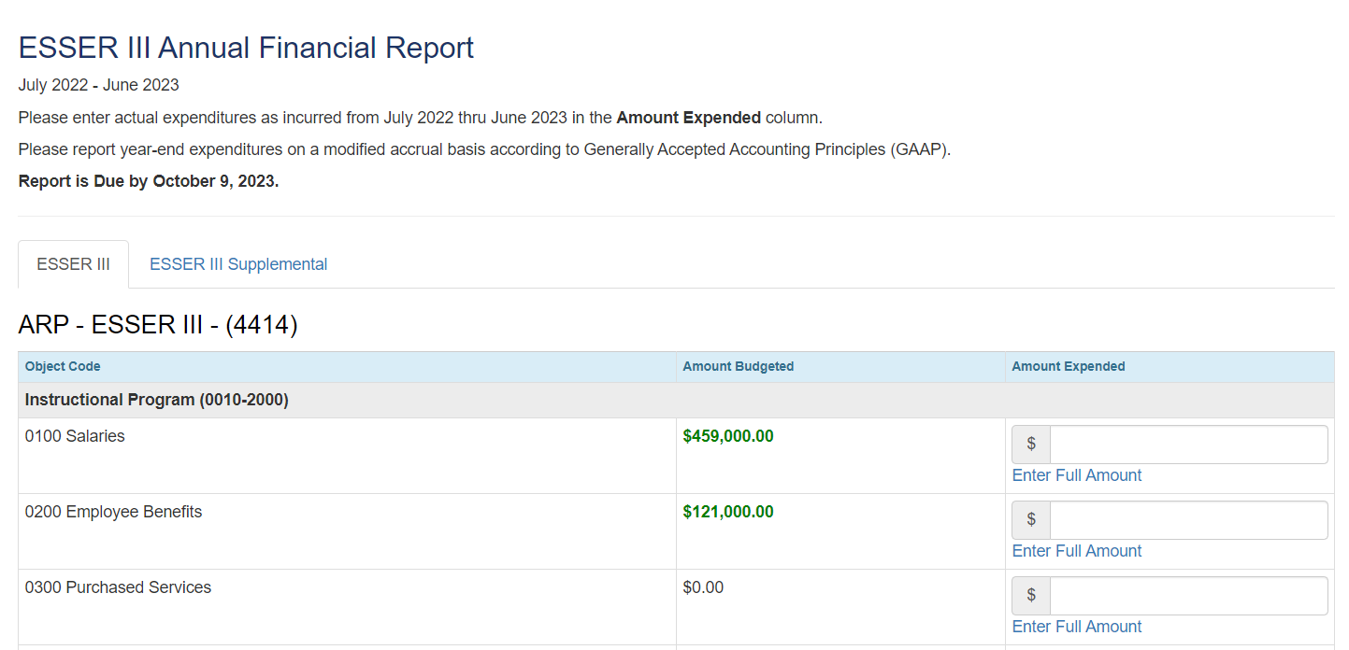
ESSER AFR
Once inside your AFR, you will see that the format hasn’t changed from the past couple of years.
Any amounts budgeted in your application will appear in green under the “Amount Budgeted” column.

Slide 16
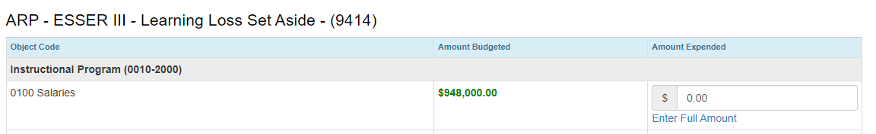
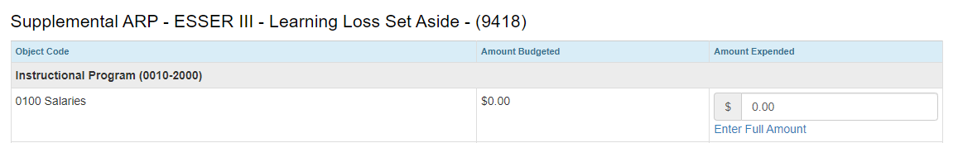
ESSER III AFR Layout
As a reminder, ESSER III has additional sections regarding what was spent on learning loss:

Slide 17

ESSER AFR Reminders!
Anytime your application is on CDE’s side, you will not be able to access or enter information for the AFR. Once it is back on your side to edit, you will then be able to select the AFR buttons.
Ensure you go through all of the tabs across the top of your AFRs before selecting “Submit Report as Final.”
If you didn’t spend money in the FY22-23, still submit the report!

Slide 18
Contact Us!
If you have questions regarding the AFR, please contact the Grants Fiscal Office:
  Steven Kaleda Kaleda_S@cde.state.co.us
  Robert Hawkins Hawkins_R@cde.state.co.us
If you have questions regarding the system, please contact the Grants Program Administration Office:
  Michelle Prael Prael_M@cde.state.co.us
  DeLilah Collins Collins_D@cde.state.co.us

Slide 19
Federal Programs Monitoring Overview
September 7, 2023

Slide 20
Outcomes for Today’s Training
Review the Federal Programs monitoring purpose and process
Understand what happens during each step of the timeline
Preview examples of resources and tools
Know how to get additional support
Meet members of the monitoring team
Acronyms used today:
LEA: Local Education Agency
PMSA: Program Monitoring Self-Assessment
FPSU: Federal Programs and Supports Unit
FMQ: Fiscal Monitoring Questionnaire
GFMU: Grants Fiscal Monitoring Unit
Notes:
Kristin:
Our main goal today is to provide LEAs with the information needed to have a successful and positive monitoring experience. We will review what the Federal Programs monitoring purpose is and what the process will look like, break down the timeline into steps, provide examples of resources and tools, and provide monitoring team contact information if any support is needed. Additionally, we have the majority of our monitoring team presenting today so that you can put faces with names.
There are also a few acronyms you will see throughout today’s presentation and throughout the monitoring process, so we want to make sure everyone is aware of what these acronyms mean. [go through list]

Slide 21
Overview
Monitoring formalizes the integral relationship between CDE and Colorado LEAs in implementing effective programs using Federal funds.
Monitoring is implemented from a program and fiscal perspective and meant to accomplish the following objectives:
  Focus on What Matters
  Reduce Burden on LEAs
  Improve Communication with LEAs
  Differentiate and Customize Support for LEAs
  Ensure Basic Requirements Are Met
Notes:
The Federal Programs and Supports Unit and Grants Fiscal vision for monitoring is to help build awareness of the requirements associated with accepting federal funds, capacity to self-assess against the requirements of the grants, and enhance understanding of how school districts and BOCES can best utilize grant funding to improve services for students. Monitoring is an opportunity to identify LEAs’ effective practices already in place, identify technical assistance and support needs, and leverage Federal funds in support of better outcomes for all students.

Slide 22
Process
Application Reviews
Site Visits
Federal Programs Monitoring
Communications, Training and Technical Assistance
Evidence Submission and Review
Self-Assessment
Notes:
Federal Programs monitoring includes many components such as communication between our units and the field, application reviews, training and technical assistance, the self-assessment and questionnaire, evidence submission and review, and site visits and interviews with stakeholders.

Slide 23

Purpose
ESEA Program Intent
ESSER Program Intent
Purpose of Monitoring
To ensure all students, particularly underserved students, have equitable access to a high-quality education
To respond to, prepare for, or prevent the spread of COVID-19 and address the impact on education
To ensure that federal funds are used appropriately to implement programs that meet the intent of each program
Notes:
During federal programs monitoring, the FPSU and GFMU reviewers are looking to ensure that federal funds have been used appropriately to implement programs that meet the intent of ESEA, most recently reauthorized as ESSA, as well as the intent of ESSER.

Slide 24
Program Monitoring
Notes:
Kristin
We are now going to jump into information specific to program and fiscal monitoring and will begin with program monitoring.

Slide 25
Lessons from 2022-2023
22-23 Key Reflections
Last year’s timeline started too late and need to begin the process earlier in the year in order to provide meaningful feedback in a timely manner
Clarify expectations, purpose, and process for the LEAs completing the Program Monitoring Self-Assessment (PMSA)
Moving Forward
Will continue to utilize self-assessments with additional training and guidance on purpose and expectations
Will continue to identify areas for additional training and technical assistance based on common recommendations (best practices) and corrective actions (required by statute/guidance)
Notes:
This will be our team’s third year incorporating ESSER monitoring into the monitoring schedule alongside ESEA. As always, we are evaluating our practices to improve our processes moving forward. Last year, we had a bit of late start and found that responses on the PMSA would benefit from a more clear explanation and training from our team. Moving forward, we’ve adjusted our timeline and training plans. Our team will continue to identify the need for additional trainings and guidance and will work to provide those as needed.

Slide 26
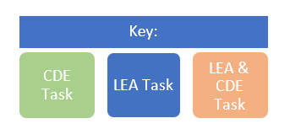
Program Monitoring Timeline
Late Summer/Early Fall
Early Fall
Late Fall/Winter
Spring
Notification
Training
Program Monitoring Self-Assessment (due October 20, 2023)
Technical Assistance
Evidence Review
Additional Evidence Requests
Potential Site Visits for Tier II and Tier III
Reports
Corrective Action Plans
Notes:
Let’s talk timeline. All LEAs being monitored in 23-24 should have received an email on August 31 containing the program monitoring notification letter. The email was sent to the authorized representative in the Consolidated Application and ESSER III application, based on which programs are being monitored. If you are someone who should have received that letter, please check with your authorized representative about receiving a copy. If you ARE the authorized representative, please reach out directly to me, crumley_k@cde.state.co.us for a copy, then ensure the contact information in the Consolidated Application and the ESSER III application is up-to-date.
We are now in the training phase and ready for LEAs to begin working on their Program Monitoring Self-Assessments which are due on October 20, 2023. Technical assistance is available as needed to support LEAs in submitting the self-assessment.
As self-assessments start coming in, the FPSU monitoring team will be reviewing submissions, determining what, if any, additional evidence is needed, and will begin planning site visits if needed for tier II and III LEAs. Once all evidence has been submitted and reviewed, FPSU monitoring team members will draft and send reports to LEAs. For tier ii and iii LEAs with corrective actions, the FPSU monitoring team will set up a meeting with the LEA and begin the corrective action planning process. More information about these steps is included in the next several slides.

Slide 27
Notification
Notes:
Kristin introduce Kriselda

Slide 28
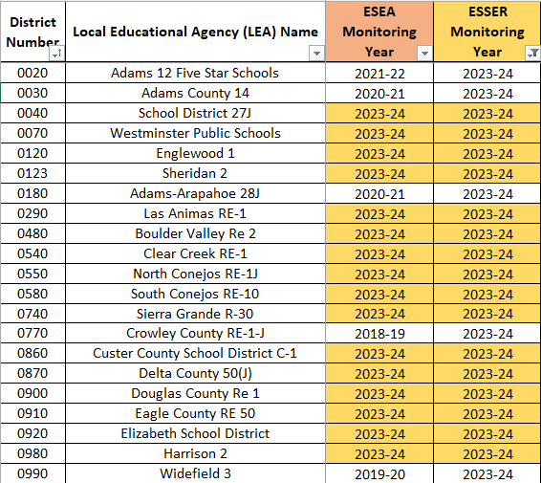
Monitoring Schedule
82 Total LEAs being Monitored
Monitoring Schedule (right) for ESEA and ESSER is located on our Monitoring Website.
Number of LEAs being monitored in 23-24
  66 Total
  31 ESSER-Only
  35 ESEA and ESSER
Notes:
All notification letters were sent on August 31, 2023, which indicates whether LEAs are being ESEA and ESSER monitored. If you see your LEA on the schedule but did not receive a letter, please reach out to Kristin Crumley to ensure the FPSU team has the most updated contact information for your LEA.
All LEAs that accept ESEA and ESSER funds will participate in monitoring during a multi-year cycle established by CDE’s Federal Programs and Supports Unit (FPSU).

Slide 29
Program Monitoring Tiers
A limited number of LEAs will be selected for Tier II and Tier III monitoring each year based on a set of selection criteria developed by CDE’s FPSU.
Tier designations can be found in the LEA’s notification letters.
LEAs will receive a separate notification for program monitoring and fiscal monitoring.
The tiers for program monitoring and fiscal monitoring may be different.
Notes:
The notification letters were sent on August 31, 2023.

Slide 30
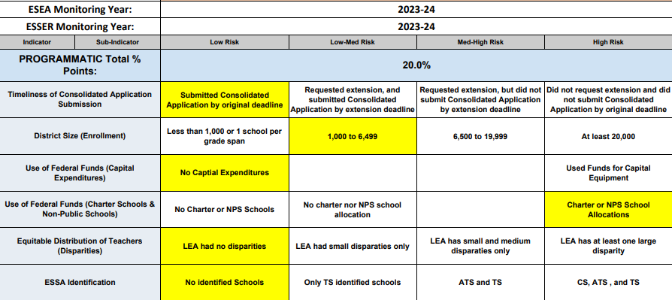
Risk Assessment - Program Indicators
Data comes from multiple sources
We use most recently available data
Rank risk from low to high for each indicator
LEA snapshots are uploaded into monitoring Syncplicity folder
  LEAs not being monitored this year may request a copy of their risk assessment snapshot for 23-24.
Notes:
Note the very last sub-bullet–if an LEA being monitored in a different year requests their risk assessment snapshot, it will be from the 23-24 year (so maybe different than the year in which they are/were monitored)

Slide 31
Notification Letters
Please read through the entirety of the notification letter for important details including:
PMSA Link
Next Steps
More information
Please forward the notification letter to anyone else on the LEA’s team who needs access.
The Syncplicity folder will be shared through a separate email from Syncplicity.

Slide 32
Completing the
Program Monitoring Self-Assessment
(PMSA)
Notes:
Kriselda introduce Kim

Slide 33
Getting Started
The Program Monitoring Self-Assessment (PMSA) will be completed and submitted using the Google Form for the program(s) being monitored.
Working copies of the PMSA are available in Word and PDF formats for LEAs.
Please note, if using a Word or PDF version, the PMSA must still be completed and submitted through the Google Form.
All formats are available on CDE’s Federal Programs Monitoring Page.
Notes:
Kim: The Program Monitoring Self-Assessment, or PMSA, will need to be completed and submitted using the Google Form for the program(s) being monitored. As Kriselda mentioned, your LEA’s Monitoring Notification letter includes a link to the PMSA form that your team will need to submit. There are 2 PMSAs, one is for LEAs that are being ESSER-only monitored, and the other is for LEAs being monitored for ESSER and ESEA Programs. We have working copies of the PMSAs posted on the Federal Programs Monitoring Page which may be useful if multiple staff are working on different sections.

Slide 34
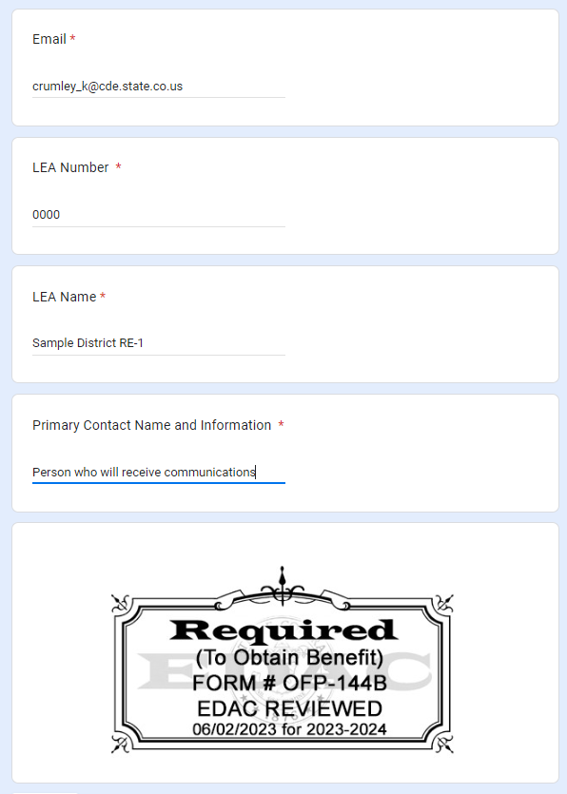
Contact Information
Although more than one person may participate in completing the PMSA, please list the primary contact for the LEA on this page. CDE will communicate any follow-up requests with the listed primary contact.
Notes:
Kim: Although a team of individuals may work on certain sections of the PMSA, please designate a primary contact for the LEA. The Program Monitoring Team will direct communications to this person via the email address provided.

Slide 35

Sections of the Self-Assessment
What is included in each section of the self-assessment?
Overview of statutory requirements
  Categories
Self-Rating
Required Narrative
Requested Support
Notes:
Kim: The PMSA is divided into sections and each section begins with the overview of statutory requirements of the categories, followed by the self-rating, the required narrative, and then requested support - all of which I’ll discuss in the next slides.

Slide 36
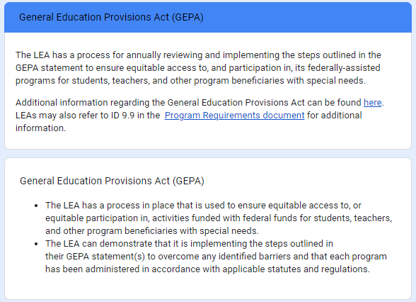
Overview of Statutory Requirements
Questions to Consider when Reviewing Requirements:
What is the LEA’s process for annually reviewing and implementing its GEPA statement? Has the statement been updated? How do federal funds of each program being monitored support the GEPA statement?
Notes:
Kim: Using the PMSA GEPA section as an example…Questions to consider when reviewing the requirements - what is the LEA’s process for annually reviewing and implementing its GEPA statement? Has the statement been updated? Are there budget activities that align with the GEPA statement? How do federal funds of each program being monitored support the GEPA statement?
PRESENTER: POINT OUT LINK TO PROGRAM REQUIREMENTS DOCUMENT which will be described in the next slide.

Slide 37
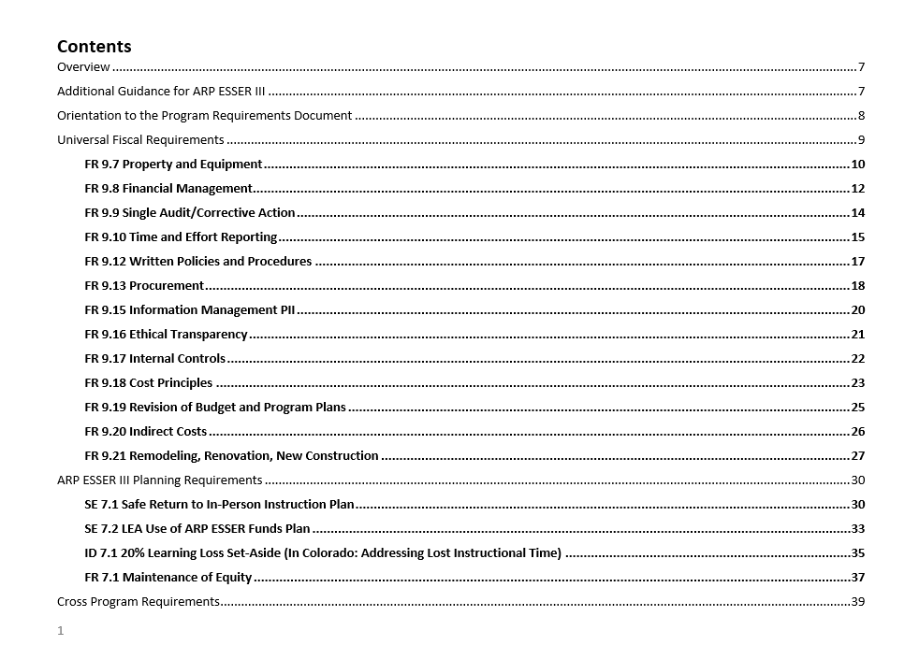

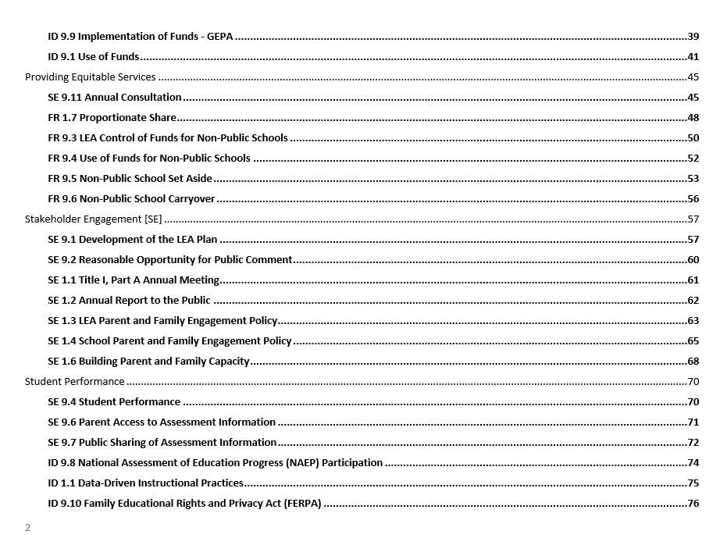
Program Requirements Document
Program Requirements Document for use in 2023-2024
Indicators have been rearranged
    Program Section
      Indicators are grouped into categories to align with PMSA
  Fiscal Section
Each category includes a link to the Program Requirements Document and lists applicable indicators for that category.
Notes:
Kim: The Program Requirements document is linked throughout the PMSA. The Indicators have been rearranged from previous years into categories to better align with the PMSA. You’ll also find the Fiscal section in the Program Requirements.

Slide 38
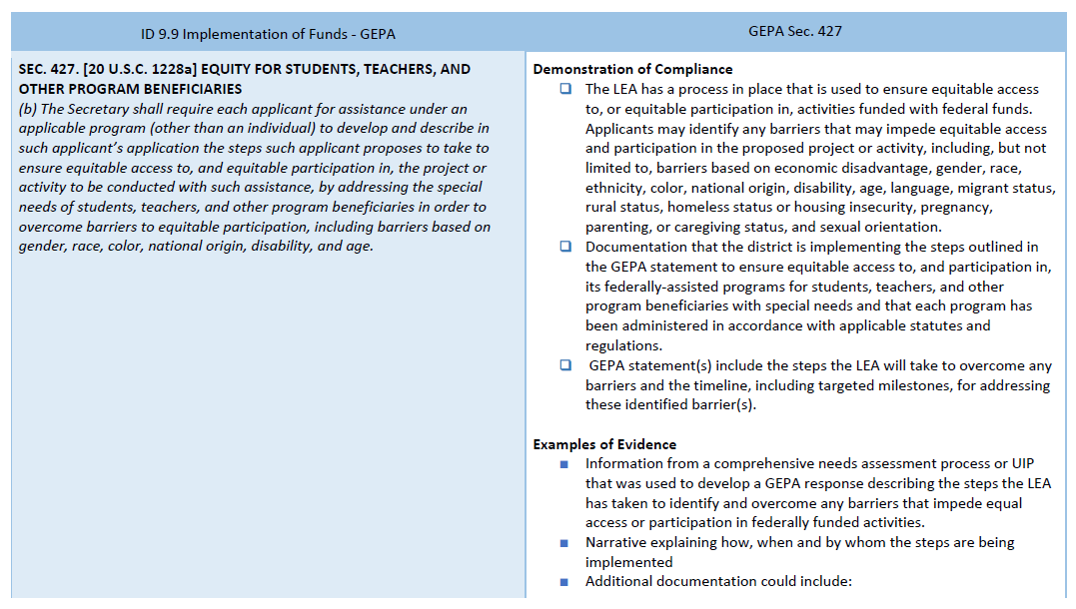
Program Requirements
The left column of the Program Requirements document references the indicator number and name, and statutory and regulatory citations that delineates the requirement(s).
The right column of the Program Requirements document provides Demonstration of Compliance checklist, and Examples of Evidence LEAs may provide to demonstrate compliance.
Notes:
Kim: Throughout the Program Requirements document, you’ll see that it is arranged in columns. The left column references the indicator number and name (in this case, it’s ID 9.9 Implementation of Funds - GEPA), and the statutory and regulatory citations that delineates the requirements. The right column provides the Demonstration of Compliance checklist, followed by Examples of Evidence that LEAs may provide to demonstrate compliance.

Slide 39
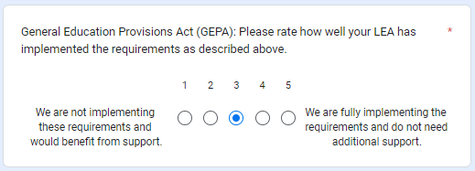
Self-Rating
Which number should our LEA select?
5: LEA is fully implementing all requirements listed above.
4: LEA is implementing all requirements, but may not be fully implementing all requirements listed above.
3: LEA is implementing most requirements listed above.
2: LEA is implementing some requirements listed above.
1: LEA is not implementing requirements listed above.
Notes:
Kim: When selecting the self-rating for each section of the PMSA, the LEA should examine how well the requirements are being implemented. A “5” indicates that the LEA is fully implementing all requirements of the section, a “4” indicates that the LEA is implementing all requirements, but may not be FULLY implementing all requirements of the section. A “3” indicates that the LEA is implementing MOST requirements, a “2” indicates that the LEA is implementing SOME of the requirements, and a “1” indicates that the LEA is not implementing the requirements listed above.

Slide 40

Self-Rating,continued
Is there a penalty if our LEA selects a lower self rating?
No. The Federal Programs monitoring team uses these ratings to plan technical assistance to the field. If your LEA requests individualized support, the Federal Programs monitoring team can provide this.
Notes:
Kim: Is there a penalty for selecting a lower self-rating? NO. The Federal Programs monitoring team uses these ratings to inform our technical assistance to the field. If your LEA requests individualized support, our team can provide this. So, have no fear!

Slide 41
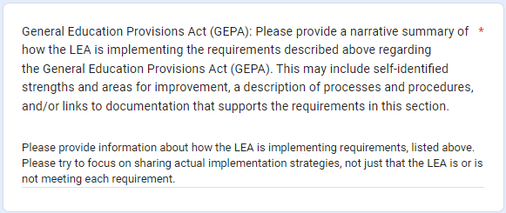

Required Narrative
Focus on Implementation
If Tier II or III, consider uploading supporting documentation to Syncplicity or within the narrative as links.
Notes:
Kim: Following the self-rating section is the Required Narrative section. This is where the LEA can further discuss and describe how the program requirements are being implemented. We ask that the LEAs try to focus on sharing actual implementation strategies, not just that the LEA is, or is not meeting each requirement. If your LEA is Tier II or Tier III, consider uploading supporting documentation to Syncplicity, or provide links to documents within the narrative. Submitting documentation with the PMSA responses will likely minimize the need for follow-up requests.

Slide 42
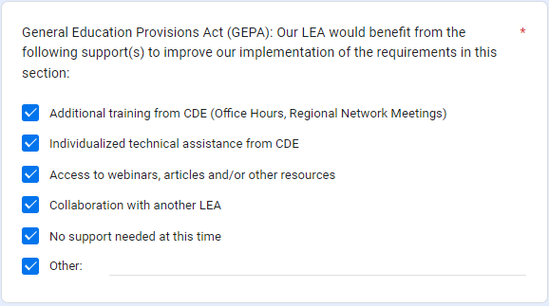

Requested Support
Please select any support that would benefit your LEA for each section.
Notes:
Kim: After the Required Narrative, the LEAs can select any support that would be beneficial to fully implement program requirements.

Slide 43
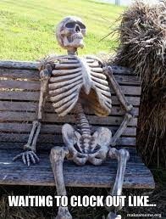
Time Commitment for the PMSA
How much time should this take?
A reasonable expectation for completing the online PMSA is approximately two hours.
If additional team members are needed to support different programs, time to check in with those team members will need to be considered.
Notes:
Kim: You may be wondering how long will it take to complete the PMSA? A reasonable expectation is about two hours. If additional team members will be providing information for different sections of the PMSA, that time will need to be considered before submitting the PMSA Google Form.

Slide 44

PMSA Deadline
Program Monitoring Self-Assessment (PMSA) due
October 20,2023
(final submission via the Google Form)
ESEA/ESSER Link
ESSER-Only Link
Notes:
Kim: The deadline to submit the PMSA via the Google Form is October 20th, which is 6 weeks and one day from today!
Thank you for your time - I will now turn it over to my colleague, Jonathan Schelke, to discuss Document Review and Evidence Submission procedures.

Slide 45
Document Review and
Additional Evidence Submission
Notes:
Kim introduce Jonathan

Slide 46
After the PMSA…
Tier I
Tier II
Tier III
If further action is needed, a follow-up call will be scheduled between the LEA and CDE’s FPSU monitoring team to discuss next steps. If no further action is needed, the FPSU monitoring team will notify the LEA in writing that the program monitoring process has concluded.
In addition to Tier I components, Tier II may include requests for additional information or submission of evidence. LEAs will use Syncplicity to submit any additional documentation. CDE’s FPSU monitoring team will provide a written report to summarize any recommendations, corrective actions, or next steps identified through the program monitoring process.
In addition to Tier I and II components, CDE’s FPSU monitoring team will work with LEAs to identify additional program requirements and potential site visit dates to review implementation practices. In Tier III monitoring, the LEA will have an opportunity to co-develop the monitoring plans and help determine which indicators would be helpful and relevant.

Slide 47

Syncplicity
CDE will utilize the Syncplicity Platform for additional evidence uploads.
Syncplicity is a secure file synchronization system that enables you to access files remotely from multiple computers and mobile devices.

Slide 48
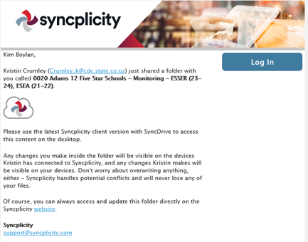
Step 1: Receiving Access
An email will be sent to Authorized Representative from Syncplicity
  Please ensure contacts in the ESSER III and Consolidated Application are up-to-date.
Email Description Example:
  "#### District Name - Monitoring - ESEA and ESSER (23-24)" has been shared with you by Kristin Crumley (Crumley_K@cde.state.co.us)”
  Be sure to check your SPAM folder
This email can’t be shared with others, it will not allow them to access the folder.
If you need access, email Kristin Crumley at Crumley_K@cde.state.co.us
Notes:
Login to your Syncplicity account to access your district’s folder by either clicking on the Syncplicity email or going to my.Syncplicity.com.
You may need to create an account to access your folder.
If you have accessed Syncplicity before, but can’t remember your password, utilize the Reset Password link.
If another LEA member needs access, email Kristin Crumley.

Slide 49

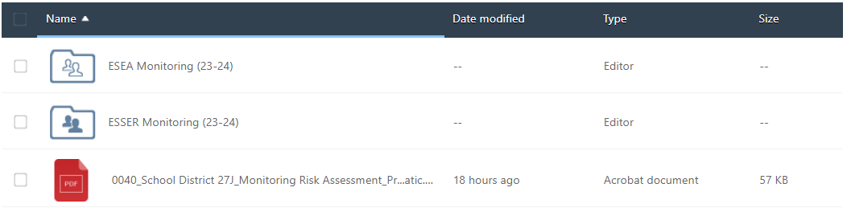
Step 2: Locating your Folder
Your folder will have your district number, name, “Monitoring” and ESEA and ESSER years.
  This is where you will upload evidence
Once you are in your folder, you will see your risk assessment portfolio, and folders for ESEA and ESSER.
Notes:
Syncplicity folders for LEA’s being monitored this year have been shared. If you have not received the email reach out to Kristim

Slide 50
Step 3: Upload Evidence
Evidence can be uploaded to support the self-assessment responses.
The FPSU monitoring team may request additional evidence specific to a program requirement/indicator.
For self-assessment category-specific evidence, please use the following naming convention:
  Category Name_Document Name
  Example: ARP ESSER III Planning Requirements: Learning Loss Set-Aside_Measuring Student Progress
For indicator-specific evidence, please use the following naming convention:
  Indicator Number_Indicator Name_Document Name
  Example: FR1.4_Rank Order_Narrative
Notes:
Be sure to note that self-assessment supporting evidence is not required but is recommended for tiers ii and iii (how do we want to include tier i here?)

Slide 51
Monitoring Reports
And
Action Planning
Notes:
Jonathan introduce Nathan

Slide 52
Report Terms to Know…
Commendation: The FPSU monitoring team may highlight any exemplary practices that were identified through the monitoring process.
Recommendation: The FPSU monitoring team may identify recommendations that the LEA should implement to improve practices in certain areas for the LEA.
Corrective Action: The FPSU monitoring team may identify corrective actions that the LEA must implement to meet statutory requirements. Corrective actions require a corrective action plan developed and submitted by the LEA and approved by the FPSU monitoring team.

Slide 53
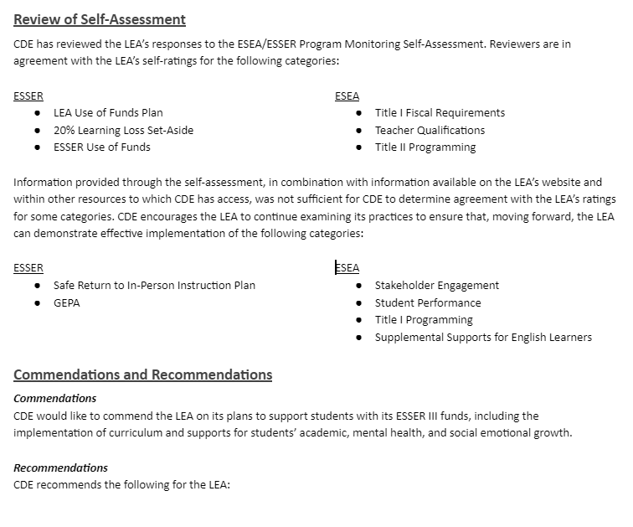
Tier I
Written Report
FPSU monitoring team will review the submitted PMSA and determine whether evidence is sufficient to support agreement with the LEA’s self-rating
  Additional information or evidence may be requested
The report may include
  Commendations
  Recommendations

Slide 54
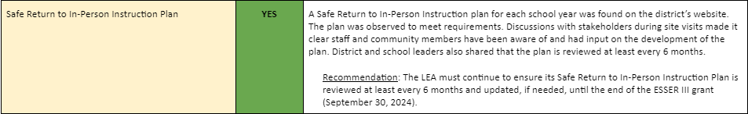
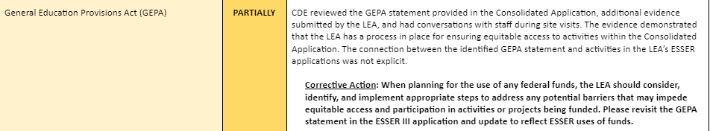
Tiers II and III
Written Report
  Preliminary report with opportunity for LEA feedback
  Final report incorporating LEA feedback
FPSU monitoring team will provide compliance ratings and feedback for each category reviewed
  Additional information and/or evidence may be requested
The report may include
  Commendations
  Recommendations
  Corrective Actions

Slide 55
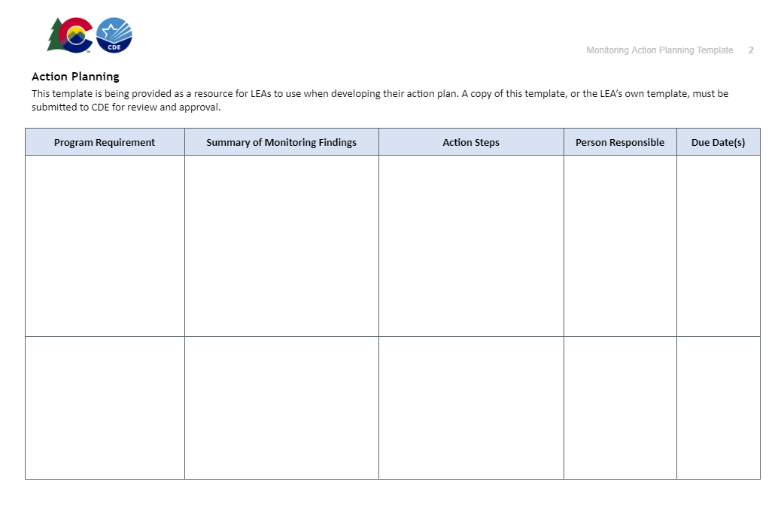
Corrective Action Planning (Tiers II and III only)
If the report includes corrective actions, the FPSU monitoring team will work with the LEA to create and implement a corrective action plan.

Slide 56
Fiscal Monitoring
Notes:
Nathan introduce Bill and Hilery (we need to confirm who’s presenting)

Slide 57
Fiscal Monitoring Notifications and Training
Based on the same population mentioned by Program in the slides above
Fiscal notifications will go out shortly - target by end of September
  Will identify Tier level (I, II or III)
  Description of the fiscal monitoring process based on tier
  List of available resources
Separate and specific monitoring trainings will be conducted for Tier I and Tier II/III
  Dates TBD, will be sent to same contacts as notification letter
    Dates targeted to fall shortly before monitoring review
  Tier II/III should occur late fall, Tier I should occur after the start of 2024
Initial document request will be sent after completion of training
  Fiscal Monitoring Questionnaire
  Supplemental Construction Questionnaire as needed
  ALL detailed general ledgers
  Payroll information
  Documentation of overall fiscal processes
  Any other items noted in notification letter

Slide 58
Items of Concern from 22-23 Fiscal Monitoring
Ongoing from items noted during 21-22 Fiscal Monitoring
  Lack of documentation for the overall fiscal process (policy/procedures)
  Budget - to - Actual variations
  Noncompliant time and effort documentation
  Noncompliant equipment/real property tracking mechanisms
Construction
  Current hot topic among states
  Davis-Bacon rules
    What are they?
    What should I have done?
    How do I become compliant?
  Contract language
  Most recently presented at August 17th Office Hours
Notes:
Note that policies/procedures are reviewed and transactions are tested against them (need to follow your procedures). Emergency procedures can fold into allowability as one example.
Document the policies/procedures
Our focus is less on which is policy and which is procedure - is the overall process documented?
Ensure review of Sam.gov for suspension and debarment when required
Should include a section speaking to emergencies
Helpful resource for documenting the process here
Budget - to - Actual variations
The expenses posted in the GL do not coincide with the activities approved in the original application
Ensure the LEA is using a PAR for any decisions to spend money in a different activity or an amount greater than 10% of original
Proper use of Chart of Accounts (most common variance is at object code)
Compliant time and effort documentation
Compliant equipment/real property tracking mechanisms

Slide 59
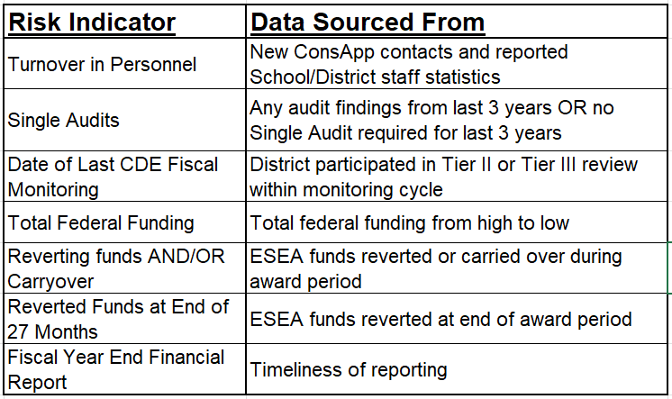
Risk Assessment - Fiscal Indicators
Data comes from multiple sources
Broken out into three levels of risk
Please reach out for specifics on your LEA
Notes:
ESEA reversion rates applicable for all federal awards only as internal control measures
All indicators used as a guide not as a gotcha - quantifiable method for setting tiers and establishing rotation (everyone gets a turn)

Slide 60
What are the Fiscal tiers?
All LEAs identified for monitoring will complete the FMQ.
Tier I
Tier II
Tier III
Initial Notification Letter Request: The LEA will complete and submit the Fiscal Monitoring Questionnaire (FMQ). If further action is needed, CDE will send an email or schedule a follow-up call between the LEA and CDE. If no further action is needed, CDE will notify the LEA by email that the fiscal monitoring process has concluded.
Initial Notification Letter Request: In addition to Tier I components, for all awards identified in the notification letter, LEAs will need to submit as part of the initial document submission:
Detailed general ledgers
A list of employees paid with federal funds
Links to board policies
Documents that outline the procedures for fiscal transactions if the LEA incurred expenditures related to those processes during the period under monitoring:
  Procurement
  Time and Effort (Payroll)
  Capital Property and Equipment
  Construction
Initial Notification Letter Request: The initial document submission requirements are the same as Tier II.
The difference in Tier III will come during follow-up sample transaction requests. Typically this will involve a larger sample than Tier II.
All LEAs identified as Tier II or III will receive a follow-up request for sample transactions, at a minimum.
All documents, including FMQ, submitted to Syncplicity.
Notes:
GLs would be for any federal awards identified in the notification letter for which there was activity during the period under monitoring

Slide 61
CDE Monitoring Team Contact Information
Program Monitoring Team
Tammy Giessinger
720-827-5291 (c)
giessinger_t@cde.state.co.us
Nathan Hickman
720-833-8194 (c)
hickman_n@cde.state.co.us
Kristin Crumley
720-660-1369 (c)
crumley_k@cde.state.co.us
TBD
Program Monitoring Team Continued
Jonathan Schelke
720-388-0842 (c)
schelke_j@cde.state.co.us
Kim Boylan
720-354-7031 (c)
boylan_k@cde.state.co.us
Kriselda Craven
720-355-1118 (c)
craven_k@cde.state.co.us
TBD
Fiscal Monitoring Team
Bill Parsley
303-910-5163 (c)
parsley_b@cde.state.co.us
Hilery Morris
720-471-4877 (c)
morris_h@cde.state.co.us
Kristina Jones
720-601-0031 (c)
jones_kristina@cde.state.co.us
Werner Hagemann
720-262-0870 (c)
hagemann_w@cde.state.co.us
Notes:
Michelle

