Slide 1
CDE Office Hours
October 7, 2021

Slide 2
CDE Team!
CDE Contacts!
Emails: LastName_FirstInital@cde.state.co.us
ESSER/ESEA Program Partners
Nazie Mohajeri-Nelson, Director of ESEA Office (mohajeri-nelson_n@cde.state.co.us)
DeLilah Collins, Assistant Director of ESEA Office (collins_d@cde.state.co.us)
ESEA Regional Contacts assigned by district
  Title I: Laura Meushaw, Kathryn Wisner, Niko Kaloudis
  Title II: Jeremy Meredith, Niko Kaloudis
  Title III: Lorenzo Moreno, Kathryn Wisner
  Title IV: Tammy Giessinger, Michelle Prael
  Title V: Kristen Collins
ESSER Team
  Kristin Crumley, ESSER Monitoring Specialist (Crumley_k@cde.state.co.us)
  Jonathan Schelke, ESSER Monitoring Specialist (schelke_j@cde.state.co.us)
  Shannon Wilson, ESSER/ESEA Grants Administration Coordinator (Wilson_s@cde.state.co.us)
  Mackenzie Owens, ESSER Reporting Specialist (owens_m@cde.state.co.us)
Data, Accountability, Reporting, and Evaluation
  Tina Negley, Alan Shimmin, Mary Shen, and Mackenzie Owens
Fiscal Partners
Jennifer Okes, Chief Operating Officer (okes_j@cde.state.co.us)
Kate Bartlett, Executive Director of School District Operations (Bartlett_k@cde.state.co.us)
Jennifer Austin, Director of Grants Fiscal Management (Austin_j@cde.state.co.us)
Robert Hawkins, Grants Fiscal Analyst (Hawkins_s@cde.state.co.us)
Steven Kaleda, Grants Fiscal Analyst (Kaleda_s@cde.state.co.us)
ESSER Team
  Bill Parsley, ESSER Fiscal Monitoring Supervisor (parsley_w@cde.state.co.us)
  Hilery Morris, ESSER Fiscal Monitoring (morris_h@cde.state.co.us)
  Sharon Mackey, ESSER Fiscal Monitoring (mackey_s@cde.state.co.us)

Slide 3
ESSER Office Hours
Topics
ESSER and ESEA Program Monitoring – How to Prep ~ Program Office ESSER Team
Notes:
Nazie

Slide 4
What are the first 3 words that come to mind when you hear “monitoring”?
Put your answer in the chat
Notes:
https://www.mentimeter.com/s/bce43cb442c5900f43dbc7b11c2fd7f1/01ba49df5963/edit

Slide 5
Agenda
Monitoring Overview
ESEA vs ESSER Monitoring
Monitoring Timeline
Monitoring Process
Training

Slide 6
Monitoring Overview

Slide 7
Purpose of Monitoring
To ensure that federal funds are used appropriately to implement program intent
ESEA Program Intent: All students, particularly underserved students, have equitable access to a high-quality education
ESSER Program Intent: To respond to, prepare for, or prevent the spread of COVID-19 and address the impact on education

Slide 8
Monitoring Participants and Pathways
U.S. Department of Education
Monitors State Educational Agencies (e.g., CDE) and selects local educational agencies to participate in monitoring (can select specific schools to participate)
Office of Inspector General can select SEAs and/or LEAs for targeted audits (can selects specific schools to participate)
Colorado Department of Education
Monitors Local Educational Agencies (districts, CSI, BOCES, & other subgrantees) and selects schools to participate (selection made in partnership with the LEA) in Tier II or III monitoring
Schools, including charter & nonpublic schools, might be selected to participate in monitoring and/or audits and may have to submit evidence or documentation to demonstrate school level compliance
Notes:
Nazie

Slide 9
CDE’s Monitoring
Who
CDE monitors the LEA (fiscal agent) and some schools might be selected to participate
Why
Demonstrate compliance with federal statute, regulations, and guidance pertaining to the grant
Programmatic requirements
Fiscal requirements
Demonstrate that plans and budgets for use of funds were implemented as approved
How
Identify and highlight LEA areas of strength and effective implementation;
Collaborate with LEAs to implement effective programs and practices to improve outcomes for students; and
Identify, disseminate, and learn from exemplary practices within Colorado.
Any entity or organization that accepts federal funds, including ESSER, is subject to monitoring and/or audits
CDE’s Mission and Vision for Monitoring:
In partnership and collaboration between State, LEA, and School
Responsibility to ensure appropriate uses of federal funds that meet program intent(s)
Notes:
Nazie

Slide 10
ESSER vs. ESEA Monitoring
How ESSER and ESEA monitoring are similar
Conducted by CDE fiscal and program teams
Same process and protocols
Use of data and documentation that CDE already collects (e.g., application) to minimize LEA burden
Iterative process to allow multiple opportunities to demonstrate compliance
How ESSER monitoring is different from ESEA monitoring
Three years to conduct all monitoring
Separate indicators
ESSER I-specific ~ non-public schools
ESSER III-specific ~ additional requirements and indicators
Maintenance of Equity
20% Set Aside
Use of Funds Plans
Safe In-Person Plans
Front-loading and training on requirements and expectations
3-Tiered approach based on risk assessment
Four categories of indicators: stakeholder engagement, identification and delivery, fiscal, and program evaluation
Notes:
Nazie

Slide 11
Monitoring Updates & Guidance

Slide 12
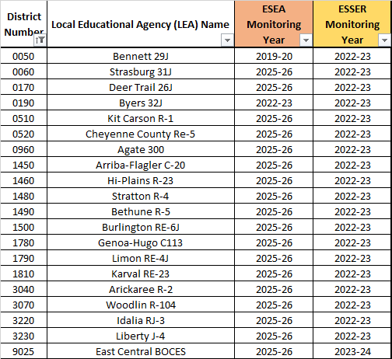
ESEA vs ESSER Monitoring
Monitoring Schedule for ESEA and ESSER is located on our Monitoring Website

Slide 13
During which school year will your LEA be monitored for ESEA? For ESSER?
Put your answer in the Zoom chat

Slide 14
Key Differences between ESSER & ESEA Monitoring
Data Year of Evidence Collection
ESEA: Most recent data year(s) available
ESSER: Any data year in which funds were expended PRIOR to monitoring year
  For 21-22 Monitoring, evidence will be collected from years 19-20 and 20-21.
  All applications with expenditures for these years will be monitored (ESSER I, II, & III).

Slide 15
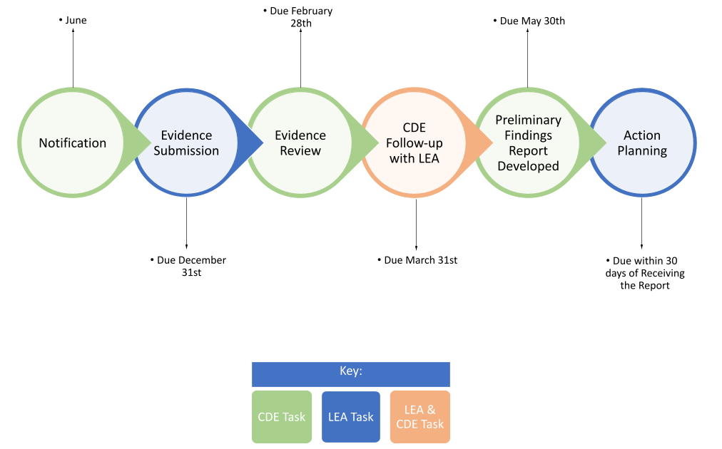
Monitoring Timeline
Notes:
This is a 21-22 timeline
The process is the same but the deadlines will change next year

Slide 16
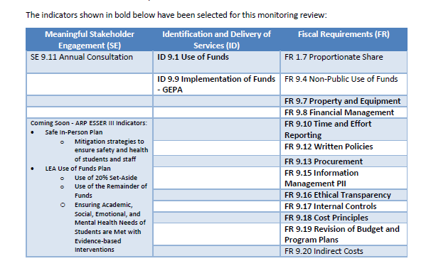
Notification
Prior to monitoring starting, in the summer LEAs will receive a Monitoring Notification Letter.
The notification letter will go to the Authorized Representatives designated in the Consolidated Application and/or ESSER Application(s).
The letter will include the indicators the LEA is being monitored on in most cases.
EXAMPLE

Slide 17
Notification: Identified Indicators
Once you have the letter, review the indicators selected by going to the ESEA-ESSER Program Requirements document.
  This document contains all of the current year indicators for ESEA and ESSER.
  You can view the ESSER only indicators on the ESSER Only Indicators document, which is significantly shorter.
The indicators contain the statutory reference, how to demonstrate compliance, and examples of evidence to upload.
The program requirements document will be updated as needed.

Slide 18
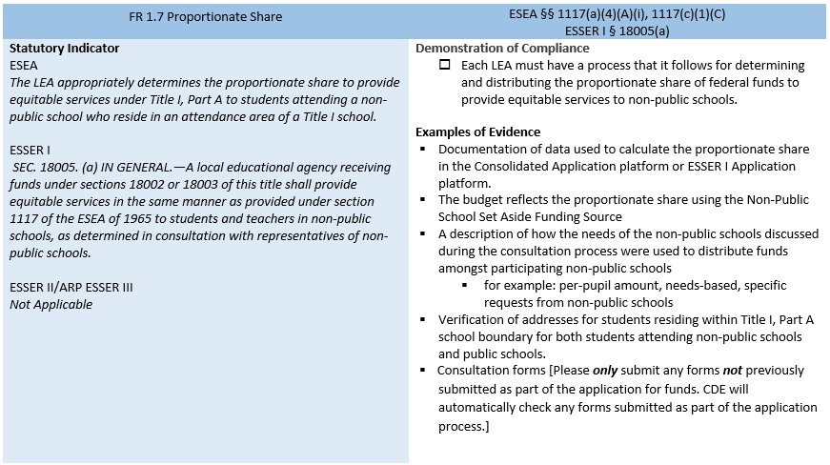
Statutory Indicator
Notes:
Demonstration of Compliance: This is the one you want to check off. It is a checkbox because it should be a charkmark that you make as a yes or no to compliance. Make sure you can say yes or no to this part of the indicator
Example of Evidence: This is just a list of ideas, not requirements. We will try to use everything that we already have submitted us. [See the last bullet regarding already submitted forms]
Initial evidence review and sometimes we have a back and forth process to submit additional evidence to meet compliance. Well targeted evidence will be better than submitting a large amount of evidence.

Slide 19
Evidence Submission
CDE will utilize the Syncplicity Platform for all evidence uploads.
Syncplicity is a secure file synchronization system that enables you to access files remotely from multiple computers and mobile devices.
CDE will share a Syncplicity folder with the Authorized Representative(s) following notification.
Once the Authorized Representative(s) receives the notification letter and the Syncplicity email, the LEA can begin to upload evidence in Syncplicity.

Slide 20
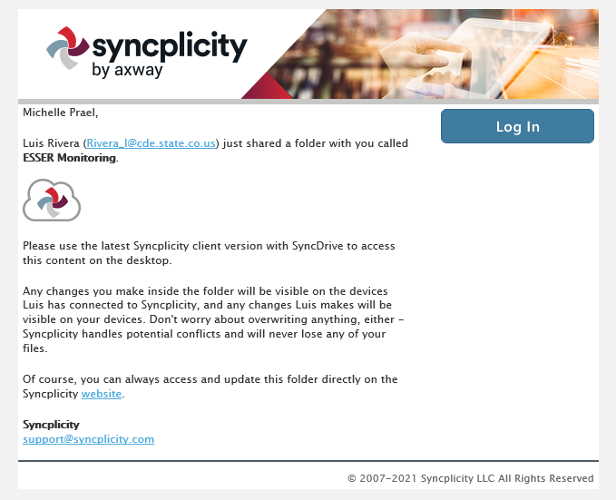
Evidence Submission: Access to Syncplicity
Email Description Example:
  "ESSER Monitoring" has been shared with you by Luis Rivera (Rivera_l@cde.state.co.us)”
  Be sure to check your SPAM folder.
This email can’t be shared with others, it will not allow them to access the folder.
  However, the Authorized Representative can inform CDE of any individuals that need access to the folder.

Slide 21
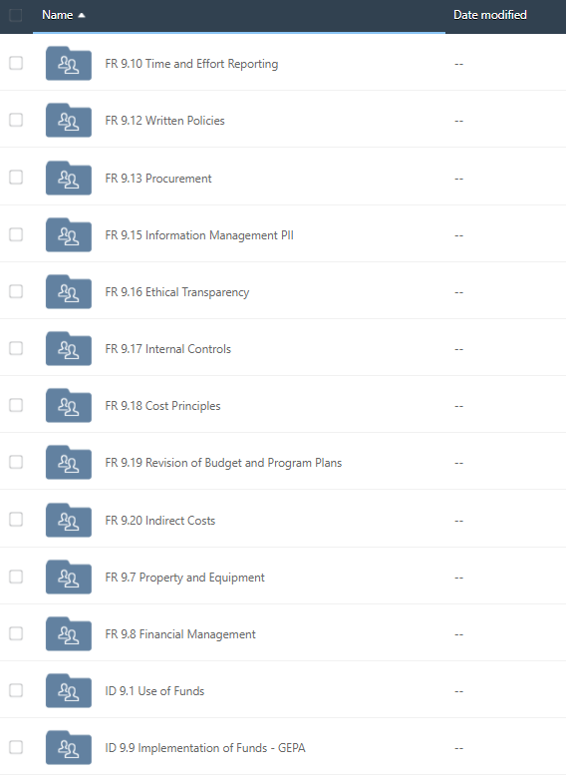

Evidence Submission: Syncplicity Folders
Your folder will have your district number, name, and “Fed Program Monitoring”.
  This is where you will upload evidence.
Once you are in your folder, you will see subfolders of each indicator identified for the LEA.

Slide 22
Evidence Submission: Uploading Evidence
Upload evidence that corresponds with each indicator.
As needed, provide a narrative description of evidence or processes that will help reviewers evaluate submitted evidence. This can be done by including a Word document in your evidence folder.
Please use the following naming convention:
  Indicator Number_Indicator Name_Document Name
  Example: FR1.4_Rank Order_Narrative

Slide 23
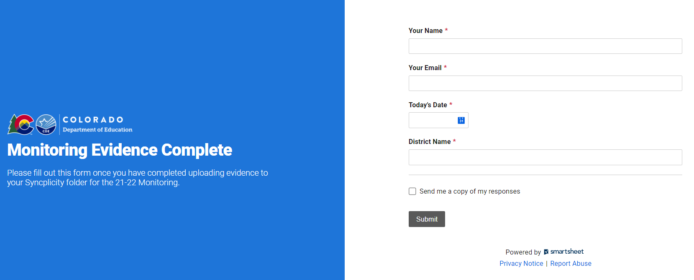
Evidence Submission: Notify CDE
Once all evidence has been uploaded, LEAs will notify CDE that the evidence upload is complete by filling out this form:

Slide 24
Evidence Review
Once CDE is notified that all the evidence has been uploaded, CDE will take time to review the evidence for compliance.
If a piece of evidence doesn’t meet the indicator, CDE will reach out to the LEA for additional evidence and/or clarification.
  The back and forth process will happen for a few weeks.
  The LEA will have multiple opportunities to demonstrate compliance (iterative process to make sure that we have a full understanding of the LEA’s processes for and implementation of program requirements).

Slide 25
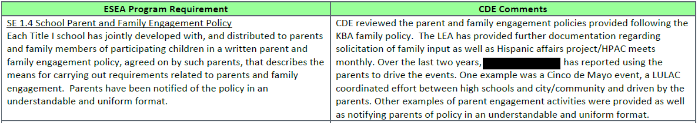
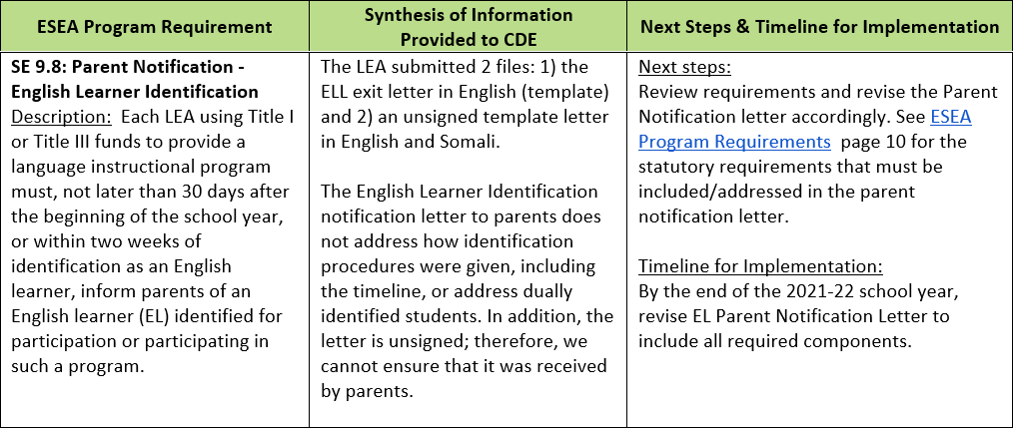
Preliminary Findings Report
CDE will then develop a Preliminary Findings Report.
  This report will contain what demonstrated compliance and what has room for improvement.
  LEA will have time to review and provide feedback on the letter (another built in iteration to all the LEA to ensure that CDE has a full understanding before finalizing report and developing next steps).
Reports are not shared on CDE website; all sharing is at the LEA’s discretion.
Notes:
The first picture is demonstrating compliance and the second picture is not.

Slide 26
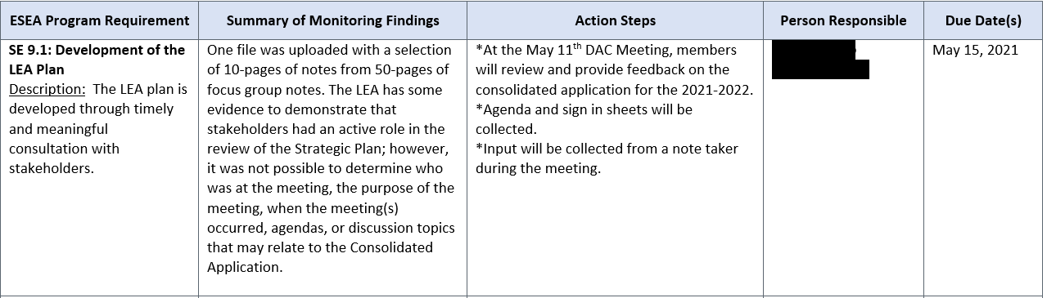
Action Plan
Once CDE sends over the Preliminary Findings Report, the LEA will need to work on an Action Plan.
  The Action Plan will outline how the LEA will address any findings or next steps.
  CDE can play as little or as big of a role as the LEA would like in the development of the plan.
Action Plans are also not shared on CDE website; all sharing is at the LEA’s discretion.

Slide 27
Training
CDE will host a Kick-Off Meeting next year for LEAs on the schedule for monitoring.
  This meeting will go over the monitoring process, important dates, and any updates to monitoring.
Trainings are currently being held around the monitoring indicators.
  They are being recorded and they will be posted on our website in the next couple of weeks.
  These will be helpful to familiarize yourself with the indicators.
  There will be separate videos for each indicator.

Slide 28
Jeremiah, Director Grants Administration, Denver Public Schools - District Monitoring Process
ESSA and ESSER strategies for your consideration
Begin identifying contacts (especially for program indicators) and ensure processes are clearly documented
How can you leverage the work you have done or are currently doing from your annual A-133 audits, such as:
  Internal Controls – how to ensure multiple people review a cost being reimbursed by the feds
  Time and Effort Certification
  Procurement
  Financial Management – process for ensuring eligibility of a cost
  General Ledger of costs
Team attends CDE Office Hours and saves all notes/presentations for future use
Proactive engagement with CDE to vet big ideas, processes and proposals, such as:
  Charter Schools requirements, forms, allocation methodology, responsibility
  Meet prior to submitting applications to review overall strategy and larger key initiatives
  Discuss and document eligibility of costs when unsure

Slide 29
Jeremiah, Director Grants Administration, Denver Public Schools - District Monitoring Process
ESSA and ESSER strategies for your consideration (continued)
When necessary work with your external auditor to discuss new proposed processes that impact federal funds
Fiscal Management
  Routinely scheduled meetings to review the spending with grant managers and/or your manager
    Is this on your calendar?
    Reports/Reconciliation used
  Do you have the appropriate level of document retention requirements for your analysts and departments
    Extra pay, stipends
    Equipment, capital expenditures
    Contracts
    Etc.

Slide 30
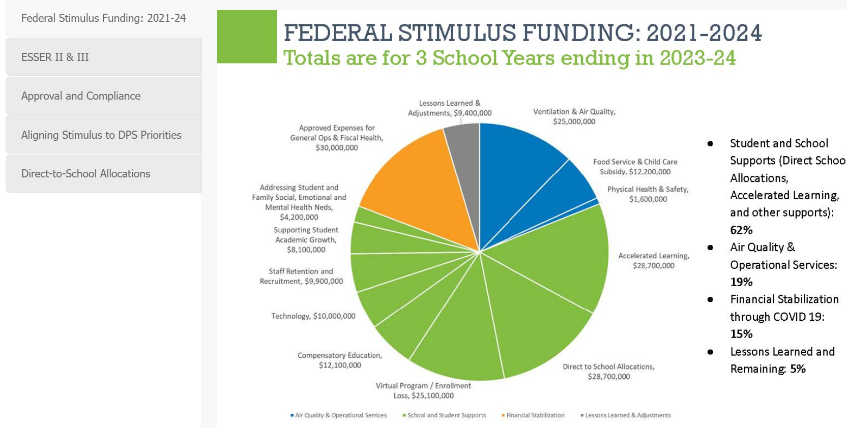
Jeremiah, Director Grants Administration, Denver Public Schools - District Monitoring Process
Unique ESSER I, II, III Requirements:
Stakeholder Engagement -
  Developed a log to track events, modalities, and populations
Transparent and authentic engagement with the community and Board of Education
  Proposed and Adopted Budget Approval
  Website for fiscal reporting to the community
  Still under construction

Slide 31
Jeremiah, Director Grants Administration, Denver Public Schools - District Monitoring Process
Unique ESSER I, II, III Requirements (Continued)
Program Evaluation and Reporting
  Created a job aid to outline a Grant Managers responsibilities and accountability
  When working with departments we ask them to be aware that the public will be asking for how these funds were used to help students learn. So as we fund initiatives we discuss how will it be measured and how will the activity and/or outcomes be tracked.
  We are working closely with our department that is an expert in reporting, outcomes, student data, assessments to be lead on many of the outcome based requirements and reporting.
  Ongoing conversations to ensure adjustments are occurring when necessary to get the best outcomes and best fiscal stewardship

Slide 32

Questions?

Slide 33
Updates and Reminders

Slide 34
Reminders
ESSER III Additional Requirements:
LEA Plans must be posted on the LEA website
Built with stakeholder input

Slide 35

Reminder and Upcoming Topics!
10/14/21 ~ ESSER Fiscal Monitoring – How to Prep ~ Grants Fiscal Unit ESSER Team

Slide 36
Questions?

Slide 37
Thank you!
Enjoy the Breakout Room Conversation!
We’ll See You Next Week!

Slide 38
CDE Team!
CDE Contacts!
Emails: LastName_FirstInital@cde.state.co.us
ESSER/ESEA Program Partners
Nazie Mohajeri-Nelson, Director of ESEA Office (mohajeri-nelson_n@cde.state.co.us)
DeLilah Collins, Assistant Director of ESEA Office (collins_d@cde.state.co.us)
ESEA Regional Contacts assigned by district
  Title I: Laura Meushaw, Kathryn Wisner, Niko Kaloudis
  Title II: Jeremy Meredith, Niko Kaloudis
  Title III: Lorenzo Moreno, Kathryn Wisner
  Title IV: Tammy Giessinger, Michelle Prael
  Title V: Kristen Collins
ESSER Team
  Kristin Crumley, ESSER Monitoring Specialist (Crumley_k@cde.state.co.us)
  Jonathan Schelke, ESSER Monitoring Specialist (schelke_j@cde.state.co.us)
  Shannon Wilson, ESSER/ESEA Grants Administration Coordinator (Wilson_s@cde.state.co.us)
  Mackenzie Owens, ESSER Reporting Specialist (owens_m@cde.state.co.us)
Data, Accountability, Reporting, and Evaluation
  Tina Negley, Alan Shimmin, Mary Shen, and Mackenzie Owens
Fiscal Partners
Jennifer Okes, Chief Operating Officer (okes_j@cde.state.co.us)
Kate Bartlett, Executive Director of School District Operations (Bartlett_k@cde.state.co.us)
Jennifer Austin, Director of Grants Fiscal Management (Austin_j@cde.state.co.us)
Robert Hawkins, Grants Fiscal Analyst (Hawkins_s@cde.state.co.us)
Steven Kaleda, Grants Fiscal Analyst (Kaleda_s@cde.state.co.us)
ESSER Team
  Bill Parsley, ESSER Fiscal Monitoring Supervisor (parsley_w@cde.state.co.us)
  Hilery Morris, ESSER Fiscal Monitoring (morris_h@cde.state.co.us)
  Sharon Mackey, ESSER Fiscal Monitoring (mackey_s@cde.state.co.us)

