Slide 1
CDE Office Hours
October 14, 2021

Slide 2
CDE Team!
CDE Contacts!
Emails: LastName_FirstInital@cde.state.co.us
ESSER/ESEA Program Partners
Nazie Mohajeri-Nelson, Director of ESEA Office (mohajeri-nelson_n@cde.state.co.us)
DeLilah Collins, Assistant Director of ESEA Office (collins_d@cde.state.co.us)
ESEA Regional Contacts assigned by district
  Title I: Laura Meushaw, Kathryn Wisner, Niko Kaloudis
  Title II: Niko Kaloudis
  Title III: Lorenzo Moreno, Kathryn Wisner
  Title IV: Tammy Giessinger, Michelle Prael
  Title V: Kristen Collins
ESSER Team
  Kristin Crumley, ESSER Monitoring Specialist (Crumley_k@cde.state.co.us)
  Jonathan Schelke, ESSER Monitoring Specialist (schelke_j@cde.state.co.us)
  Shannon Wilson, ESSER/ESEA Grants Administration Coordinator (Wilson_s@cde.state.co.us)
  Mackenzie Owens, ESSER Reporting Specialist (owens_m@cde.state.co.us)
Data, Accountability, Reporting, and Evaluation
  Tina Negley, Alan Shimmin, Mary Shen, and Mackenzie Owens
Fiscal Partners
Jennifer Okes, Chief Operating Officer (okes_j@cde.state.co.us)
Kate Bartlett, Executive Director of School District Operations (Bartlett_k@cde.state.co.us)
Jennifer Austin, Director of Grants Fiscal Management (Austin_j@cde.state.co.us)
Robert Hawkins, Grants Fiscal Analyst (Hawkins_s@cde.state.co.us)
Steven Kaleda, Grants Fiscal Analyst (Kaleda_s@cde.state.co.us)
ESSER Team
  Bill Parsley, ESSER Fiscal Monitoring Supervisor (parsley_w@cde.state.co.us)
  Hilery Morris, ESSER Fiscal Monitoring (morris_h@cde.state.co.us)
  Sharon Mackey, ESSER Fiscal Monitoring (mackey_s@cde.state.co.us)

Slide 3
ESSER Office Hours
Topics
KPMG ~ CRF Monitoring Update
Compliance Supplement Delays ~ Update
ESSER Fiscal Monitoring – How to Prep ~ Grants Fiscal Unit ESSER Team
AFR ~ Update and Training
Updates and Reminders ~ if time allows
Notes:
Nazie

Slide 4
KPMG Update on CRF Monitoring

Slide 5
Coronavirus Relief Fund (CRF) Monitoring Update
Colorado Department of Education
ESEA Office Hours October 14, 2021
5

Slide 6
AGENDA
Risk Assessment
Next Steps
Q&A
6

Slide 7
Risk Assessments

Slide 8
Risk Assessments
Friendly reminder to please complete and send in your CRF risk assessments.
For those that have provided their risk assessments we thank you!
We are currently analyzing responses and generating ratings.
Some of you will be receiving follow-up emails to complete the risk assessment as certain questions were not answered.

Slide 9
Next Steps

Slide 10
Next Steps
Based on risk assessment results and a statistically valid sample, some LEAs will be receiving a request for all Grant Code 4012 CRF transaction detail (in an excel format).
  Note: Some LEAs have already provided this transaction detail to CDE and we will leverage that information
Upon receiving the transaction level detail we will select a sample of transactions to further test.
This will involve requesting and reviewing supporting documentation for those selected transaction-level CRF expenditures and determining if any exceptions are found.
For transactions marked as a possible exception or open, KPMG will seek further evidentiary matter and/or clarifying responses from the LEA allowing them an opportunity to remediate.
Following completion of the transaction-level review, KPMG will record the individual transaction-level results and any relevant observations and recommendations into a monitoring report and provide the report to the LEA and CDE.

Slide 11
Q&A
Q&A

Slide 12
Thank You!

Slide 13
Compliance Supplement

Slide 14
Compliance Supplement Delays
Updates to the Compliance Supplement are expected
This may result in potential delays to the completion of districts’ Single Audit
Districts may want to consider requesting extensions from the Office of the State Auditor
  The extension form is posted:
  https://apps.leg.co.gov/osa/lg

Slide 15
Fiscal Indicators
Training Session
FY22 Monitoring of FY20 and FY21 Activity
October 14, 2021
Notes:
BIll - 9.10, 9.13, 9.17 - 9.20
Hilery - 9.7, 9.8, 9.12, 9.15, 9.16

Slide 16
2021 Fiscal Monitoring - Overview
Grants Fiscal works in conjunction with Federal Programs and the LEA to perform the fiscal review portion of the monitoring engagement
Mostly looking for compliance with the Uniform Grant Guidance
Not a “gotcha” process - monitoring is to provide technical assistance and help LEAs ensure they are in compliance
  Must ensure we are good stewards of federal funds to prevent any fraud, waste or abuse
Monitoring will focus on policies and procedures and actual expenditures
  Will look at all completed fiscal years with actual award activity
    FY22 monitoring year --> activity from FY20 and FY21 for ESSER and activity from FY21 for ESEA (for example)
Look to your compliant procedures under other federal awards as a guide
  Fiscal compliance is generally consistent across all federal funds

Slide 17
2021 Fiscal Requirement Indicators
2021 Fiscal Requirement Indicators
CDE must perform subrecipient monitoring for all LEAs receiving pass-thru Federal Funds (2 CFR §200.331 and 332)
Fiscal criteria broken out into 11 fiscal indicators for FY22 engagements
FR 9.7 Property and Equipment
FR 9.8 Financial Management
FR 9.10 Time and Effort Reporting
FR 9.12 Written Policies
FR 9.13 Procurement
FR 9.15 Information Management PII
FR 9.16 Ethical Transparency
FR 9.17 Internal Controls
FR 9.18 Cost Principles
FR 9.19 Revision of Budget and Program Plans
FR 9.20 Indirect Costs
Notes:
Tim / Kate

Slide 18
FR 9.7 Property and Equipment
Governing Citations
2 CFR §200.313(d)(1-5)
Statutory Indicator
The LEA utilizes an inventory and tracking system for supplies and equipment purchased with Federal funds that aligns with written policy and/or procedures and meets the following requirements (see next slide) to safeguard all assets. This would include the allowance of technology items to be checked out/loaned to students and staff.

Slide 19
FR 9.7 Property and Equipment
Demonstration of Compliance
Documented physical inventory with results reconciled to property records at least every two years.
LEAs written inventory procedures must include the following:
Process performed when inventory is received;
Process describing what type of property is tagged and what position/office performs the tagging;
Process to adjust the inventory records in the event the property is sold, lost, or stolen, or cannot be repaired.
Property records should include at a minimum:
Description and serial number or other identification number
Source of funding for the property, including FAIN# (Federal Award Identification Number); and CFDA#
Title owner/holder
Acquisition date
Acquisition cost
Percentage of cost related to Federal participation for the program under which the property was acquired
Location, use and condition of property
Any ultimate disposition data including the date of disposal and sale price of the property, federal release of title/approval to dispose.
19

Slide 20
FR 9.7 Property and Equipment
Examples of Evidence
Written procedures (e.g., inventory dates/frequency, equipment check out procedures, property disposition process, etc.)
Current property records that include the minimum requirements for this indicator listed on slide 5

Slide 21
FR 9.7 Property and Equipment
Noteworthy Items
Federal capitalization threshold is $5,000 but LEA must follow internal policy
  Monitoring will look for $5,000 or internal policy (whichever is more restrictive)
Property records/inventory listings need to include the required elements listed on slide 5
Common Concerns
Did the LEA follow its policies regarding capitalization?
Are documented inventories being performed at least every two years and in accordance with LEA policy?
CDE strongly recommends the best practice of accountability for highly walkable items
  Consider coding these items as 0735 Non-Cap Equipment rather than 0600 Supplies
  Methods such as tagging highly walkable items and check out procedures help track items and ensure good stewardship of federal funds
Follow Up Requests
Supporting documentation (invoices, procurement documents, etc.)
May be monitored via Procurement and Internal Control indicators FR 9.13 and FR 9.17, respectively
Notes:
What does this mean for LEAs?

Slide 22
FR 9.7 Property and Equipment
Object Codes/Definitions for Usage
0600 Supplies: Amounts paid for items that are consumed, worn out, or deteriorated through use; or items that lose their identity through fabrication or incorporation into different or more complex units or substances. Items that do not contribute to a district’s capital assets, as evaluated by the district’s capital assets policy, may be coded as supply items, or may be coded as 0735, Non-Capital Equipment. Items that contribute to a district’s capital assets must be coded as equipment items in the 0700 series.
0730 Equipment: Expenditures for the initial and replacement items of equipment, such as machinery, furniture, fixtures, and vehicles; machinery, furniture, and fixtures (including teacher desks, chairs, and file cabinets), technology equipment, and other equipment that are used for instructional purposes should be charged to appropriate instructional programs. The district’s capital asset policy establishes criteria for when an equipment item must be capitalized and included on the district’s property inventory records. Usually this criteria requires equipment costing above a certain dollar amount to be capitalized. Capitalized equipment must be coded with an object 0730.
0735 Non-Capital Equipment: Expenditures for items classified as equipment but costing less than the district policy for capital assets inventory. Alternatively, non-capital equipment may be coded as a supply to an object in the 0600 series.

Slide 23
FR 9.8 Financial Management
Governing Citations
2 CFR §200.302(b)(1-7)
EDGAR 34 CFR §76.702
Title I Part A Assurances: §8306(a)(2)(A-B)
Statutory Indicator
LEAs must expend and account for Federal funds in accordance with Federal and State laws and procedures for expending and accounting for these funds. LEAs accounting systems must satisfy Federal and State requirements regarding the ability to track the use of funds and permit the disclosure of financial results. LEAs must follow written procedures for determining cost allowability and must have effective control over all funds.

Slide 24
FR 9.8 Financial Management
Demonstration of Compliance
Awards are received and expended under the programs for which they were received.
Accurate, current, and complete disclosure of the financial results of each award.
Records that identify the source and application of funds for federally funded activities.
Effective control over and accountability for all funds, property, and other assets to assure that they are used solely for authorized purposes.
Comparison of expenditures to budget amounts, to include a system/process in place to prevent over budgeted expenditures.
Written procedures to implement payments (advance payment awards)
Written procedures to determine allowability of costs.
Examples of Evidence
Generate report of budget to actual amounts (interim financial report generated from proprietary accounting system, general ledger).
LEA revenue and expenditure detail report. Policy/procedure representing the requirement for federal funds being managed independently of all other funds.

Slide 25
FR 9.8 Financial Management
Noteworthy Items
May be monitored via other indicators (e.g., use of funds, written policies, etc.)
Common Concerns
Provide budget to actual or general ledger
Can the LEA track individual awards?
Track funds start to finish
Follow Up Requests
Nothing typically but perhaps some questions for clarification
Notes:
What does this mean for LEAs?

Slide 26
FR 9.10 Time and Effort Reporting
Governing Citation
2 CFR §200.430(8)(i)
Statutory Indicator
The LEA maintains proper time and effort documentation that accounts for 100% of the effort of any employee that is paid in whole or in part with Federal funds.
Personnel activity reports (PAR): If an employee works on multiple activities or cost objectives, a distribution of the employee’s salary and wages must be supported by a personnel activity report or equivalent documentation.
A PAR must reflect an after-the-fact distribution of the actual activity of the employee; account for the total activity for which each employee is compensated for the payment period in question, be prepared at least monthly and coincide with one or more pay periods; the PAR (or time and effort report) must be approved by an individual (program manager/supervisor) with direct knowledge of the time and activity (effort) performed.
Semi-annual certifications are also an allowable form of time and effort tracking, must include all detail in the PAR description above, but are allowable to be completed on a semi-annual basis for individuals working on a single cost objective.

Slide 27
FR 9.10 Time and Effort Reporting
Demonstration of Compliance
Semi-annual certification (single cost objective 100%)
Personnel Activity Reports (PARs) (multiple cost objectives)
Substitute system (multiple cost objectives with predetermined, set schedule, must be pre-approved by CDE)
Examples of Evidence
Written procedures for documenting time and effort to include approval and allocations of labor expenditures which:
tie to PAR/Semi-annual certification; financial payroll reporting; and general ledger reporting:
and are in support of the program objectives.

Slide 28
FR 9.10 Time and Effort Reporting
Noteworthy Items
What do you use for other federal awards?
Semi-annual certification for a single cost objective vs Personnel Activity Reports (PAR) for multiple cost objectives
Submit payroll ledger for award
  Who is paid with award (even partially) and how much
Common Concerns
Signatures (timely and appropriate)
Should be based on actuals instead of budgeted time
100% of activity should be included
Follow Up Requests
CDE will choose sample of individuals from accounting records
  Could be 100% of T&E for a particular month
  Could be sample of employees and request all T&E for year for those individuals
  Job descriptions for selected individuals
Notes:
What does this mean for LEAs?

Slide 29
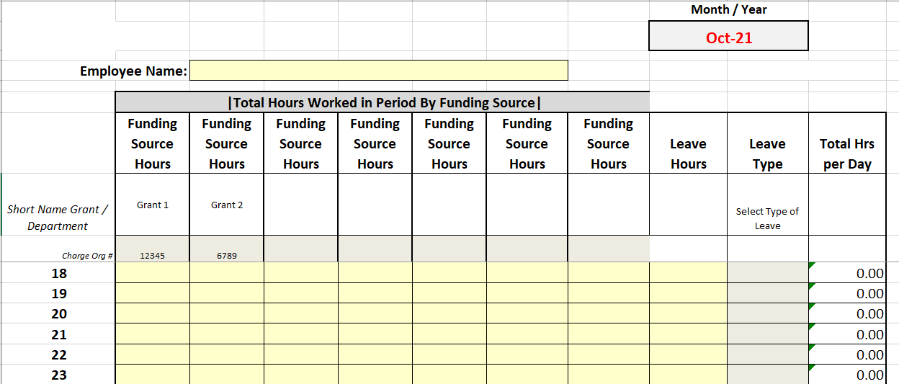
FR 9.10 Time and Effort Reporting
http://www.cde.state.co.us/cdefisgrant/faq - final question on this page has additional discussion and sample certifications related to Employee Time and Effort for Federal Grant Programs
https://www.aeffa.org/resources - Association of Educational Federal Finance Administrators website has several good links to additional information on time and effort
Timesheet example for someone working on multiple cost objectives

Slide 30
FR 9.12 Written Policies
FR 9.12 Written Policies
Governing Citations
2 CFR §200.302(b)(1-4), 34.75.730 - Financial Management System
2 CFR §200.302(6) - Cash Management System
2 CFR §200.302(6); §200.403-405 - Allowability of Costs
2 CFR §200.318(a) - Procurement
2 CFR §200.318(c)(1) - Conflict of Interest
2 CFR §200.475 - Travel
2 CFR §200.313; 2 CFR §200.439 - Property
2 CFR §200.338, 34 CFR §75.740 - Personally Identified Information
2 CFR §200.334 - Records Retention
Statutory Indicator
Written policies and procedures exist for the items above in accordance with UGG
Demonstration of Compliance
Policies, procedures and/or desk level procedures exist for each of the required items

Slide 31
FR 9.12 Written Policies
FR 9.12 Written Policies
Examples of Evidence
Policies that meet all requirements relating to:
Financial Management System (levels of approval, handbook, grant approval process, internal procedures, evidence federal funds are tracked separately from other funds, board policies, budget to actual reporting, separation of duties)
Cash Management System (policy/procedure to ensure adhere to CMA, district does not draw down funds in advance of expenditure for federal funds)
Allowability of Costs (process for reviewing expenditures to ensure they are allocable, allowable, reasonable, necessary and align to the program objectives)
Procurement (proper levels of approval for purchase cost levels, separation of duties, micro-purchase thresholds are followed, proper and complete documentation)
Conflict of Interest (policy/procedure for safeguarding against and notification to pass through entity of potential conflict)
Travel (proper levels of approval, reasonable and necessary, when are costs actually obligated and process for determination)
Property (are internal capital expenditure processes followed consistently) and inventory (inventory, tracking, and disposition procedures)
Personally Identified Information (policy/procedure for safeguarding)
Records Retention (where stored, how, and what process is followed for destruction)

Slide 32
FR 9.12 Written Policies
Noteworthy Items
Policies serve as a starting point to identify what monitoring procedures CDE will employ
LEAs must follow UGG or internal policy (whichever is more restrictive)
Colorado Association of School Boards (CASB) has example policies to use as a resource (https://www.casb.org/). Go to the website and search on the exact phrase, “sample policies.” Fee may be required.
Common Concerns
Incomplete written policies/procedures that fail to include each item required for this indicator (as shown on slide 16)
LEAs with written policies that contradict the UGG
LEAs that do not adhere to their written policies
Follow Up Requests
Clarification of policies
Missing in submission or no documented policy/procedure in place

Slide 33
FR 9.13 Procurement
Governing Citations
2 CFR §200.318
2 CFR §200.319
2 CFR §200.320
Statutory Indicator
The non-Federal entity must use its own documented procurement procedures which reflect applicable State and local laws and regulations, provided that the procurement conform to applicable Federal law and the standards identified in this section.
Should the non-federal entity’s internal policy and/or procedures be less restrictive than federal procurement regulations, the federal regulation should be followed.
Demonstration of Compliance
LEAs written procedures for procurement transactions, including vendor selection process. The procedures shall also describe the method(s) of procurement chosen by the LEA in regards to:
micro purchases;
small purchases;
sealed bids;
competitive proposals;
non-competitive (sole source) proposals, detail around conflicts of interest, approval authority, and separation of duties.

Slide 34
FR 9.13 Procurement
Examples of Evidence
Sample evidence or contracts from a variety of purchases
  micro purchases
  small purchases
  sealed bids
  competitive proposals
  non-competitive (sole source) proposals
All evidence should include approvals for procurement, rationale pertaining to the type of procurement process used, receipts, receiving documents/packing slips; copies of competitive pricing/bids, copy of payment, cancelled check/pCard. If services or contract, include a copy of contract and invoice for services.
Supporting documentation should support the internal policy/procedures for each type of procurement used. For instance, for small purchases, a simple print out from vendor websites showing price and availability can substantiate the vendor chosen. It is also a good practice to indicate on the receipt what cost objective/budget line item the purchase is supporting.

Slide 35
FR 9.13 Procurement
Items to be aware of
Submit general ledger for award showing all ESSER expenses
This is also used to determine compliance in FR9.8 (no need to submit more than once)
Common concerns
Small purchase vs micro purchases (UGG follows the FAR so an LEA’s internal policy is most likely more restrictive)
Follow internal procedures
Thresholds defined in policy/procedure
Ensure UGG referenced in policy (also affects FR9.12)
Follow Up requests
Sample selections of specific transactions
  Provide invoice, approval support, etc.

Slide 36
FR 9.15 Information Management PII
Governing Citations
2 CFR §200.303E
GEPA Sec. 444 and 445
Statutory Indicator
The LEA takes reasonable measures to safeguard and protect Personally Identifiable Information (PII).

Slide 37
FR 9.15 Information Management PII
Demonstration of Compliance
Policy and/or procedures regarding protection of PII for students and staff
Examples of Evidence
Reports or public facing websites demonstrating redacted information
Policy and/or procedures regarding protection of PII (vendors, internal, students)

Slide 38
FR 9.15 Information Management PII
Noteworthy Items
Applies to students, parents, and staff
Common Concerns
No documented policy referencing protection of PII
Follow Up Requests
Nothing typically but perhaps some questions for clarification

Slide 39
FR 9.16 Ethical Transparency
Governing Citations
2 CFR §180 - OMB Guidelines on Debarment & Suspension
2 CFR §200.214 - Suspension & Debarment
2 CFR §200.112 - Conflict of Interest
2 CFR §200.113 - Mandatory Disclosures
Statutory Indicator
The LEA has procedures to identify and disclose in writing any violations of Federal criminal law involving fraud, bribery, or gratuity violations potentially affecting the Federal award to the Federal awarding agency or pass-through entity in accordance with policy.
The LEA has procedures to identify and disclose in writing any potential conflict of interest to the Federal awarding agency or pass-through entity in accordance with policy.
The LEA has a procedure to identify and refrain from engaging with certain parties that are debarred, suspended or otherwise ineligible for participation in Federal assistance programs or activities.

Slide 40
FR 9.16 Ethical Transparency (cont)
Demonstration of Compliance
Procedures to identify fraud or bribery, conflict of interest, and parties that have been debarred or otherwise ineligible from participations in federal assistance programs or activities.
Examples of Evidence
Written policy/procedures identifying district process to ensure Ethical Transparency and examples of process, to include disclosure to pass-through of any violation including fraud, waste, abuse, or conflicts of interest.
Documentation in procurement support indicating the review of debarred status for vendors, contractors, and providers.

Slide 41
FR 9.16 Ethical Transparency (cont)
Noteworthy Items
Ensure your procurement policies (FR 9.12) reference this suspensions and debarment review
LEA response to vendor’s showing up on these checks
Auditors outside of the CDE monitoring process may want evidence of the LEA’s review of suspension and debarment for larger dollar purchase
Common Concerns
No documented policy or procedure
Follow Up Requests
Potential clarifying questions

Slide 42
FR 9.17 Internal Controls
Governing Citations
2 CFR §200.303 - Internal Controls
Statutory Indicator
The LEA must establish and maintain effective internal control over the Federal award that provides reasonable assurance that the non-Federal entity is managing the Federal award in compliance with Federal statutes, regulations, and the terms and conditions of the Federal award.
LEAs are required to minimize the time elapsing between transfer of funds from U.S. or State Treasury (or pass through) and disbursement, so as not to exceed 3 days. CDE requires that all federal awards be managed on a reimbursement basis.

Slide 43
FR 9.17 Internal Controls (cont)
Demonstration of Compliance
The LEA has internal controls in place that identify:
  Accounting Functions, to include requests for funds reimbursement, general accounting functions (coding expenditures, managing accounts payable, etc.)
  Cash Management/treasury functions to include interest liability
  Process and procedures for the internal accounting system to track obligations, unobligated balances and interest earned, and how these are monitored.
  Policy/procedures for review and approval of all federally funded expenditures, obligations, payroll expenditures, requests for funds and interim and annual reporting.
  Policy/procedures in place for ensuring separation of duties as well as review process for expenditures, time and effort, etc.
Examples of Evidence
  Written procedures for general ledger and payment systems.
  Interview with financial staff.
  Authorized requestors are updated appropriately identified to CDE via ConsApp or email.
  Audit/Single Audit.
  Corrective Action for prior year findings on internal control.

Slide 44
FR 9.17 Internal Controls (cont)
Noteworthy Items
Proper segregation of duties
Staff levels can make this difficult - look for compensating controls (i.e. - job rotation, multiple review levels, …)
Common Concerns
No documented policies or procedures
Not following those procedures (reviewed during FR9.13 Procurement and/or FR9.10 Time & Effort monitoring as well)
Repeat findings from Single Audit with no corrective action
Follow Up Requests
Potential staff interviews
Clarifying questions

Slide 45
FR 9.18 Cost Principles
Governing Citations
2 CFR §200.400-415 - General Provisions
2 CFR §200.420-476 - General Provisions for Selected Items of Cost
ESEA § 8306(a)(2)(A-B) - Other General Assurances
Statutory Indicator
The LEA must adhere to the Cost Principles, as applicable per grant award and awarding agency or pass-through entity policy.
These principles must be used in determining the allowable costs of work performed by the non-Federal entity under Federal awards. These principles also must be used by the non-Federal entity as a guide in the pricing of fixed-price contracts and subcontracts where costs are used in determining the appropriate price.

Slide 46
FR 9.18 Cost Principles (cont)
Demonstration of Compliance
Procedures for determining allowable and allocable costs.
A cost is reasonable if:
  in its nature and amount, does not exceed the market prices for comparable goods or services for the geographic area;
  does not exceed what would be incurred by a prudent person;
  meets requirements imposed by such factors as:
    sound business practices;
    arm’s-length bargaining;
    Federal, state and other laws and regulations;
    and terms and conditions of the Federal award.
Documentation to be included in files supporting the allowability of costs, association to federal award as well as how the activity or cost supports the objective and in support of the required outcomes of the federal award.
Examples of Evidence
Written procedure for allowable cost and determination of reasonableness
Procurement policies
Allowable per program (by statute) and documentation and guides for non-federal entity completing the work under the federal award, indicating what is and is not allowable.

Slide 47
FR 9.18 Cost Principles (cont)
Noteworthy Items
Must be reasonable and necessary
Properly documented
ESSER - prevent, prepare for, and respond to COVID-19
Do grant personnel review all grant charges?
Common concerns
No documented policy or procedure
Questionable allowability but no documentation of grant personnel sign off or approval
Follow Up requests
None typically as these are part of the FR9.13 Procurement requests

Slide 48
FR 9.19 Revision of Budget and Program Plans
Governing Citations
2 CFR §200.308 - Revision of budget and program plans
Statutory Indicator
The approved budget for the Federal award summarizes the financial aspects of the project or program as approved during the Federal award process. It must be related to performance for program evaluation purposes whenever appropriate. Federal requirements:
  Change in the scope or the objective of the project or program (even if there is no associated budget revision requiring prior written approval).
  Change in a key person specified in the application
  The disengagement from the project for more than three months, or a 25% reduction in time devoted to the project
  The inclusion, unless waived by the Federal awarding agency, of costs that require prior approval in accordance with subpart E of this part as applicable.
  The transfer of funds budgeted for participant support costs to other categories of expense.
  Unless described in the application and funded in the approved Federal awards, the subawarding, transferring or contracting out of any work under a Federal award, including fixed amount subawards as described in §200.333. This provision does not apply to the acquisition of supplies, material, equipment, or general support services.
  Changes in the approved cost-sharing or matching provided by the non-Federal entity.
  The need arises for additional Federal funds to complete the project.

Slide 49
FR 9.19 Revision of Budget and Program Plans (cont)
Demonstration of Compliance
Changes to program or budget that require prior approval have been accomplished, with documented CDE approval.
Prior-approval if required for specific items of costs.
Examples of Evidence
Post award revisions have been requested and approved.
Supporting documentation of allowable changes, requirements/reason for required changes.

Slide 50
FR 9.19 Revision of Budget and Program Plans (cont)
Noteworthy Items
Ensure all changes to how funds are spent are reflected in PAR’s for the applicable fund
ICR fluctuations across years will need to be accounted for in a PAR
Looking at high level cost categories on application to ensure reasonableness
Common Concerns
Missing or insufficient support for spending funds in a significantly different manner than approved in the application
PAR submitted after purchase without any documentation of approval (email, etc…) - may not be as large of a concern with ESSER application portals
Follow Up Requests
Not typical but may require clarification

Slide 51
FR 9.20 Indirect Costs
Governing Citations
2 CFR §200.412 - Classification of Costs
2 CFR §200.414 - Indirect (F&A) Costs
Statutory Indicator
There is no universal rule for classifying certain costs as either direct or indirect (F&A) under every accounting system. A cost may be direct with respect to some specific service or function, but indirect with respect to the Federal award or other final cost objective. Therefore, it is essential that each item of cost incurred for the same purpose be treated consistently in like circumstances either as a direct or an indirect (F&A) cost in order to avoid possible double-charging of Federal awards.
Items of cost which are included in a negotiated Indirect Cost Rate base, cannot also be charged to a federal award as a direct cost, as this would result in ‘double dipping’.

Slide 52
FR 9.20 Indirect Costs (cont)
Demonstration of Compliance
Expenditure detail by job class code and object code
Expenses included in general costs, review of calculation of ICR to ensure no administrative costs used to calculate ICR, are also charged as direct costs to award.
Calculating based on actual expenditures vs. allocation, review of calculation.
Examples of Evidence
General ledger-review of indirect journal entries
Review of Indirect Cost rate calculation and base costs used.

Slide 53
FR 9.20 Indirect Costs (cont)
Noteworthy Items
Only applicable if taking ICR
Use Indirect presentation from Office Hours as a resource - found here http://www.cde.state.co.us/fedprograms/resourcesandtechnicalassistance
Common Concerns
Use ICR for appropriate year (i.e. - expenses in FY22, use FY22 ICR)
Follow Up Requests
Support and review for indirect costs calculated and requested for reimbursement for a particular RFF - may need to work with your Accounting department for support

Slide 54
CDE Contacts
Bill Parsley
ESSER Fiscal Monitoring Supervisor
Office of Grants Fiscal Management
EMAIL: Parsley_b@cde.state.co.us
Sharon Mackey
Fiscal Monitoring Specialist
Office of Grants Fiscal Management
Email: Mackey_s@cde.state.co.us
Hilery Morris
Fiscal Monitoring Specialist
Office of Grants Fiscal Management
Email: Morris_h@cde.state.co.us
Robert Hawkins
Lead Grants Fiscal Analyst
Office of Grants Fiscal Management
Email: Hawkins_r@cde.state.co.us
Steven Kaleda
Grants Fiscal Analyst
Office of Grants Fiscal Management
EMAIL: Kaleda_s@cde.state.co.us

Slide 55
AFR Updates and Training

Slide 56
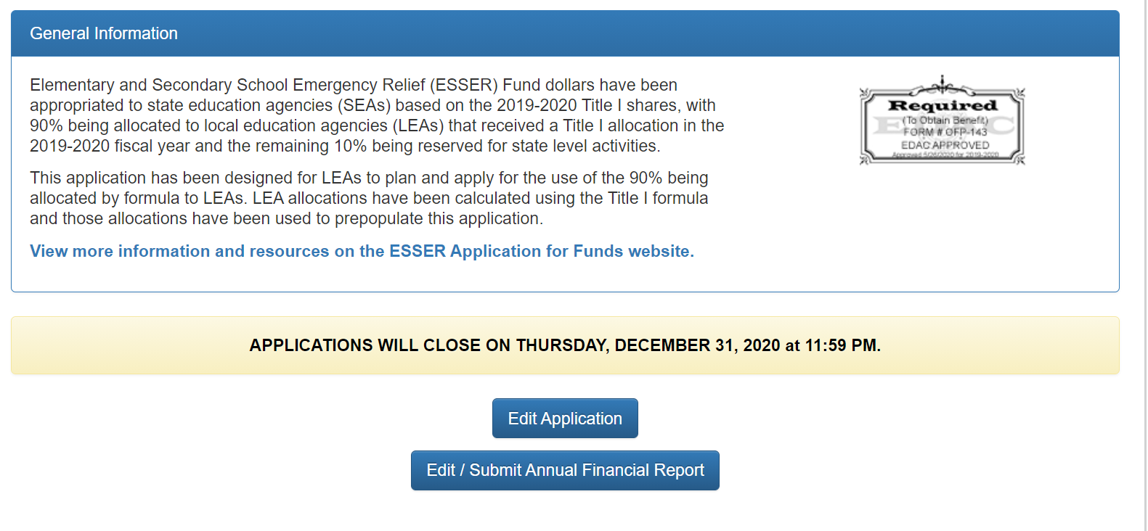
ESSER AFR

Slide 57
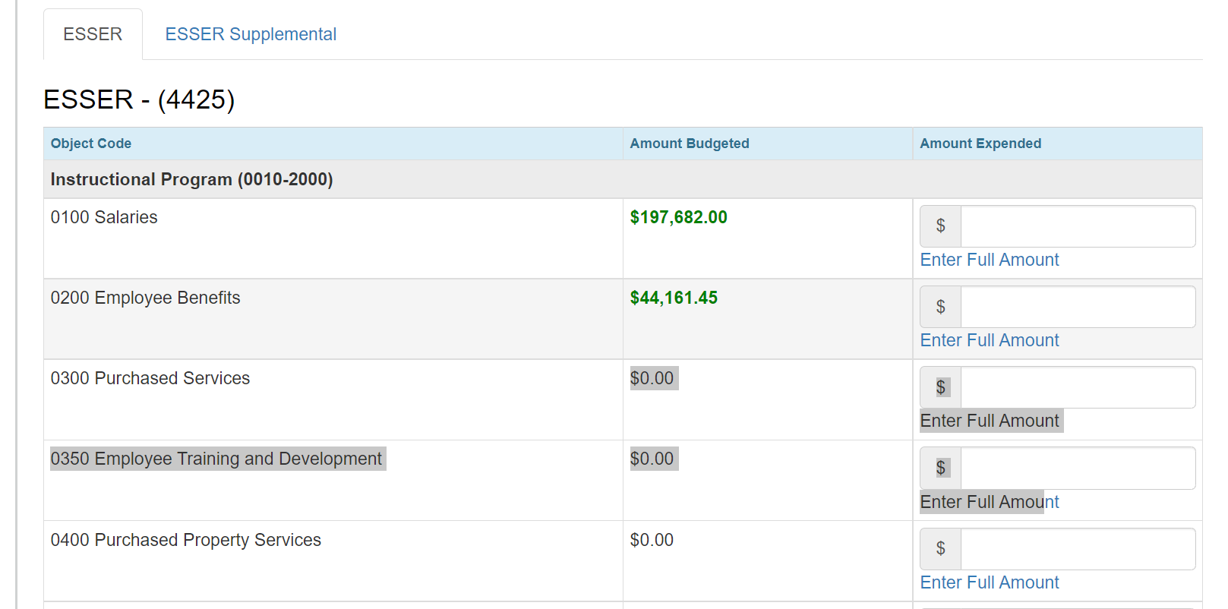
Completing the ESSER AFR

Slide 58
Frequently Asked Questions
Does the ESSER budget need to match the amount being entered into the AFR?
  No. LEAs should be reporting actual expenses that incurred from March 2020 – June 31, 2021.
What expenses should I report in the AFR?
  Report the actual expenses that incurred from the time of the grant award through June 30, 2021.
What about the ESSER II and ESSER III expenditures? Where do I report those?
  ESSER II expenditures will be reported on the AFR that is due on September 30, 2022, and ESSER III actual expenses will be reported on the AFR that is due on September 30, 2023.

Slide 59
Frequently Asked Questions cont.
I’ve submitted my PAR/Carryover request and now I cannot see the ESSER AFR link. How do I get access to the AFR?
  While the PAR/Carryover application is under review, the AFR link is not available. Once the application review is complete, the AFR link will become available again. You may want to complete the AFR first before submitting the PAR/Carryover request.
When is the ESSER AFR due?
  The ESSER AFR is due on October 29, 2021
If I have questions about the ESSER AFR, who do I contact?
  Steven Kaleda Kaleda_s@cde.state.co.us
  Robert Hawkins Hawkins_r@cde.state.co.us

Slide 60
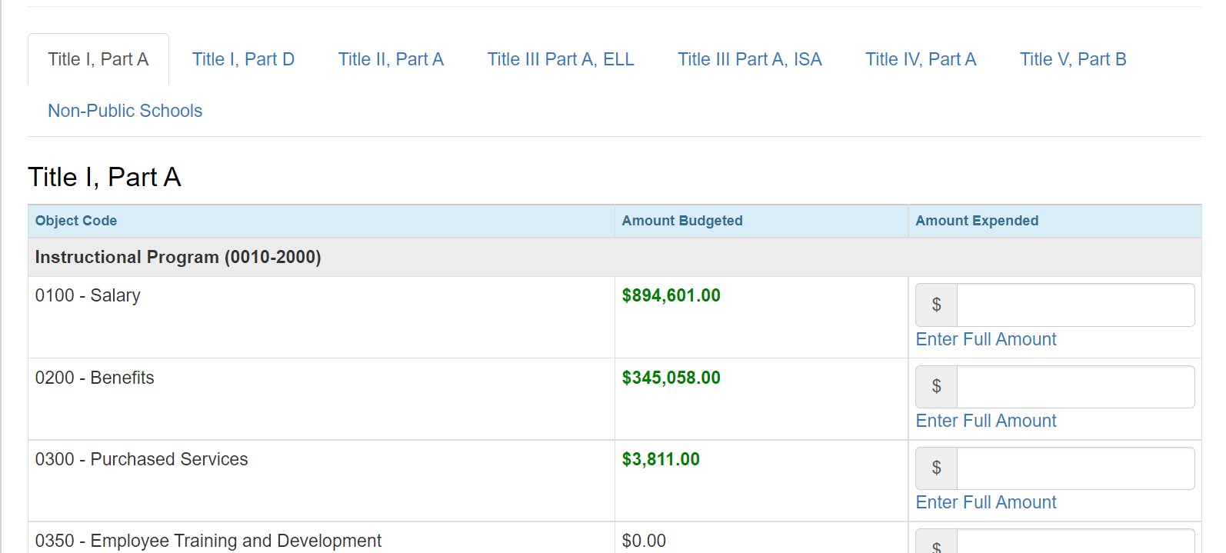
Consolidated Application AFR

Slide 61
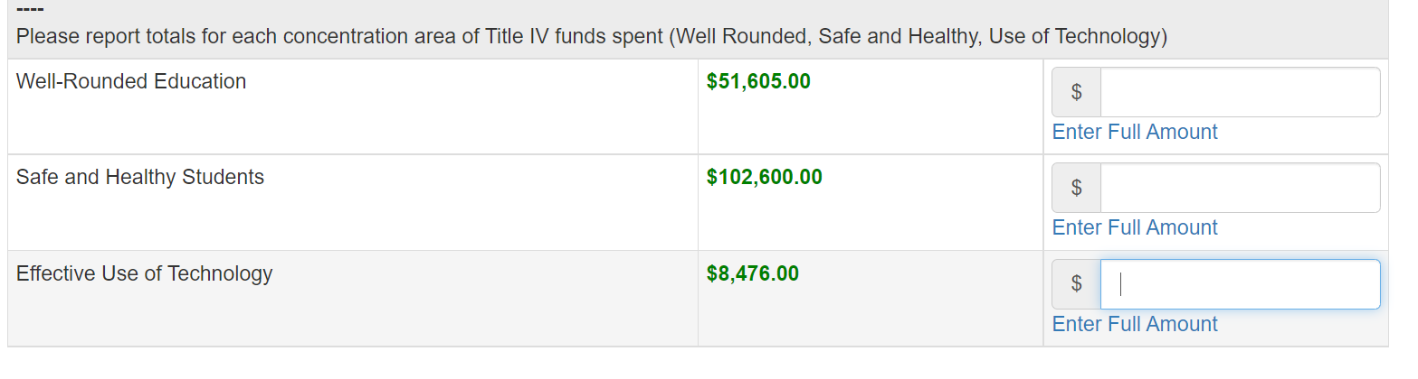
Title IV Collection

Slide 62
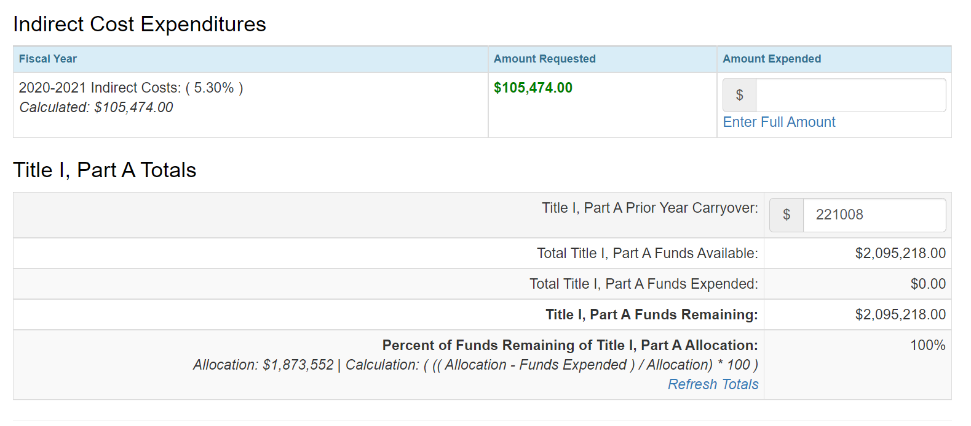
Consolidated Application AFR cont.

Slide 63
Consolidated Application AFR Frequently Asked Questions
When is the Consolidated Application AFR due?
  November 15, 2021
If I have questions about the Consolidated Application AFR, who do I contact?
  Steven Kaleda Kaleda_s@cde.state.co.us
  Robert Hawkins Hawkins_r@cde.state.co.us

Slide 64
Updates and Reminders

Slide 65
Updates
Based on the USDE’s Guidance, CDE has prepared a list of high-poverty schools to submit for Maintenance of Equity reporting. The list will be posted on the CDE website by Monday.
Emails sent to ESSER contacts! Please review the list and let us know if any changes are needed as soon as possible.

Slide 66
Reminders
Placeholders must be revised through the Post Award Revision process prior to drawing down funds.
Principal discretionary and/or school level allocations ~ responsibility of LEA to ensure that all applicable statutory and regulatory requirements are met, including ensuring that activities are allowable, reasonable, and allocable.

Slide 67

Any Requests for Upcoming Topics or Questions!

Slide 68
Thank you!
We’ll See You Next Week!

Slide 69
CDE Team!
CDE Contacts!
Emails: LastName_FirstInital@cde.state.co.us
ESSER/ESEA Program Partners
Nazie Mohajeri-Nelson, Director of ESEA Office (mohajeri-nelson_n@cde.state.co.us)
DeLilah Collins, Assistant Director of ESEA Office (collins_d@cde.state.co.us)
ESEA Regional Contacts assigned by district
  Title I: Laura Meushaw, Kathryn Wisner, Niko Kaloudis
  Title II: Niko Kaloudis
  Title III: Lorenzo Moreno, Kathryn Wisner
  Title IV: Tammy Giessinger, Michelle Prael
  Title V: Kristen Collins
ESSER Team
  Kristin Crumley, ESSER Monitoring Specialist (Crumley_k@cde.state.co.us)
  Jonathan Schelke, ESSER Monitoring Specialist (schelke_j@cde.state.co.us)
  Shannon Wilson, ESSER/ESEA Grants Administration Coordinator (Wilson_s@cde.state.co.us)
  Mackenzie Owens, ESSER Reporting Specialist (owens_m@cde.state.co.us)
Data, Accountability, Reporting, and Evaluation
  Tina Negley, Alan Shimmin, Mary Shen, and Mackenzie Owens
Fiscal Partners
Jennifer Okes, Chief Operating Officer (okes_j@cde.state.co.us)
Kate Bartlett, Executive Director of School District Operations (Bartlett_k@cde.state.co.us)
Jennifer Austin, Director of Grants Fiscal Management (Austin_j@cde.state.co.us)
Robert Hawkins, Grants Fiscal Analyst (Hawkins_s@cde.state.co.us)
Steven Kaleda, Grants Fiscal Analyst (Kaleda_s@cde.state.co.us)
ESSER Team
  Bill Parsley, ESSER Fiscal Monitoring Supervisor (parsley_w@cde.state.co.us)
  Hilery Morris, ESSER Fiscal Monitoring (morris_h@cde.state.co.us)
  Sharon Mackey, ESSER Fiscal Monitoring (mackey_s@cde.state.co.us)

