Slide 1
Program Requirement for the
Implementation of Funds - GEPA

Slide 2
Training Overview
Overview of GEPA Statement
Federal Statute
Demonstration of Compliance
Examples of Evidence

Slide 3
ID 9.9 Implementation of Funds - GEPA
ID 9.9 Implementation of Funds - GEPA | § 1112(c)(3)
Statutory Indicator The LEA will meet the requirements of section 442 and section 427 of the General Education Provisions Act (GEPA, 20 U.S.C. 1232(e) & 1228(a)). | Demonstration of Compliance Documentation that the district is implementing the steps outlined in the GEPA statement to ensure equitable access to, and participation in, its federally-assisted programs for students, teachers, and other program beneficiaries with special needs and that each program has been administered in accordance with applicable statutes and regulations. GEPA statement(s) outlining the steps the LEA will take to overcome any barriers to ensure that teachers and students have equitable access to programs and opportunities provided with federal grant funds. Examples of Evidence Information from a comprehensive needs assessment process or UIP that was used to develop a GEPA response describing the steps the LEA has taken to overcome any barriers that impede equal access or participation in federally funded activities. Narrative explaining how, when and by whom the steps are being implemented Additional documentation could include: An employee handbook/how to manual for implementing the steps outlined in the GEPA statement Job description of the individual(s) responsible for implementation of the action steps outline in the GEPA statement Meeting agenda/notes regarding the implementation of action steps outlined in the GEPA statement

Slide 4
Overview of GEPA Statement

Slide 5
General Education Provisions Act (GEPA) Requirement
General Education Provisions Act (GEPA)
“Based on local circumstances, you should determine whether these or other barriers may prevent your students, teachers, etc. from such access or participation in, the Federally-funded project or activity. The description in your application of steps to be taken to overcome these barriers need not be lengthy; you may provide a clear and succinct description of how you plan to address those barriers that are applicable to your circumstances. …
In designing your projects, applicants for Federal funds address equity concerns that may affect the ability of certain potential beneficiaries to fully participate in the project and to achieve to high standards. Consistent with program requirements and its approved application, an applicant may use the Federal funds awarded to it to eliminate barriers it identifies.”
https://www2.ed.gov/fund/grant/apply/appforms/gepa427.pdf

Slide 6
What is a GEPA Statement?
GEPA Statement IS: | GEPA Statement is NOT:
A description of potential barriers or challenges in accessing federally-funded programs A summary of the steps that an LEA/applicant is taking to ensure equity of access and participation in grant programs Focus on historically underserved categories such as race, gender, national origin, color, disability, or age Something that can be updated each time a federal program application needs to be completed | A request for approval of funding of specific activities Based solely on an LEA’s vision, mission, or equity statement

Slide 7
Federal Statute

Slide 8
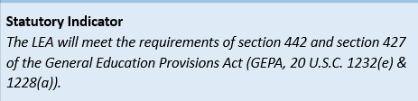
Statutory Requirements
Section 442: Provision says that LEA will sign off on assurances in the application for funds. CDE already has this on file.
Section 427: Ensure that all students and staff have equitable access to federally funded programs.

Slide 9
Demonstration of Compliance

Slide 10
Demonstration of Compliance
GEPA statement identifying potential barriers or challenges in accessing federally-funded programs and the steps that an LEA/applicant is taking to ensure equity of access and participation in grant programs
Evidence or narratives provided must explain how the GEPA statement was implemented.

Slide 11
Examples of Evidence

Slide 12
Review GEPA Selection(s) in Applications
Review GEPA Selection(s) in Applications of Programs being Monitored
Using ESSER Funds to support GEPA?
Using ESEA Funds to support GEPA?
No
Yes
No
Provide evidence to show how steps are being implemented in addition to expenditure detail
Provide evidence to show how steps are being implemented
ConsApp GEPA Used
New/Updated GEPA in ESSER
GEPA will be reviewed in ESEA monitoring
Provide evidence to show how steps are being implemented

Slide 13
ESSER GEPA Statement Example (I, II, III)
ESSER I:
The GEPA statement provided through the 2019-2020 Consolidated Application has been updated to include steps the LEA will take to permit students, teachers, and other program beneficiaries to overcome barriers that impede equal access to, or participation in, programs funded with federal funds and should reflect the information listed below:
Barrier Description: The Example School District has identified a lack of access to technology devices and services as well as a lack of cultural competency in instruction, specifically in regard to the social, emotional, and academic success of its free & reduced learners, as a root cause of low student achievement. The LEA will provide one to one devices for all students K-12 as well as professional development opportunities for teachers to address online instruction and culturally responsive instructional practices. How will LEA mitigate barriers? Example will assistant families in obtaining access and acquiring funding for internet access to support remote learning and technology needs. Consistent progress monitoring will determine instructional direction. Current practices include awareness of the home culture including personal hygiene, scholarships for students in need and additional support in time and mental health counseling. Academic strategies include CITW Strategies and Kagan Strategies. Funds to support these activities: State Local funds
Notes:
Note these examples are from same district.

Slide 14
ESSER GEPA Statement Example (I, II, III)
ESSER II:
The GEPA statement provided through the 2019-2020 or 2020-2021 Consolidated Application has been updated to include steps the LEA will take to permit students, teachers, and other program beneficiaries to overcome barriers that impede equal access to, or participation in, programs funded with these federal funds and should reflect the information listed below:
Barrier Description: The Example School District has identified a lack of access to instruction, training, and services related to mental health support as well as the social, emotional, and academic success of its free & reduced learners, as a root cause of low student achievement. The LEA will provide training for staff and designate personnel to support students who need access to tiered interventions for mental health as well as social emotional learning. All K-12 students as well as staff will receive specific instruction and professional development opportunities to address the impact of the COVID-19 pandemic on academics as well as other cultural issues impacting students today. The District will also work to ensure proper social distancing and a safe and healthy learning environment. How will LEA mitigate barriers? To ensure equal access, Example will provide personnel directly or support students in accessing the support needed for mental and social emotional health. Technology will be provided for virtual meetings as approved. The facility and transportation will be updated to provide the safest environment possible for physical health and emotional well being. MTSS and interventions will be implemented for students who have demonstrated a learning loss due to the COVID-19 pandemic. Example will assist families in obtaining access and acquiring funding for internet access to support remote learning and technology needs. Consistent progress monitoring will determine instructional direction. Current practices include awareness of the home culture including personal hygiene, scholarships for students in need and additional support and mental health counseling. Academic strategies include CITW Strategies and Kagan Strategies. Funds to support these activities: State Local funds
Notes:
Note these examples are from same district.

Slide 15
ESSER GEPA Statement Example (I, II, III)
ESSER III:
The following describes the steps the LEA will take to permit students, teachers, and other program beneficiaries to overcome barriers that impede equal access to, or participation in, programs funded with ARP ESSER III Funds.
Barrier Description: The Example School District has identified a lack of access to instruction, training, and services related to mental health support as well as the social, emotional, and academic success of its free & reduced learners, as a root cause of low student achievement. The LEA will provide training for staff and designate personnel to support students who need access to tiered interventions for mental health as well as social emotional learning. All K-12 students as well as staff will receive specific instruction and professional development opportunities to address the impact of the COVID-19 pandemic on academics as well as other cultural issues impacting students today. The District will also work to ensure proper social distancing and a safe and healthy learning environment. How will LEA mitigate barriers? To ensure equal access, Example will provide personnel directly or support students in accessing the support needed for mental and social emotional health. Technology will be provided for virtual meetings as approved. The facility and transportation will be updated to provide the safest environment possible for physical health and emotional well being. MTSS and interventions will be implemented for students who have demonstrated a learning loss due to the COVID-19 pandemic. Example will assist families in obtaining access and acquiring funding for internet access to support remote learning and technology needs. Consistent progress monitoring will determine instructional direction. Current practices include awareness of the home culture including personal hygiene, scholarships for students in need and additional support and mental health counseling. Academic strategies include CITW Strategies and Kagan Strategies.
Notes:
Note these examples are from same district.

Slide 16
Review GEPA Selection(s) in Applications
Review GEPA Selection(s) in Applications of Programs being Monitored
Using ESSER Funds to support GEPA?
Using ESEA Funds to support GEPA?
No
Yes
No
Provide evidence to show how steps are being implemented in addition to expenditure detail
Provide evidence to show how steps are being implemented
ConsApp GEPA Used
New/Updated GEPA in ESSER
GEPA will be reviewed in ESEA monitoring
Provide evidence to show how steps are being implemented

Slide 17
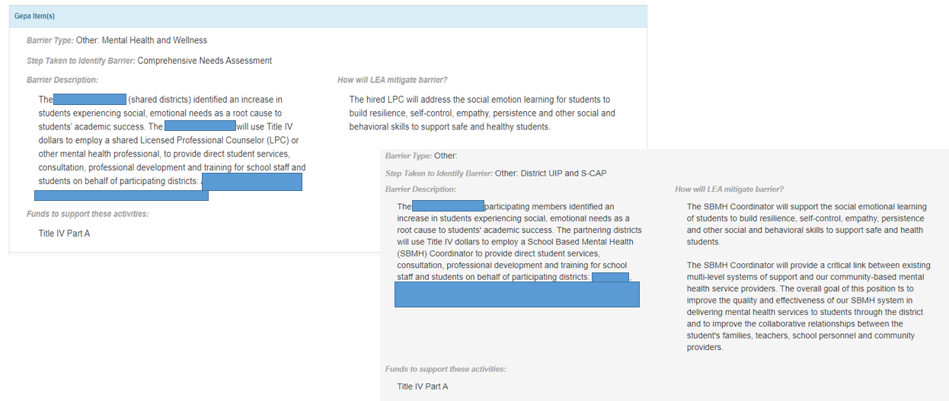
ESSER GEPA Statements: Selecting 19-20 or 20-21 Cons. App.

Slide 18
Review GEPA Selection(s) in Applications
Review GEPA Selection(s) in Applications of Programs being Monitored
Using ESSER Funds to support GEPA?
Using ESEA Funds to support GEPA?
No
Yes
No
Provide evidence to show how steps are being implemented in addition to expenditure detail
Provide evidence to show how steps are being implemented
ConsApp GEPA Used
New/Updated GEPA in ESSER
GEPA will be reviewed in ESEA monitoring
Provide evidence to show how steps are being implemented

Slide 19
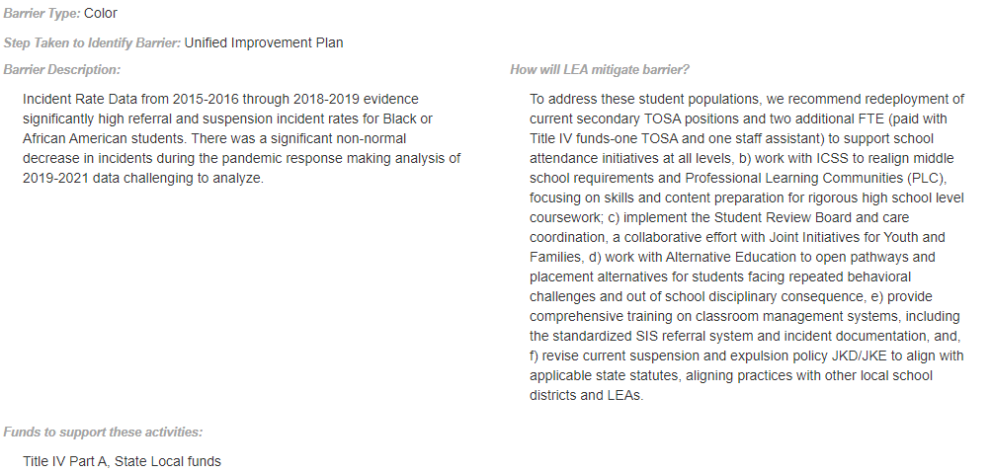
ESEA GEPA Statement: Example 1

Slide 20
Review GEPA Selection(s) in Applications
Review GEPA Selection(s) in Applications of Programs being Monitored
Using ESSER Funds to support GEPA?
Using ESEA Funds to support GEPA?
No
Yes
No
Provide evidence to show how steps are being implemented in addition to expenditure detail
Provide evidence to show how steps are being implemented
ConsApp GEPA Used
New/Updated GEPA in ESSER
GEPA will be reviewed in ESEA monitoring
Provide evidence to show how steps are being implemented

Slide 21
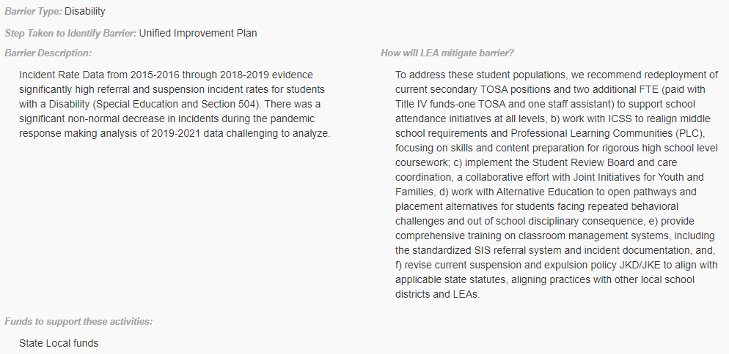
ESEA GEPA Statement: Example 2

Slide 22
Review GEPA Selection(s) in Applications
Review GEPA Selection(s) in Applications of Programs being Monitored
Using ESSER Funds to support GEPA?
Using ESEA Funds to support GEPA?
No
Yes
No
Provide evidence to show how steps are being implemented in addition to expenditure detail
Provide evidence to show how steps are being implemented
ConsApp GEPA Used
New/Updated GEPA in ESSER
GEPA will be reviewed in ESEA monitoring
Provide evidence to show how steps are being implemented

Slide 23
ESEA GEPA Statement: Example 1
Examples of Evidence:
-Job descriptions for TOSA
-Job description for staff assistant
-Samples of PLC work products, notes, agendas, or other documentation that shows what work was done to overcome barriers
-Samples of documentation showing work done with AEC
-Documentation of trainings implemented for behavior management
-Copy of revised policies

Slide 24
Monitoring Resources
Monitoring Resources
Federal Programs Monitoring Webpage
Trainings Page
Monitoring Schedule
Programs Requirement Document

Slide 25
Contacts
If you have any questions, contact:
Your regional contact
ESEA monitoring leads
ESSER monitoring leads

