Slide 1
Interpreting EDT Data Workshop
Training #2 in the EDT Series
Notes:
RUNTIME: did in 2 hours, closer to 2.5 ideally
Niko leads speaking

Slide 2
Upcoming Training
Equitable Distribution of Teachers Series Training #2: Interpreting EDT Data Workshop
This training will guide LEAs through reading and then interpreting their annual EDT data from CDE. LEAs will then draw actionable conclusions about how equitably minority students and students of poverty are being served in their schools.
Target Audience: LEAs with 1,000+ students and more than 1 school per grade span (district leadership, HR, hiring managers, principals)
Prep: LEAs will need access to their 20-21 EDT data from Syncplicity.
Date: January 25, 2022
Time: 1-3pm
Register HERE
Agenda
Reading District Level Data
Small vs Med/Large Gaps
Reading School Level Data
Common “Ah-has”
LEA Specific Analyses & Realizations
Contact Wilson_S@cde.state.co.us for any logistics questions or Kaloudis_N@cde.state.co.us with questions about the training.

Slide 3
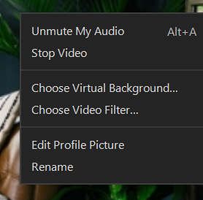
Introductions
Niko Kaloudis - ESEA Title I & II Specialist
Tina Negley - DARE Coordinator
Please change your name to your preferred name by right clicking your image. Consider including your LEA and any preferred pronouns.

Slide 4

Objectives
LEA staff will be able to:
Access 20-21 EDT data.
Differentiate between small vs medium/large EDT gaps.
Read both the district and school level EDT data.
Draw conclusions from EDT data about the distribution of experienced, in-field, and effective teachers in their district/schools.
Better articulate their LEAs EDT data to stakeholders.

Slide 5
About this Training
We will follow a workshop model.
  Participation and engagement are crucial.
Parts of the training will be interactive.
  Participation and engagement are crucial.
You will need access to your LEA’s 20-21 EDT Data file.
  Excel file found in Syncplicity.
  Chat for help if you do not have access.
  Access comes from an email from Syncplicity itself (check junk/spam)
Notes:
We may stumble, so we appreciate your grace with any technical issues that come up.

Slide 6

Agenda
Training Norms
Grounding the Work
Reading District Level Data
Small vs Med/Large Gaps
LEA Specific Analyses & Realizations
Reading School Level Data
LEA Specific Analyses & Realizations

Slide 7

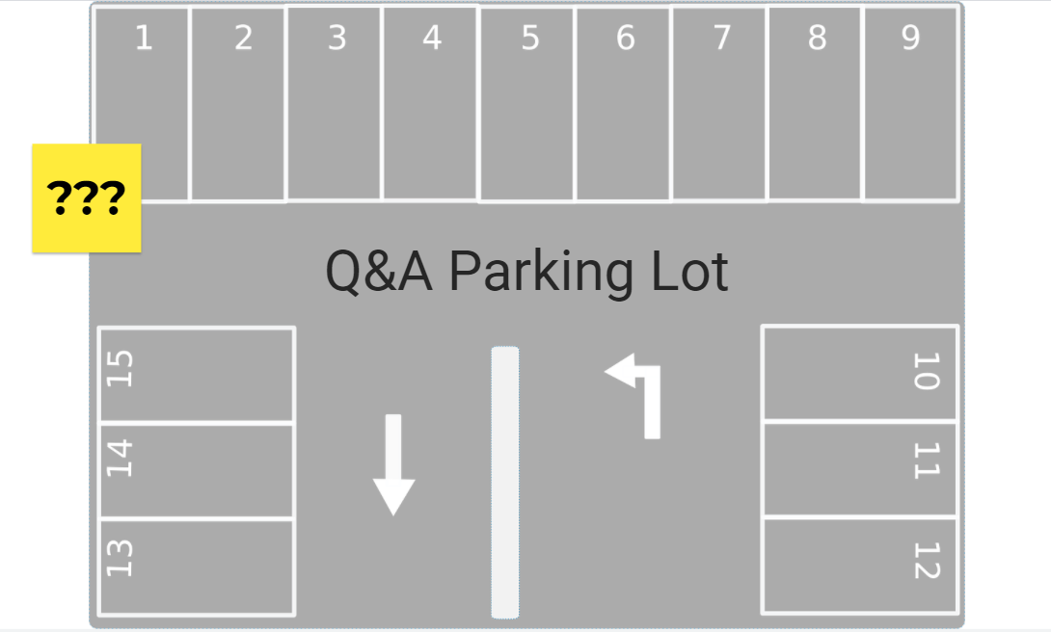
Training Norms
Participate fully.
Lean into discomfort; have a growth mindset.
Enter questions into the chat at any time or come off mute during question pauses.
Use the Jamboard Parking Lot for one-off questions (answered later).
Share the space with others in breakout rooms; invite people into the conversation.
Come on camera when speaking in large group and when in breakouts (whenever possible).
Notes:
Niko screen shares for Jamboard demo
Explain jamboard and using a sticky

Slide 8

Grounding the Work
Why talk about EDT now?
Annual requirement for Title I schools over 1,000 students and more than 1 school per grade span to address disparities. (ESSA)
Pandemic has heavily impacted the teacher workforce; more so for minority students and students of poverty.
EDT can help LEAs quantify the impacts of COVID and help LEAs address them.
Notes:
As we run EDT analyses during and after the COVID years, that data could be very useful and could be used in your comp needs assessments.

Slide 9
Prework
To get the most out of this training, you will need access to the following:
Your LEA’s 20-21 EDT Data file (from Syncplicity).
  Use the chat feature if you don’t have access to your LEA’s Syncplicity folder.
Optionally,
Access to local HR data pertaining to the experience, in-field status, and effectiveness of employees in 20-21 and 21-22.
Notes:
Other data may be useful in seeing the full picture of your EDT data. Historical data can help identify if a problem is persisting or lessening. Local data can ensure accuracy in reporting as well. Putting faces to the data is also beneficial.

Slide 10
Intro. to EDT

Slide 11
Poll Question
Q: How comfortable are you with interpreting EDT data from the annual data file?
1: Not Comfortable - I’ve never looked at it.
2: Slightly Comfortable - I’ve seen it but I need a lot of help making sense of it.
3: Somewhat Comfortable - I can read it and make some basic conclusions.
4: Comfortable - I can read it and interpret the data to make conclusions.
5: Very Comfortable - I can interpret the data, draw actionable conclusions, and explain it to others.

Slide 12
Overview of EDT
The Every Student Succeeds Act (ESSA) requires state education agencies (SEAs) to evaluate annually whether low-income and minority students are taught disproportionately by ineffective, out-of-field, or inexperienced teachers.
LEAs with 1,000+ students and more than 1 school per grade span receive data.
For more information on how EDT is calculated:
  EDT Series Training #1: Using Data to Inform Comparability & EDT
    PowerPoint | Recorded Webinar

Slide 13
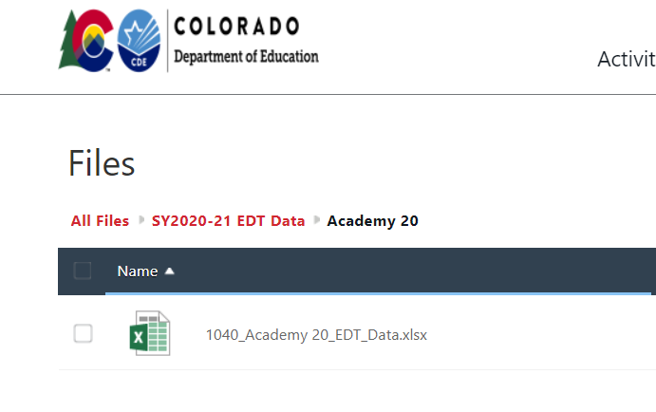

Accessing Your Data
Annual EDT files are sent out via Syncplicity to ConsApp Authorized Reps.
If you or your colleagues need access, please email kaloudis_n@cde.state.co.us.
The EDT Analysis excel data file is broken down into two tabs:
  District Level
  School Level
Notes:
Now would be a great times to pull up your EDT data file so you can follow along as Tina explains how to read the analyses.

Slide 14
Reading District Level Data
Notes:
Tina leads these slides

Slide 15
Purpose
Gain a better understanding of the distribution of experienced, in-field, and effective teachers within your district
Learn to identify potential disparities between low minority/poverty schools and high minority/poverty schools

Slide 16
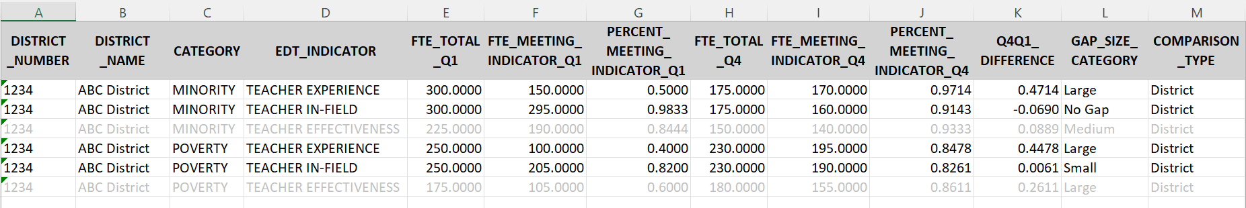
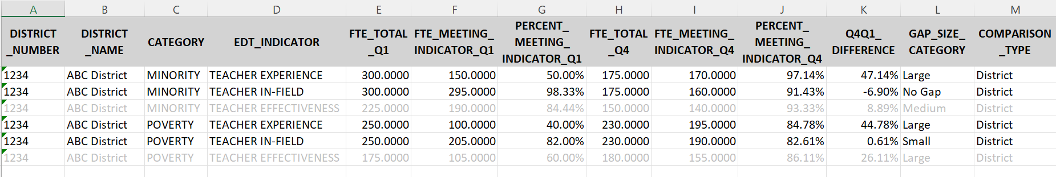
District Level Tab TIPS
Highly suggest selecting the following columns and changing the formatting to %s:
  Column G - PERCENT_MEETING_INDICATOR_Q1
  Column J - PERCENT_MEETING_INDICATOR_Q4
  Column K - Q4Q1_DIFFERENCE

Slide 17
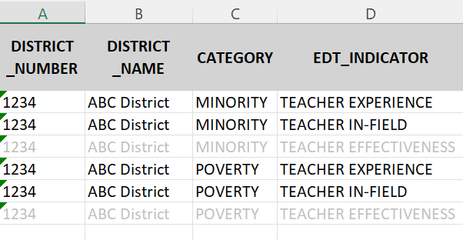
Descriptive Data Fields
DISTRICT_NUMBER
DISTRICT_NAME
CATEGORY - Indicates the student group of interest: minority students or students experiencing poverty
EDT_INDICATOR - Indicates the EDT indicator of interest: teacher experience, teacher in-field status, or teacher effectiveness (learn more here)

Slide 18
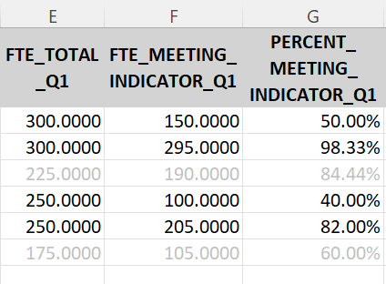
Quartile 1 (Highest Poverty/Minority Schools) Data Fields
FTE_TOTAL_Q1 - Total FTE of teachers in Quartile 1 schools
FTE_MEETING_INDICATOR_Q1 - FTE of teachers in Quartile 1 schools that meet the EDT Indicator of interest (i.e., teachers that are experienced, in-field, or effective)
PERCENT_MEETING_INDICATOR_Q1 - Percentage of FTE in Quartile 1 schools that meet the EDT Indicator of interest
  FTE_MEETING INDICATOR_Q1 / FTE_TOTAL_Q1
To learn more about EDT Quartiles and how they’re calculated, click here.

Slide 19
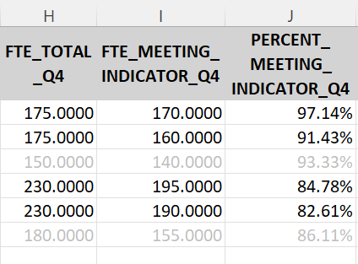
Quartile 4 (Lowest Poverty/Minority Schools) Data Fields
FTE_TOTAL_Q4 - Total FTE of teachers in Quartile 4 schools
FTE_MEETING_INDICATOR_Q4 - FTE of teachers in Quartile 4 schools that meet the EDT Indicator of interest (i.e., teachers that are experienced, in-field, or effective)
PERCENT_MEETING_INDICATOR_Q4 - Percentage of FTE in Quartile 4 schools that meet the EDT Indicator of interest
  FTE_MEETING INDICATOR_Q4 / FTE_TOTAL_Q4
To learn more about EDT Quartiles, click here.
To learn more about EDT Quartiles and how they’re calculated, click here.

Slide 20
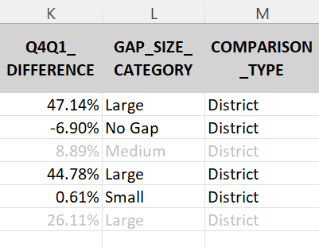
Comparison Data Fields
Q4Q1_DIFFERENCE - Difference between the percentage meeting the EDT Indicator in Quartile 4 schools compared to Quartile 1 schools:
  PERCENT_MEETING_INDICATOR_Q4 – PERCENT_MEETING_INDICATOR_Q1
GAP_SIZE_CATEGORY - Indication of the magnitude of the gap between Quartile 4 and Quartile 1 schools (e.g., No Gap, Small Gap, Medium Gap, Large Gap)
COMPARISON_TYPE - Indication of whether a district’s Quartile 1 schools were compared to Quartile 4 schools within the district (District comparison) or to the statewide average for Quartile 4 schools (State comparison)
BIG TAKEAWAY

Slide 21
Poll Question
Q: Quartile 1 (Q1) schools are schools that have the _______ percentage of minority students or students in poverty.
A: highest

Slide 22
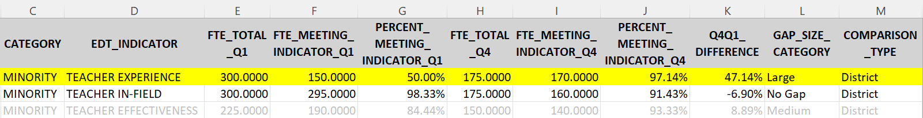
District Level Example - District Comparison
Analysis: Teacher Experience in Low (Q4) vs. High (Q1) Minority Schools
  Total of 300 FTE across all Q1 schools in the district, of which 150 FTE met the criteria for experience (50.00% experienced)
  Total of 175 FTE across all Q4 schools in the district, of which 170 FTE met the criteria for experience (97.14% experienced)
  Low minority (Q4) schools have a higher percentage of experienced teachers than high minority (Q1) schools, therefore minority students are being disproportionately taught by inexperienced teachers.
    There is a gap of 47.14 percent (97.14 – 50.00)

Slide 23
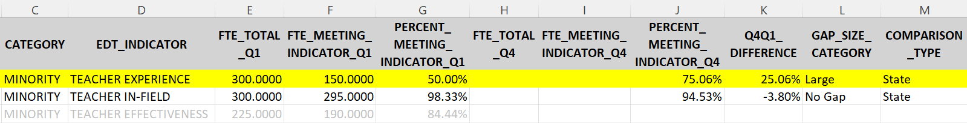
District Level Example - State Comparison
Analysis: Teacher Experience in Low (Q4) vs. High (Q1) Minority Schools
  Total of 300 FTE across all Q1 schools in the district, of which 150 FTE met the criteria for experience (50.00% experienced)
  District does not have any Q4 schools; instead, the statewide average for all Q4 schools is used (75.06% experienced)
  Low minority (Q4) schools in the state have a higher percentage of experienced teachers than the high minority (Q1) schools in the district, therefore minority students are being disproportionately taught by inexperienced teachers.
    There is a gap of 25.06 percent (75.06 – 50.00)

Slide 24
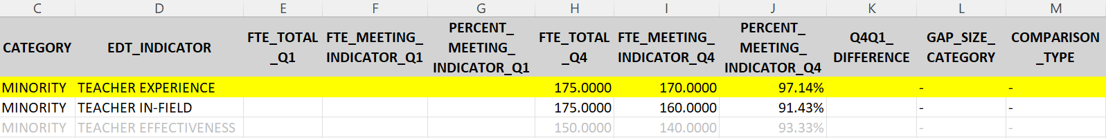
District Level Example - No Q1 schools
If a district does not have any Q1 schools (lowest minority/poverty):
  Quartile 1 data fields will be blank
  Q4 vs. Q1 comparison data will not be calculated

Slide 25
Poll Question
Q: If the number in the Q4Q1_DIFFERENCE column is negative, that means ______.
A: No gap exists - high minority/poverty schools (Q1) are being served by a greater percentage of in-field, experienced, or effective teachers

Slide 26
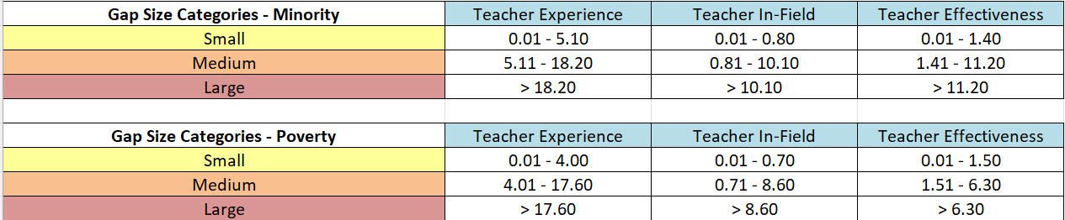
Determining Gap Sizes
In addition to the Q4 vs. Q1 difference, the district-level dataset also shows the magnitude of the gap (GAP_SIZE_CATEGORY)
  CDE developed gap size categories by establishing cut points based on the distribution of gaps, using 2017-18 percentiles as a baseline for Teacher Experience and Teacher In-Field, and 2018-19 percentiles as a baseline for Teacher Effectiveness

Slide 27
Gap Size Example
In this example, there is a gap of 47.14% between low (Q4) and high (Q1) minority schools in the district, in regards to teacher experience
  Comparing this to the cut points established, this reflects a Large gap (> 18.20%)

Slide 28
Small vs Medium/Large Gap
Gap sizes are used to identify what next steps a district needs to take
LEAs with small gaps must:
  Develop a plan to address the gaps.
  Maintain the plan locally for monitoring.
LEAs with medium or large gaps must:
  Develop a plan to address the gaps.
  Submit the plan to CDE by answering the 5 questions in the Consolidated Application.
Learn more about this in the next two EDT series trainings!
Notes:
Niko starts talking

Slide 29
Poll Questions
Q: Districts with identified _______ gaps must create an EDT Plan to address those disparities. (select all that apply)
A: Small, Medium, Large
Q: Districts with identified _______ gaps must submit their EDT Plan to CDE through the Consolidated Application. (select all that apply)
A: Medium, Large

Slide 30
LEA Workshopping
Round 1
Notes:
Niko leads speaking

Slide 31
Breakouts for Activity
If you want a CDE person to hop into your room, have someone go back to the main room and chat us.
Main Room
  Tech issues; help with Zoom
Rooms 1 (most support)
  CDE staff to help with quick LEA technical questions
  Help understanding the spreadsheet
Rooms 2-11 (some support)
  Districts to collaborate with other districts or their own team
  CDE popping in & out to answer questions
Parking Lot - Jamboard Slide 1
  Specific questions about EDT (wide range questions)
If your team needs an additional breakout room, let us know in the main room.
Notes:
Review next two slides too before starting breakout rooms.

Slide 32
Activity: Independent Work (5 minutes)
Complete this summary stem for at least one of the 20-21 district level EDT indicators:
District ABC - Our teacher experience indicator for minority students shows a small gap of 3%. This means that students in our Q4 schools have more access to experienced teachers than our Q1 schools.
Notes:
Message into all rooms at the end of 5 minutes

Slide 33
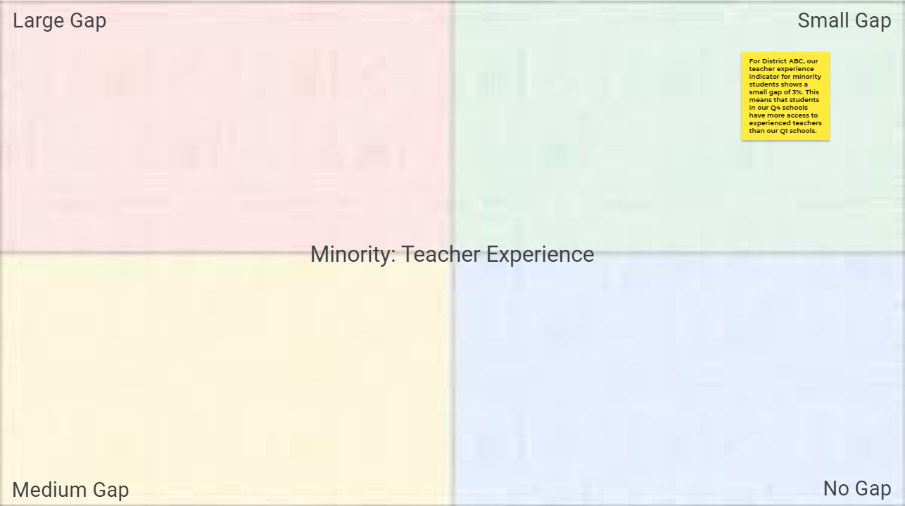
Activity: Breakout Room Discussion (15 minutes)
Review one of your indicator summaries with your group. Have them check your work by sharing your screen with your EDT excel file open.
Add your indicator summaries to the corresponding Jamboard slide for that indicator using a sticky note and placing it in the corresponding area. (slides 4-7)
Be ready to share out your thought process when making your summaries.
Notes:
Be sure to explain how to use jamboard.
Open breakout rooms after explaining this slide.
Message into all rooms a 5 minute warning.

Slide 34
Activity: Whole Group (5-10 minutes)
Review the 4 Jamboard slides.
What were some realizations that you had about EDT or your district’s data?

Slide 35
Do you feel like any of your data isn’t accurate?
CDE bases our EDT analyses off HR reporting data.
To learn more about ensuring submission of accurate data, watch training #1 of this EDT series.
Notes:
Tina starts presenting

Slide 36
Reading School Level Data
Notes:
Tina leads speaking

Slide 37
Purpose
Gain a better understanding of the distribution of experienced, in-field, and effective teachers within and between your schools
Identify which schools may be contributing to district-level gaps
Notes:
Remember to review school level data even if you don’t have any district level gaps

Slide 38
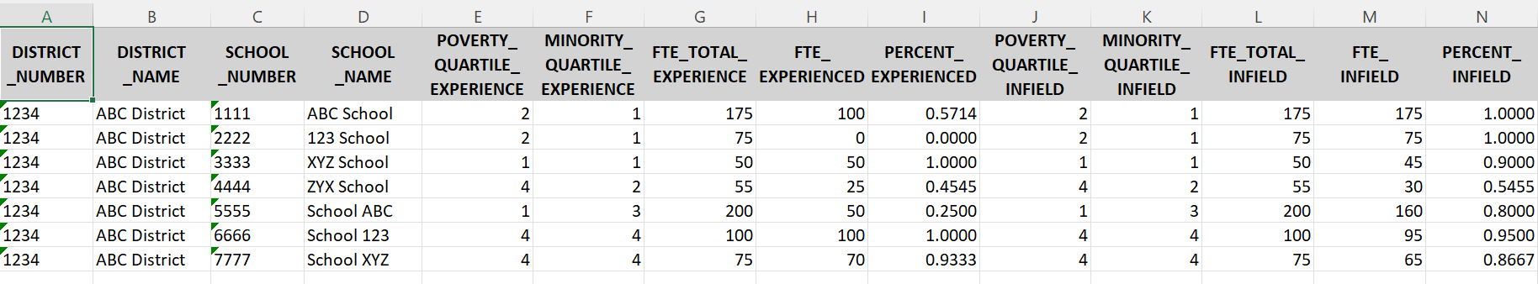
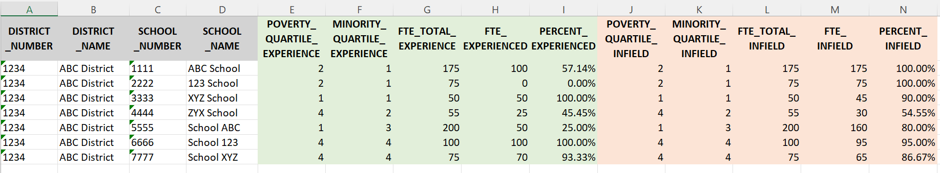
School Level Tab TIPS
Highly suggest selecting the following columns and changing the formatting to %s:
  Column I - PERCENT_EXPERIENCED
  Column N - PERCENT_INFIELD
Turn on filtering for the header row to help sort your schools.
Change the background color of columns E-I to be one color and J-N to be another.

Slide 39
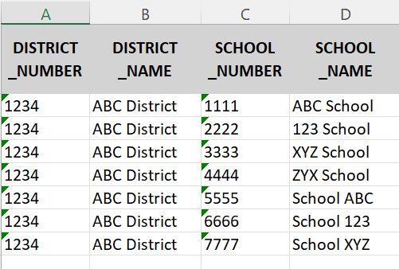
Descriptive Data Fields
DISTRICT_NUMBER
DISTRICT_NAME
SCHOOL_NUMBER
SCHOOL_NAME

Slide 40
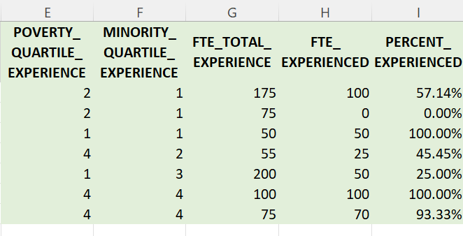
Teacher Experience Data Fields
POVERTY_QUARTILE_EXPERIENCE - Indication of the quartile in which the school is included for the poverty analyses
MINORITY_QUARTILE_EXPERIENCE - Indication of the quartile in which the school is included for the minority analyses
FTE_TOTAL_EXPERIENCE - Total FTE of teachers included for the Teacher Experience indicator
FTE_EXPERIENCED - FTE of teachers considered experienced
PERCENT_EXPERIENCED - Percentage of FTE considered experienced
  FTE_EXPERIENCED / FTE_TOTAL_EXPERIENCE
Notes:
Talk about difference in quartiles poverty vs. minority

Slide 41
Poll Question
Q: Can a school be in one quartile for a poverty indicator and in a different quartile for a minority indicator?
A: Yes

Slide 42
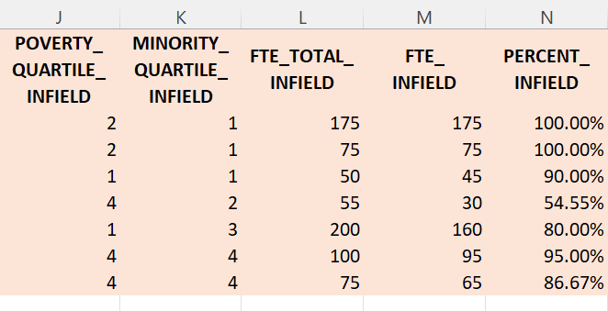
Teacher In-Field Data Fields
POVERTY_QUARTILE_INFIELD - Indication of the quartile in which the school is included for the poverty analyses
MINORITY_QUARTILE_INFIELD - Indication of the quartile in which the school is included for the minority analyses
FTE_TOTAL_INFIELD - Total FTE of teachers included for the Teacher In-Field indicator
FTE_INFIELD - FTE of teachers considered in-field
PERCENT_INFIELD - Percentage of FTE considered in-field
  FTE_INFIELD / FTE_TOTAL_INFIELD

Slide 43
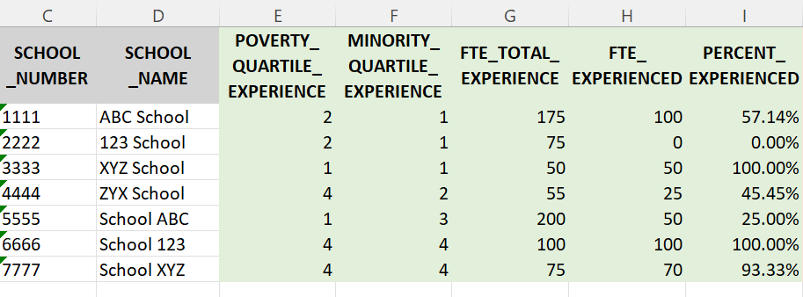
School Level Example - Understanding District Aggregations
Analysis: Teacher Experience in Low (Q4) vs. High (Q1) Minority Schools
175 + 75 + 50 = 300
100 + 0 + 50 = 150

Slide 44
School Level Example - Identifying Trends
Analysis: Teacher Experience in Low (Q4) vs. High (Q1) Minority Schools
Determine which schools may be contributing to this gap
Only 50% of teachers in Q1 schools are experienced, compared to 97.14% in Q4 schools
  ABC School only has 57.14% experienced teachers
  XYZ School has 100% experienced teachers
  123 School has 0% experienced teachers

Slide 45
LEA Workshopping
Round 2
Notes:
Niko leads speaking

Slide 46
Breakouts for Activity
If you want a CDE person to hop into your room, have someone go back to the main room and chat us.
Main Room
  Tech issues; help with Zoom
Rooms 1 (most support)
  CDE staff to help with quick LEA technical questions
  Help understanding the spreadsheet
Rooms 2-11 (some support)
  Districts to collaborate with other districts or their own team
  CDE popping in & out to answer questions
Parking Lot - Jamboard Slide 1
  Specific questions about EDT (wide range questions)
If your team needs an additional breakout room, let us know in the main room.
Notes:
Review next slide too before starting breakout rooms.

Slide 47
Activity: Guiding Questions for Breakout Rooms (15 minutes)
Review and discuss your data in breakout rooms by answering the following questions. Individuals or a group note taker should capture thoughts on the Jamboard slides 8-11 as sticky notes. (Feel free to sort and filter as you wish. It’s playtime!)
When you sort the schools by % experience, are there any patterns that you see?
When you sort the schools by % in-field, are there any patterns that you see?
Does your school level data seem like an accurate reflection of how you’ve perceived staffing at various schools?
What are some overall thoughts you have about your LEA’s EDT school level data?
(Are there individual schools whose data is concerning and may require action?)
Be prepared to share out your answers with the whole group.
Notes:
Open breakout rooms after slide
Give time reminder after 10 min.
Ask if they need any additional time after coming back from breakouts.

Slide 48
Next Steps

Slide 49
Next Steps
Reflect on internal systems/procedures for annually reviewing EDT data.
Discuss your LEA’s 20-21 EDT data with appropriate staff in your district.
Begin having conversations with key stakeholder groups (superintendent/leadership, school board, DAC, union, etc.) about conclusions that can be drawn from the data.
  EDT Stakeholder PPT Template
Prepare for action planning based off EDT realizations.
  Attend training #3 of this EDT series. (March/April)

Slide 50
Questions and Parking Lot
Any unanswered questions will be collected and responded to via email.

Slide 51
Closing

Slide 52

Upcoming Trainings
EDT Series Training #3: Implementing Changes Using EDT Data
Date: TBD Feb/March
EDT Series Training #4: Building an EDT Plan
Date: TBD April/May
*more info will be in the Beeline and in Office Hours

Slide 53
EDT Resources
EDT Website & FAQs
EDT Planning Guidance
Talent Systems Self-Assessment Tool & Instructions
Stakeholder Engagement PPT Template
Notes:
Useful resources for this stage in the process and if you want to start taking it a little further:
Explore this for additional tools and guidance
Gets into the whole EDT planning process, staring with looking at results and root causes then working to building your plan.
Helps evaluate your HR or talent system by guiding you through a rubric
Helps frame the EDT conversation with stakeholders (boards, DAC/SAC, staff, the public, etc)

Slide 54
Poll Question: Exit Ticket
Q: How comfortable are you with interpreting EDT data from the annual data file?
1: Not Comfortable - I’ve never looked at it.
2: Slightly Comfortable - I’ve seen it but I need a lot of help making sense of it.
3: Somewhat Comfortable - I can read it and make some basic conclusions.
4: Comfortable - I can read it and interpret the data to make conclusions.
5: Very Comfortable - I can interpret the data, draw actionable conclusions, and explain it to others.

Slide 55

Survey
With the remaining time, please make sure you complete the training evaluation survey.
Your feedback is appreciated!

Slide 56
Contact Information
For questions about EDT programmatic requirements:
Niko Kaloudis
kaloudis_n@cde.state.co.us (720) 284-4356
For questions about EDT data calculations:
Tina Negley
negley_t@cde.state.co.us (303) 866-5243
Notes:
Thank people for participating

