Slide 1
ESEA - February Virtual Training
Federal Programs Monitoring
February 15, 2022

Slide 2
Agenda
We will start each session on time
  We may take short breaks in between if time allows
Feel free to stay on for all three or leave and come back
Type questions in the chat or come off mute to interact
All recordings and slides will be posted on the RNM webpage after the meeting
9:00- 10:00 am | Consolidating Funds Schoolwide
10:00 - 11:00 am | Title III
11:00 am - 12:00 pm | Monitoring

Slide 3
Federal Programs Monitoring

Slide 4

The Monitoring Team
ESEA and ESSER Programs
Tammy Giessinger
Michelle Prael
Shannon Wilson
Kristin Crumley
Jonathan Schelke
Mackenzie Owens
Grants Fiscal
Bill Parsley
Hilery Morris
Sharon Mackey
Steven Kaleda
Robert Hawkins

Slide 5
Today’s Topics
Federal Programs Monitoring Overview
Program Requirements
Our Why for Today:
Many LEAs are not submitting sufficient documentation for CDE to review in their initial evidence submission. Our goal is to provide support before monitoring begins to save time by minimizing the need to submit additional documentation during the monitoring process.

Slide 6
Federal Programs Monitoring
Overview

Slide 7

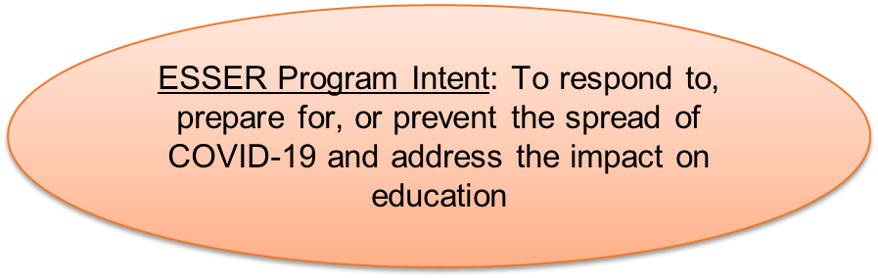
Purpose of Monitoring
•To ensure that federal funds are used appropriately to implement program intent

Slide 8
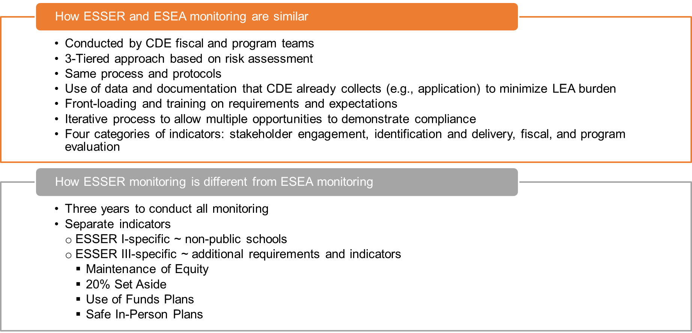
ESEA vs ESSER Monitoring

Slide 9
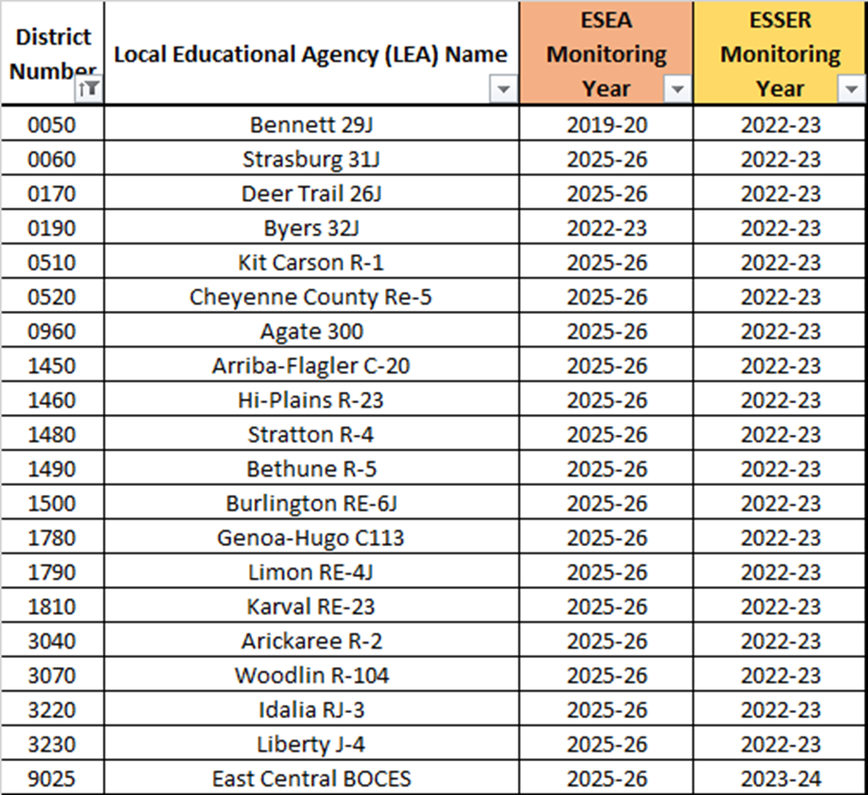
Monitoring Schedule
Monitoring Schedule for ESEA and ESSER is located on our Monitoring Website.
Notes:
LEAs should make sure to update contact information in applications when there are changes.

Slide 10
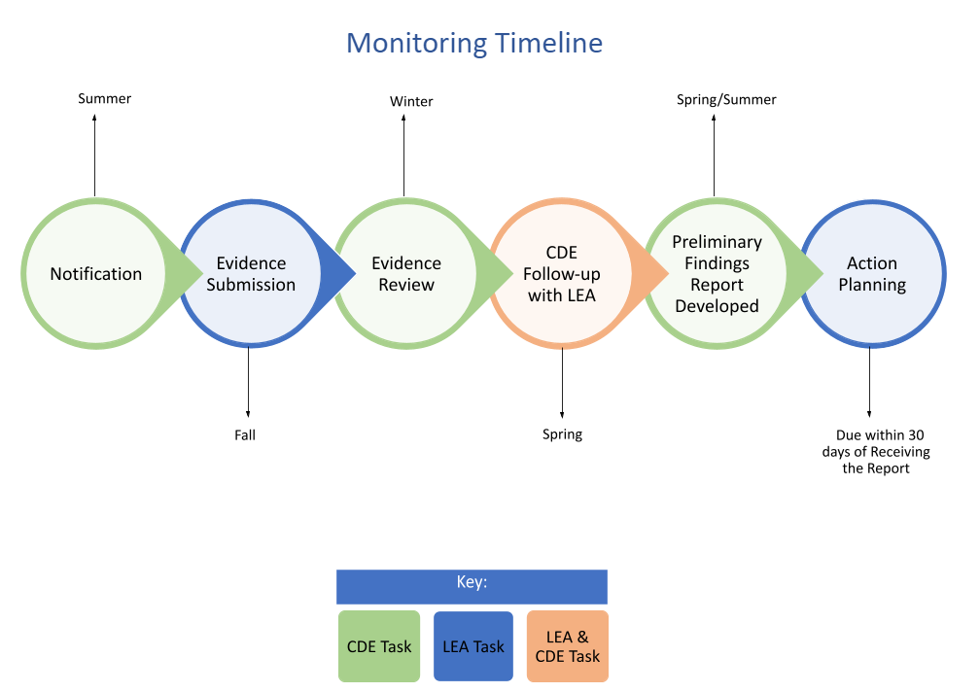
Monitoring Timeline

Slide 11
Program Requirements

Slide 12
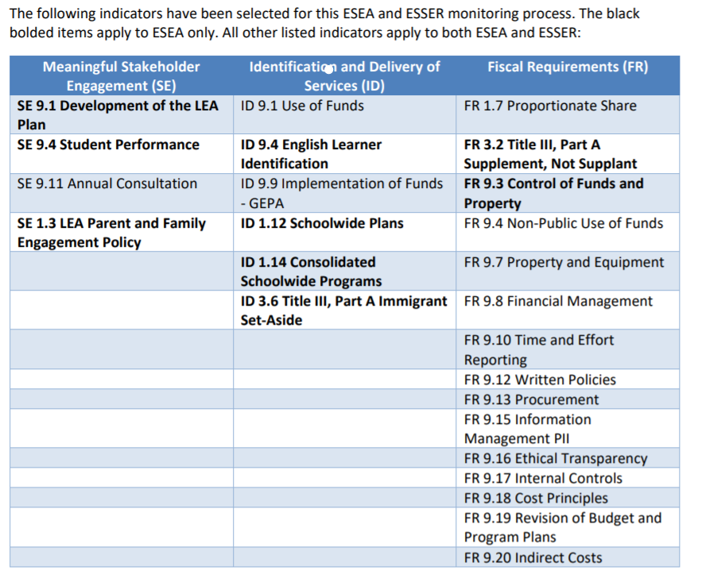
Notification Letter
●The process begins when LEAs receive the Monitoring Notification Letter.
●The notification letter will go to the Authorized Representatives designated in the Consolidated Application and/or ESSER Application(s).
●The letter will include the indicators the LEA is being monitored on for ESEA and/or ESSER (in most cases).
EXAMPLE
Notes:
LEAs should make sure to update contact information in applications when there are changes.

Slide 13
Indicator-Level Process Overview
For each indicator:
Review the statutory requirement(s) in the Program Requirements document.
Based on the Demonstration of Compliance, evaluate if your LEA is compliant with each checkbox.
Determine the evidence that needs to be submitted to demonstrate compliance. Refer to the examples of evidence for additional guidance.
Upload evidence into the folder for the specific indicator in Syncplicity.

Slide 14
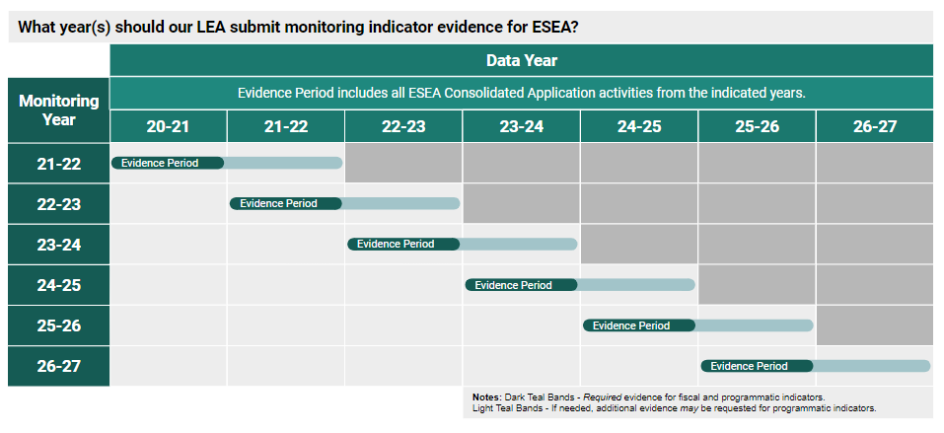
Evidence Year - ESEA

Slide 15
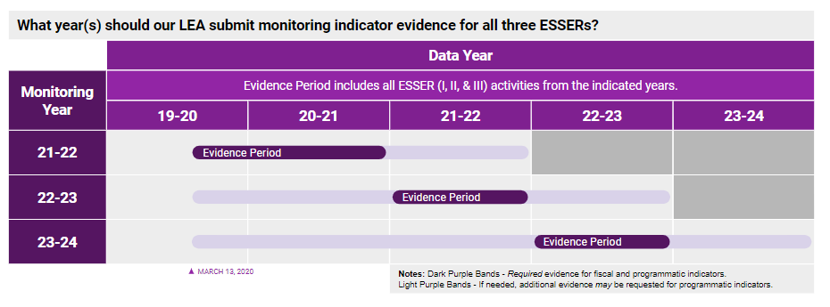
Evidence Year - ESSER

Slide 16
ID 9.1 Use of Funds

Slide 17
ID 9.1 Use of Funds
Statutory Indicator
ESEA:
All activities and expenditures align with those described in the approved LEA Plan, are reasonable, and allocable (necessary to meet the purpose of the grant, as outlined in each section of ESEA Titles I-V)
ESSER I:
All activities and expenditures align with those described in the approved ESSER I application and are in compliance with CARES Act Sec. 18003(d)(1-12).
ESSER II:
All activities and expenditures align with those described in the approved ESSER II application and are in compliance with CRSAA Sec. 313(d)(1-15).
ARP ESSER III:
All activities and expenditures align with those described in the approved ARP-ESSER III application and are in compliance with ARP Act Sec. 2001(e)(1) and 2001(e)(2)(A-J).
All ESSER-funded activities must also be reasonable and allocable (necessary to respond to, prepare for, or prevent the spread of COVID-19).
Demonstration of Compliance
Funds expended and activities implemented match the application for funds as approved by CDE.
Funded activities must be reasonable - based on a prudent person’s judgment, align with similar activities funded with other funds, align with fair market values for such items, with additional considerations made for the LEA’s geographical area and the accessibility of items, or be the most cost-effective way to implement such an activity/purchase such items.
For ESSER:
Activities must be allocable, meaning that funded activities or items were made necessary as a result of the COVID-19 pandemic and were necessary in order for the LEA to respond to, prepare for, or prevent the spread of COVID-19.
ESSER-funded activities were obligated within the performance period (on or after March 13, 2020) and prior to September 30, 2022 for ESSER I, prior to September 30, 2023 for ESSER II, and prior to September 30, 2024 for ARP-ESSER III.

Slide 18
Evidence to Submit
Expenditure detail report showing your actual purchases
Invoices for at least 30% of your purchases
  Submitting invoices at the beginning of the process will help you avoid a back-and-forth with CDE
NOTE: Evidence should show cost (reasonableness), what was actually purchased (allocability), and dates (within the performance period)
District Exemplar

Slide 19
SE 9.1 Development of the LEA Plan

Slide 20
SE 9.1 Development of the LEA Plan
Statutory Indicator
The LEA plan is developed through timely and meaningful consultation with stakeholders.
Demonstration of Compliance
Stakeholder engagement approved in the consolidated application was implemented

Slide 21
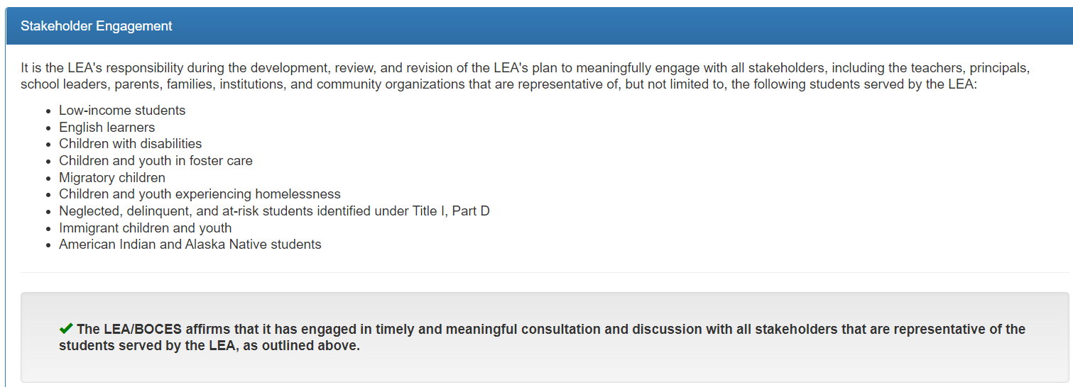
Consolidated Application Assurance

Slide 22
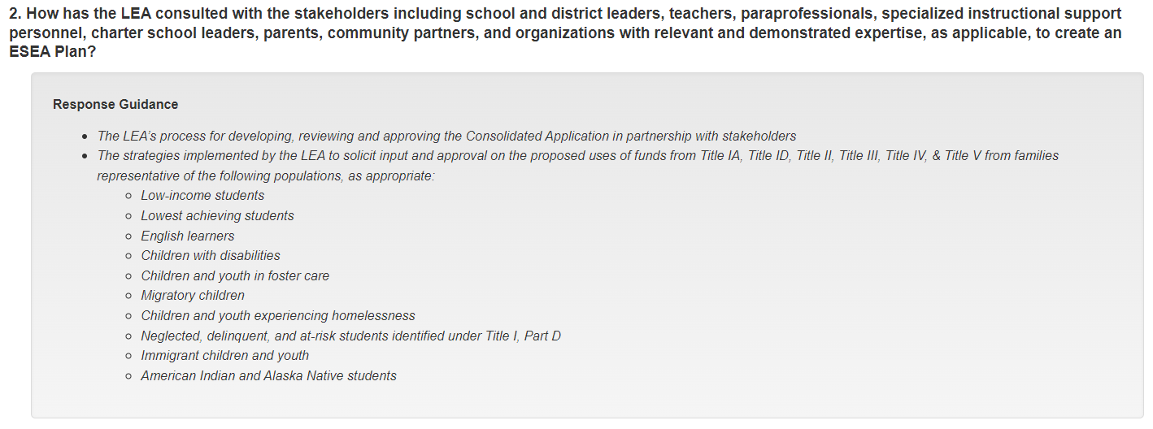
Consolidated Application Narrative Prompt

Slide 23
A Sample Consolidated Application Response
Parents and family members are offered multiple opportunities to provide input into the district’s ESEA Plan. Parent surveys at the district level are conducted periodically and are always available on the district’s website.
The Title I Office conducts an annual parent survey in all Title I schools to plan for the following year using Title I Parent and Family Engagement allocation at the school level.
During the School Accountability Committee planning process, parents and community members have the opportunity to offer input into how ESEA funds will be used at the individual school level (if applicable) and at the district level.
District Accountability Committee members from all schools have the opportunity to review and provide input into both the district UIP and the Consolidated Application. These documents are presented publicly at Board of Education for comment and approval.
Teachers, principals, other school leaders, paraprofessionals and specialized instructional support personnel are also given multiple opportunities to provide input into the district’s ESEA plan. Teachers self-identify areas of need through the teacher evaluation for which professional development opportunities can be provided. Paraprofessionals are surveyed at their annual conference.
Charter school administrators are offered an additional and separate opportunity to provide input into the ESEA plan for professional development. Each charter school is provided with an annual evaluation of last year’s professional development activities (if applicable) and a needs assessment document to complete.
An ESSA Plan Summary is posted to the district website homepage and those who review it have the opportunity to provide comments. Dissenting comments are included in the Consolidated Application narrative for review by CDE.
Notes:
Next slide shows evidence that will support the narrative

Slide 24
Evidence Needed…from the approved response
Parents and family members are offered multiple opportunities to provide input into the district’s ESEA Plan. Parent surveys at the district level are conducted periodically and are always available on the district’s website.
The Title I Office conducts an annual parent survey in all Title I schools to plan for the following year using Title I Parent and Family Engagement allocation at the school level.
During the School Accountability Committee planning process, parents and community members have the opportunity to offer input into how ESEA funds will be used at the individual school level (if applicable) and at the district level.
District Accountability Committee members from all schools have the opportunity to review and provide input into both the district UIP and the Consolidated Application. These documents are presented publicly at a Board of Education meeting for comment and approval.
Teachers, principals, other school leaders, paraprofessionals and specialized instructional support personnel are also given multiple opportunities to provide input into the district’s ESEA plan. Teachers self-identify areas of need through the teacher evaluation for which professional development opportunities can be provided. Paraprofessionals are surveyed at their annual conference.
Charter school administrators are offered an additional and separate opportunity to provide input into the ESEA plan for professional development. Each charter school is provided with an annual evaluation of last year’s professional development activities (if applicable) and a needs assessment document to complete.
An ESSA Plan Summary is posted to the district website homepage and those who review it have the opportunity to provide comments. Dissenting comments are included in the Consolidated Application narrative for review by CDE.

Slide 25
Evidence to Submit
Results of surveys from all stakeholder groups
Documentation of any feedback provided by stakeholders and how it was incorporated into the LEA’s plan
Agenda and presentation materials from Board of Education meeting(s)
Link to the district website where ESSA plan materials can be found

Slide 26


Questions

Slide 27
I’m being monitored next year, now what?
I’m ready. I have already started gathering evidence.
I will start gathering evidence after I get the notification letter.
I’m not ready. I hope my letter gets lost in the mail!

Slide 28
On a scale of 1-10, how familiar are you with the Program Requirements?
I have never seen the Program Requirements before today.
(10) I could provide a training on the Program Requirements.

Slide 29
Readiness Check
This training was helpful. I am ready to go.
This training was helpful, but I still have questions.
This training was not as helpful as I wanted it to be, but I know where to get more information.
This training was not helpful.

Slide 30
Closing Thoughts
Do:
Refer to the Program Requirements.
Ask for help!
Don’t:
Take time to submit a copy of the application or other documents we already have.

Slide 31
CDE Contact Information
ESEA Monitoring Team
Tammy Giessinger
720-827-5291 (c)
giessinger_t@cde.state.co.us
Michelle Prael
720-545-7368 (c)
prael_m@cde.state.co.us
Grants Fiscal Team
Bill Parsley
303-910-5163 (c)
parsley_b@cde.state.co.us
Sharon Mackey
303-358-4672 (c)
mackey_s@cde.state.co.us
Hilery Morris
720-471-4877 (c)
morris_h@cde.state.co.us
ESSER Monitoring Team
Kristin Crumley
720-660-1369 (c)
crumley_k@cde.state.co.us
Jonathan Schelke
720-388-0842 (c)
schelke_j@cde.state.co.us
Shannon Wilson
720-456-9701 (c)
wilson_s@cde.state.co.us
Mackenzie Owens
720-601-7112 (c)
owens_m@cde.state.co.us
Notes:
Michelle

