Slide 1
School Nurse Workforce Grant
Pursuant to the Coronavirus Preparedness and Response Supplemental Appropriations Act, 2020 CDC-RFA-TP18-1802
January 2022
Notes:
SARAH
Welcome everyone, and thank you for coming! This webinar today will be covering the information on the School Nurse Workforce Grant. We will be addressing:
Application Key Elements
The School Nurse Workforce Grant Application
Program Toolkit and Support
We will open this up for questions at the end. If you have questions throughout, you can post them in the chat to our host, Anita Brodecky. We will open the mics at the end for those who want to ask questions verbally.
We will post questions and answers on our website by the middle of next week
If there are questions we aren’t able to answer during the webinar, you will be able to find those answers in the Q and A section on our website next week
This webinar will be recorded, and posted on our website as well. During the presentation, we ask that you turn your cameras off. When we get to the question section, you may want to turn your cameras back on.
Before we begin, I would like to introduce our presenter team:
Jacklyn Thompson - School Nurse Workforce Grant Coordinator
Anita Brodecky - Regional School Nurse Specialist
Megan Murray - Regional School Nurse Specialist
Kim Burnham, Competitive Grants and Awards Supervisor
Jennifer Austin, Grants Fiscal Management Director
Tricia Miller, Grants Specialist
And I am Sarah Blumenthal…..Assistant Director of health and wellness and Colorado State School Nurse consultant

Slide 2

Introduction
Notes:
SARAH
The COVID-19 pandemic has highlighted the fact that school nurses provide more than individual care to students. The role of the school nurse includes clinical care, public health, leadership, quality improvement, and care coordination. As you have seen throughout this pandemic, school nurses have an essential role in keeping schools open while protecting the health and safety of school community members.
In addition to addressing public health needs, school nurses play a significant role in managing the mental and physical health needs of students. According to the Centers for Disease Control and Prevention (CDC), more than 40% of school-aged children and adolescents have at least one chronic health condition.
This pandemic has motivated districts to enhance professional school nursing services to support the application of health guidance and address the growing needs of students with chronic conditions in the school setting. The purpose of this grant is aimed at supporting districts in their efforts to enhance these supports in order to keep school open for in-person learning while protecting community members.
Now, I’d like to hand this over to Jacklyn Thompson, CDE’s grant coordinator for the school nurse workforce grant!
MAY NOT GO INTO THIS PART:
STOP School nurses also make a positive impact by:
Decreasing student absences and improving student academic achievement
Increasing access to early intervention and decreasing costly pediatric emergency room visits
Reducing parent’s missed time from work to care for sick children
Building healthy and supportive school communities
For the 2020-21 school year, Colorado’s student enrollment was 883,199. School district reporting data shows that 763 school nurses were employed with a total FTE of 693.8. The calculated student to full-time nurse ratio for the 2020-21 school year was 1,273 students to 1 full time school nurse. According to the Colorado Department of Education, during the 2020-2021 school year, 88.69% of Colorado public schools had a CDE Licensed school nurse available during school hours. The National Association of School Nurses supports the idea that having access to a registered professional nurse all day, every day can improve a student’s health, safety, and educational achievement.
To achieve adequate school nurse staffing, the following factors should be considered:
COVID-19 management needs in the school setting and access to community supports
# of students with at least one chronic health condition
# of students with complex health conditions
# of students with qualifying disabilities under IDEA and Section 504
Social determinants of health
Access and proximity to emergency and ongoing health care

Slide 3
Application Key Elements
Notes:
Jacklyn: Thanks, Sarah! I am grateful to be here with you all today to share information about this funding opportunity. Here are some Key Application Elements.

Slide 4
Introduction
As a result of the American Rescue Plan Act of 2021 (P.L. 117-2), March 22, 2021, the Centers for Disease Control and Prevention (CDC) activated CDC-RFA-TP18-1802 Cooperative Agreement for Emergency Response: Public Health Crisis Response to provide additional relief to address the continued impact of the COVID-19 pandemic.
This funding is intended to establish, expand, train, and sustain the public health workforce to support jurisdictional COVID-19 prevention, preparedness, response, and recovery initiatives, including school nursing.
COVID-19 has highlighted the fact that school nurses are considered specialists in public health and uniquely qualified to address pandemic preparedness, management, and response efforts in the school setting. This program will support Local Education Providers in their efforts to recruit, hire, and retain school nurse staff.
Notes:
Jacklyn: The School Nurse Workforce Grant originated from the American Rescue Plan Act of 2021 and the Cooperative Agreement for Emergency Response: - Public Health Crisis Response to provide support during the COVID19 pandemic. The funding is intended to establish, expand, train, and sustain the public health workforce, including school nurses. As Sarah explained, school nurses are uniquely qualified to support pandemic prevention, preparedness, response, and recovery initiatives.

Slide 5
Purpose and Program Activities
Local Education Providers may apply for funding in any or all of the focus areas of the School Nurse Workforce Grant:
To help schools achieve adequate school nurse staffing to support the application of COVID-19 health guidance and to respond to the growing needs of students with chronic conditions.
To increase the school nurse’s capacity to successfully keep schools open for in-person learning while protecting the health and safety of school community members.
To support local education providers in their efforts to recruit and retain qualified school nurses.
Notes:
Jacklyn: And, so the purpose of this specific pot of money is to: 1) to help schools achieve adequate staffing to respond to the pandemic alongside supporting students with chronic conditions; 2) to support schools’ ability to stay open for in person learning; and 3) to support education providers in recruiting and retaining school nurses.

Slide 6
Eligible Applicants and Priority Criteria
Local Education Providers (LEPs) are eligible to apply for this opportunity. An eligible LEP is:
A School District;
A Board of Cooperative Services (BOCES);
A Charter School authorized by a School District;
A Charter School authorized by the Charter School Institute;
Indian tribe or tribal organization (as such terms are defined in section 4 of the Indian Self-Determination and Education Act (25 U.S.C. 450b);
The Colorado School for the Deaf and Blind or
A consortium of two or more such local education providers.
Note: A charter school’s authorizer will be the fiscal agent, if funded.
Notes:
Jacklyn: Local Education Providers are invited to apply for this funding opportunity. The types of local education providers are listed on this slide. Individual charter schools may apply with authorization from their district or other authorizing representative. Also, a consortium of two or more providers may apply jointly. This may be useful since nurses work across schools and districts.

Slide 7
Priority Consideration
Available grant funding will be distributed to LEPs (as indicated in the lists above) with school(s) demonstrating high need based on Priority Criteria. Priority will be given to applicants that demonstrate one or more of the following needs:
Need for additional full time school nurses demonstrated by a student-to-full-time school nurse ratio greater than 1:225;
Need for additional full time Registered Nurse (RN) staff based on county COVID-19 vaccination rates for individuals ages 12 years and older; and/or
Need for school nurse retention incentives based on 2020-2021 school nurse attrition rate.
LEP serves a high percentage (greater than 40%) of students eligible for free or reduced-price lunch (FRL). (See the CDE District and School Dashboard for FRL data)
The LEP serves students:
  in communities with moderate to high levels of social vulnerability based on the CDC Social Vulnerability Index 2018 (link to SVI map),
  in a rural, frontier, or rural area in an urban county community as designated by the Colorado Rural Health Center (link to rural health map),
  in a county/community designated as a Medically Underserved Area (MUA) (link to MUA map),
  in a county/community designated as a Geographic or Low-Income Population Health Professional Shortage Area by the HRSA (link to HPSA map), and/or
  who live on a Colorado Native American reservation.
Notes:
Jacklyn: The application includes several priority considerations listed on this slide. The priority considerations help CDE prioritize funding to education providers with the highest needs and fewest resources. Among other considerations, the CDC Social Vulnerability Index is included, since this is a tool used to support emergency preparedness work.

Slide 8
Available Funds
Approximately $8 million is available for the 2021-2022 and 2022-2023 school years.
CDE anticipates awarding grants in the amount of $20,000 - $350,000 over an 18-month period.
  Funding requests may be lower than $20,000 but should not exceed $350,000.
Funding in subsequent years for grantees is contingent upon continued appropriations and upon grantees meeting all grant, fiscal and reporting requirements.
Notes:
Jacklyn: There is approximately 8 million dollars to award through June 2023. And CDE anticipates awarding grants in the amount of 20 thousand to 350 thousand dollars. Providers may apply for less than 20 thousand dollars but should not apply for more than 350 thousand dollars.

Slide 9
Allowable Use of Funds
CDE anticipates awarding the following approximate amounts for the allowable activities identified below:
$3,944,000 to hire full time nurses for two years (2021-2022, 2022-2023), including:
  Hiring full time RNs to perform the duties of a school nurse
  Full time RN devoted to managing COVID-19 related needs for the school and/or district
  Full time District Lead RN devoted to supervising school nursing staff, managing COVID-19 efforts and building strong school nursing infrastructure focused on retaining school nursing staff
$1,972,000 to increase part-time school nurse positions to full-time positions for two years (2021-22, 2022-23), including:
  Conversion of part time positions to full time positions
$240,000 to support recruitment efforts for school nurses, including:
  Hiring bonuses
$1,878,000 to support retention of school nurses, including:
  Retention bonuses
Note: Funding may not be used for food.
Notes:
Jacklyn: This 8 million dollars breaks down as follows: About 4 million dollars to hire full-time nurses; about 2 million dollars to convert part-time nursing positions to full-time nursing positions; 240 thousand dollars for recruitment and hiring bonuses; and 1.8 million dollars to support retention of current staff. The full time nurses hired could focus on school nursing duties, school nursing leadership duties, COVID response, or all three. The goal is to support capacity building and retention of nursing staff in a way that looks best for your school and community.

Slide 10
Allowable Use of Funds
(continued)
Ideas for recruitment and retention
  Use of recruitment agencies or online programs
  Hazard pay
Considerations
  Does cost fit within personnel services/fringe?
  Have you used these types of services or incentives before?
Notes:
Jacklyn: Some additional ideas for recruitment and retention include using recruitment agencies, online job boards, or offering hazard pay. In planning how the funds can be used, you will want to consider if the cost is a personnel or fringe cost, and if this is a service or incentive you have used before. If so, this is most likely an allowable use of funds.

Slide 11
Allowable Use of Funds - Summary
Recruitment and Hiring
  Recruitment outreach
  Recruitment bonuses
  Salary and benefits for new staff
Conversion of part-time to full-time staff
  Salary and benefits
Retention of current staff
  Retention bonuses
    At the least, schools can apply to retain current staff!
Notes:
Jacklyn: This slide provides a summary of the different ways the funding can be used. Education providers may apply for funding in any or all of these areas. And I want to point out, that at the least, providers can apply for funding to retain their current school nursing staff.

Slide 12
Duration of Grant
Grants will be awarded for an 18-month term beginning in the 2021-2022 fiscal year and ending in the 2023 fiscal year.
Additional grant funding for subsequent years will be contingent upon continued funding appropriations from the Centers for Disease Control and Colorado Department of Public Health and Environment.
Funded applicants for the 2021-2022 school year are not guaranteed any additional funding beyond the 2022-2023 school year at this time.
Funds must be expended by June 30, 2023. There will be no carryover of funds.
Notes:
Jacklyn: The grant duration is 18 months – January 2022 - June 2023. Additional funding is not guaranteed and is contingent upon future appropriations. The funding must be spent by June 30th, 2023 and cannot be carried over.

Slide 13
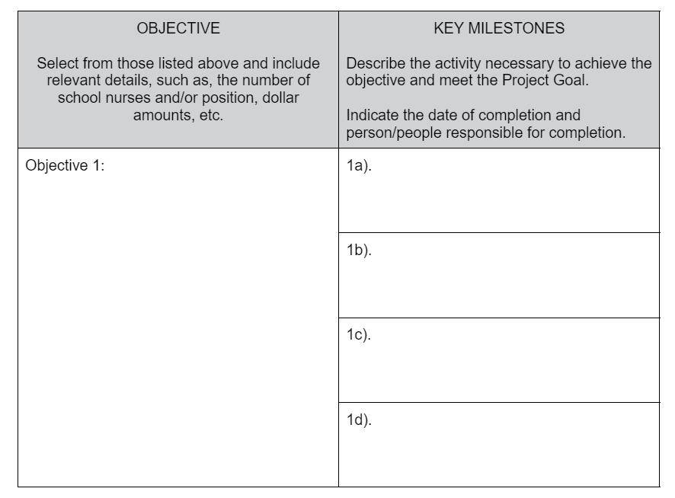
Evaluation and Reporting: Action Plan
Complete within 45 days of the grant award letter date.
Can be updated by the grantee as the program evolves.
Contact the grant coordinator for support.
Notes:
Jacklyn: There are some program reporting requirements that I want to share. The first piece is the action plan that identifies the program objectives and milestones. It’s pretty straightforward and can evolve with your program. Here’s a screenshot of the Action Plan template. This template is also available on the School Nurse Workforce Grant webpage.

Slide 14
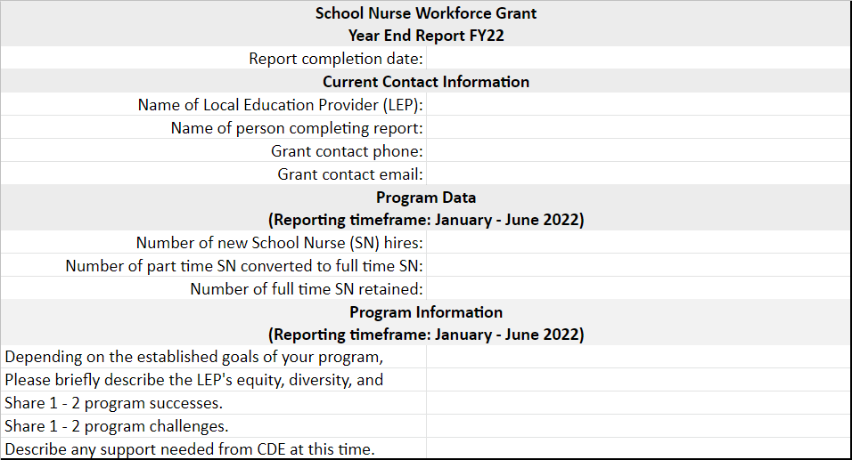
Evaluation and Reporting
Program Reporting
  Four (4) total reports
    Year end (x2), mid-year, and final reports
    First report due July 8. 2021 - 2022 year end
Notes:
Jacklyn: There are also a total of 4 program reports, including 1 mid year, 2 year end, and 1 final report. Again, it’s pretty straightforward, and here is a screenshot of the template for the 2022 year-end report. All of the reports are similar to this, except for the final report, which asks for cumulative information. This workbook template is also available on the program webpage. I want to point out that we are asking for information about equity, diversity, and inclusion efforts in regards to recruitment, hiring, and retention, and that you will also see this in the grant application narrative as well. This is a common thread throughout the program, and to support your efforts we will offer supplemental resources on the topic. Next, I want to turn it over to my colleague Kim Burnham who will share more with you about the application process.

Slide 15
Review Process and Timeline
Applications will be reviewed by CDE staff and peer reviewers to ensure they contain all required components. Applicants will be notified of final award status no later than Friday, February 25, 2022.
Note: This is a competitive process – applicants must score at least 70 points out of the 100 possible points to be approved for funding.
  Applications that score below 70 points may be asked to submit revisions that would bring the application up to a fundable level.
If interested in applying for this funding opportunity, submit the Intent to Apply by Friday, January 7, 2022, by 11:59 p.m. Completion of the Intent to Apply form is encouraged, but not required to submit an application.
Notes:
Kim B thru slide 24

Slide 16
Submission Process and Deadline
Information must be completed (including all elements outlined below) and submitted through the online application by Monday, January 31, 2022, at 11:59 p.m. The Program Assurances Form must also be uploaded to the online application at the time of submission.
Application resources and required documents to include in the submission are available on CDE’s School Nurse Workforce Grant webpage. Incomplete or late applications will not be considered.
Note: applicants should receive an automated confirmation email from the online system upon submission. If you do not, please email CompetitiveGrants@cde.state.co.us.
Notes:
Kim B

Slide 17
Required Elements
The School Nurse Workforce Grant online application includes the following elements, all of which must be completed.
Part IA: Applicant Information
Part IB: Recipient School Information: Complete and upload the Recipient School Information Form (PDF or Word file) within the online application.
Part II: Application Narrative and Excel Budget Workbook
Part III: Program Assurances Form: Upload the Program Assurances Form (PDF or Word file) within the online application. Funding will not be awarded until all signatures are in place. Applications may be submitted without signatures; however, please attempt to obtain all signatures before submitting the application.
Part IV: Financial Management Survey: Complete and upload the Financial Management Survey (PDF or Word file) within the online application.
Notes:
Kim B

Slide 18
School Nurse Workforce Grant
Application
Notes:
Kim B

Slide 19
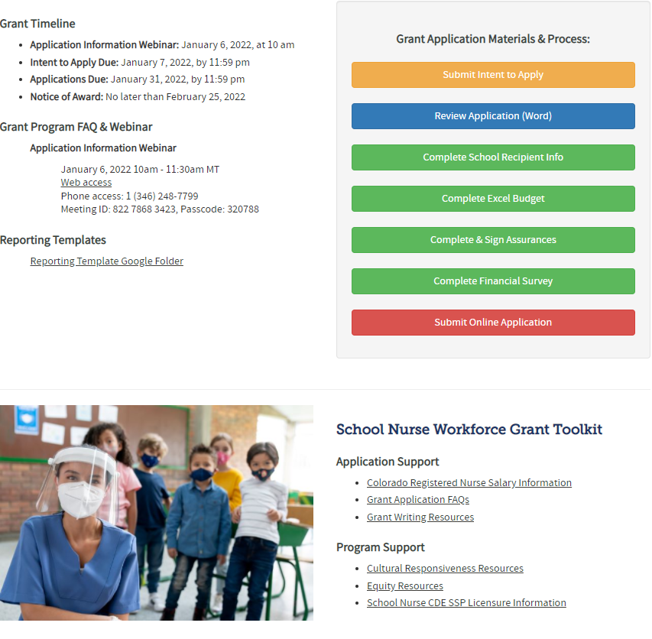
Application Resources
Visit the School Nurse Workforce Grant Website for the Request for Application, Online Application Form, and additional Resources.
Notes:
Kim B

Slide 20
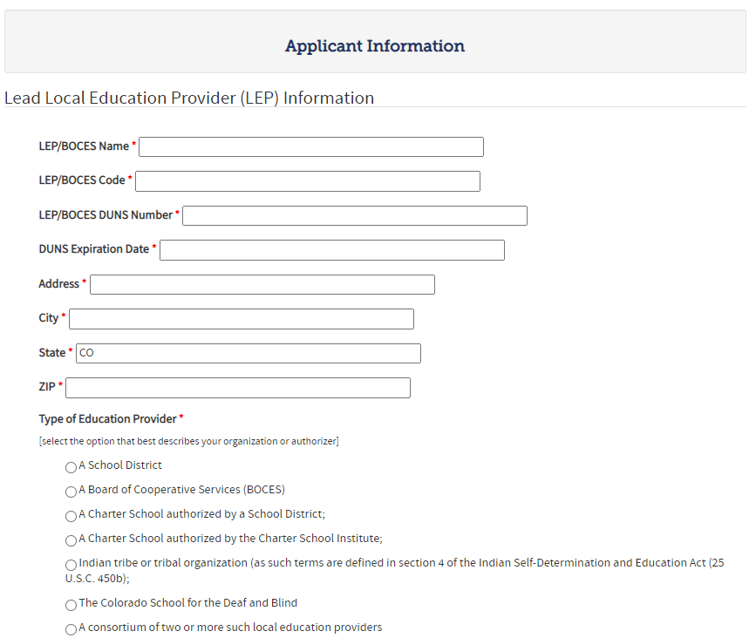
Online Application - Applicant Information
Notes:
Kim B

Slide 21
Online Application - Narrative Questions
Describe the LEP’s need to increase School Nurse capacity and/or retain current qualified staff. Describe how students will be identified for participation in the program. LEPs are encouraged to consider a wide variety of relevant data sources when determining criteria for student identification.
Provide a brief program narrative and plan for how School Nurse Workforce Grant funding will be used to recruit, hire and/or retain qualified School Nurses and reduce the impacts of COVID-19 on the LEP. Include information about how the program will:
  recruit from diverse applicants;
  address principles of equity, diversity, and inclusion in recruitment, hiring, and/or retention processes;
  collaborate with and/or outreach to relevant organizations and stakeholders; and
  track School Nurse recruitment, hiring and/or retention.
School Nurse Workforce funding will be used to (check all that apply):
  Hire full time RNs to perform the duties of a school nurse
  Hire full time RNs devoted to managing COVID-19 related needs for the school and/or district
  Hire full time District Lead RN devoted to supervising school nursing staff, managing COVID-19 efforts and building strong school nursing infrastructure focused on retaining school nursing staff
  Convert part time school nurse positions to full time school nurse positions
  Provide hiring bonuses to recruit and retain new nursing staff
  Provide retention bonuses to retain existing nursing staff
Complete the Excel Budget Workbook, and upload in the online application. Ensure that all costs included in the budget are linked to the program plan within the narrative for funding.
Please answer the following questions to help us determine needs within your district and prioritize funding requests. The data provided should be the most current data available as of the date of the application.
  1. How many FTE (full time equivalent) school nurses are employed by the Local Education Provider LEP? ____ (number)
  2. What is the current student-to-full time school nurse ratio in the Local Education Provider (LEP)? To calculate the ratio, divide the total number of students in the LEP by the total number of FTE school nurses: ____ (number)
  3. How many school nurse staff in the LEP terminated employment (voluntary/involuntary) within the last school year (2020-2021)? ____ (number)
Notes:
Kim B

Slide 22
Online Application - Narrative Questions
(continued)
Please answer the following questions to help us determine needs within your district and prioritize funding requests. The data provided should be the most current data available as of the date of the application.
  4. How many school nurse positions are vacant? ____ (number)
  5. Is the county’s COVID-19 vaccination rate for individuals ages 12 years and older less than 80%? (Colorado Vaccine Data):____ (yes/no)
  If yes, what is the percentage? ____ (percentage)
  6. Do more than 40% of students qualify for free or reduced lunch? _____ (yes/no) (data dashboard)
  If yes, what is the percentage? _____ (percentage)
  7. Is the county’s Overall 2018 Social Vulnerability Index Score greater than 0.49? (SVI map): _________ (yes/no)
  a. If yes, what is the county’s Overall 2018 Social Vulnerability Index Score? ___________ (number)
  8. Does your LEP serve students who live in a rural, frontier, or rural area in an urban county community? (rural health map): ___________ (yes/no)
  9. Does the LEP serve students from a Medically Underserved Area? (MUA map): ___________ (yes/no)
  10. Does the LEP serve students from a geographic or low-income population Health Professional Shortage Area? (any discipline) (HPSA map): ___________ (yes/no)
  11. Does the LEP serve students from a Native American reservation? ___________ (yes/no)
  If yes, which reservation?______________________
Notes:
Kim B

Slide 23
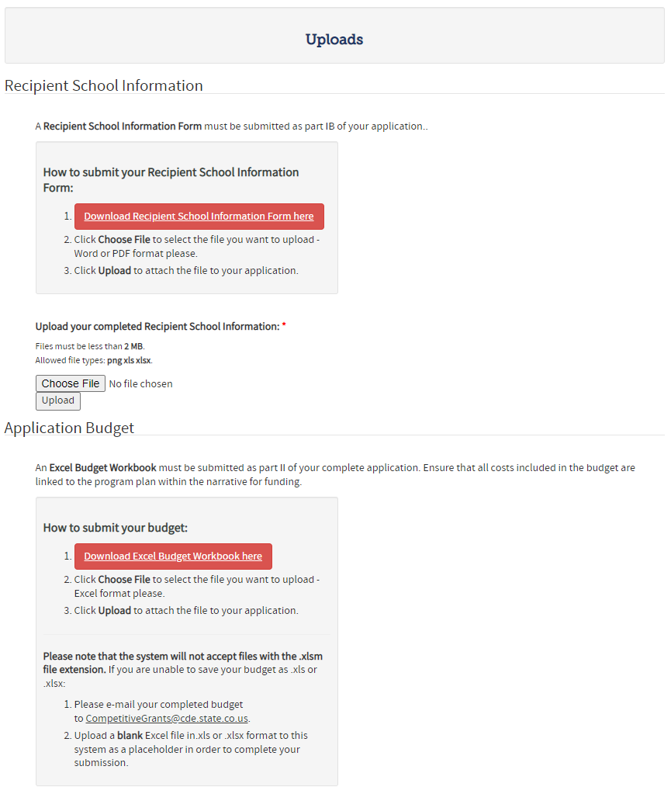
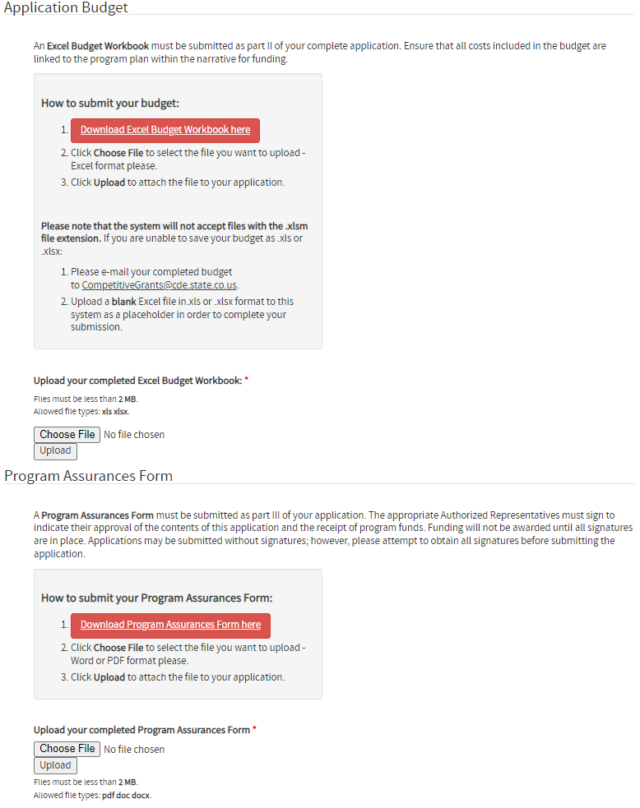
Online Application - Uploads
Notes:
Kim B

Slide 24
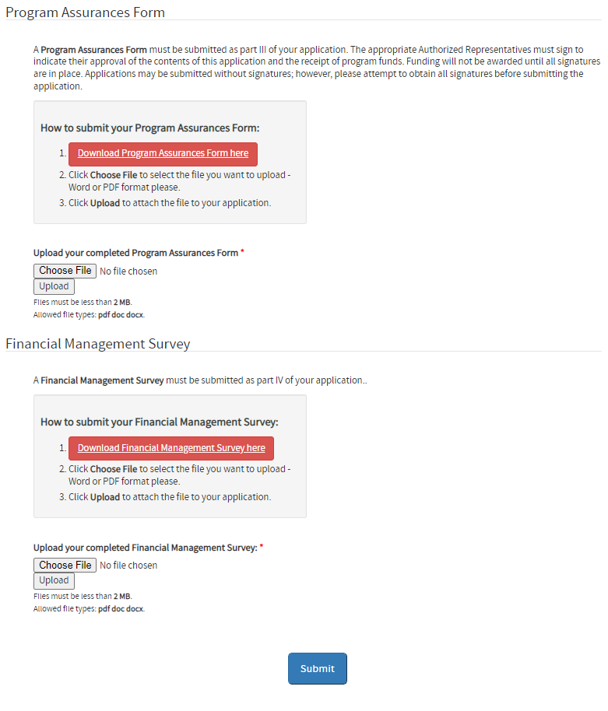
Online Application – Uploads
(continued)
Notes:
Kim B

Slide 25
Program Toolkit and Support
Notes:
Jacklyn: Thanks Kim. Next I wanted to share more with you all about the toolkit available on the program website.

Slide 26
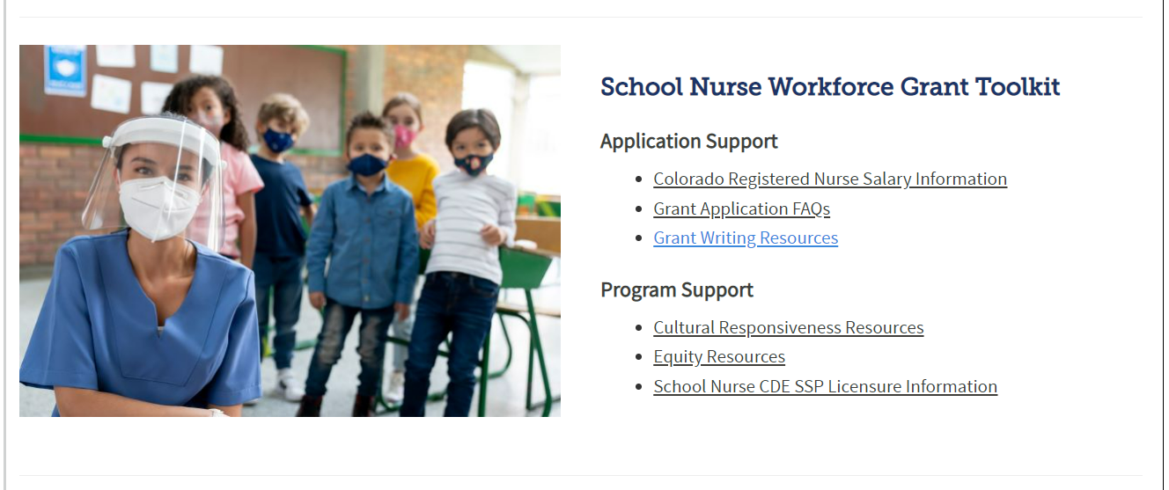
Program Toolkit
Bookmark: https://www.cde.state.co.us/healthandwellness/schoolnurseworkforcegrant
Notes:
Jacklyn: Here is a screen clip of the toolkit, and some of the resources currently available. If you haven’t already, it could be good to bookmark the program website for easy access to the toolkit.

Slide 27
Program Toolkit
(continued)
Application Support
  Salary information to inform budget
  Grant application FAQs
  Grant writing resources
    Recorded webinar specific to CDE
Program Support
  Cultural Responsiveness and Equity Resources
    Grantees will report EDI efforts
    Recruitment and retention resources
  Licensure information
If there is a resource you would like to see added, please reach out!
Notes:
Jacklyn: Specifically, for application support, we have Registered Nurse salary and wage information to help inform your budgets; we have the application frequently asked questions; and also grant writing resources with information specific to CDE grants. We also have program resources to support cultural responsiveness and equity practices, as well as school nurse licensing information. There are also are equitable recruitment and retention resources that may be useful to your application narratives. Please reach out if you have ideas for additional resources you would like to see in the toolkit.

Slide 28
Program Support
Technical Assistance provided during grant.
  School Nursing – Anita B.
  Programmatic – Jacklyn T.
CDE Program Team collaborating to make the program a success.
  Health & Wellness
  Grants Management Unit
  Grants Fiscal
  Communications
Notes:
Jacklyn: One of our goals is to make this a user friendly experience, and we also want to provide the level of support most useful to your organization. Anita, who has been supporting throughout the webinar, is available for school nursing technical assistance, and I am available for programmatic assistance. There is also a team of folks at CDE who will be supporting you and collaborating to make the program a success, including folks from the units listed here, and other units as well.

Slide 29
See the Grant Program FAQ on our website to view answers to questions asked during the webinar.
https://www.cde.state.co.us/healthandwellness/schoolnurseworkforcegrant
Notes:
Jacklyn: That said, several of these folks are here today to answer your questions.

Slide 30
Application Contacts
Program Questions:
Jacklyn Thompson, School Nurse Workforce Grant Coordinator
Thompson_J@cde.state.co.us
School Nurse Questions:
Anita Brodecky, Regional Nurse Specialist
Brodecky_A@cde.state.co.us
Budget/Fiscal Questions:
Jennifer Austin, Grants Fiscal Management Director
Austin_J@cde.state.co.us
Application Process Questions:
Mandy Christensen, Competitive Grants and Awards
Christensen_A@cde.state.co.us

