Slide 1
Colorado’s District Sample Curriculum Project
Brian Sevier- Standards Project Director
http://www.cde.state.co.us/standardsandinstruction/index.asp

Slide 2
Colorado’s District Sample Curriculum Project
Rationale/origins
From its beginnings, the field of educators across the state has been the force behind this project. This will continue to be the case as the project and its outcomes are:
  Driven by the field
  Generated by the field
  Relevant to the field
As the next step in standards support for the state, the project is oriented around three fundamental goals:
  Facilitating successful implementation of the CAS
  Helping build the capacity of Colorado educators to create curriculum materials based on the standards
  Bringing together Colorado’s educators to create a variety of samples that reflect the diversity of our school districts

Slide 3
Colorado’s District Sample Curriculum Project
Project phases and major outcomes
Phase One:
Work with Colorado educators to create unit overview samples based on the CAS for all subjects and grades.
  Phase Two:
  Conduct area workshops across the state to build capacity around the process and products associated with the Project
  Phase Three:
  Work with Colorado educators to create units based on the overview samples for all subjects and grades based on select unit overviews

Slide 4
Colorado’s District Sample Curriculum Project
Phase One outcomes
Participants
  500+ educator participants
  47 of 64 counties represented
  61 of 178 districts represented
Products
  670 unit overviews- all content areas (k-12) and STEM (1st, 8th, high school)
  Coded to the CAS
  Teacher/educator authorship and district affiliation on every page of unit overviews
Postings
  January 31st- Standards and Instructional website-Individual content area and Sample Curriculum Project webpages
  Coming months eNet Colorado access (DREAM Marketplace)
Notes:
can get list of MALL teachers

Slide 5
Colorado’s District Sample Curriculum Project
Sample unit overviews
The Colorado Department of Education (CDE) defines curriculum as an organized plan of instruction for engaging students in mastering the standards.
The samples:
  Represent the translation of the CAS into unit overviews for all (10) content areas
  Illuminate possibilities for sequencing grade-level expectations (GLEs) and content-specific standards across courses/years
  Offer one possible foundation for exploring standards-based unit and lesson-plan development
A closer look at a 4th Grade social studies to:
  Highlight major components of the template
  Explain key terms
  Offer possible uses for the samples

Slide 6
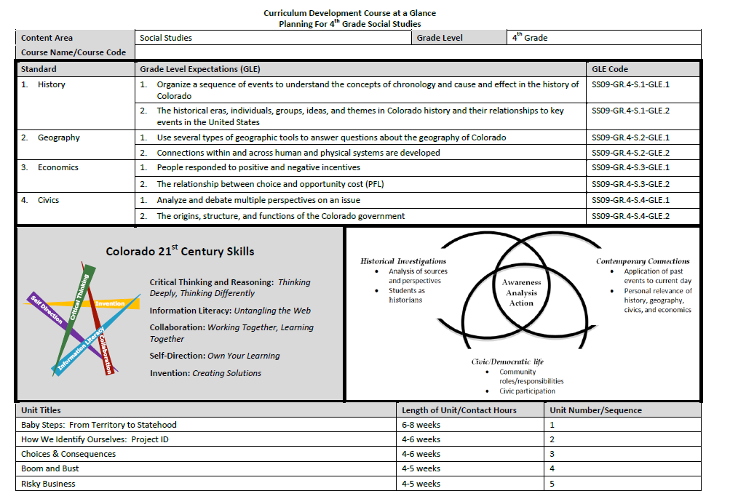
SS09-GR.4-S.3-GLE.1

Slide 9
SS09-GR.4-S.3-GLE.1

Slide 10
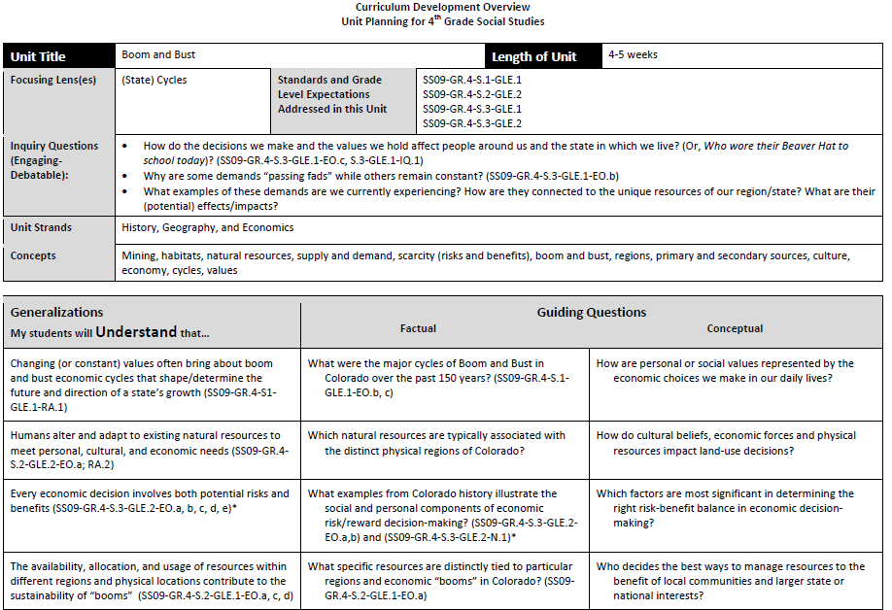

Slide 11
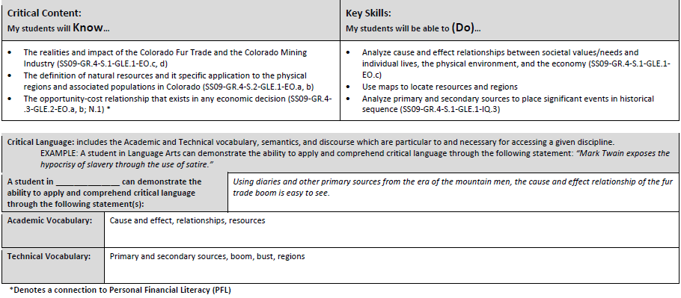

Slide 12
Focusing Lens
Inquiry Questions
Unit Strands
Concepts

Slide 14
Colorado’s District Sample Curriculum Project
  Samples:
  The samples offer organizing structures for addressing the grade-level expectations (GLEs), evidence outcomes (EOs) and 21st century skills that build students' mastery of the standards at each grade level.
  Design reflects emphasis on concepts and content in Colorado Academic Standards
    Centers around ideas
    Supports teaching to greater intellectual depth
    Emphasizes knowledge TRANSFER and APPLICATION
      Generalizations (Big understandings) transfer
      Concepts transfer
      Skills transfer
Design reflects feedback from educators across the state with technical assistance from Dr. Lynn Erickson
    This is Colorado’s Template!

Slide 16
Colorado’s District Sample Curriculum Project
Next Steps:
  Phase Three:
  Develop an instructional-unit template for all subjects and grades
  Work with Colorado educators to create unit samples for all subjects and grades based on select unit overviews
  Three-four day workshops in late July and early August
  Look for the participation application on the Standards and Instructional Support website in late spring

