Slide 1
Overview of the Mathematics Unit Samples
Colorado’s District Sample Curriculum Project
Mary Pittman- Mathematics Content Specialist, CDE
http://www.cde.state.co.us/standardsandinstruction

Slide 2
Webinar Goals
Describe the process for creating the mathematics instructional units
Highlight components of the learning experiences specific to mathematics:
  Enactive-Iconic-Symbolic
  Teacher notes
  Mathematical Practices
  Fluency Expectations

Slide 3
Colorado District Sample Curriculum Project
Big Picture
From its beginning, the District Sample Curriculum Project has had a singular focus: to build the capacity of teachers to use their content expertise and passion for student learning to create samples that support teaching to student mastery of the Colorado Academic Standards.

Slide 4
Colorado District Sample Curriculum
Year at a Glance

Slide 5
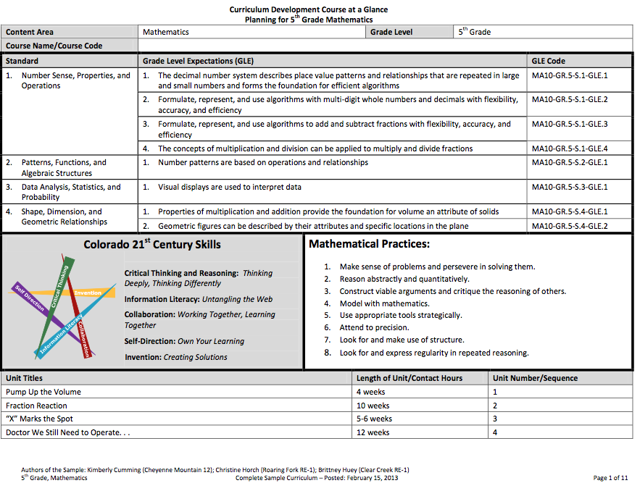
Year at a Glance

Slide 6
Year at a Glance
Units

Slide 7
Colorado District Sample Curriculum
Year at a Glance
Unit Overview
Unit Overview
Unit Overview
Unit Overview . . .

Slide 8
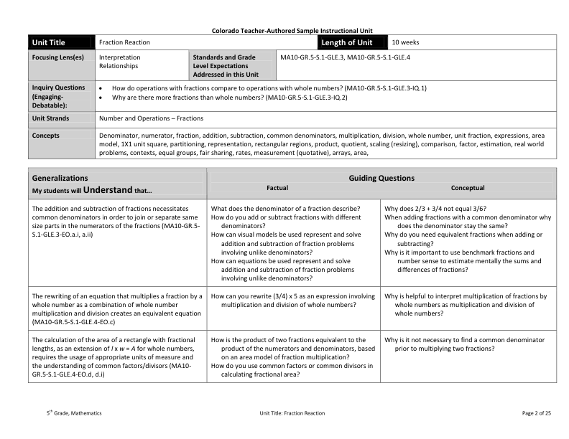
Unit Overview

Slide 9
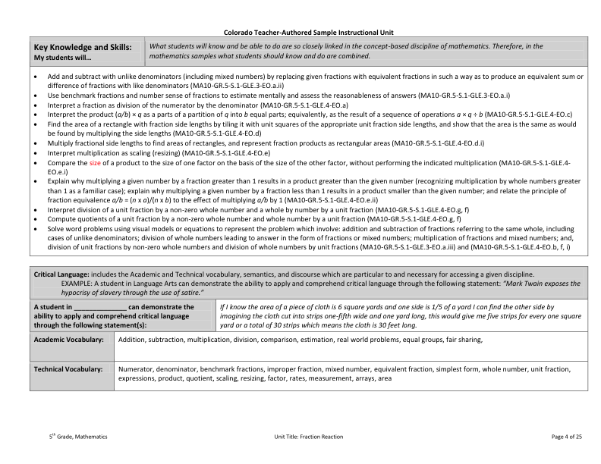
Unit Overview

Slide 10
Colorado District Sample Curriculum
Year at a Glance
Unit Overview
Unit Overview
Unit Overview
Instructional Unit
Unit Overview . . .

Slide 11
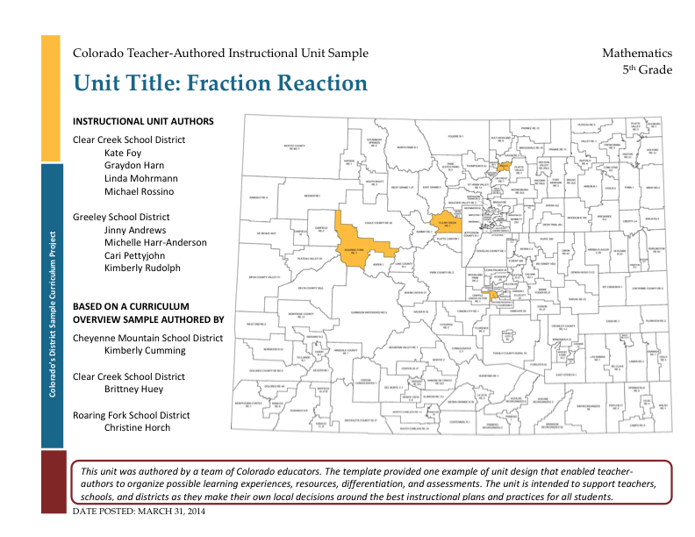
Sample Mathematics Instructional Unit: Title Page

Slide 12
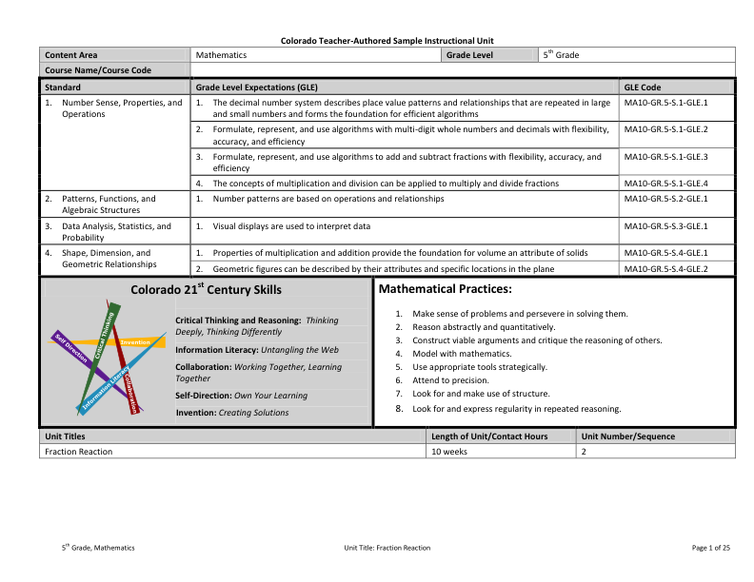
Sample Mathematics Instructional Unit: Year at a Glance Page
Unit

Slide 13
Sample Mathematics Instructional Unit: Overview

Slide 14
Sample Mathematics Instructional Unit: Overview

Slide 15
Teacher-Authored Samples
Instructional Units
During a three-day workshop a team of educators created an instructional unit designed to provide teachers with support for using their professional judgment to teach to student mastery of the standards-based generalizations, content, and skills of one selected overview.
Teams were typically comprised of:
  2 general education teachers (content specialists)
  1 ELL teacher
  1 Gifted and Talented teacher
  1 Special education teacher
  1 Title One teacher
  100+ units developed and published on March 31, 2014 (one for each grade k-12 mathematics, reading, writing, and communicating, science, social studies, comprehensive health, visual arts, drama/theatre, dance, and music).

Slide 16
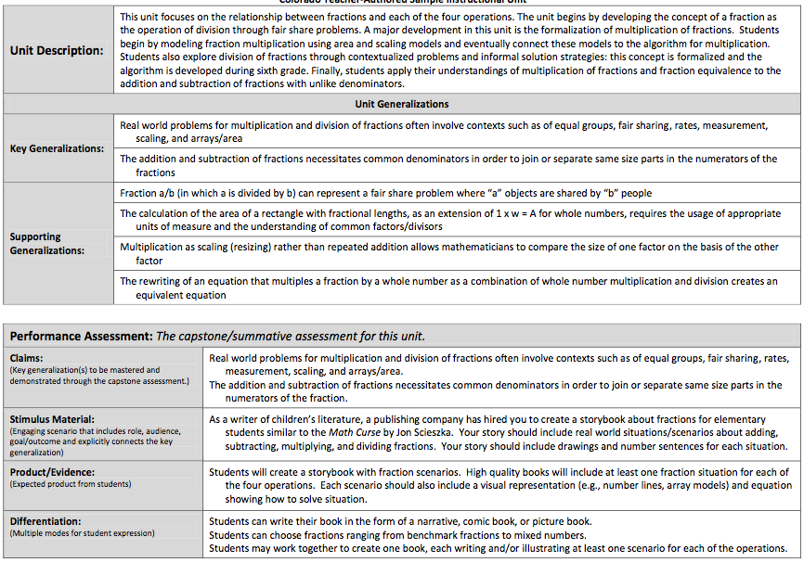
Mathematics Instructional Unit

Slide 17
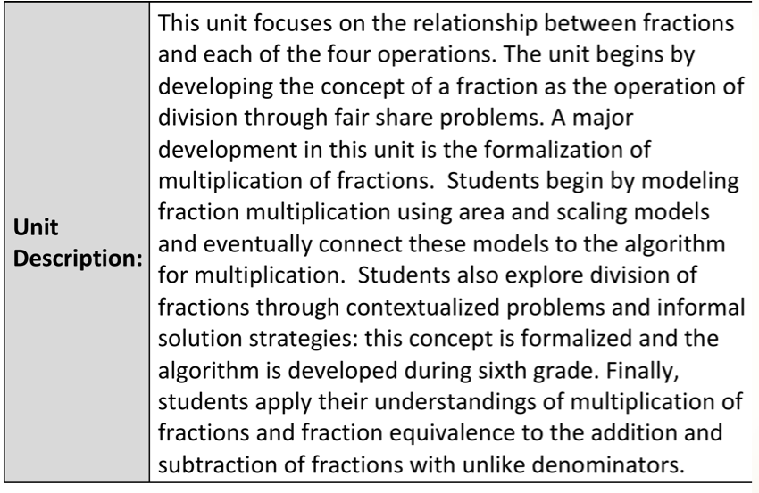
Mathematics Instructional Unit

Slide 18
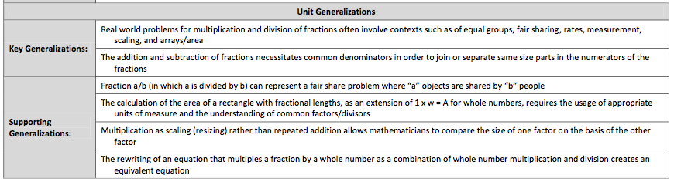
Mathematics Instructional Unit

Slide 19
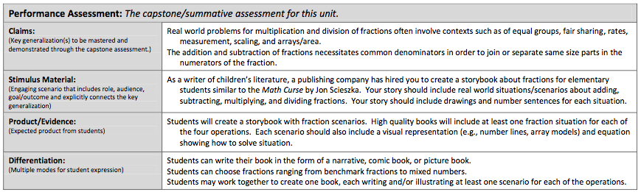
Mathematics Instructional Unit

Slide 20
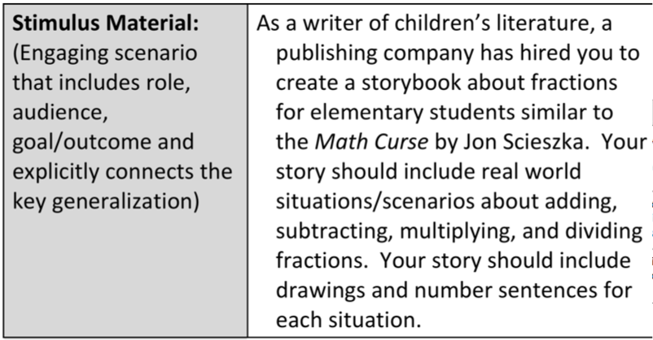
Mathematics Instructional Unit

Slide 21
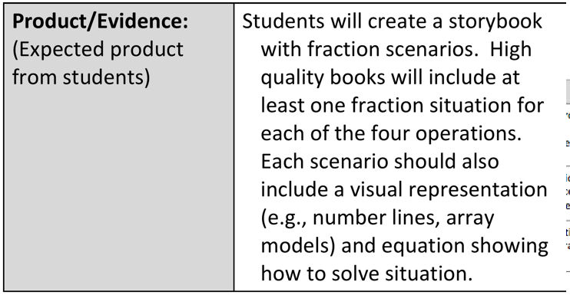
Mathematics Instructional Unit

Slide 22
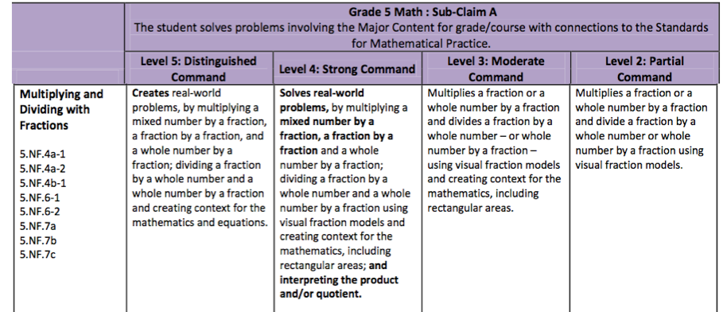

Slide 23
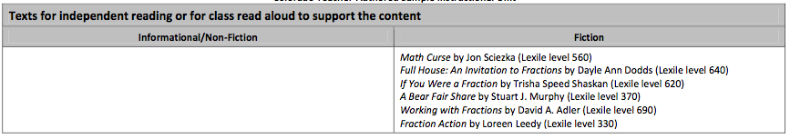
Mathematics Instructional Unit

Slide 24
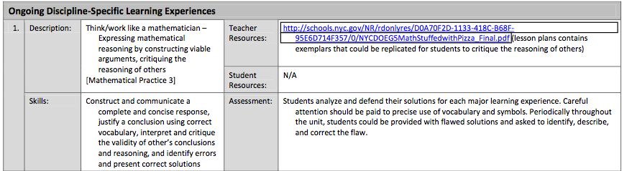
Mathematics Instructional Unit

Slide 25
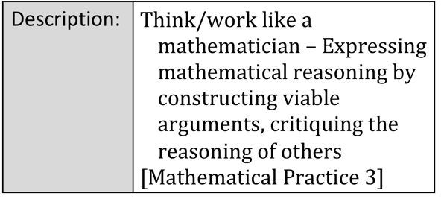
Mathematics Instructional Unit

Slide 26
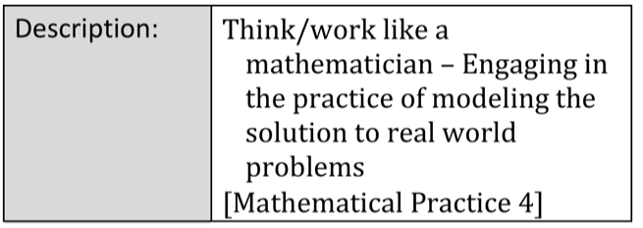
Mathematics Instructional Unit

Slide 27
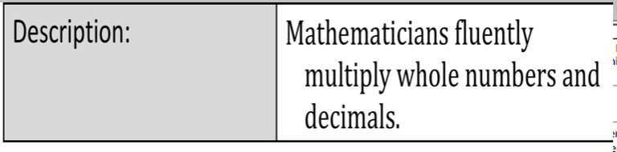
Mathematics Instructional Unit

Slide 28
Required Fluencies in K-6
Grade | Standard | Required Fluency
K | K.OA.5 | Add/subtract within 5
1 | 1.OA.6 | Add/subtract within 10
2 | 2.OA.2 2.NBT.5 | Add/subtract within 20 (know single-digit sums from memory) Add/subtract within 100
3 | 3.OA.7 3.NBT.2 | Multiply/divide within 100 (know single-digit products from memory) Add/subtract within 1000
4 | 4.NBT.4 | Add/subtract within 1,000,000
5 | 5.NBT.5 | Multi-digit multiplication
6 | 6.NS.2,3 | Multi-digit division Multi-digit decimal operations
Notes:
This chart shows a breakdown of the required fluencies in grades K-6.
Fluent in the particular Standards cited here means “fast and accurate.” It might also help to think of fluency in math as similar to fluency in a foreign language: when you’re fluent, you flow. Fluent isn’t halting, stumbling, or reversing oneself.
The word fluency was used judiciously in the Standards to mark the endpoints of progressions of learning that begin with solid underpinnings and then pass upward through stages of growing maturity.
Some of these fluency expectations are meant to be mental, others need pencil and paper. But for each of them, there should be no hesitation about how to proceed in getting the answer with accuracy.

Slide 29
Mathematics Instructional Unit

Slide 30
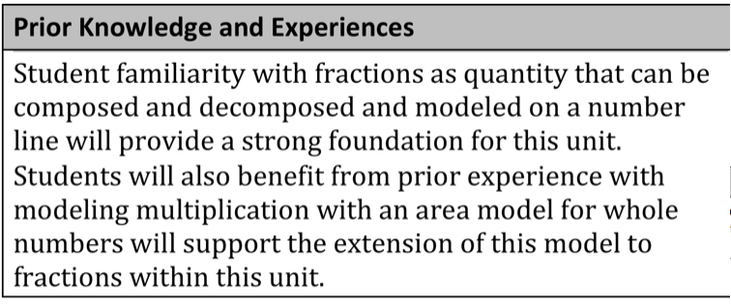
Mathematics Instructional Unit

Slide 31
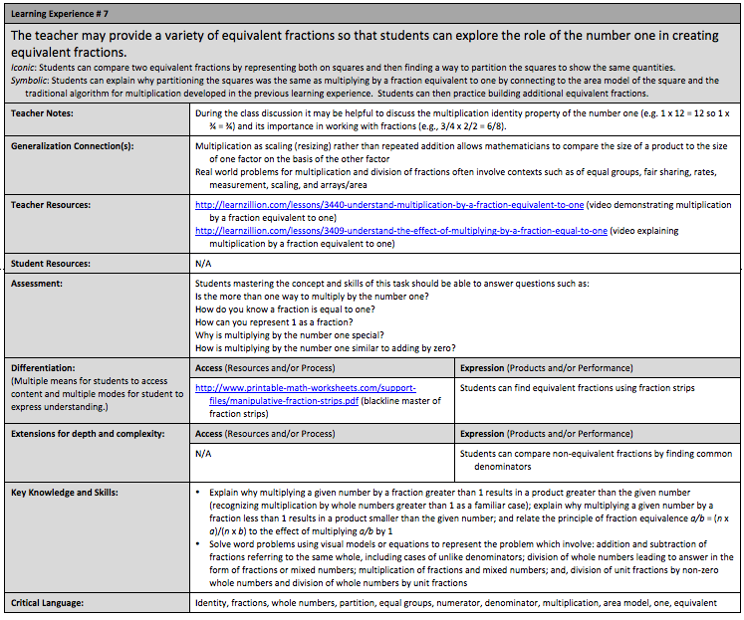
Mathematics Instructional Unit

Slide 32
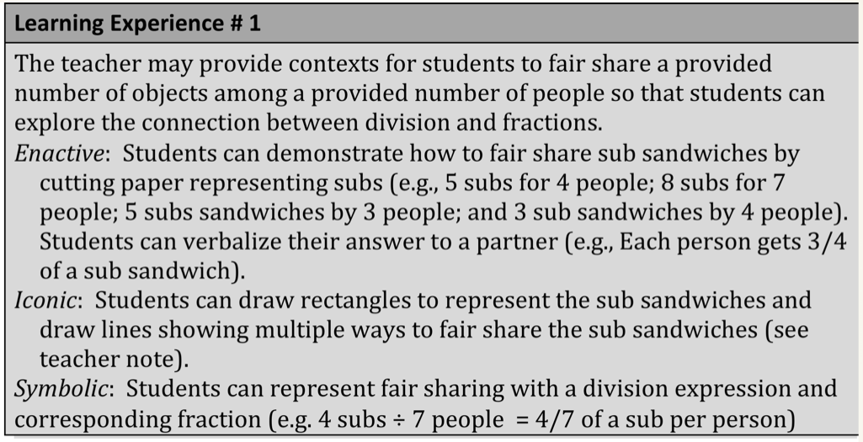
Mathematics Instructional Unit

Slide 33
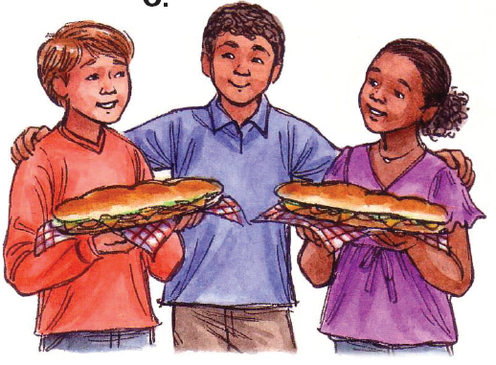
Enactive-Iconic-Symbolic

Slide 34
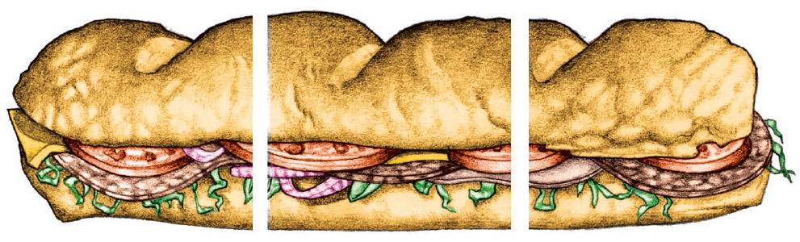
Progressive Formalization
1/3 + 1/3 = 2/3
Symbolic
Iconic
Enactive
Notes:
enactive (action-based)Sometimes called the concrete stage, this first stage involves a tangible hands-on method of learning. Bruner believed that "learning begins with an action - touching, feeling, and manipulating" (Brahier, 2009, p. 52). In mathematics education, manipulatives are the concrete objects with which the actions are performed. Common examples of manipulatives used in this stage in math education are algebra tiles, paper, coins, etc. - anything tangible.
iconic (image-based)Sometimes called the pictoral stage, this second stage involves images or other visuals to represent the concrete situation enacted in the first stage. One way of doing this is to simply draw images of the objects on paper or to picture them in one's head. Other ways could be through the use of shapes, diagrams, and graphs.
symbolic (language-based) Sometimes called the abstract stage, the last stage takes the images from the second stage and represents them using words and symbols. The use of words and symbols "allows a student to organize information in the mind by relating concepts together" (Brahier, 2009, p. 53). The words and symbols are abstractions, they do not necessarily have a direct connection to the information. For example, a number is a symbol used to describe how many of something there are, but the number in itself has little meaning without the understanding of it means for there to be that number of something. Other examples would be variables such as x or y, or mathematical symbols such as +, -, /, etc. Finally, language and words are another way to abstractly represent the idea. In the context of math, this could be the use of words such as addition, infinite, the number three, etc.

Slide 35
Enactive
Sometimes called the concrete stage
Involves a tangible hands-on method of learning
From real-world or realistic contexts
Students’ language

Slide 36
Iconic
Motivates… structure and chunking
Sometimes called the pictorial or representational stage
Involves images or other visuals to represent actions and objects in the enactive stage
  Drawings on paper
  Images in one's head.
  Shapes, diagrams, and graphs

Slide 37
Symbolic
Sometimes called the abstract stage
Mathematical abstractions and abbreviations
Often far removed from contextual cues
  e.g., “Efficient” algorithms
To off-load cognitive demand, potentially limits sense-making
Depends on some degree of recall (hopefully supported by conceptual understanding)
Notes:
Sometimes called the abstract stage, the last stage takes the images from the second stage and represents them using words and symbols. The use of words and symbols "allows a student to organize information in the mind by relating concepts together" (Brahier, 2009, p. 53). The words and symbols are abstractions, they do not necessarily have a direct connection to the information.

Slide 38
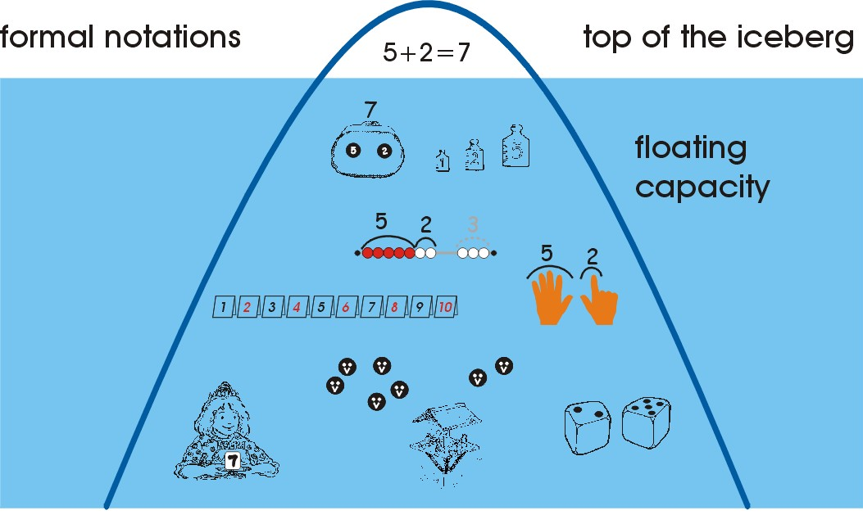
The Iceberg Metaphor
Symbolic
Formal
Iconic
Structured
Preformal
Enactive
Experiential Informal
© F.M.- N.B.

Slide 39
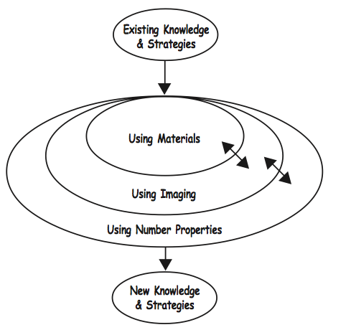
Creating Mathematical Knowledge
© Ministry of Education, Wellington, New Zealand.

Slide 40
Mathematics Instructional Unit

Slide 41
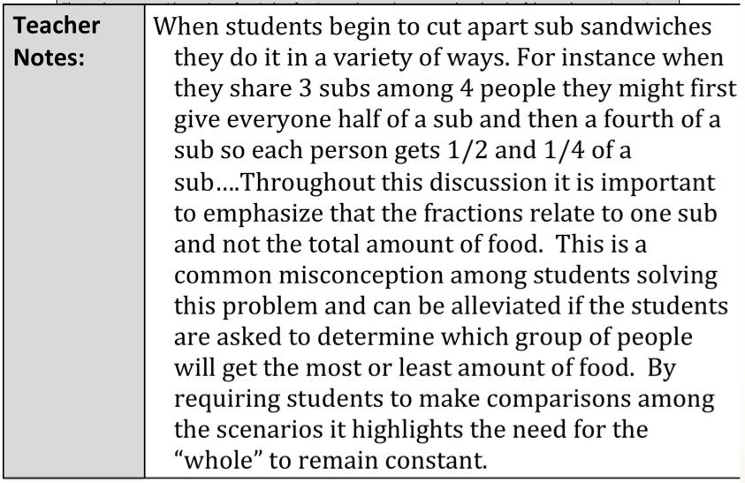
Mathematics Instructional Unit

Slide 42
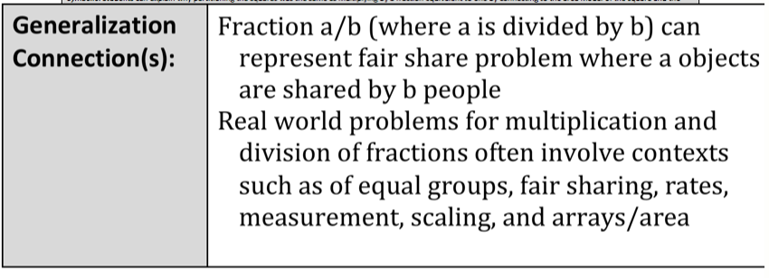
Mathematics Instructional Unit

Slide 43
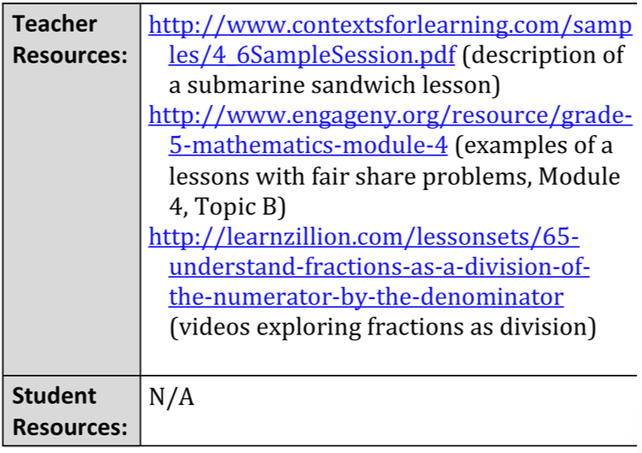
Mathematics Instructional Unit

Slide 44
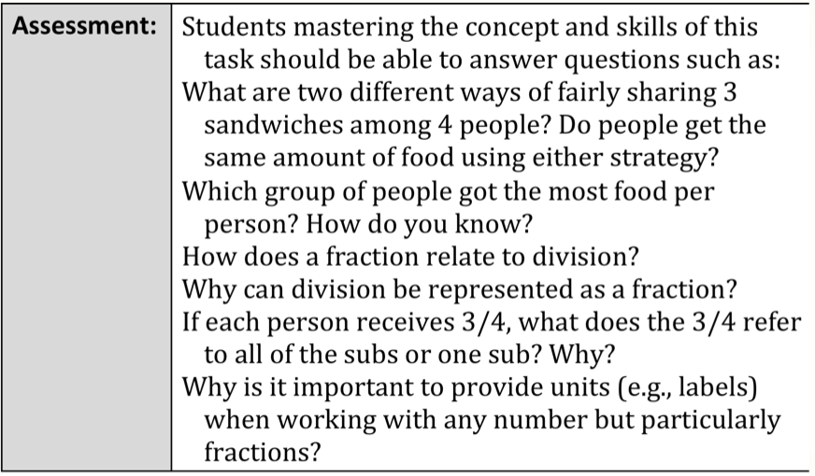
Mathematics Instructional Unit

Slide 45
Unit Overview

Slide 46
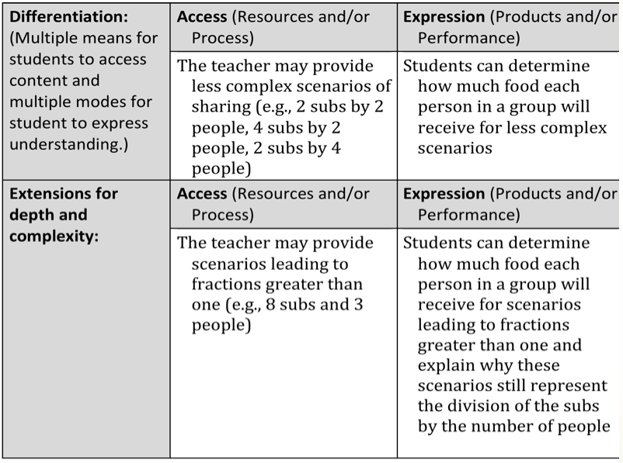
Mathematics Instructional Unit

Slide 47
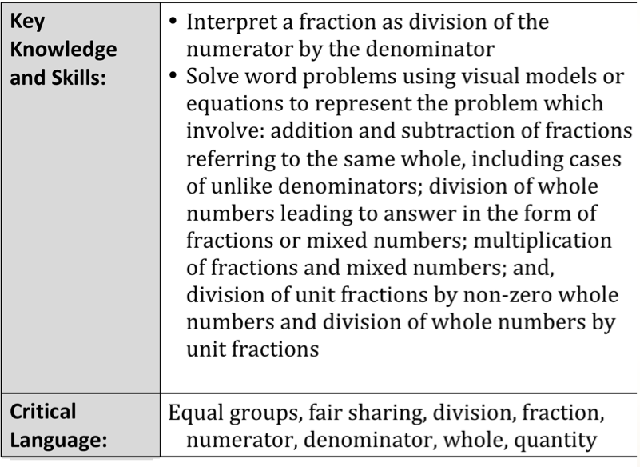
Mathematics Instructional Unit

Slide 48
Unit Overview

Slide 49
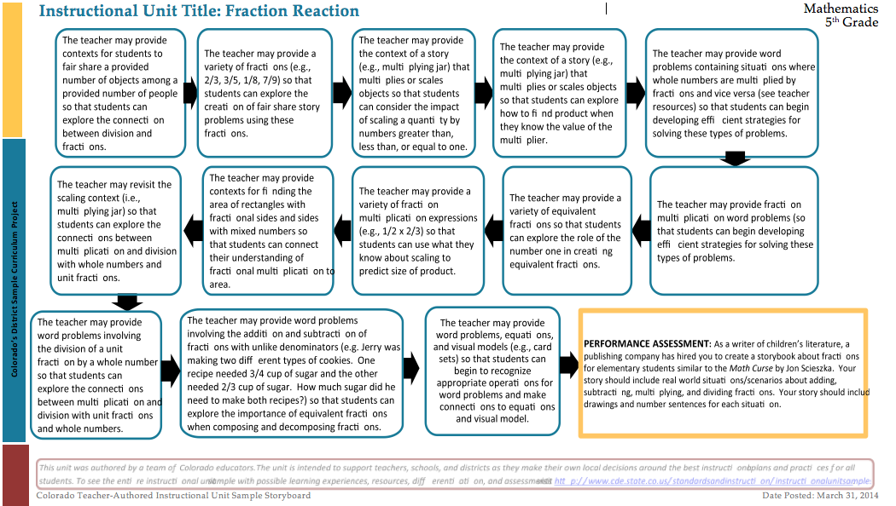
Unit Storyboard

Slide 50
Unit Storyboard

Slide 51
Colorado District Sample Curriculum
Year at a Glance
Unit Overview
Unit Overview
Unit Overview
Instructional Unit
Unit Overview . . .

Slide 52

Discussion Time
Questions?

Slide 53
Webinars
Previously recorded webinars can be viewed at: http://www.cde.state.co.us/standardsandinstruction/instructionalunit-resources
Social Studies Instructional Units April 25 @ 12:30 http://connect.enetcolorado.org/siu_socialstudies/

Slide 54
Contact Information
Mary Pittman
Mathematics Content Specialist
Colorado Department of Education
Pittman_m@cde.state.co.us

