Slide 1
An Introduction:
Instructional Unit Samples in Reading, Writing, and Communicating
Vince Puzick
Literacy Content Specialist, CDE
http://www.cde.state.co.us/standardsandinstruction/instructionalunits-rwc
April 18, 2014

Slide 2
Objectives for Webinar
Participants will
  Be introduced to the instructional unit template in Reading,
  Writing, and Communicating
  Walk through the structure of the instructional unit
  Understand the purposes of the instructional unit samples
What we will not cover in this webinar:
  Standardized assessments of any kind
  Conversation regarding Colorado Academic Standards or CCSS
  (other than being the instructional focus of the units)
  Instructional practices or approaches (except as identified by the
  unit authors in Teacher Resources)

Slide 3
In our time together …
We will
  Walk through different sections of the instructional unit
  Explore questions at different points as we go through the unit
  Dialogue at the end about the purpose and suggested uses of the instructional units

Slide 4

Participating in the Webinar
Let’s introduce ourselves using the chat box.
Please type
the grade level you teach,
or
the role you have in your district,
and
if you choose to, the name of your district.

Slide 5
Structure of the Instructional Units
The Unit Overview pages (from Curriculum Overviews)
Unit Description • Performance Assessment • Texts for Independent Reading • Ongoing Learning Experiences • Prior Knowledge
Learning Experiences
and the
Trajectory of the Unit (Storyboard)

Slide 6
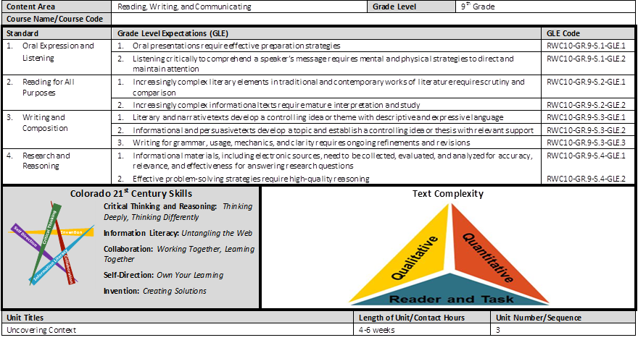
from Curriculum Overviews

Slide 7
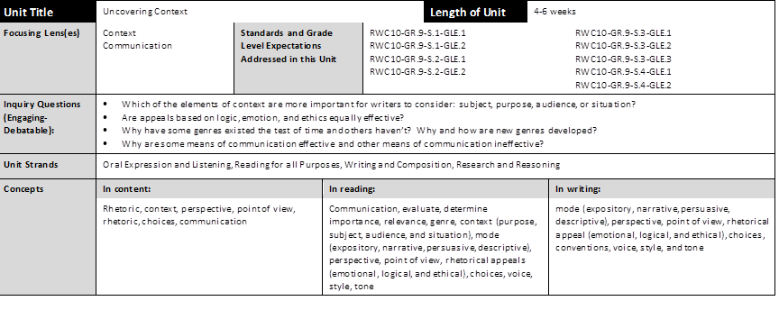
from Curriculum Overviews

Slide 8
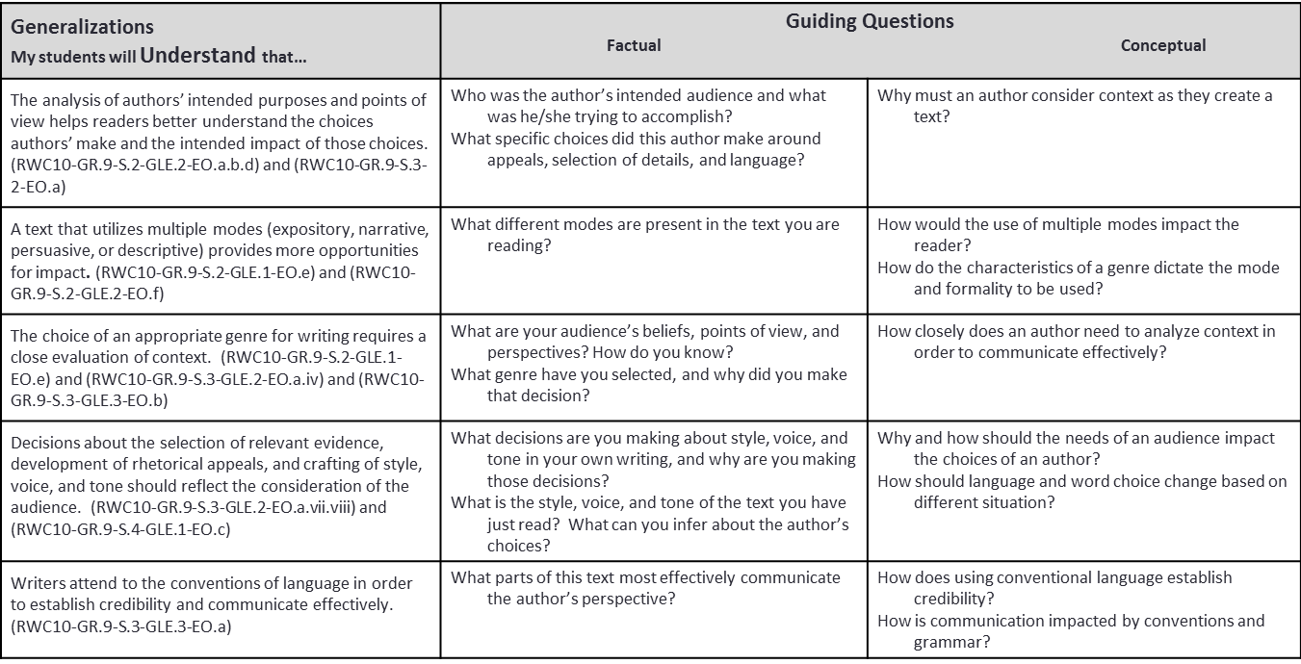
from Curriculum Overviews

Slide 9
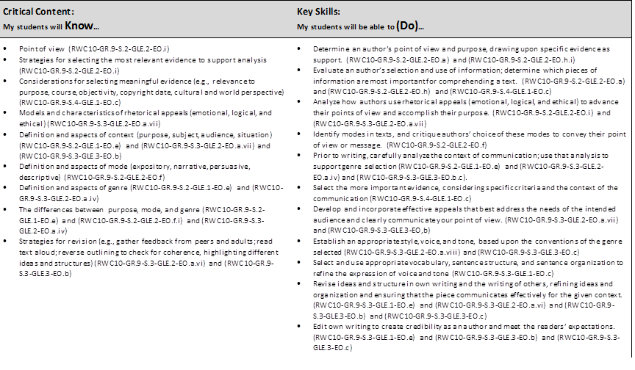
from Curriculum Overviews

Slide 10
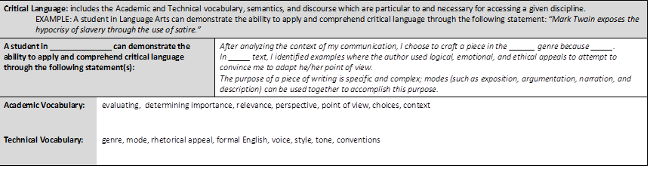
from Curriculum Overviews

Slide 11
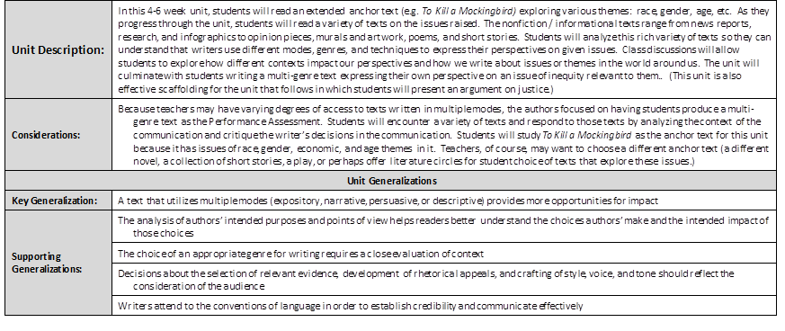
The Instructional Unit

Slide 12
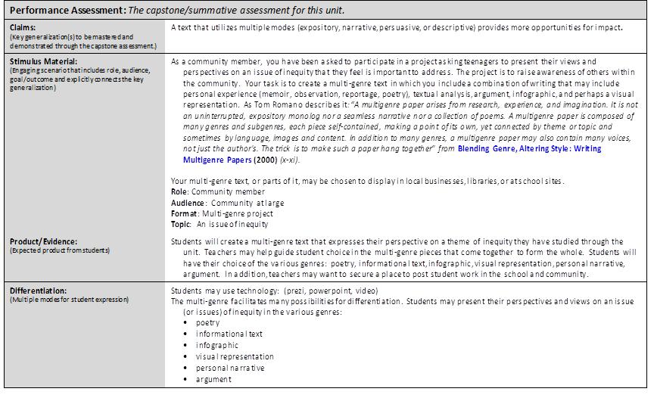
from Instructional Unit

Slide 13
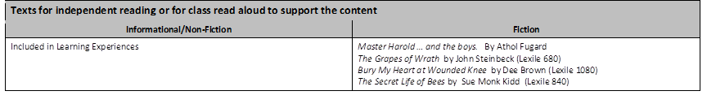
from Instructional Unit

Slide 14
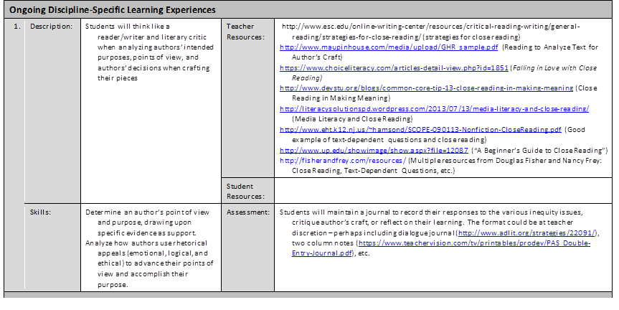
from Instructional Unit

Slide 15
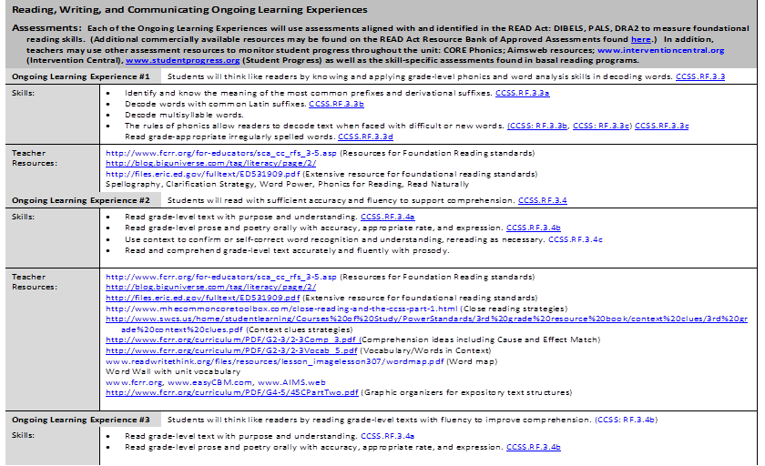
Third Grade Example of Ongoing Learning Experiences

Slide 16
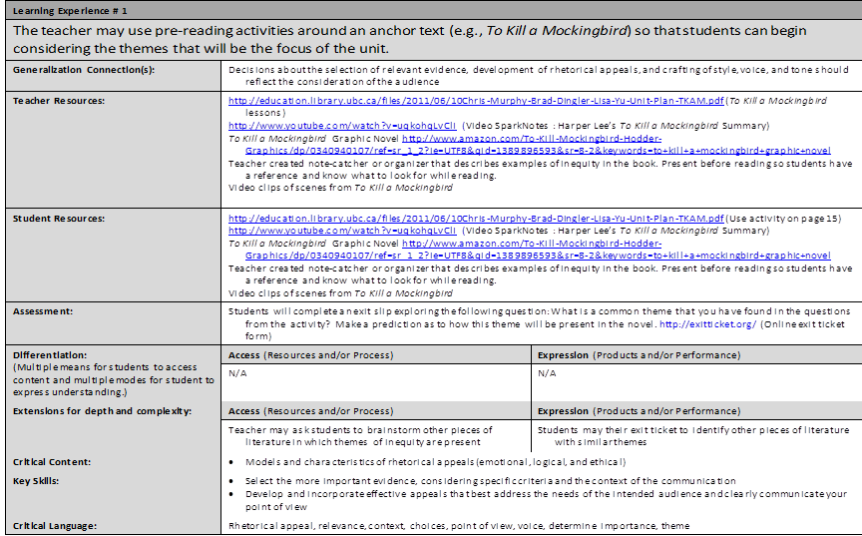
from Instructional Unit

Slide 17
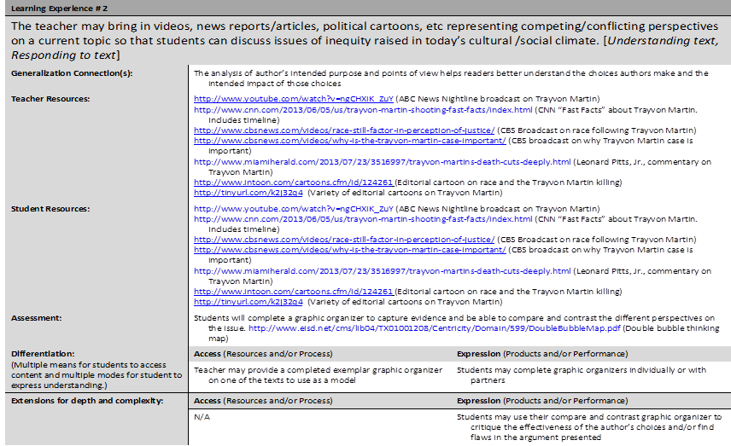
from Instructional Unit

Slide 18
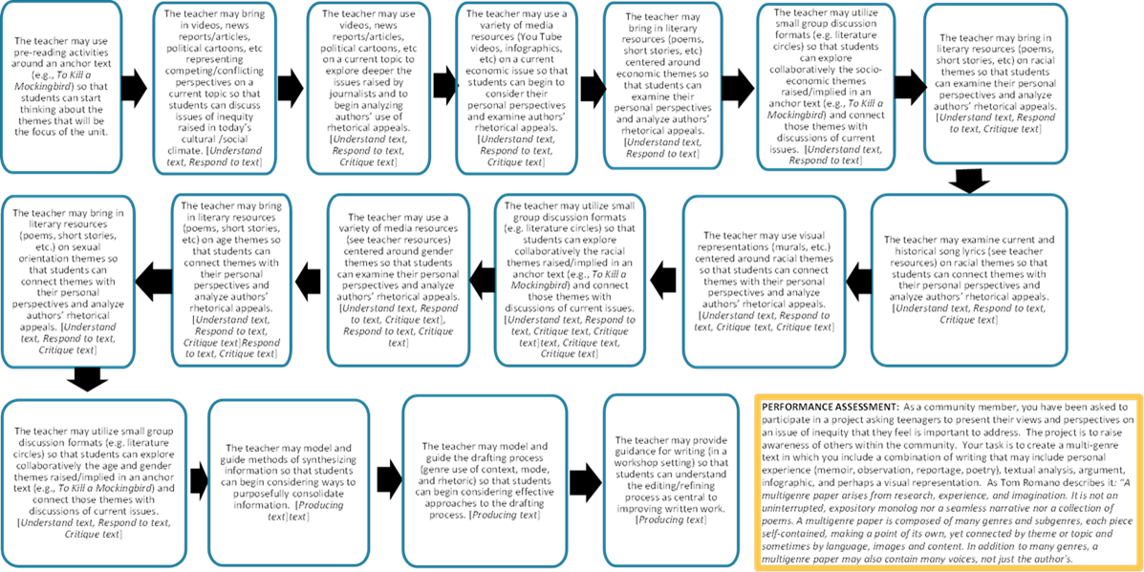
Storyboard

Slide 19
RWC-Specific Aspects
Working with Texts
Understanding Text: comprehension, constructing meaning; inference, cause-effect relationships, text structure, word choice … other
Responding to Text: citing evidence to substantiate analysis, reflecting, collaborative exploration of the text
Critiquing Text: being discerning about the text; evaluating an argument; critiquing graphics, photos, other elements of text; appreciating author’s craft; comparing multiple texts for effective expression
Producing Text: producing different modes and genre; identifying appropriate digital texts and media to produce; moving through the writing process; exploring voice
Text is defined as “any media, print or non-print, used to communicate and idea, emotion, or
information.” Instructional Unit authors tried – and I think they were very successful – to incorporate a
variety of texts and text types in every unit.

Slide 20
RWC Instructional Units: Highlights
Kindergarten – Third Grade
Ongoing Learning Experiences
Understand and Respond to a Variety of Texts
Cause-Effect Analysis in 3rd Grade
Interdisciplinary connections are possible (Social Studies, Science, The Arts)
Producing text: a book, an “Innovator’s Notebook,” a problem-solution persuasive piece.
Fourth Grade – Fifth Grade
Analyze the language, structure, and strategies writers use in persuasive texts.
Examine how different points of view may add to or help resolve conflict
Interdisciplinary connections are possible (Social Studies, Science, The Arts)
Producing text: argument, narrative

Slide 21
RWC Instructional Units: Highlights
6th Grade – 8th Grade
Explore how biases and assumptions influence perspectives.
Students study a variety of speeches for claims, evidence, persuasive techniques.
Students will examine diversity, tolerance and intolerance from a global perspective through a variety of texts.
Producing text: debates or mock trials, present an argument on Service Learning Project, Ted Talk-like presentation synthesizing a variety of texts.

Slide 22
RWC Instructional Units: Highlights
9th Grade - 10th Grade
Students will read and study the themes in an anchor text by exploring a range of supplemental texts (informational, visual, news articles, short stories, poems). Students will learn how different contexts impact perspectives and the kind of texts writers produce.
Students explore how cultural experiences and societal influences impact authors and individuals in those cultures.
Producing text: Students will produce a multi-genre text expressing their perspective on the thematic issue. Students will produce a narrative text.
11th Grade – 12th Grade
Students will explore bias in the literature they study and how bias influences how we respond to what we read as well as the texts we produce.
Students will study three different literary movements to show how the literary movements are diverse in their themes, style, purpose, and cultural contexts.
Producing text: portfolio of personal narrative, literary analysis, personal reflection, and argument

Slide 23
Purposes and Uses
Instructional Unit samples serve as examples of concept-based curriculum.
Teachers may
Modify the samples to meet the needs of their students (relevant texts and topics that are meaningful to their community; variations on differentiation; etc.);
Use the samples to guide their instructional planning and unit design;
Use the sample “as is.”
Instructional choices – for example, the length of time devoted to the Learning Experiences, which instructional strategies to use, specific formative assessment tasks – are local decisions (individual teachers, school or district decisions).

Slide 24
Instructional Unit Process
Author Teams: choice of unit from the Curriculum Overview to build out
Question: Which unit seems a big enough challenge that I would not want to tackle the planning on my own?
Distinguish the key generalization from the supporting
Draft a Performance Assessment task
Draft a Storyboard
Build out the Learning Experiences
Revisit the Performance Assessment task
Draft the Unit Description and Considerations

Slide 25
Upcoming Webinars
Visual and Performing Arts Instructional Units April 21 @ 12:30 http://connect.enetcolorado.org/siu_arts/
Science Instructional Units April 22 @ 12:30 http://connect.enetcolorado.org/siu_science/
Comprehensive Health Instructional Units April 23 @ 12:30 http://connect.enetcolorado.org/siu_health/
Mathematics Instructional Units April 24 @ 12:30 http://connect.enetcolorado.org/siu_mathematics/
Social Studies Instructional Units April 25 @ 12:30 http://connect.enetcolorado.org/siu_socialstudies/

Slide 26
Wrapping up
I’d appreciate:
  Feedback on this webinar
  Comments on the Instructional Units
  Suggestions for future webinars
Email me:
  Puzick_v@cde.state.co.us
Thank you for your time!

