Slide 1
Science Instructional Unit Samples
Colorado’s District Sample Curriculum Project
Joanna Bruno-Science Content Specialist, CDE
http://www.cde.state.co.us/standardsandinstruction

Slide 2

How to Chat
Notes:
The primary way you’ll be participating is through chat. For those who may be new to these web conferencing systems – to chat, you just type your comment or question in the text box here, and then click the talk bubble or click return. Your chat will appear up in the window for all to see.

Slide 3
Science Instructional Unit Samples
Colorado’s District Sample Curriculum Project
Joanna Bruno-Science Content Specialist, CDE
http://www.cde.state.co.us/standardsandinstruction

Slide 4
Webinar Goals
During this webinar, we will be using one instructional unit to explore:
  The components of the units
  The processes utilized to create them
  The possible next steps in utilizing these resources
This webinar will not address:
  State summative assessments
  Educator evaluation
Send questions-I will pause and also address them at the end

Slide 5
Colorado District Sample Curriculum Project
Big Picture
From its beginning, the District Sample Curriculum Project has had a singular focus: to build the capacity of teachers to use their content expertise and passion for student learning to create samples that support teaching to student mastery of the Colorado Academic Standards.

Slide 6
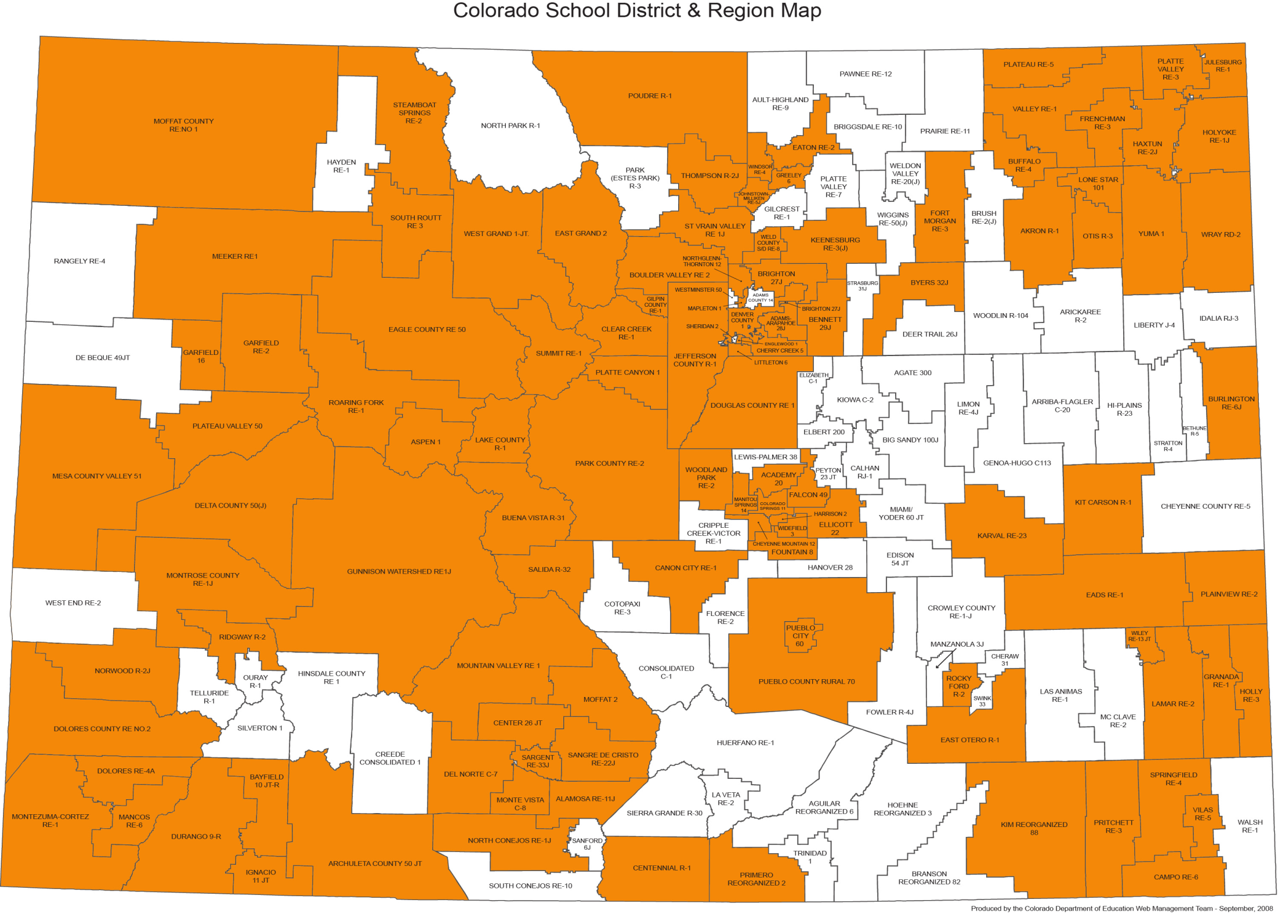

Slide 7
Teacher-Authored Samples
Curriculum Overviews
  700+ unit overviews- all content areas (k-12)
  All samples coded to the Colorado Academic Standards-Ensuring attention to all Evidence Outcomes (indicators of mastery)
  Teacher/educator authorship and district affiliation noted at the bottom of every unit overview
  Samples available in PDF and Word formats on the Standards and Instructional Support website-by individual content area and grade level
  Videos detailing specific aspects of the unit overviews available as a resource
  Each sample provides an option for standards-based planning that emphasizes what students should understand, know, and be able to do at the end of a given unit of instruction

Slide 8
Content Area | Science |  |  | Grade Level | High School
Course Name/Course Code | Physical Science
Standard | Grade Level Expectations (GLE) |  |  |  |  |  | GLE Code
Physical Science | Newton’s laws of motion and gravitation describe the relationships among forces acting on and between objects, their masses, and changes in their motion – but have limitations |  |  |  |  |  | SC09-GR.HS-S.1-GLE.1
 | Matter has definite structure that determines characteristic physical and chemical properties |  |  |  |  |  | SC09-GR.HS-S.1-GLE.2
 | Matter can change form through chemical or nuclear reactions abiding by the laws of conservation of mass and energy |  |  |  |  |  | SC09-GR.HS-S.1-GLE.3
 | Atoms bond in different ways to form molecules and compounds that have definite properties |  |  |  |  |  | SC09-GR.HS-S.1-GLE.4
 | Energy exists in many forms such as mechanical, chemical, electrical, radiant, thermal, and nuclear, that can be quantified and experimentally determined |  |  |  |  |  | SC09-GR.HS-S.1-GLE.5
 | When energy changes form, it is neither created not destroyed; however, because some is necessarily lost as heat, the amount of energy available to do work decreases |  |  |  |  |  | SC09-GR.HS-S.1-GLE.6
Colorado 21st Century Skills Critical Thinking and Reasoning: Thinking Deeply, Thinking Differently Information Literacy: Untangling the Web Collaboration: Working Together, Learning Together Self-Direction: Own Your Learning Invention: Creating Solutions |  | Reading & Writing Standards for Literacy in Science and Technical Subjects 6 - 12 Reading Standards Key Ideas & Details Craft And Structure Integration of Knowledge and Ideas Range of Reading and Levels of Text Complexity Writing Standards Text Types & Purposes Production and Distribution of Writing Research to Construct and Present Knowledge Range of Writing
Unit Titles |  |  | Length of Unit/Contact Hours |  |  | Unit Number/Sequence
Motion and Force |  |  | 7-9 weeks |  |  | 1
Characteristics of Matter |  |  | 6-8 weeks |  |  | 2
Chemical Reactions |  |  | 7-9 weeks |  |  | 3
Forms and Transformation of Energy |  |  | 8-9 weeks |  |  | 4

Slide 9
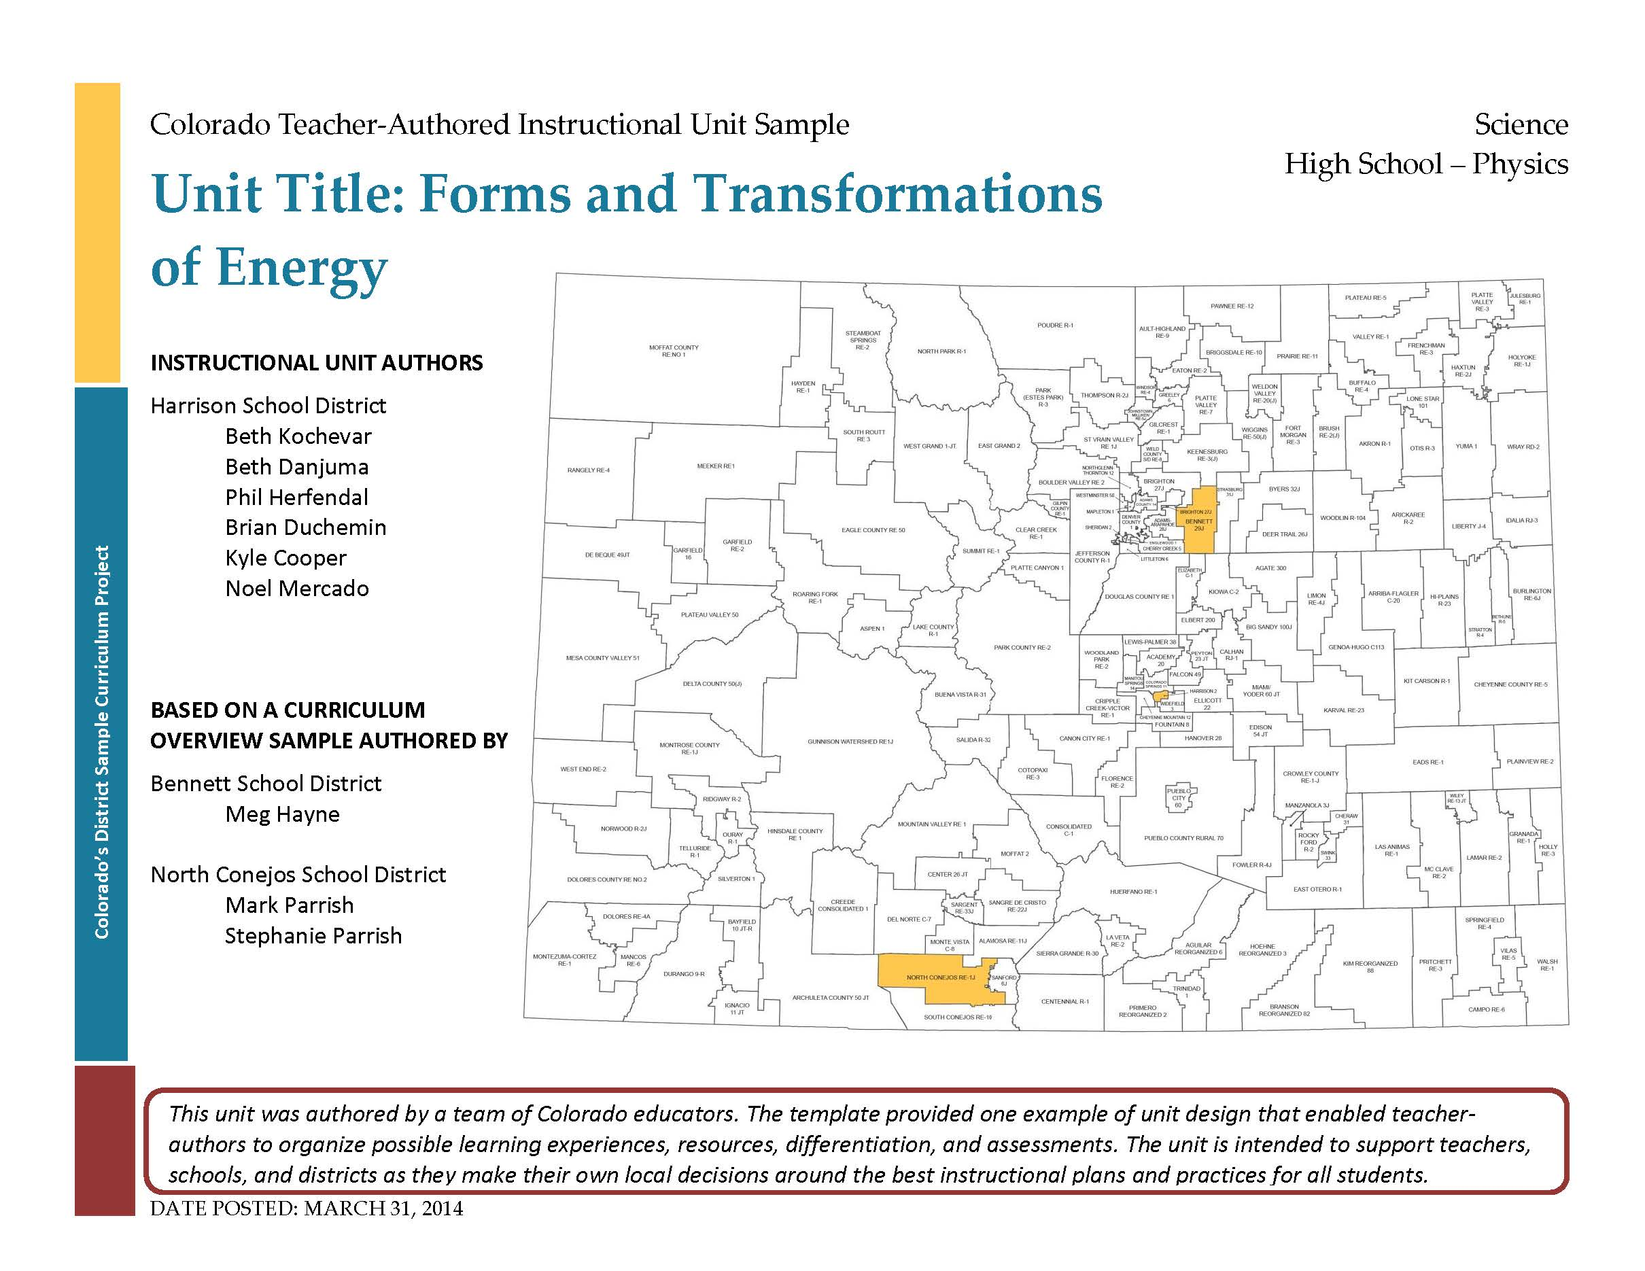

Slide 10
Content Area | Science |  |  | Grade Level | High School
Course Name/Course Code | Physics
Standard | Grade Level Expectations (GLE) |  |  |  |  |  | GLE Code
Physical Science | Newton’s laws of motion and gravitation describe the relationships among forces acting on and between objects, their masses, and changes in their motion – but have limitations |  |  |  |  |  | SC09-GR.HS-S.1-GLE.1
 | Matter has definite structure that determines characteristic physical and chemical properties |  |  |  |  |  | SC09-GR.HS-S.1-GLE.2
 | Matter can change form through chemical or nuclear reactions abiding by the laws of conservation of mass and energy |  |  |  |  |  | SC09-GR.HS-S.1-GLE.3
 | Atoms bond in different ways to form molecules and compounds that have definite properties |  |  |  |  |  | SC09-GR.HS-S.1-GLE.4
 | Energy exists in many forms such as mechanical, chemical, electrical, radiant, thermal, and nuclear, that can be quantified and experimentally determined |  |  |  |  |  | SC09-GR.HS-S.1-GLE.5
 | When energy changes form, it is neither created not destroyed; however, because some is necessarily lost as heat, the amount of energy available to do work decreases |  |  |  |  |  | SC09-GR.HS-S.1-GLE.6
Colorado 21st Century Skills Critical Thinking and Reasoning: Thinking Deeply, Thinking Differently Information Literacy: Untangling the Web Collaboration: Working Together, Learning Together Self-Direction: Own Your Learning Invention: Creating Solutions |  | Reading & Writing Standards for Literacy in Science and Technical Subjects 6 - 12 Reading Standards Key Ideas & Details Craft And Structure Integration of Knowledge and Ideas Range of Reading and Levels of Text Complexity Writing Standards Text Types & Purposes Production and Distribution of Writing Research to Construct and Present Knowledge Range of Writing
Unit Titles |  |  | Length of Unit/Contact Hours |  |  | Unit Number/Sequence
Forms and Transformations of Energy |  |  | 8-9 weeks |  |  | 4

Slide 11
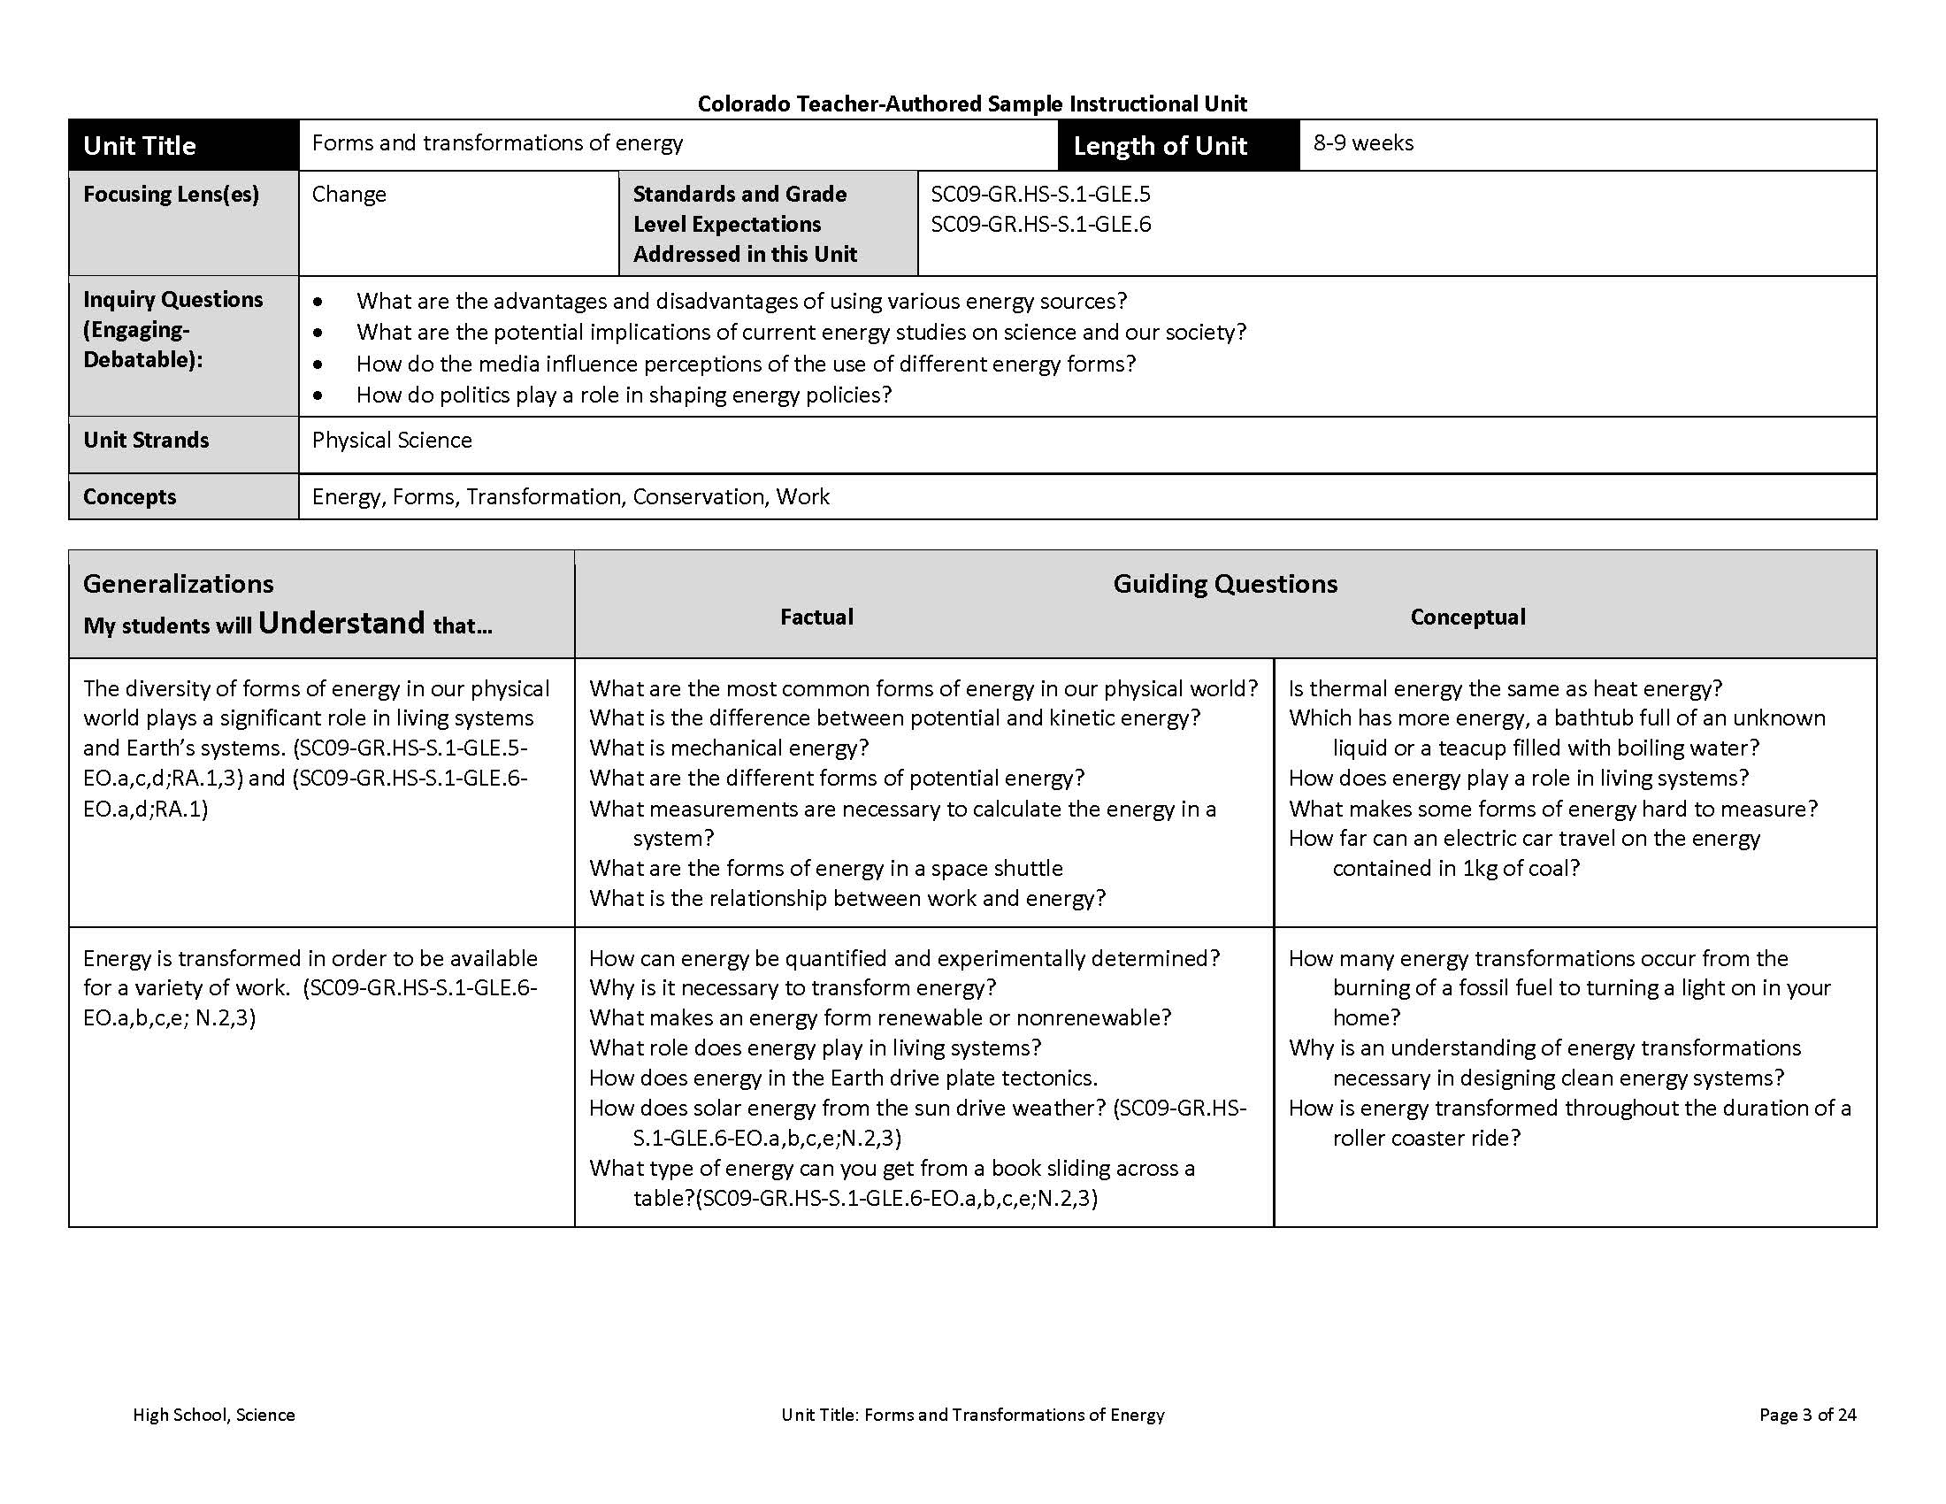
Notes:
Begin with course at a glance- in this case 4th grade social studies
Pre-populated with the standards and GLEs
Here’s a closer look at the economic standard for elementary SS and its 2 GLEs
Codes-Explain and highlight that these will recur throughout the document-visual illustration that ALL GLES and EOs are attended to within the units for a grade/content area
21st century skills cut across the standards Colorado's description of 21st century skills is a synthesis of the essential abilities students must apply in our fast changing world-emphasized and embedded across the standards

Slide 12
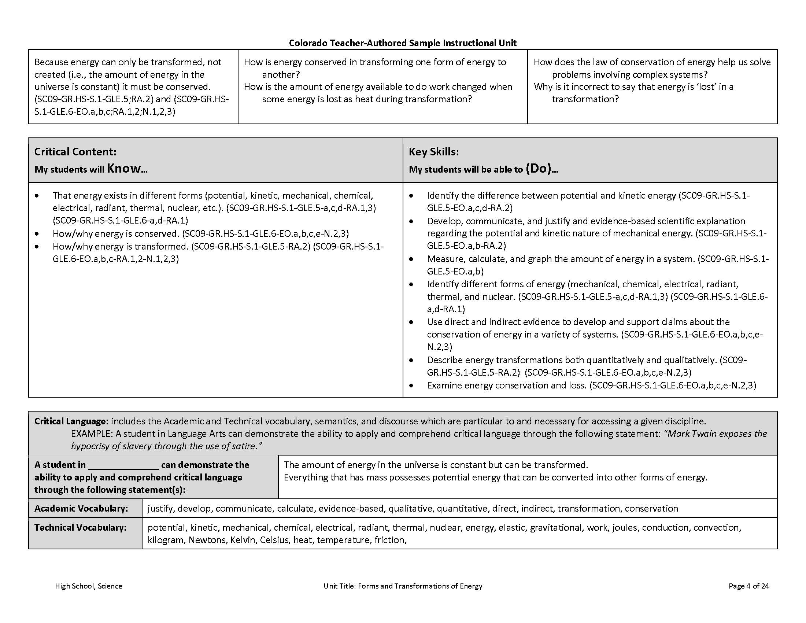
Notes:
Title
Length of unit
Standards and Grade Level Expectations
(Coding again….across the unit overview- coding illustrates the truly standards based nature of the units and will, eventually, add searchable and customizable options in the future postings of the samples)
Generalizations and associated guiding questions- The generalizations represent what students will understand as a result of the unit. In other words, the generalizations are the hoped-for outcomes that provide the basis for designing backwards the rest of the unit.
Right next to the generalizations are the guiding questions, both factual and conceptual, that represent inquiries directly linked to the generalizations/understandings.
Factual (Specific convergent content questions that have specific and/or right or wrong answers): What were the major cycles of Boom and Bust in Colorado over the past 150 years?
Conceptual (Broader divergent questions designed to provoke thoughtful, multiple, even subjective answers): How are personal or social values represented by the economic choices we make in our daily lives?
Both kinds of questions are essential for building those understandings, those generalizations.

Slide 13
Project Overview
Lesson Plans will be the work of individual schools and teachers.
Lesson Plan
Standards
Lesson Plan
Instructional Unit Development
Lesson Plan
Unit Overview
Year At A Glance
(page 1)

Slide 14
Teacher-Authored Samples
Instructional Units
During a three-day workshop a team of educators created an instructional unit designed to provide teachers with support for using their professional judgment to teach to student mastery of the standards-based generalizations, content, and skills of one selected overview.
Teams were typically comprised of:
  2 general education teachers (content specialists)
  1 ELL teacher
  1 Gifted and Talented teacher
  1 Special education teacher
  1 Title One teacher
  100+ units developed and published on March 31, 2014 (one for each grade k-12 mathematics, reading, writing, and communicating, science, social studies, comprehensive health, visual arts, drama/theatre, dance, and music).

Slide 15
Specific Items within the Science Instructional Units
Possible misconceptions
Vertical articulation
Cross-cutting concepts
Scientific Practices

Slide 16
Generalizations: The Starting Point
Generalizations My students will Understand that… | Guiding Questions Factual Conceptual
The diversity of forms of energy in our physical world plays a significant role in living systems and Earth’s systems. | What are the most common forms of energy in our physical world? What is the difference between potential and kinetic energy? What is mechanical energy? What are the different forms of potential energy? What measurements are necessary to calculate the energy in a system? What is the relationship between work and energy? | Is thermal energy the same as heat energy? Which has more energy, a bathtub full of an unknown liquid or a teacup filled with boiling water? How does energy play a role in living systems? What makes some forms of energy hard to measure? How far can an electric car travel on the energy contained in 1kg of coal?
Energy is transformed in order to be available for a variety of work. | How can energy be quantified and experimentally determined? Why is it necessary to transform energy? What makes an energy form renewable or nonrenewable? What role does energy play in living systems? How does energy in the Earth drive plate tectonics. How does solar energy from the sun drive weather? What type of energy can you get from a book sliding across a table? | How many energy transformations occur from the burning of a fossil fuel to turning a light on in your home? Why is an understanding of energy transformations necessary in designing clean energy systems? How is energy transformed throughout the duration of a roller coaster ride?
Because energy can only be transformed, not created (i.e., the amount of energy in the universe is constant) it must be conserved. | How is energy conserved in transforming one form of energy to another? How is the amount of energy available to do work changed when some energy is lost as heat during transformation? | How does the law of conservation of energy help us solve problems involving complex systems? Why is it incorrect to say that energy is ‘lost’ in a transformation?
Notes:
Had teachers engage with the standards to contextualize the generalizations and re-orient them to the particular standards that were tied to this unit.

Slide 17
Digging into the Generalizations
What do the generalizations mean?
      What examples would illustrate the generalization?
      What content, concepts, and skills could be taught in order to help students reach the generalization?
      What needs to be taught?
      What have I done in the past or am currently doing?
Notes:
Sequence, Clusters, sense-making

Slide 18
The KEY Generalization- The all encompassing heart of the unit!
Key Generalization: | Because energy can only be transformed, not created (i.e., the amount of energy in the universe is constant) it must be conserved
Supporting Generalizations: | The diversity of forms of energy in our physical world plays a significant role in living systems and Earth’s systems
 | Energy is transformed in order to be available for a variety of work

Slide 19
The Capstone Performance Assessment-R.A.F.T.
Key generalization-the basis for the creation of the PA (RAFT):
  Role: Who are you? A scientist? A community member? A student?
  Audience: To whom are you writing/speaking/presenting? A political forum? School Board? City Council?
  Format: In what format are you writing/speaking/presenting? A letter? An advertisement? A speech? A report?
  Topic: What are you writing/speaking/presenting about ?
R: Student
A: Local School Board
F: Report
T: Decreasing energy consumption across the district

Slide 20
Performance Assessment
R.A.F.T. | You have been asked by your local school board to investigate four scenarios around decreasing energy consumption across the district in order to conserve energy and to create a report recommending two of the four for consideration. In your investigation you must calculate efficiency and total energy used, compare current energy usage to the proposed options, explain why there is not 100% efficiency for any option, and what happens to the unusable energy. In your report you must recommend two options that lead to decreased energy consumption, provide written rationale based on data collected, and support recommendations using graphical representation of data. Scenarios: Replace 50,000 inefficient light bulbs with high efficiency L.E.D. bulbs. Replace school’s current gas-powered lawnmower with electrical lawnmower. Replace current computer screens with newer models. Replace soda machines with candy machines.

Slide 21
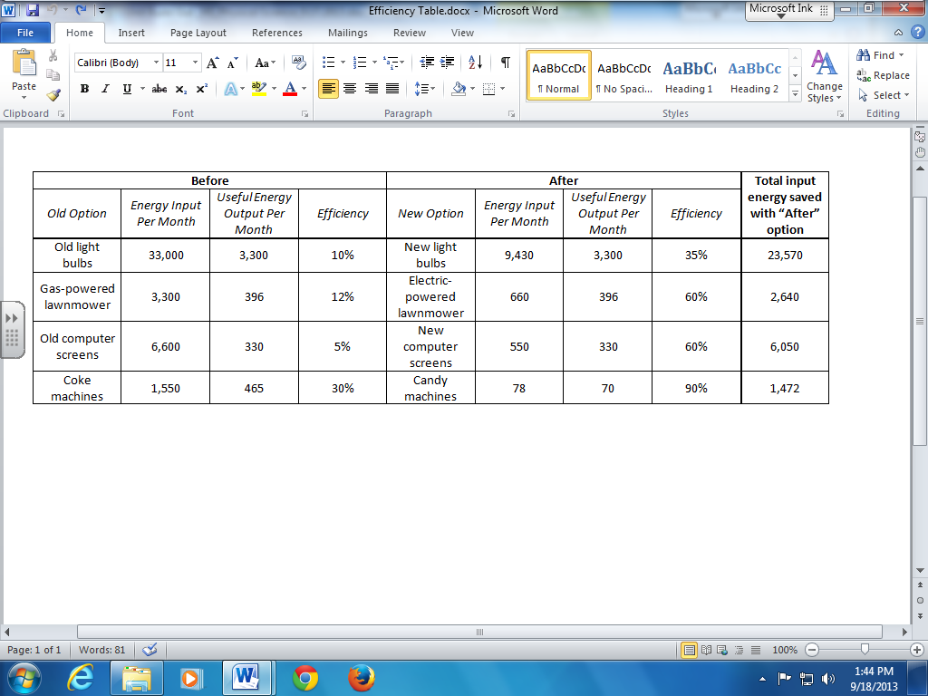
Performance Assessment: The capstone/summative assessment for this unit.
Claims: (Key generalization(s) to be mastered and demonstrated through the capstone assessment.) | Because energy can only be transformed, not created (i.e., the amount of energy in the universe is constant) it must be conserved.
Stimulus Material: (Engaging scenario that includes role, audience, goal/outcome and explicitly connects the key generalization) | You have been asked by your local school board to investigate four scenarios around decreasing energy consumption across the district in order to conserve energy and to create a report recommending two of the four for consideration. In your investigation you must calculate efficiency and total energy used, compare current energy usage to the proposed options, explain why there is not 100% efficiency for any option, and what happens to the unusable energy. In your report you must recommend two options that lead to decreased energy consumption, provide written rationale based on data collected, and support recommendations using graphical representation of data. Scenarios: Replace 50,000 inefficient light bulbs with high efficiency L.E.D. bulbs. Replace school’s current gas-powered lawnmower with electrical lawnmower. Replace current computer screens with newer models. Replace soda machines with candy machines. Data table should not be provided in full. Students should be asked to calculate efficiency, input, or output given the other two. The entire final column should be blank.
Product/Evidence: (Expected product from students) | Students will produce a report to their local school board based on their recommendations for decreasing energy consumption using energy efficiency as a consideration. They must complete necessary calculations to fill in a data table, compare and contrast current usage and proposed options in a graphical format, provide written rationale/justification for the two selected options using data and graphs, and explain why there is not 100% efficiency with any energy usage and what happens to the unusable energy
Differentiation: (Multiple modes for student expression) | The teacher may incorporate accommodations/modifications of IEP such as extended time, oral presentation, use of dictionaries, etc. The teacher may reduce the number of options proposed The teacher may scaffold report, providing the structure of the report (e.g., data table calculation, graph axes, stems or prompts for rationale The teacher may provide opportunity to produce a report using alternative modes of communication The teacher may provide defined independent and dependent variables for graphs and have student fill in label blanks on graph, or provide skeleton graph as a prompt The teacher may provide appropriate formulas for use during calculation To extend this work, students may research options to collect own data. Have students also research cost-effectiveness of each option and reevaluate best options in light of new information. Have students generate own options to propose, research and evaluate.

Slide 22
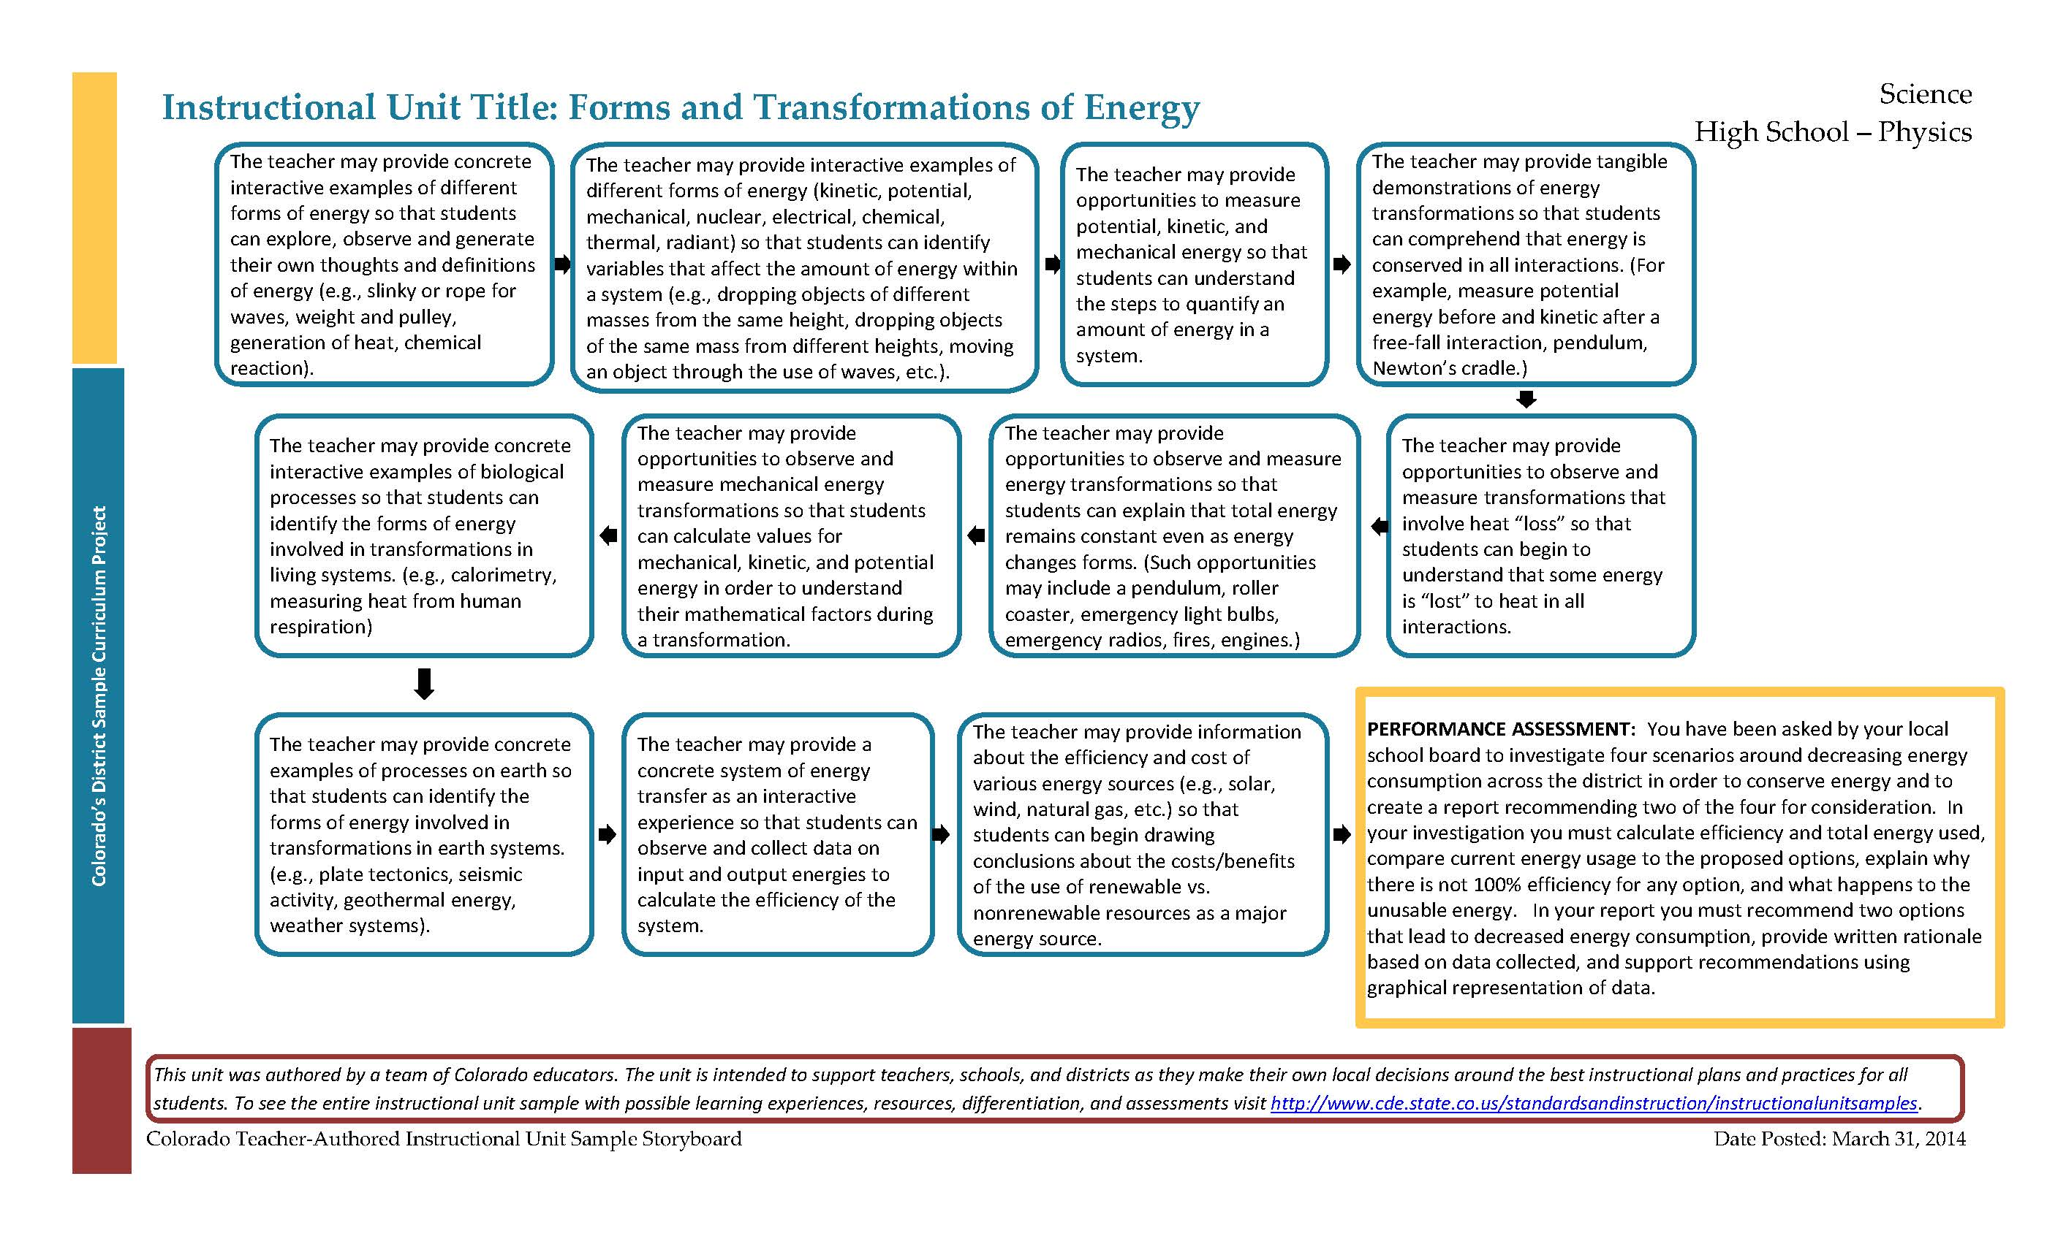
Unit Trajectory- Learning Experiences

Slide 23
Instructional Unit Learning Experiences
Learning Experience # 6
The teacher may provide opportunities to observe and measure energy transformations so that students can explain that total energy remains constant even as energy changes forms. (Such opportunities may include a pendulum, roller coaster, emergency light bulbs, emergency radios, fires, engines.)
Generalization Connection(s): | The diversity of forms of energy in our physical world plays a significant role in living systems and Earth’s systems Energy is transformed in order to be available for a variety of work
Teacher Resources: | http://examples.yourdictionary.com/law-of-conservation-of-energy-examples.html (Examples of various energy transformations) http://electronics.howstuffworks.com/gadgets/travel/hand-powered-generators.htm (Explanation of how hand held generators work)
Student Resources: | http://www.passmyexams.co.uk/GCSE/physics/energy-transfer.html (Energy transformation diagrams and explanation) http://www.math.com/school/subject2/lessons/S2U1L2GL.html (Walks students through order of operations problems step-by-step checking for understanding along the way) http://www.algebrahelp.com/worksheets/view/simplifying/oops.quiz (Online order of operations worksheet with a worked out example and step-by-step instructions available for each problem) http://www.coolmath.com/prealgebra/05-order-of-operations/01-order-of-operations-why-01.htm (Slide show overview order of operations including worked out examples and practice problems)
Assessment: | Students will describe a variety of energy transformations in terms of the forms and values of their input energy and output energy. (For example, a product made on a production line, the operation of an appliance, an engine, a fire, etc. and/or students can write a letter from the viewpoint of a production line manager detailing the transformations and input/output energy.)
Differentiation: (Multiple means for students to access content and multiple modes for student to express understanding.) | Access (Resources and/or Process) | Expression (Products and/or Performance)
 | The teacher may provide consistent steps to complete when analyzing a transformation The teacher may provide word bank to complete analysis of energy transformation The teacher may provide diagrams of transformations for students to fill in forms of energy http://www.bbc.co.uk/bitesize/ks3/science/energy_electricity_forces/energy_transfer_storage/revision/3/ (Diagrams of energy transfer in various everyday objects) | The student may diagram transformations of energy
Extensions for depth and complexity: | Access (Resources and/or Process) | Expression (Products and/or Performance)
 | http://www.education.com/science-fair/article/converting-motion-into-energy/ (Simple device design experiment) http://www.ptc.com/company/community/education/schools/students/real-world-design-challenge/ (Competition high school students can enter for energy design challenges) http://pbskids.org/designsquad/parentseducators/resources/ (Ideas for numerous design challenge devices) | The student may design a device that accomplishes an everyday task around the home, utilizing different energy transformations.
Critical Content: | Total input energy = total output energy Common transformations (e.g., mechanical to electrical, chemical to thermal, potential to kinetic)
Key Skills: | Identifying forms of energy Differentiating input and output energy
Critical Language: | Energy, transformation, input, output, constant, identify, differentiate, design, describe
The teacher may provide opportunities to observe and measure energy transformations so that students can explain that total energy remains constant even as energy changes forms. (Such opportunities may include a pendulum, roller coaster, emergency light bulbs, emergency radios, fires, engines.)

Slide 24
Instructional Unit Learning Experiences
Learning Experience # 6
The teacher may provide opportunities to observe and measure energy transformations so that students can explain that total energy remains constant even as energy changes forms. (Such opportunities may include a pendulum, roller coaster, emergency light bulbs, emergency radios, fires, engines.)
Generalization Connection(s): | The diversity of forms of energy in our physical world plays a significant role in living systems and Earth’s systems Energy is transformed in order to be available for a variety of work
Teacher Resources: | http://examples.yourdictionary.com/law-of-conservation-of-energy-examples.html (Examples of various energy transformations) http://electronics.howstuffworks.com/gadgets/travel/hand-powered-generators.htm (Explanation of how hand held generators work)
Student Resources: | http://www.passmyexams.co.uk/GCSE/physics/energy-transfer.html (Energy transformation diagrams and explanation) http://www.math.com/school/subject2/lessons/S2U1L2GL.html (Walks students through order of operations problems step-by-step checking for understanding along the way) http://www.algebrahelp.com/worksheets/view/simplifying/oops.quiz (Online order of operations worksheet with a worked out example and step-by-step instructions available for each problem) http://www.coolmath.com/prealgebra/05-order-of-operations/01-order-of-operations-why-01.htm (Slide show overview order of operations including worked out examples and practice problems)
Assessment: | Students will describe a variety of energy transformations in terms of the forms and values of their input energy and output energy. (For example, a product made on a production line, the operation of an appliance, an engine, a fire, etc. and/or students can write a letter from the viewpoint of a production line manager detailing the transformations and input/output energy.)
Differentiation: (Multiple means for students to access content and multiple modes for student to express understanding.) | Access (Resources and/or Process) | Expression (Products and/or Performance)
 | The teacher may provide consistent steps to complete when analyzing a transformation The teacher may provide word bank to complete analysis of energy transformation The teacher may provide diagrams of transformations for students to fill in forms of energy http://www.bbc.co.uk/bitesize/ks3/science/energy_electricity_forces/energy_transfer_storage/revision/3/ (Diagrams of energy transfer in various everyday objects) | The student may diagram transformations of energy
Extensions for depth and complexity: | Access (Resources and/or Process) | Expression (Products and/or Performance)
 | http://www.education.com/science-fair/article/converting-motion-into-energy/ (Simple device design experiment) http://www.ptc.com/company/community/education/schools/students/real-world-design-challenge/ (Competition high school students can enter for energy design challenges) http://pbskids.org/designsquad/parentseducators/resources/ (Ideas for numerous design challenge devices) | The student may design a device that accomplishes an everyday task around the home, utilizing different energy transformations.
Critical Content: | Total input energy = total output energy Common transformations (e.g., mechanical to electrical, chemical to thermal, potential to kinetic)
Key Skills: | Identifying forms of energy Differentiating input and output energy
Critical Language: | Energy, transformation, input, output, constant, identify, differentiate, design, describe
Generalization Connection(s): | The diversity of forms of energy in our physical world plays a significant role in living systems and Earth’s systems Energy is transformed in order to be available for a variety of work

Slide 25
Instructional Unit Learning Experiences
Learning Experience # 6
The teacher may provide opportunities to observe and measure energy transformations so that students can explain that total energy remains constant even as energy changes forms. (Such opportunities may include a pendulum, roller coaster, emergency light bulbs, emergency radios, fires, engines.)
Generalization Connection(s): | The diversity of forms of energy in our physical world plays a significant role in living systems and Earth’s systems Energy is transformed in order to be available for a variety of work
Teacher Resources: | http://examples.yourdictionary.com/law-of-conservation-of-energy-examples.html (Examples of various energy transformations) http://electronics.howstuffworks.com/gadgets/travel/hand-powered-generators.htm (Explanation of how hand held generators work)
Student Resources: | http://www.passmyexams.co.uk/GCSE/physics/energy-transfer.html (Energy transformation diagrams and explanation) http://www.math.com/school/subject2/lessons/S2U1L2GL.html (Walks students through order of operations problems step-by-step checking for understanding along the way) http://www.algebrahelp.com/worksheets/view/simplifying/oops.quiz (Online order of operations worksheet with a worked out example and step-by-step instructions available for each problem) http://www.coolmath.com/prealgebra/05-order-of-operations/01-order-of-operations-why-01.htm (Slide show overview order of operations including worked out examples and practice problems)
Assessment: | Students will describe a variety of energy transformations in terms of the forms and values of their input energy and output energy. (For example, a product made on a production line, the operation of an appliance, an engine, a fire, etc. and/or students can write a letter from the viewpoint of a production line manager detailing the transformations and input/output energy.)
Differentiation: (Multiple means for students to access content and multiple modes for student to express understanding.) | Access (Resources and/or Process) | Expression (Products and/or Performance)
 | The teacher may provide consistent steps to complete when analyzing a transformation The teacher may provide word bank to complete analysis of energy transformation The teacher may provide diagrams of transformations for students to fill in forms of energy http://www.bbc.co.uk/bitesize/ks3/science/energy_electricity_forces/energy_transfer_storage/revision/3/ (Diagrams of energy transfer in various everyday objects) | The student may diagram transformations of energy
Extensions for depth and complexity: | Access (Resources and/or Process) | Expression (Products and/or Performance)
 | http://www.education.com/science-fair/article/converting-motion-into-energy/ (Simple device design experiment) http://www.ptc.com/company/community/education/schools/students/real-world-design-challenge/ (Competition high school students can enter for energy design challenges) http://pbskids.org/designsquad/parentseducators/resources/ (Ideas for numerous design challenge devices) | The student may design a device that accomplishes an everyday task around the home, utilizing different energy transformations.
Critical Content: | Total input energy = total output energy Common transformations (e.g., mechanical to electrical, chemical to thermal, potential to kinetic)
Key Skills: | Identifying forms of energy Differentiating input and output energy
Critical Language: | Energy, transformation, input, output, constant, identify, differentiate, design, describe
Teacher Resources: | http://examples.yourdictionary.com/law-of-conservation-of-energy-examples.html (Examples of various energy transformations) http://electronics.howstuffworks.com/gadgets/travel/hand-powered-generators.htm (Explanation of how hand held generators work)
Student Resources: | http://www.passmyexams.co.uk/GCSE/physics/energy-transfer.html (Energy transformation diagrams and explanation) http://www.math.com/school/subject2/lessons/S2U1L2GL.html (Walks students through order of operations problems step-by-step checking for understanding along the way) http://www.algebrahelp.com/worksheets/view/simplifying/oops.quiz (Online order of operations worksheet with a worked out example and step-by-step instructions available for each problem) http://www.coolmath.com/prealgebra/05-order-of-operations/01-order-of-operations-why-01.htm (Slide show overview order of operations including worked out examples and practice problems)

Slide 26
Instructional Unit Learning Experiences
Learning Experience # 6
The teacher may provide opportunities to observe and measure energy transformations so that students can explain that total energy remains constant even as energy changes forms. (Such opportunities may include a pendulum, roller coaster, emergency light bulbs, emergency radios, fires, engines.)
Generalization Connection(s): | The diversity of forms of energy in our physical world plays a significant role in living systems and Earth’s systems Energy is transformed in order to be available for a variety of work
Teacher Resources: | http://examples.yourdictionary.com/law-of-conservation-of-energy-examples.html (Examples of various energy transformations) http://electronics.howstuffworks.com/gadgets/travel/hand-powered-generators.htm (Explanation of how hand held generators work)
Student Resources: | http://www.passmyexams.co.uk/GCSE/physics/energy-transfer.html (Energy transformation diagrams and explanation) http://www.math.com/school/subject2/lessons/S2U1L2GL.html (Walks students through order of operations problems step-by-step checking for understanding along the way) http://www.algebrahelp.com/worksheets/view/simplifying/oops.quiz (Online order of operations worksheet with a worked out example and step-by-step instructions available for each problem) http://www.coolmath.com/prealgebra/05-order-of-operations/01-order-of-operations-why-01.htm (Slide show overview order of operations including worked out examples and practice problems)
Assessment: | Students will describe a variety of energy transformations in terms of the forms and values of their input energy and output energy. (For example, a product made on a production line, the operation of an appliance, an engine, a fire, etc. and/or students can write a letter from the viewpoint of a production line manager detailing the transformations and input/output energy.)
Differentiation: (Multiple means for students to access content and multiple modes for student to express understanding.) | Access (Resources and/or Process) | Expression (Products and/or Performance)
 | The teacher may provide consistent steps to complete when analyzing a transformation The teacher may provide word bank to complete analysis of energy transformation The teacher may provide diagrams of transformations for students to fill in forms of energy http://www.bbc.co.uk/bitesize/ks3/science/energy_electricity_forces/energy_transfer_storage/revision/3/ (Diagrams of energy transfer in various everyday objects) | The student may diagram transformations of energy
Extensions for depth and complexity: | Access (Resources and/or Process) | Expression (Products and/or Performance)
 | http://www.education.com/science-fair/article/converting-motion-into-energy/ (Simple device design experiment) http://www.ptc.com/company/community/education/schools/students/real-world-design-challenge/ (Competition high school students can enter for energy design challenges) http://pbskids.org/designsquad/parentseducators/resources/ (Ideas for numerous design challenge devices) | The student may design a device that accomplishes an everyday task around the home, utilizing different energy transformations.
Critical Content: | Total input energy = total output energy Common transformations (e.g., mechanical to electrical, chemical to thermal, potential to kinetic)
Key Skills: | Identifying forms of energy Differentiating input and output energy
Critical Language: | Energy, transformation, input, output, constant, identify, differentiate, design, describe
Assessment: | Students will describe a variety of energy transformations in terms of the forms and values of their input energy and output energy. (For example, a product made on a production line, the operation of an appliance, an engine, a fire, etc. and/or students can write a letter from the viewpoint of a production line manager detailing the transformations and input/output energy.)

Slide 27
Instructional Unit Learning Experiences
Learning Experience # 6
The teacher may provide opportunities to observe and measure energy transformations so that students can explain that total energy remains constant even as energy changes forms. (Such opportunities may include a pendulum, roller coaster, emergency light bulbs, emergency radios, fires, engines.)
Generalization Connection(s): | The diversity of forms of energy in our physical world plays a significant role in living systems and Earth’s systems Energy is transformed in order to be available for a variety of work
Teacher Resources: | http://examples.yourdictionary.com/law-of-conservation-of-energy-examples.html (Examples of various energy transformations) http://electronics.howstuffworks.com/gadgets/travel/hand-powered-generators.htm (Explanation of how hand held generators work)
Student Resources: | http://www.passmyexams.co.uk/GCSE/physics/energy-transfer.html (Energy transformation diagrams and explanation) http://www.math.com/school/subject2/lessons/S2U1L2GL.html (Walks students through order of operations problems step-by-step checking for understanding along the way) http://www.algebrahelp.com/worksheets/view/simplifying/oops.quiz (Online order of operations worksheet with a worked out example and step-by-step instructions available for each problem) http://www.coolmath.com/prealgebra/05-order-of-operations/01-order-of-operations-why-01.htm (Slide show overview order of operations including worked out examples and practice problems)
Assessment: | Students will describe a variety of energy transformations in terms of the forms and values of their input energy and output energy. (For example, a product made on a production line, the operation of an appliance, an engine, a fire, etc. and/or students can write a letter from the viewpoint of a production line manager detailing the transformations and input/output energy.)
Differentiation: (Multiple means for students to access content and multiple modes for student to express understanding.) | Access (Resources and/or Process) | Expression (Products and/or Performance)
 | The teacher may provide consistent steps to complete when analyzing a transformation The teacher may provide word bank to complete analysis of energy transformation The teacher may provide diagrams of transformations for students to fill in forms of energy http://www.bbc.co.uk/bitesize/ks3/science/energy_electricity_forces/energy_transfer_storage/revision/3/ (Diagrams of energy transfer in various everyday objects) | The student may diagram transformations of energy
Extensions for depth and complexity: | Access (Resources and/or Process) | Expression (Products and/or Performance)
 | http://www.education.com/science-fair/article/converting-motion-into-energy/ (Simple device design experiment) http://www.ptc.com/company/community/education/schools/students/real-world-design-challenge/ (Competition high school students can enter for energy design challenges) http://pbskids.org/designsquad/parentseducators/resources/ (Ideas for numerous design challenge devices) | The student may design a device that accomplishes an everyday task around the home, utilizing different energy transformations.
Critical Content: | Total input energy = total output energy Common transformations (e.g., mechanical to electrical, chemical to thermal, potential to kinetic)
Key Skills: | Identifying forms of energy Differentiating input and output energy
Critical Language: | Energy, transformation, input, output, constant, identify, differentiate, design, describe
Differentiation: (Multiple means for students to access content and multiple modes for student to express understanding.) | Access (Resources and/or Process) | Expression (Products and/or Performance)
 | The teacher may provide consistent steps to complete when analyzing a transformation The teacher may provide word bank to complete analysis of energy transformation The teacher may provide diagrams of transformations for students to fill in forms of energy http://www.bbc.co.uk/bitesize/ks3/science/energy_electricity_forces/energy_transfer_storage/revision/3/ (Diagrams of energy transfer in various everyday objects) | The student may diagram transformations of energy

Slide 28
Instructional Unit Learning Experiences
Learning Experience # 6
The teacher may provide opportunities to observe and measure energy transformations so that students can explain that total energy remains constant even as energy changes forms. (Such opportunities may include a pendulum, roller coaster, emergency light bulbs, emergency radios, fires, engines.)
Generalization Connection(s): | The diversity of forms of energy in our physical world plays a significant role in living systems and Earth’s systems Energy is transformed in order to be available for a variety of work
Teacher Resources: | http://examples.yourdictionary.com/law-of-conservation-of-energy-examples.html (Examples of various energy transformations) http://electronics.howstuffworks.com/gadgets/travel/hand-powered-generators.htm (Explanation of how hand held generators work)
Student Resources: | http://www.passmyexams.co.uk/GCSE/physics/energy-transfer.html (Energy transformation diagrams and explanation) http://www.math.com/school/subject2/lessons/S2U1L2GL.html (Walks students through order of operations problems step-by-step checking for understanding along the way) http://www.algebrahelp.com/worksheets/view/simplifying/oops.quiz (Online order of operations worksheet with a worked out example and step-by-step instructions available for each problem) http://www.coolmath.com/prealgebra/05-order-of-operations/01-order-of-operations-why-01.htm (Slide show overview order of operations including worked out examples and practice problems)
Assessment: | Students will describe a variety of energy transformations in terms of the forms and values of their input energy and output energy. (For example, a product made on a production line, the operation of an appliance, an engine, a fire, etc. and/or students can write a letter from the viewpoint of a production line manager detailing the transformations and input/output energy.)
Differentiation: (Multiple means for students to access content and multiple modes for student to express understanding.) | Access (Resources and/or Process) | Expression (Products and/or Performance)
 | The teacher may provide consistent steps to complete when analyzing a transformation The teacher may provide word bank to complete analysis of energy transformation The teacher may provide diagrams of transformations for students to fill in forms of energy http://www.bbc.co.uk/bitesize/ks3/science/energy_electricity_forces/energy_transfer_storage/revision/3/ (Diagrams of energy transfer in various everyday objects) | The student may diagram transformations of energy
Extensions for depth and complexity: | Access (Resources and/or Process) | Expression (Products and/or Performance)
 | http://www.education.com/science-fair/article/converting-motion-into-energy/ (Simple device design experiment) http://www.ptc.com/company/community/education/schools/students/real-world-design-challenge/ (Competition high school students can enter for energy design challenges) http://pbskids.org/designsquad/parentseducators/resources/ (Ideas for numerous design challenge devices) | The student may design a device that accomplishes an everyday task around the home, utilizing different energy transformations.
Critical Content: | Total input energy = total output energy Common transformations (e.g., mechanical to electrical, chemical to thermal, potential to kinetic)
Key Skills: | Identifying forms of energy Differentiating input and output energy
Critical Language: | Energy, transformation, input, output, constant, identify, differentiate, design, describe
Extensions for depth and complexity: | Access (Resources and/or Process) | Expression (Products and/or Performance)
 | http://www.education.com/science-fair/article/converting-motion-into-energy/ (Simple device design experiment) http://www.ptc.com/company/community/education/schools/students/real-world-design-challenge/ (Competition high school students can enter for energy design challenges) http://pbskids.org/designsquad/parentseducators/resources/ (Ideas for numerous design challenge devices) | The student may design a device that accomplishes an everyday task around the home, utilizing different energy transformations.

Slide 29
Instructional Unit Learning Experiences
Learning Experience # 6
The teacher may provide opportunities to observe and measure energy transformations so that students can explain that total energy remains constant even as energy changes forms. (Such opportunities may include a pendulum, roller coaster, emergency light bulbs, emergency radios, fires, engines.)
Generalization Connection(s): | The diversity of forms of energy in our physical world plays a significant role in living systems and Earth’s systems Energy is transformed in order to be available for a variety of work
Teacher Resources: | http://examples.yourdictionary.com/law-of-conservation-of-energy-examples.html (Examples of various energy transformations) http://electronics.howstuffworks.com/gadgets/travel/hand-powered-generators.htm (Explanation of how hand held generators work)
Student Resources: | http://www.passmyexams.co.uk/GCSE/physics/energy-transfer.html (Energy transformation diagrams and explanation) http://www.math.com/school/subject2/lessons/S2U1L2GL.html (Walks students through order of operations problems step-by-step checking for understanding along the way) http://www.algebrahelp.com/worksheets/view/simplifying/oops.quiz (Online order of operations worksheet with a worked out example and step-by-step instructions available for each problem) http://www.coolmath.com/prealgebra/05-order-of-operations/01-order-of-operations-why-01.htm (Slide show overview order of operations including worked out examples and practice problems)
Assessment: | Students will describe a variety of energy transformations in terms of the forms and values of their input energy and output energy. (For example, a product made on a production line, the operation of an appliance, an engine, a fire, etc. and/or students can write a letter from the viewpoint of a production line manager detailing the transformations and input/output energy.)
Differentiation: (Multiple means for students to access content and multiple modes for student to express understanding.) | Access (Resources and/or Process) | Expression (Products and/or Performance)
 | The teacher may provide consistent steps to complete when analyzing a transformation The teacher may provide word bank to complete analysis of energy transformation The teacher may provide diagrams of transformations for students to fill in forms of energy http://www.bbc.co.uk/bitesize/ks3/science/energy_electricity_forces/energy_transfer_storage/revision/3/ (Diagrams of energy transfer in various everyday objects) | The student may diagram transformations of energy
Extensions for depth and complexity: | Access (Resources and/or Process) | Expression (Products and/or Performance)
 | http://www.education.com/science-fair/article/converting-motion-into-energy/ (Simple device design experiment) http://www.ptc.com/company/community/education/schools/students/real-world-design-challenge/ (Competition high school students can enter for energy design challenges) http://pbskids.org/designsquad/parentseducators/resources/ (Ideas for numerous design challenge devices) | The student may design a device that accomplishes an everyday task around the home, utilizing different energy transformations.
Critical Content: | Total input energy = total output energy Common transformations (e.g., mechanical to electrical, chemical to thermal, potential to kinetic)
Key Skills: | Identifying forms of energy Differentiating input and output energy
Critical Language: | Energy, transformation, input, output, constant, identify, differentiate, design, describe
Critical Content: | Total input energy = total output energy Common transformations (e.g., mechanical to electrical, chemical to thermal, potential to kinetic)

Slide 30
Instructional Unit Learning Experiences
Learning Experience # 6
The teacher may provide opportunities to observe and measure energy transformations so that students can explain that total energy remains constant even as energy changes forms. (Such opportunities may include a pendulum, roller coaster, emergency light bulbs, emergency radios, fires, engines.)
Generalization Connection(s): | The diversity of forms of energy in our physical world plays a significant role in living systems and Earth’s systems Energy is transformed in order to be available for a variety of work
Teacher Resources: | http://examples.yourdictionary.com/law-of-conservation-of-energy-examples.html (Examples of various energy transformations) http://electronics.howstuffworks.com/gadgets/travel/hand-powered-generators.htm (Explanation of how hand held generators work)
Student Resources: | http://www.passmyexams.co.uk/GCSE/physics/energy-transfer.html (Energy transformation diagrams and explanation) http://www.math.com/school/subject2/lessons/S2U1L2GL.html (Walks students through order of operations problems step-by-step checking for understanding along the way) http://www.algebrahelp.com/worksheets/view/simplifying/oops.quiz (Online order of operations worksheet with a worked out example and step-by-step instructions available for each problem) http://www.coolmath.com/prealgebra/05-order-of-operations/01-order-of-operations-why-01.htm (Slide show overview order of operations including worked out examples and practice problems)
Assessment: | Students will describe a variety of energy transformations in terms of the forms and values of their input energy and output energy. (For example, a product made on a production line, the operation of an appliance, an engine, a fire, etc. and/or students can write a letter from the viewpoint of a production line manager detailing the transformations and input/output energy.)
Differentiation: (Multiple means for students to access content and multiple modes for student to express understanding.) | Access (Resources and/or Process) | Expression (Products and/or Performance)
 | The teacher may provide consistent steps to complete when analyzing a transformation The teacher may provide word bank to complete analysis of energy transformation The teacher may provide diagrams of transformations for students to fill in forms of energy http://www.bbc.co.uk/bitesize/ks3/science/energy_electricity_forces/energy_transfer_storage/revision/3/ (Diagrams of energy transfer in various everyday objects) | The student may diagram transformations of energy
Extensions for depth and complexity: | Access (Resources and/or Process) | Expression (Products and/or Performance)
 | http://www.education.com/science-fair/article/converting-motion-into-energy/ (Simple device design experiment) http://www.ptc.com/company/community/education/schools/students/real-world-design-challenge/ (Competition high school students can enter for energy design challenges) http://pbskids.org/designsquad/parentseducators/resources/ (Ideas for numerous design challenge devices) | The student may design a device that accomplishes an everyday task around the home, utilizing different energy transformations.
Critical Content: | Total input energy = total output energy Common transformations (e.g., mechanical to electrical, chemical to thermal, potential to kinetic)
Key Skills: | Identifying forms of energy Differentiating input and output energy
Critical Language: | Energy, transformation, input, output, constant, identify, differentiate, design, describe
Key Skills: | Identifying forms of energy Differentiating input and output energy

Slide 31
Instructional Unit Learning Experiences
Learning Experience # 6
The teacher may provide opportunities to observe and measure energy transformations so that students can explain that total energy remains constant even as energy changes forms. (Such opportunities may include a pendulum, roller coaster, emergency light bulbs, emergency radios, fires, engines.)
Generalization Connection(s): | The diversity of forms of energy in our physical world plays a significant role in living systems and Earth’s systems Energy is transformed in order to be available for a variety of work
Teacher Resources: | http://examples.yourdictionary.com/law-of-conservation-of-energy-examples.html (Examples of various energy transformations) http://electronics.howstuffworks.com/gadgets/travel/hand-powered-generators.htm (Explanation of how hand held generators work)
Student Resources: | http://www.passmyexams.co.uk/GCSE/physics/energy-transfer.html (Energy transformation diagrams and explanation) http://www.math.com/school/subject2/lessons/S2U1L2GL.html (Walks students through order of operations problems step-by-step checking for understanding along the way) http://www.algebrahelp.com/worksheets/view/simplifying/oops.quiz (Online order of operations worksheet with a worked out example and step-by-step instructions available for each problem) http://www.coolmath.com/prealgebra/05-order-of-operations/01-order-of-operations-why-01.htm (Slide show overview order of operations including worked out examples and practice problems)
Assessment: | Students will describe a variety of energy transformations in terms of the forms and values of their input energy and output energy. (For example, a product made on a production line, the operation of an appliance, an engine, a fire, etc. and/or students can write a letter from the viewpoint of a production line manager detailing the transformations and input/output energy.)
Differentiation: (Multiple means for students to access content and multiple modes for student to express understanding.) | Access (Resources and/or Process) | Expression (Products and/or Performance)
 | The teacher may provide consistent steps to complete when analyzing a transformation The teacher may provide word bank to complete analysis of energy transformation The teacher may provide diagrams of transformations for students to fill in forms of energy http://www.bbc.co.uk/bitesize/ks3/science/energy_electricity_forces/energy_transfer_storage/revision/3/ (Diagrams of energy transfer in various everyday objects) | The student may diagram transformations of energy
Extensions for depth and complexity: | Access (Resources and/or Process) | Expression (Products and/or Performance)
 | http://www.education.com/science-fair/article/converting-motion-into-energy/ (Simple device design experiment) http://www.ptc.com/company/community/education/schools/students/real-world-design-challenge/ (Competition high school students can enter for energy design challenges) http://pbskids.org/designsquad/parentseducators/resources/ (Ideas for numerous design challenge devices) | The student may design a device that accomplishes an everyday task around the home, utilizing different energy transformations.
Critical Content: | Total input energy = total output energy Common transformations (e.g., mechanical to electrical, chemical to thermal, potential to kinetic)
Key Skills: | Identifying forms of energy Differentiating input and output energy
Critical Language: | Energy, transformation, input, output, constant, identify, differentiate, design, describe
Critical Language: | Energy, transformation, input, output, constant, identify, differentiate, design, describe

Slide 32
Ongoing Learning Experiences
Ongoing Discipline-Specific Learning Experiences
1. | Description: | Thinking like a scientist: Provide written summary/justification of data | Teacher Resources: | http://cfahs-science.wikispaces.com/Claim,+Evidence+and+Reasoning+(CER) (Format for how to write a summary and support with evidence) http://science.dadeschools.net/middleSchool/documents/professionalDevelopment/feb12/grade6/NSTA_resource[1].pdf (Power Point rolling out claim, evidence and reasoning)
 |  |  | Student Resources: | http://school.discoveryeducation.com/sciencefaircentral/Science-Fair-Projects/Investigation-Analyze-Data-and-Draw-Conclusions.html (Walks students through the analysis of a data set in order to draw conclusions) http://www.csef.colostate.edu/Resources/Conclusion.pdf (A step-by-step guide to writing up a conclusion based on data from a scientific investigation) A guide (Writing up a conclusion to a scientific investigation) http://www.sophia.org/concepts/drawing-conclusions-based-on-data (Video presentations overviewing the process of drawing conclusions from data)
 | Skills: | Identify position based on point of view Evaluate data to find conclusion Verbally or in writing, explain how data supports conclusion given a frame of reference | Assessment: | Students will be assessed within learning experiences
2. | Description: | Work like a scientist: Create and analyze graphs | Teacher Resources: | Power Point presentation (Dealing with identification of dependent and independent variables) http://professionaldevelopment.ibo.org/files/ocd/TaughtPractice%20with%20%20identifying%20variables.pdf (Practice worksheet for identifying dependent and independent variables) http://www.clemson.edu/ces/phoenix/tutorials/graph/index.html (Rules for graphing) http://www.wtamu.edu/academic/anns/mps/math/mathlab/beg_algebra/beg_alg_tut9_bar.htm#line3 (Teaches how and why to use different graphs and also teaches how to read a graph) http://www.teachervision.fen.com/skill-builder/graphs-and-charts/48946.html?page=1&detoured=1 (Provides questions to ask students as they analyze a graph) http://nces.ed.gov/nceskids/createagraph/default.aspx (Online way to create different types of graphs)
 |  |  | Student Resources: | http://nces.ed.gov/nceskids/createagraph/default.aspx (Online way to create different types of graphs)
Thinking like a scientist: Provide written summary/justification of data

Slide 33
Connections to Literacy
Texts for independent reading or for class read aloud to support the content
Informational/Non-Fiction | Fiction
What Einstein Told His Barber and What Einstein Didn’t Know– Robert L. Wolke [lexile level 1150-1220] Ferguson’s Careers in Focus: Energy – Ferguson [lexile level 1150-1220] | Exploring Energy – Scholastic Books, Gallimard Jeunesse (1995) [lexile level 1150-1220] Out of Gas – The End of the Oil Age – David Goodstein (2005) [lexile level 1150-1220]

Slide 34
Prior Knowledge
Prior Knowledge and Experiences
Students must have an understanding of the scientific method, the metric system (including prefixes and conversions), algebra, use of a scientific calculator, graphing (including setting up the axes, appropriate scale, labeling, and identifying dependent and independent variables). Vertical Articulation: The last time students have seen these concepts related to this unit was in 8th and 4th grades.

Slide 35
Unit Trajectory- Learning Experiences

Slide 36
Instructional Unit Description & Considerations
Unit Description: | This unit focuses on forms of energy and how those forms are transformed and conserved in a variety of situations. Beginning with the foundation of energy conservation, students explain and calculate how various types of energy (kinetic, potential, mechanical, thermal, chemical, nuclear, electrical, and radiant, etc.) are used in real life scenarios. They identify efficient forms of energy used to do work and recognize that the transformations involved conserve instead of “lose” energy. The unit culminates in a performance assessment that asks students to investigate ways top decrease energy consumption for their school and present a report to their local school board.
Considerations: | Consideration: Teachers need to consider that the timing of the unit may not coincide with the original intention of the unit creators due to district high school scheduling differences. Possible misconceptions: Energy that is renewable is efficient. Energy is lost not transformed.

Slide 37
The samples leave work to be done….

Slide 38

Discussion Time
Questions?

Slide 39
Other Upcoming Webinars
Comprehensive Health Instructional Units April 23 @ 12:30 http://connect.enetcolorado.org/siu_health/
Mathematics Instructional Units April 24 @ 12:30 http://connect.enetcolorado.org/siu_mathematics/
Social Studies Instructional Units April 25 @ 12:30 http://connect.enetcolorado.org/siu_socialstudies/

Slide 40
Contact Information
Joanna Bruno
Science Content Specialist
Colorado Department of Education
Bruno_j@cde.state.co.us
303-919-3907

