Slide 1
Emergency Evacuations
School Transportation Unit
2020

Slide 2
Definitions
Emergency
1. an unforeseen combination of circumstances or the resulting state that calls for immediate action
2. an urgent need for assistance or relief
Evacuation
1. the action of evacuating a person or a place.
An unforeseen combination of circumstances that calls for immediate action to evacuate a school bus.

Slide 3
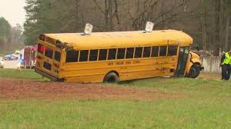
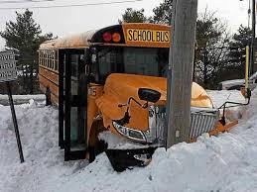
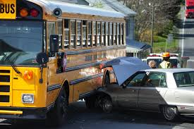
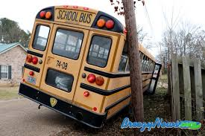
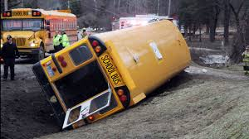
Accidents Happen – Some are minor….

Slide 4
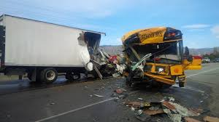
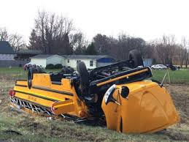
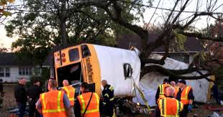
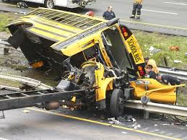
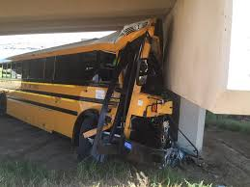
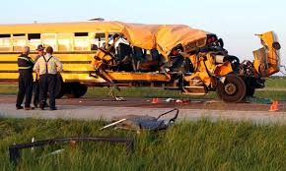
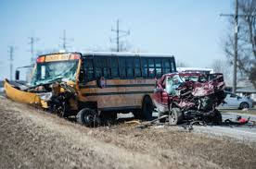
Others……..not so minor.

Slide 5
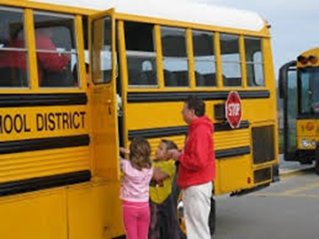
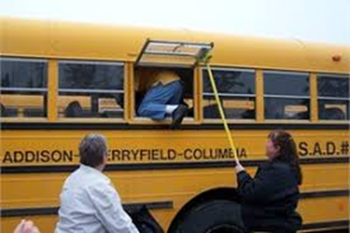
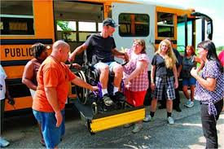
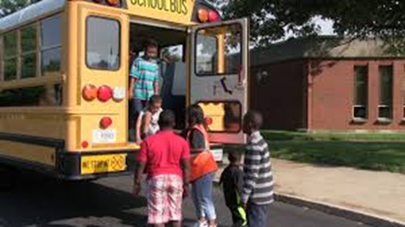
Emergency Evacuations require that students be removed from the vehicle.

Slide 6
What can we do as school bus drivers?
Plan Ahead!!

Slide 7
If you don’t…… it may look like this!
Plan Ah
e
a
d

Slide 8
CDL Manual States
An emergency can happen to anyone, anytime,
anywhere. It could be a crash, a stalled school bus on a railroad-highway crossing or in a high-speed intersection, an electrical fire in the engine compartment, a medical emergency to a student on the school bus, etc. Knowing what to do in an emergency–before, during and after an evacuation–can mean the difference between life and death.

Slide 9
Are we required to perform evacuation drills?
4204-R-18.00 Emergency Evacuation Drills
18.01 Emergency evacuation drills shall be conducted with students by all school transportation vehicle operators and school transportation paraprofessionals at least twice during each school year.
18.01(a) One drill shall be conducted in the fall and the second drill conducted in the spring.
18.01(b) Substitute and Multifunction operators of 16 or greater capacity (counting the driver) vehicles shall be trained how to conduct the emergency evacuation drills.
18.02 Students on school related events shall receive emergency evacuation instruction prior to departure.
18.03 School district, charter schools and service providers shall maintain records documenting that the required evacuation drills were conducted and/or evacuation instruction was given.

Slide 10
Have school bus information card readily available.
Include
Route Number
Bus Driver Name
District Name
District Address
District Contacts

Slide 11
What is your school district policy/procedure?
How often am I required to perform drills?
Do I need permission to perform drills?
Where do I perform drills?
When do I perform drills?
Can I release students to parents on scene?
Who do you contact first if you have to evacuate?
  9-1-1
  Supervisor
  Dispatch
What do you tell them?

Slide 12
Ask yourself
Are my students safer on the bus or off the bus?
Is evacuation necessary?
Are there injuries?
Do I move them?
How?
Which exit is best to use?
Where is my safe waiting area?
How many students are on the bus?

Slide 13
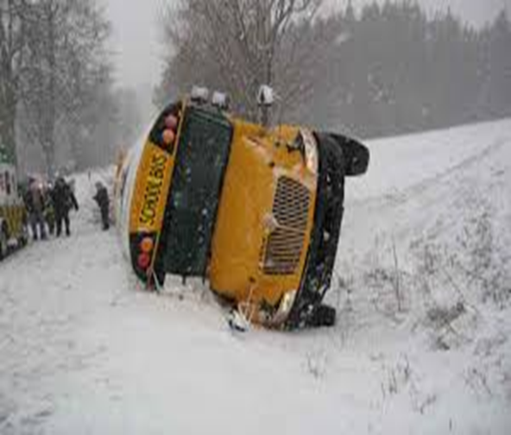
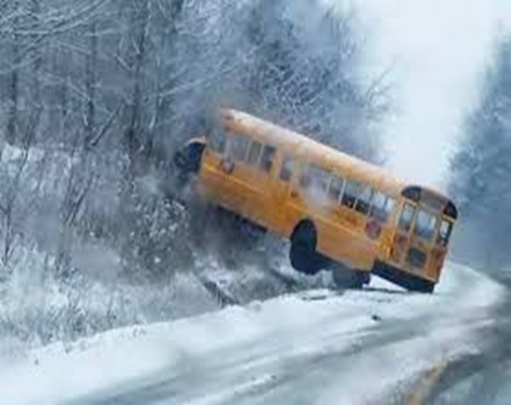
Safer on the bus or off the bus?

Slide 14
In the majority of emergency situations, the bus is the safest place for the passengers unless extenuating circumstances warrant evacuation from the bus.

Slide 15
Always evacuate if
The bus is on fire or there is a threat of a fire.
The bus is stalled on or adjacent to a railroad-highway crossing.
The position of the bus may change and increase the danger
There is an imminent danger of collision
There is a need to quickly evacuate because of a hazardous materials spill.

Slide 16
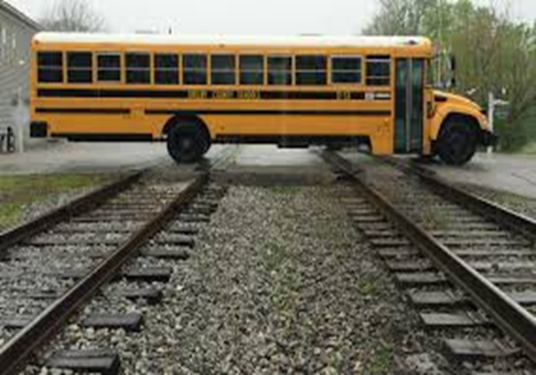
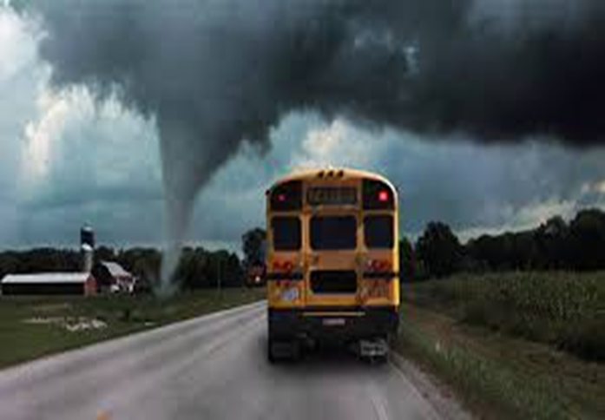
What about these situations? Evacuate?

Slide 17
In most cases, the front door evacuation is the safest.
The fastest evacuation is a combination of front door and rear/side door.
The side door/window evacuation is the most difficult

Slide 18
Helpers
Identify Student Helpers BEFORE an emergency occurs.
Teach the Student Helper how to help you.

Slide 19
Performing Drills
Set the park brake
Put transmission in neutral(automatic), or park if so equipped
Turn off engine (do you have communication if your bus is turned off?)
Turn on 4-way hazard lamps

Slide 20
Front Door

Slide 21
Front Door
Notify the proper authorities and school administrators as soon as possible.
Driver should stand and face students.
Get students’ attention - speak clearly and concisely.
Announce - “Remain seated, emergency evacuation, front door.” Tell students the location of the safe waiting area, at least 100 feet or more from the bus and roadway. All belongings are to be left on the bus.
Students should be supervised, if possible.

Slide 22
Evacuate the bus by dismissing students. Driver should move backwards down the aisle, dismissing the student's row by row.
If possible, give the first aid kit(s) to the first two responsible students exiting the bus. Do not impede the flow of the students exiting.
Begin at the front of the bus, starting at the right side; alternate side-to-side, row by row, until students have exited the bus.
Check each seat as you move back to the front of the bus to make sure all students have evacuated the bus.
Account for all students.
Render first aid if necessary.

Slide 23
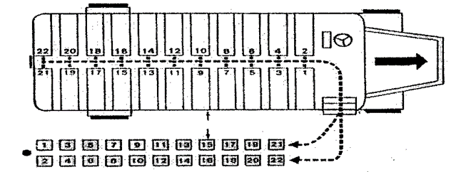
Front Door

Slide 24
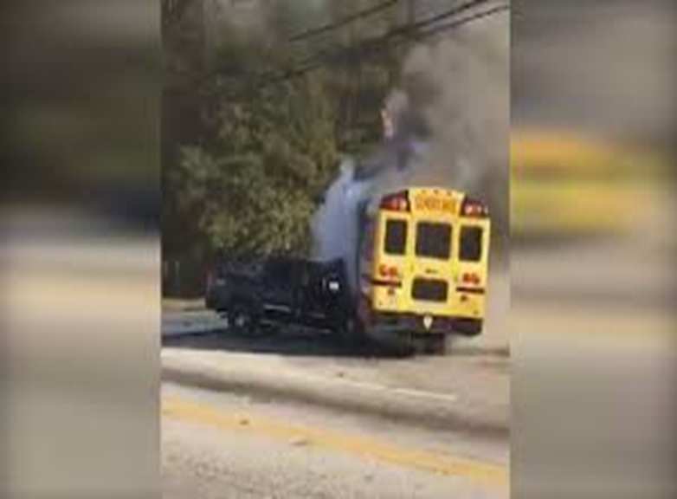
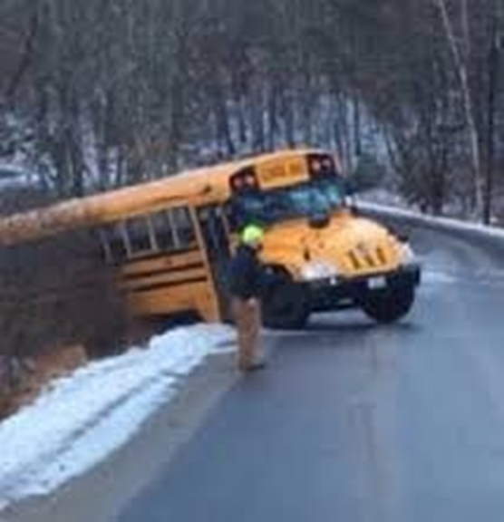
Which exit would you use to evacuate?

Slide 25
Rear Door

Slide 26
Rear Door
Notify proper authorities and school administrators as soon as possible.
Announce, “Remain seated, emergency evacuation, rear door.” Tell students the location of the safe waiting area. All belongings are to be left on the bus.
Assign two (2) “helpers” to assist students. Have them “sit” on the floor at the emergency door and “scoot” out of the door onto the ground. One helper is positioned with their back to the emergency door, so door will not swing against the students. The other helper is positioned on the other side of door area.
Helpers need to hold a hand open, palm upward and extended for the student to place his/her hand on it. The other hand will support the upper part of the arm of the student to minimize the possibility of the student falling forward.
Evacuate the bus by dismissing students. Driver will move backwards from rear row of seats, dismissing students' row by row.

Slide 27
Begin at the back row and continue to the front; alternate side-to-side, row-by-row, until students have exited the bus. If possible, give the first aid kit(s) to the last two responsible students when they are out of the bus.
Students should sit at the rear door, and then scoot through the door onto the ground with the helper assistance.
Students should walk to the safe waiting area.
Check all seats for students as you move towards the back of the bus.
Have the helpers “assist” you out of the rear of the bus.
Account for all students.
Render first aid as necessary.

Slide 28
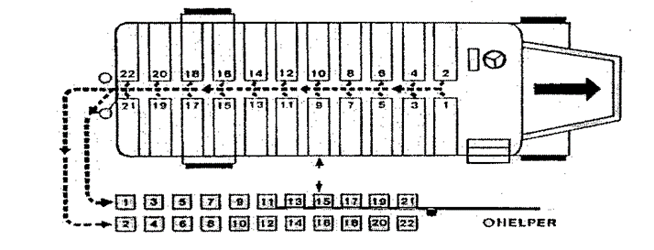
Rear Door

Slide 29
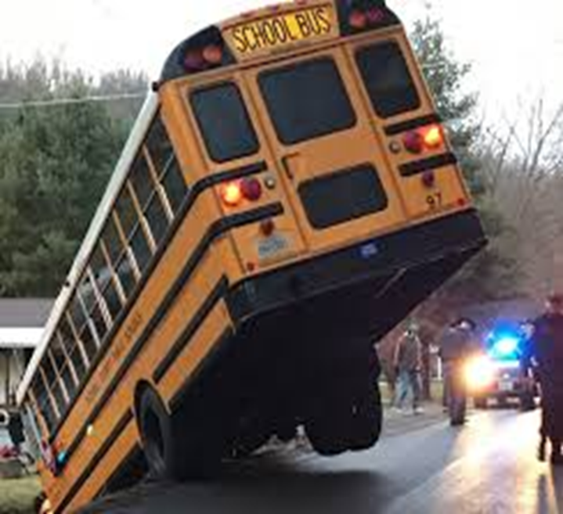
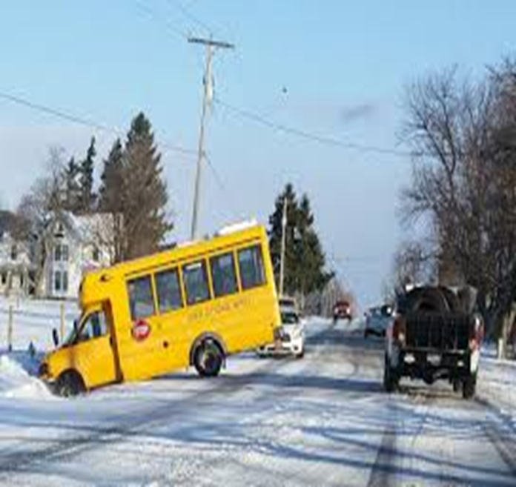
Evacuate or not?

Slide 30
Side Door Split

Slide 31
Other
Side Door – Same as rear with the following exceptions:
Begin at the seat nearest the exit, approximately 6th from the rear. Work to the rear alternating side-to-side, then return to seat immediately in front of the rear side exit and work to the front alternating side to side.
Front and Rear – Driver will not be able to dismiss the rows.
Front and Side – Begin at the seat nearest the side exit, work to the rear alternating side-to-side. Use a helper to evacuate front door students.

Slide 32
Special Needs

Slide 33
Special Needs
Know your students’ needs and disabilities.
Talk to staff and parents about how their special needs student might react during a drill
Written plan maintained with route sheet – highly confidential.
The order in which you evacuate students is an important consideration. If an evacuation becomes necessary, it is quicker and easier to first evacuate ambulatory students. Next, you should evacuate wheelchair students. However, if your ambulatory students have behavioral disorders, do not evacuate them first unless they are accompanied by an aid or the driver.
Which riders must NOT be removed from wheelchair, specialized seat or CSRS or need specialized equipment removed with them.

Slide 34
Special needs
Speed may become particularly important during an evacuation. And make sure you don’t ignore your own personal safety when evacuating students off the bus.
When lifting, kneeling or carrying students, you should use proper body mechanics. You should always lift with your legs and not your back.
When kneeling, do so in a manner that will not require over stretching. Over stretching could strain your back.

Slide 35
Most Common Techniques
One-Person Lift
Two Person Lift
Blanket Drag
Wheelchair drop
Lift Down

Slide 36
General Lifting Guidelines
NEVER lift anyone more than half your weight
  Ask for help if you are unsure
Test your lifting ability with a small movement that can be stopped.
  If the student weighs too much, use another method
Process
  Clear the path to the exit
  Tell the student exactly what you are going to do before you do it
  If necessary, cut the seat belt and other positioning straps
  Stand balanced with your feet shoulder width apart
    Face the student
    Face the direction you want to go, if possible

Slide 37
Process - continued
Get a good grip on the student or the students clothing; use your palms, not just your fingers
Squat down but keep your heels off the floor
Get as close to the student as you can
Lift gradually (without jerking) using your leg abdominal, and buttock muscles
Keep the student as close to you as possible
Keep your chin tucked in to keep a relatively straight back and neckline
Once you are standing, change directions be pointing your feet in the direction you want to go and turning your whole body
Avoid twisting at your waist while carrying a student
Take small steps, keeping the student close to your body.
With student with poor muscle control
  Curl the student as much as possible to keep the student’s arms and legs from flopping
  Support the student’s head and neck

Slide 38
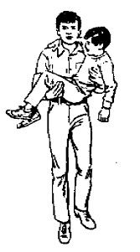
One Person
Pass the student’s near arm over your shoulder
Place one of your arms behind the student’s shoulders with your hand under the student’s other arm
Place your other arm under the student’s knees
Squat down with feet shoulder width apart
Lift the student with the load equally divided
between both arms, holding the student close to you.

Slide 39
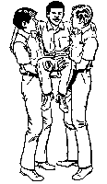
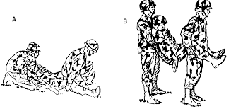
Two Person
Move the student in a wheel-chair as close to the exit as possible
Slide the student on a seat next to the aisle
The taller person stands behind the student and the other person stands in front of the student and off to the side
If the student is in a wheelchair, the person in front should remove the armrests and fold up the footrests
The person in back reaches under the student’s arms and
Either grasps right hand to student’s right wrist and left hand to student’s left wrist
Clasps hands across the student’s chest
The person in front lifts the lower extremities under the thighs and hips
Squat down and lift together on a count of three
Move to the designated area and lower the student on the count of three

Slide 40
Blanket Drag
Using a blanket reduces stress on the student’s body and the chance of injury
The blanket drag is also a way to move heavier students or fragile students who might be hurt by lifting
However, the blanket drag is not a good choice for students who are medically fragile.
Fold a blanket in half and place on the floor next to the student
Lower the student’s legs onto the blanket first, then the head
Place the student with his head toward the exit
Wrap the blanket around the student to prevent arms and legs from being caught on obstacles
Grasp the blanket near the student’s head and drag the student to the exit

Slide 41
Lift Door
Practice manually operating the lift door
Another option:
Lower the lift approximately ½ way down and you can use it as a
step-down evacuation
step-down wheelchair evacuation

Slide 42
Car Seats

Slide 43
Pre-School/Child Safety Seats
Child safety restraint systems (CSRS’s) should not be placed in school bus seats adjacent to emergency exits
DO NOT REMOVE the rider from the seat
  Remove the rider from the bus IN the seat. Simply cut the seat belt and take the rider and seat off the bus together.
  Remove them from bus and place in a safe location

Slide 44
Teach your students
Teach all riders some key things they should know how to do in the event the driver is incapacitated:
  How to set the air brake
  How to open the air door
  How to use the radio
  What to say on the radio
    Route #/Driver
    Location – Who just got off/on? What can you see?
    How many, if any hurt
  When to take the key

Slide 45
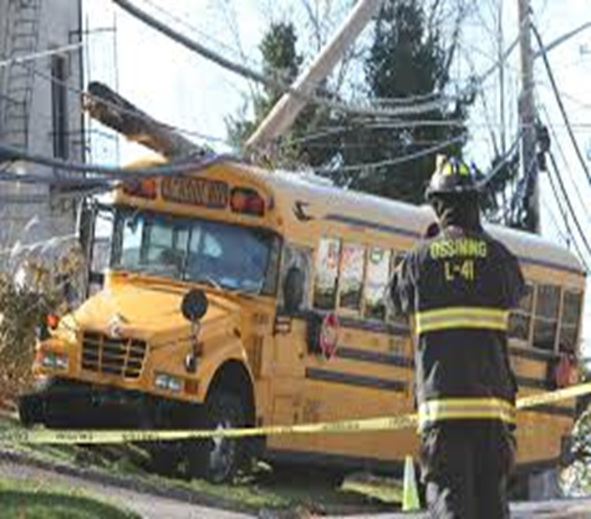
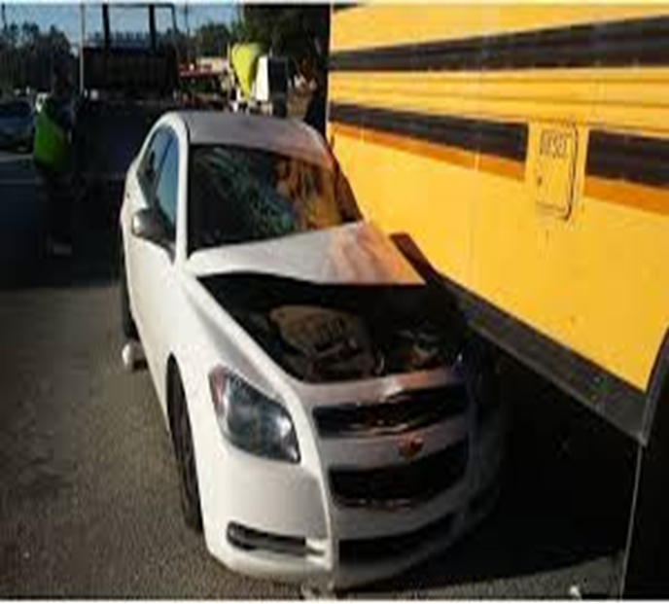
Emergency Evacuation or not?

Slide 46
You make the call!!
Are your students safer on the bus or off the bus?

Slide 47

Questions?

